Slide 1
Thanks for downloading this free syllabus template!
Please choose the slide you would like to customize, and then delete the others.
SLIDE 1
All of the headers are editable. In order to make the fonts match, you will need to download the font KG One More Light from TpT with the link below. This font is free.
https://www.teacherspayteachers.com/Product/KG-One-More-Light-Font-Personal-Use-3473029
SLIDE 2
Only the Course Name header is editable. In order to make the fonts match, you will need to download the font KG One More Light from TpT with the link below. This font is free.
https://www.teacherspayteachers.com/Product/KG-One-More-Light-Font-Personal-Use-3473029
SLIDE 3
All of the headers are editable. In order to make the fonts match, you will need to download the font AG Running Late is My Cardio from TpT with the link below. This font is $6.00.
https://www.teacherspayteachers.com/Product/Amy-Groesbeck-Fonts-Volume-One-2932560
©Maneuvering the Middle LLC, 2018

Slide 2
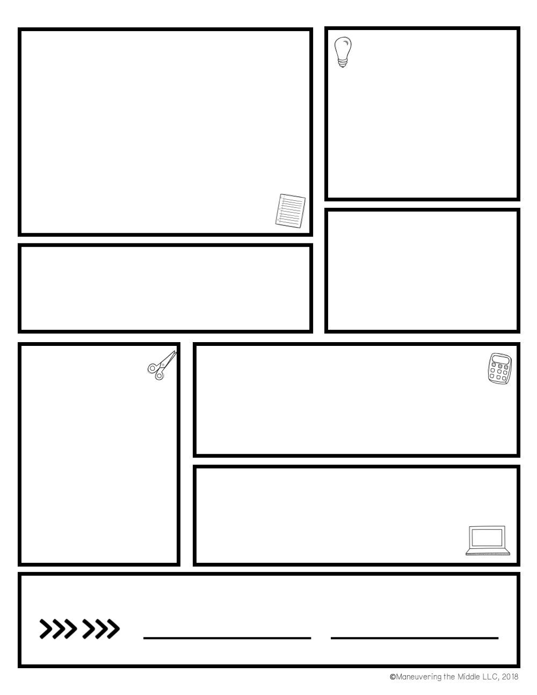

Homework expectations
Units of study
Two types of homework will be assigned each week:
Article of the Week: Each Monday, students will receive an Article of the Week, along with an assignment to complete. The assignment will be Friday.
*These will only be assigned on 5-day weeks.*
Independent Reading: In addition to reading in class,
students will read his/her Independent Reading Book at
home AT LEAST 3 nights each week. Not sure if this
matters? Check out the info about nightly reading on
my website. ☺
Investigating Characters
Narrative Writing
Nonfiction Reading
Nonfiction Writing
Developing a Critical Lens for Nonfiction
Tackling Complex Texts
Contact
Nicky Locklear
704.260.6490 (ext 36615)
nicole.locklear@
cabarrus.k12.nc.us
6th Grade ELA
vOCABULARY
Tests/Projects – Count 3 times
Quizzes – Count 2 times
Classwork/Homework – Counts 1 time
September 16th we will begin Vocabulary. Vocabulary lists will be based on the most common Greek and Latin roots and bases in the English language. We will study these words for two weeks in class. Students should also be studying these words at home. The quiz format will fill-in-the-blank sentences.
grading
Class website
Go to the Hickory Ridge Middle webpage, go to Faculty/Staff Directory. Find Nicole Locklear.
Check here for homework and class updates!
Sign here
Parent signature
student signature

Slide 3
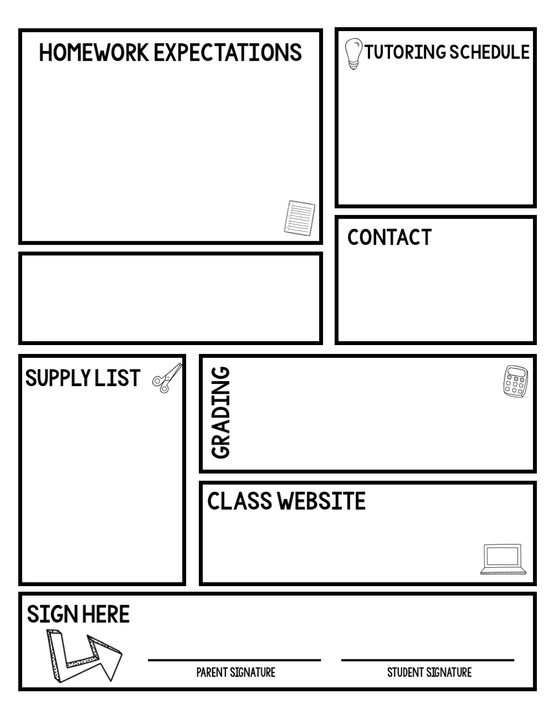
Two types of homework will be assigned each week:
Article of the Week: Each Friday, students will receive an Article of the Week, along with an assignment to complete. The assignment will be due the following Friday. *These will only be assigned on 5 day weeks.*
Independent Reading: In addition to reading in class, students will read his/her Independent Reading Book at home AT LEAST 3 nights each week. Not sure if this matters? Check out the info about nightly reading on my website. ☺
Investigating Characters
Narrative Writing
Nonfiction Reading
Nonfiction Writing
Developing a Critical Lens for Nonfiction
Tackling Complex Texts
Nicky Locklear
704.260.6490 (ext 36615)
nicole.locklear@
cabarrus.k12.nc.us
6th Grade ELA
Tests/Projects – Count 3 times
Quizzes – Count 2 times
Classwork/Homework – Count 1 time
The following supplies should be brought to class daily:
Pencil
2 marble composition books
Independent Reading Book (IRB)
Colored Pencils
Colored Pens (optional for taking notes)
https://www.cabarrus.k12.nc.us//site/Default.aspx?PageID=6108
Check here for homework and class updates!
©Maneuvering the Middle LLC, 2018

Slide 4
Homework expectations
Tutoring schedule
type text here
type text here
Contact
type text here
course name
Supply List
type text here
type text here
grading
Class website
type text here
Sign here
Parent signature
student signature

