Slide 1
 | MONDAY | TUESDAY | WEDNESDAY | THURSDAY | FRIDAY
4:00-4:30
4:30-5:00
5:00-5:30
5:30-6:00
6:00-6:30
6:30-7:00
7:00-7:30
7:30-8:00
8:00-8:30
8:30-9:00
9:00-9:30
9:30-10:00
10:30-11:00
 |  | Practice |  |  | Chores
 |  | Dinner |  |  | Free Time
 |  | Homework |  |  | Other

Slide 2
 | MONDAY | TUESDAY | WEDNESDAY | THURSDAY | FRIDAY
4:00-4:30
4:30-5:00
5:00-5:30
5:30-6:00
6:00-6:30
6:30-7:00
7:00-7:30
7:30-8:00
8:00-8:30
8:30-9:00
9:00-9:30
9:30-10:00
10:30-11:00
 |  | Practice |  |  | Chores
 |  | Dinner |  |  | Free Time
 |  | Homework |  |  | Other

Slide 3
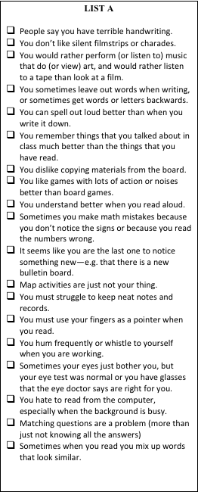
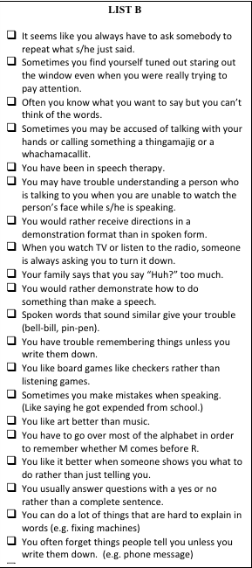

Slide 4
If list A is very much higher than list B= AUDITORY LEARNER
If list B is much higher= VISUAL LEARNER
If both lists are high= TACTILE/KINESTHETIC
(you learn by touching and doing)

Slide 7
548759654

Slide 8
548 759 654

Slide 9
Calisthenics
(def: simple athletic exercises)

