Slide 1
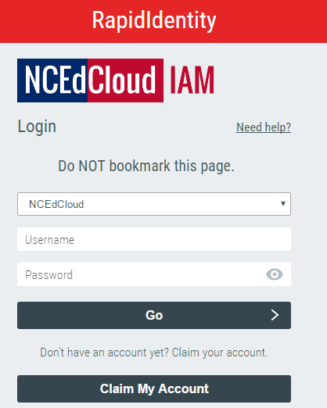
Claiming IAM account
my.ncedcloud.org

Slide 2
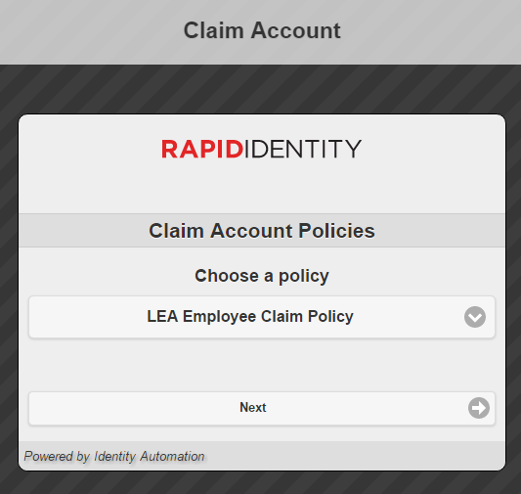
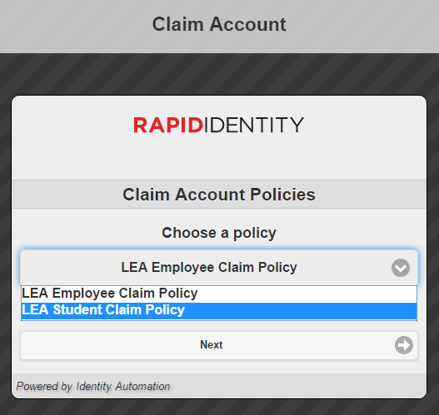
Claiming IAM account
Select dropdown arrow to change to
“LEA Student Claim Policy”
2
1

Slide 3
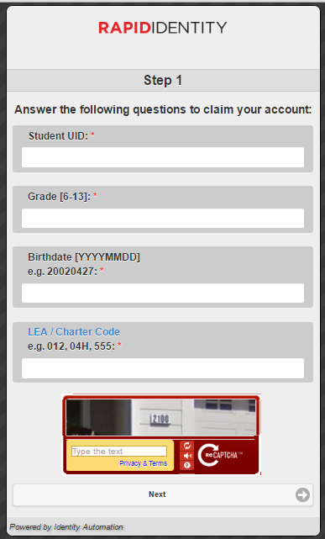
10012345
Student ID Number/”Lunch Number”
6
Numeric Grade (6, 7, or 8)
19850517
Birthday: Be sure to follow the correct format
130
Cabarrus County LEA: 130

Slide 4
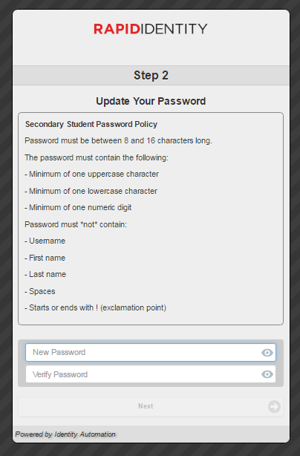
Update Password
  Whole school password of
  MPtigers1
MPtigers1
MPtigers1

Slide 5
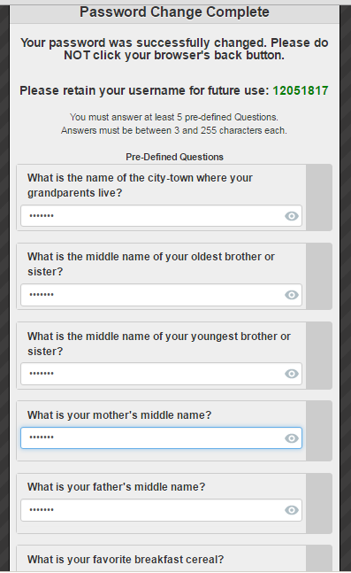
Security Questions
Students type school mascot for all (tigers)
Answer ALL questions, not just 5
tigers
tigers
tigers
tigers
tigers

Slide 6
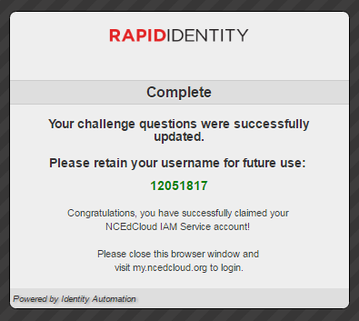
Complete
Once complete:
  Close out browser
  Return to website
  Log in

Slide 7
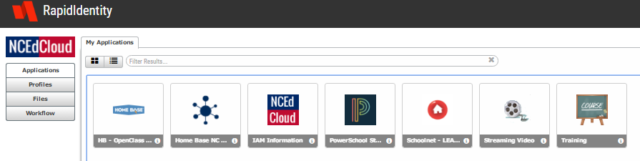
Student view
Schoolnet

Slide 8
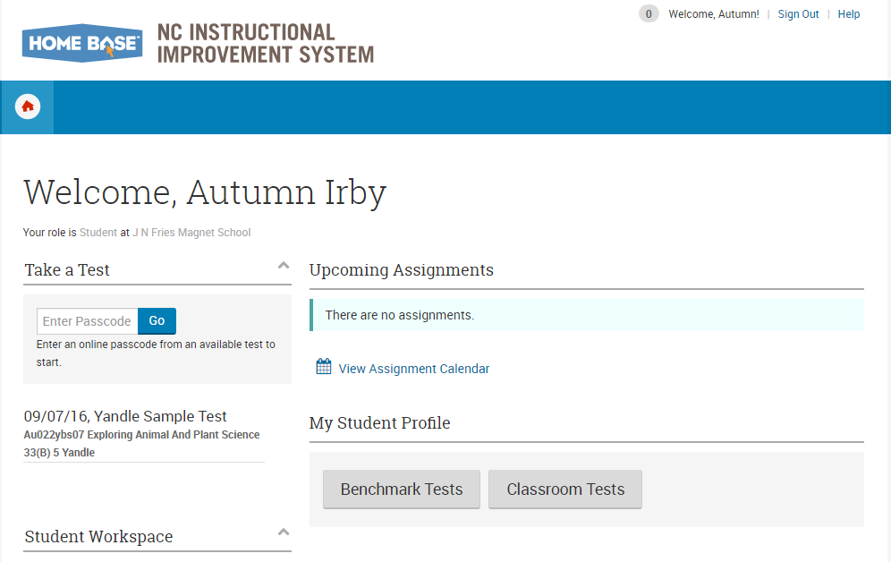
Schoolnet

