Slide 1


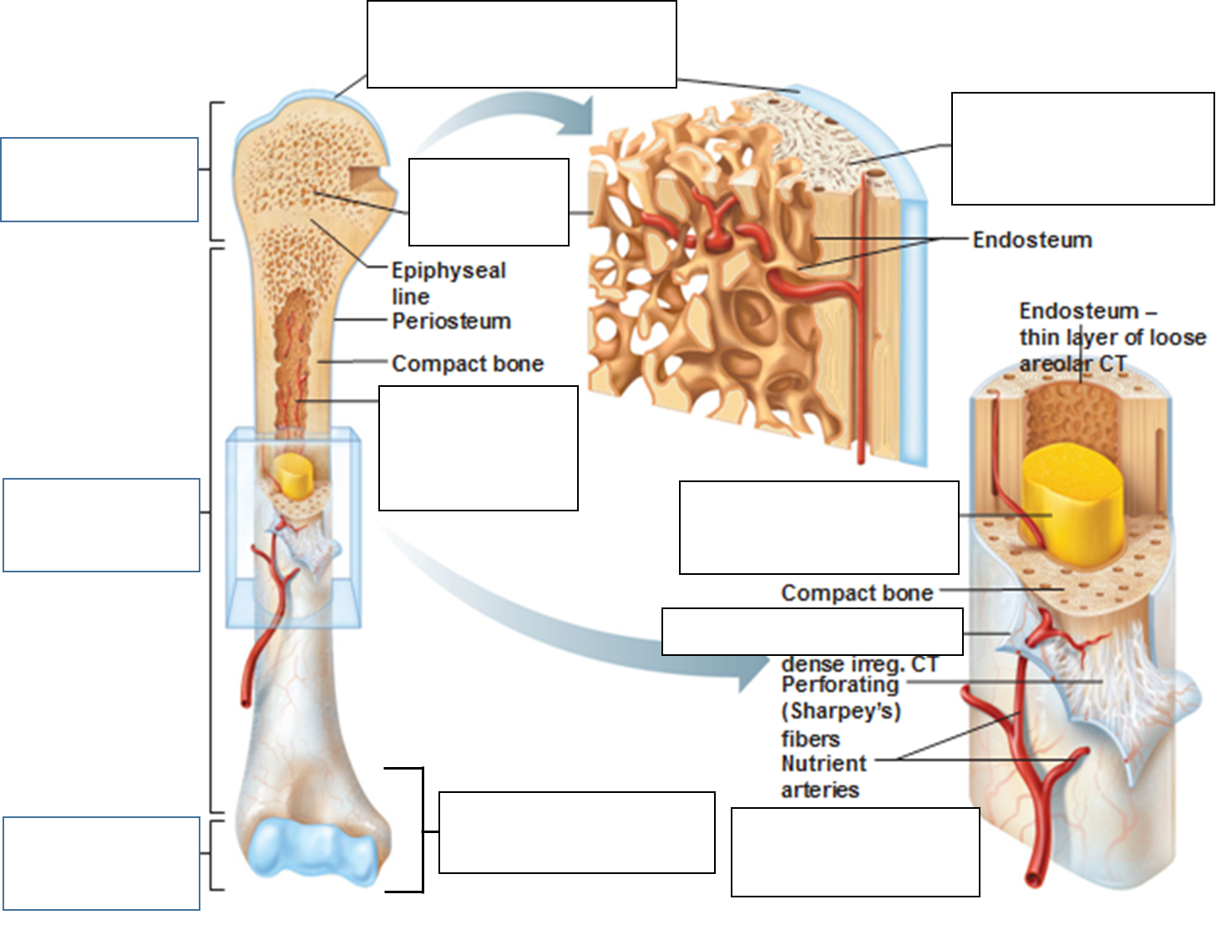
Compact
Bone
Diaphysis

Slide 2
DIAPHYSIS
Shaft/midsection of a long bone consisting of mostly compact/hard bone.
Compact bone is relatively solid and dense.
Has few spaces and is also found in the outer layer of most other types of bones.

Slide 3
Compact
Bone
Proximal
Epiphysis
Spongy
Bone
Diaphysis
Distal
Epiphysis
Epiphysis

Slide 4
EPIPHYSIS (Proximal & Distal)
Made up of cancellous or spongy bone.
Cancellous/Spongy bone has an irregular latticework structure (like honeycomb) where there are many spaces.
It is also found in short, flat and irregular bones.
Red marrow is stored there, blood cell production occurs here.

Slide 5
Articular
Cartilage
Compact
Bone
Proximal
Epiphysis
Spongy
Bone
Diaphysis
Distal
Epiphysis
Epiphysis

Slide 6
ARTICULAR CARTILAGE
Thin layer covers the ends of the bone where they articulate with other bones to form joints.
Main functions are to reduce friction between the bones and absorb shock.
Red marrow is stored there, blood cell production occurs here.

Slide 7
Articular
Cartilage
Compact
Bone
Proximal
Epiphysis
Spongy
Bone
Diaphysis
Periosteum
Distal
Epiphysis
Epiphysis

Slide 8
PERIOSTEUM
The area of the bone not covered by cartilage but instead by a thin, shiny white membrane.
This forms the outer lining of the bone and is important for bone growth, repair, nutrition and attachment of ligaments and tendons.

Slide 9
Articular
Cartilage
Compact
Bone
Proximal
Epiphysis
Spongy
Bone
Medullary
(Marrow)
Cavity
Yellow Bone
Marrow
Diaphysis
Periosteum
Distal
Epiphysis
Epiphysis
Blood
Vessels

Slide 10
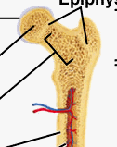
MEDULLARY (MARROW) CAVITY
Space within the diaphysis where yellow bone marrow is stored.
There is a small opening in the diaphysis called the nutrient foramen.
Blood vessels pass through here, enter the medullary cavity and provide the marrow and compact bone with blood and nutrients.

Slide 11
Articular
Cartilage
Compact
Bone
Proximal
Epiphysis
Spongy
Bone
Medullary
(Marrow)
Cavity
Yellow Bone
Marrow
Diaphysis
Periosteum
Distal
Epiphysis
Epiphysis
Blood
Vessels

