Slide 1


STORE OPTIONS
All images are available on www.google.com with a Creative Commons 0 License.

Slide 2
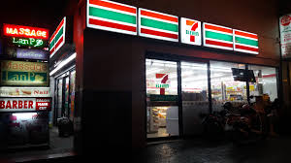
Convenience Stores
Limited selection
Open 24 hours
Usually more expensive

Slide 3

Electronic Ordering/Pick Up At Store
Order online/someone shops for you
You pick it up and pay for order
Usually more expensive

Slide 4
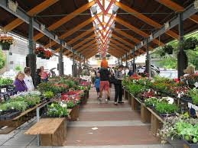
Farmers’ Markets
Food sold directly from grower

Slide 5
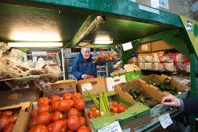
Food Cooperatives
Group of consumers own and operate stores

Slide 6

Home Grown
Not really a store, but YOU grow or raise some of your own food needs

Slide 7
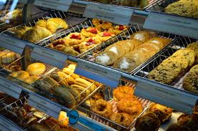
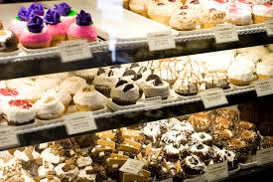
Specialty Stores
Stores that sell only one item or only a few items

Slide 8
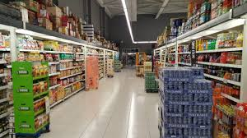
Supermarkets/Supercenters
Carry a variety of foods and non-food items

Slide 9
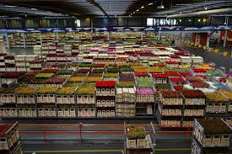
Warehouse Stores
Sell food in bulk quantities

