Slide 1


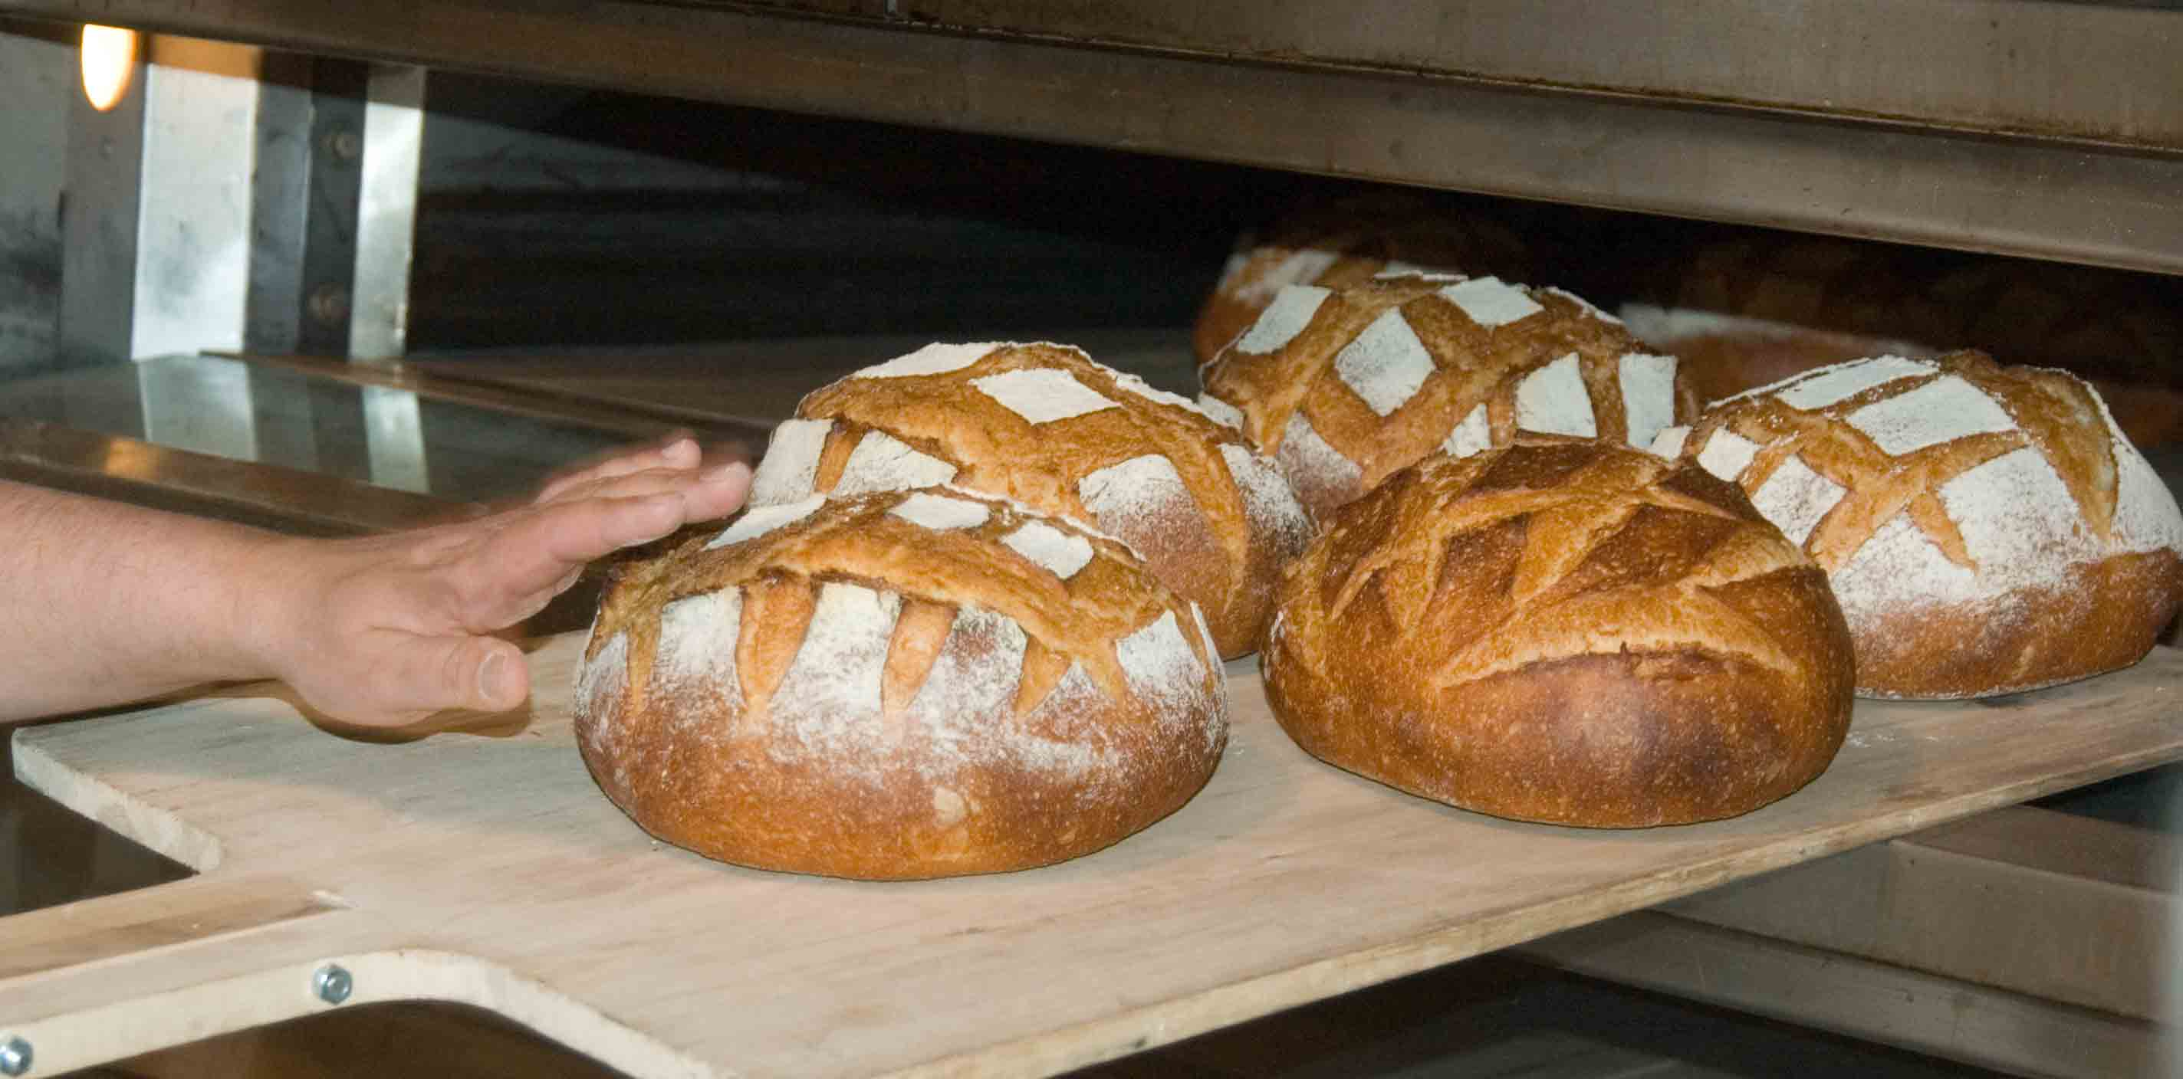


Steps to Making Yeast Bread

Slide 2
MIXING
KNEADING
RISING (Fermentation)
PUNCHING, SHAPING & PROOFING
BAKING

Slide 3
MIXING: Traditional Mixing Method
Dissolve active dry yeast in water that is between 105°F and 115°F
Separately, combine sugar with additional liquid (also 105°-115°) and melted fat (if using)
Add yeast & eggs (if using) to bowl
with liquids
Add flour to form dough
This dough will RISE TWICE!

Slide 4
MIXING: Quick-Mix Mixing Method
Mix rapid-rise yeast with SOME flour, sugar, and salt
Heat liquid and fat to 120°F-130°F
Add liquids to dry ingredients; beat until blended
Add remaining flour to form dough
This dough will often RISE ONCE!

Slide 5
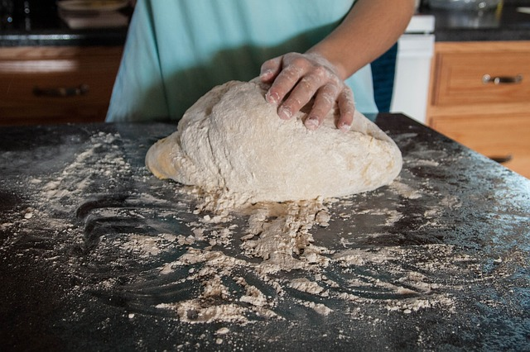
KNEADING
Remember: we knead to activate GLUTEN!
Your dough should go from a rough, sticky mess to a smooth, glossy, and elastic ball.
Can press, fold, and turn the dough with your hands for 8-10 minutes
  Flour counter & hands first, but avoid adding too much flour!
OR use dough hook & stand mixer
Recipes with only one rise need to REST (5-10 min) before shaping

Slide 6
RISING (Fermentation)
Remember: we are allowing FERMENTATION to occur!
Transfer dough to a greased bowl covered with plastic wrap
Let dough rise in a warm place until the dough has doubled in size
  How long? At least 45 min. up to several hours
    Rapid-rise yeast- smaller granules, 50% faster rise
  Can use oven turned off with the light on
Longer rising (overnight/refrigerator) = more flavor

Slide 7
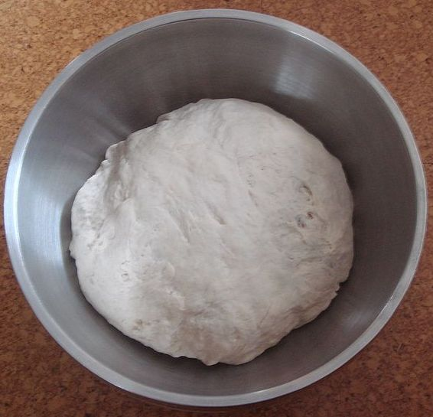
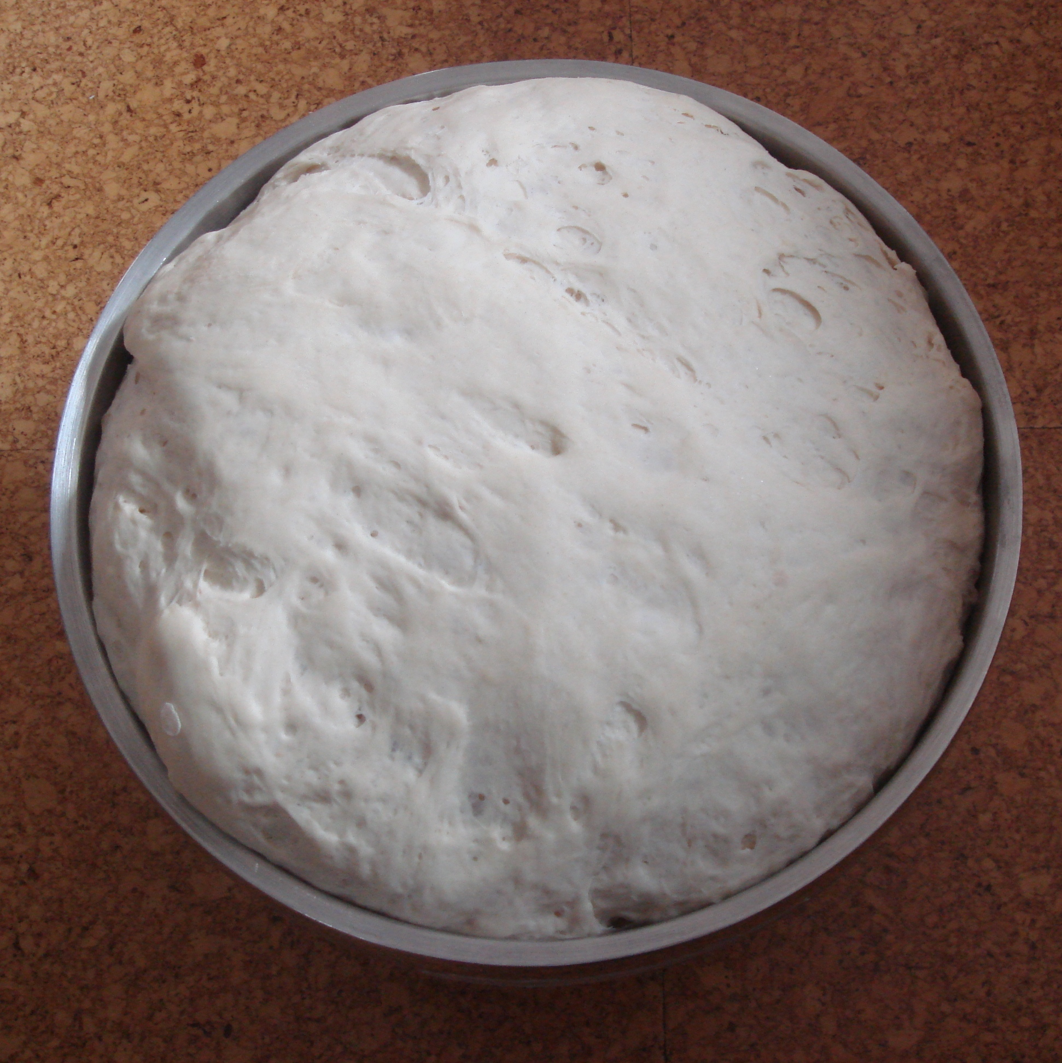
RISING (Fermentation)

Slide 8
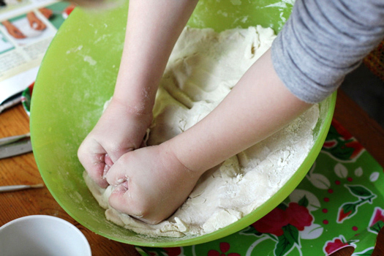
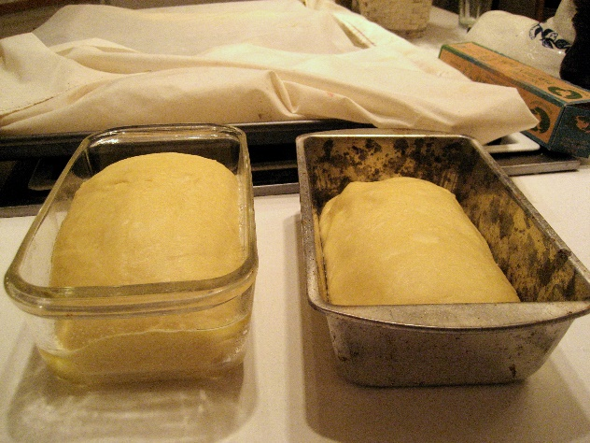
PUNCHING, SHAPING, & PROOFING
PUNCHING: redistribution of CO₂ before shaping
  Don’t need to literally punch… lightly drop in bowl or fold
SHAPING: could be folding dough into loaf pan, dividing & shaping dough into rolls, etc. – lots of options!
PROOFING: 2nd rise that occurs after dough is shaped but before baking
  Dough should double in size again
One-rise recipes – this is the only rise!

Slide 9
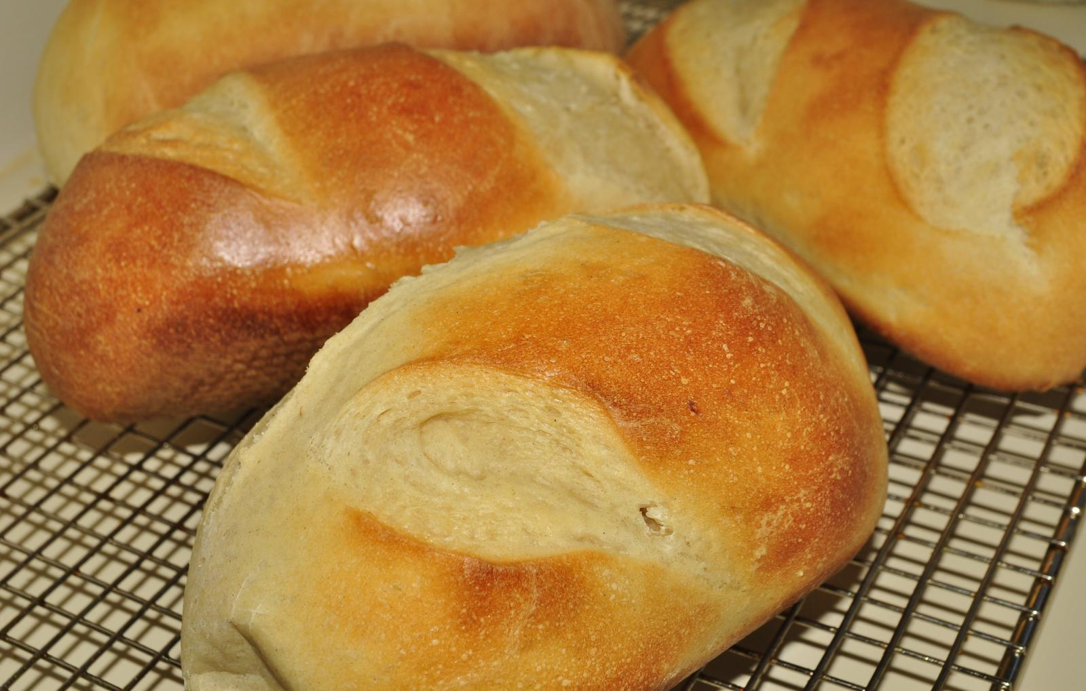
BAKING
Oven should be pre-heated so OVEN SPRING (rapid rising in first minutes of baking) occurs
If crust begins to look too brown, add aluminum foil to top
How to know if bread is done? Tap the bottom – should sound hollow
Allow to cool completely before slicing

