Slide 1
Expansion and Contraction of Solids, Liquids, and Gases
Carl A Furr-Grade 5

Slide 2
Important Vocabulary
Expansion-the condition of making something larger.
Contraction-the condition of making something smaller.

Slide 3
What happens to a solid when it is heated?
When a solid is heated, it will EXPAND (get longer or appear larger). The molecules spread out.
When a solid is cooled, it will CONTRACT (get shorter or appear smaller).The molecules become tightly packed.
Video

Slide 4
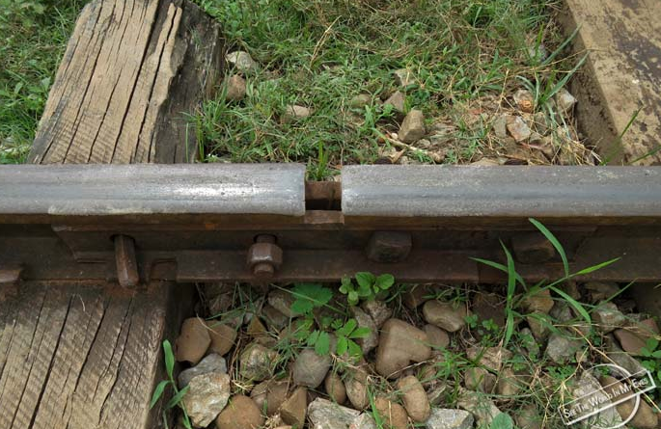
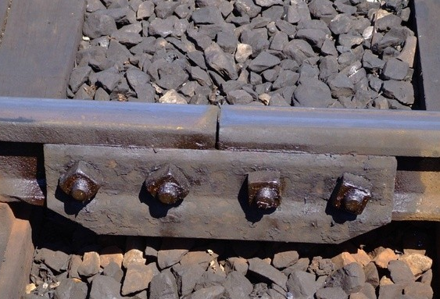
Real World Example
BEFORE AFTER
Railroad tracks are made with gaps because when they are heated by the sun, extreme heat or friction from the train, they get longer. What do you think would happen if they gap wasn’t there?

Slide 5
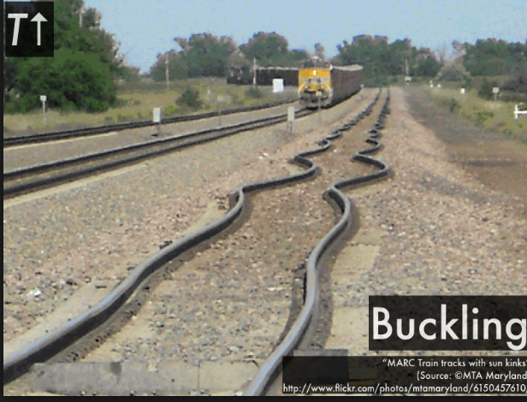
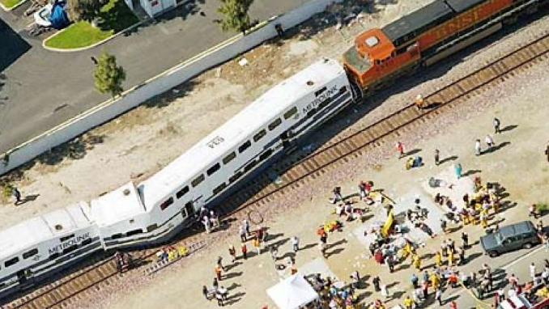
Buckling (bending) can cause the train to derail and crash

Slide 6
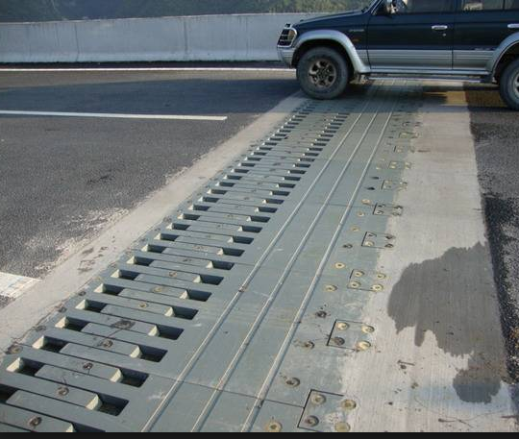
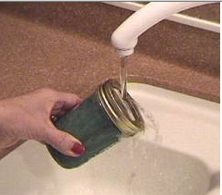
More Examples
Bridges Opening a jar

Slide 7
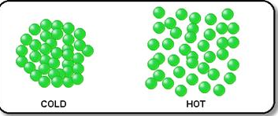
What happens to a gas when it is heated?
When a gas is heated, its molecules move rapidly causing the gas to disperse (spread out).

Slide 8
What happens to liquids as heat is added or taken away?
Liquids, such as water, have a special molecular bond. Unlike solids, liquids expand when they are cooled and contract when they are heated.
Have you ever put a water bottle in the freezer on a hot summer day? What happened to the bottle once it was frozen?

Slide 9
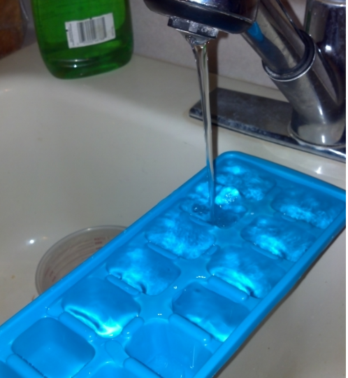
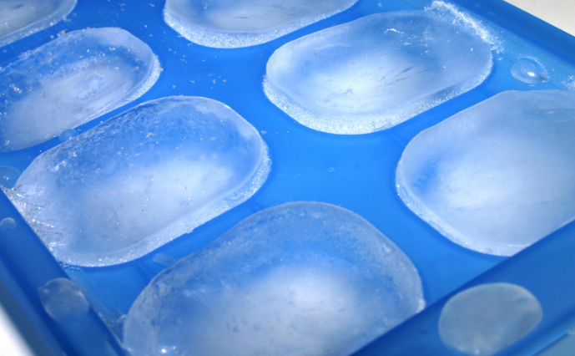
Ice Cube Tray
BEFORE AFTER
What do you see? What happened?

Slide 10
Real World Damage Caused by Water
In the winter, when it rains, the water seeps into the cracks in the roads and sidewalks. Once the temperature falls below freezing (32 degrees Fahrenheit), what do you think happens to the water in the ground?
Think about the ice cube tray and the water bottle.

Slide 11
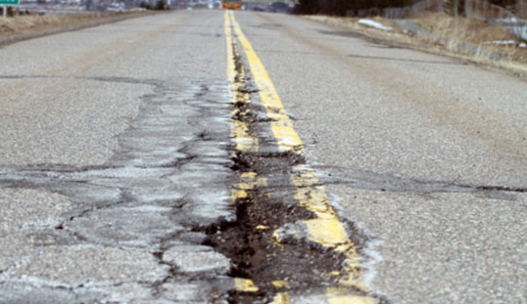
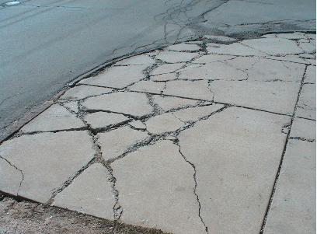
Cracks and Potholes

Slide 12
Conclusion
Solids, liquids, and gases are affected by the change in temperature.
Temperature can cause things to:
Expand-get longer or larger
Contract-get shorter or smaller

