Slide 1
Soil and Water
6th Grade PBL Colonizing a Planet

Slide 2
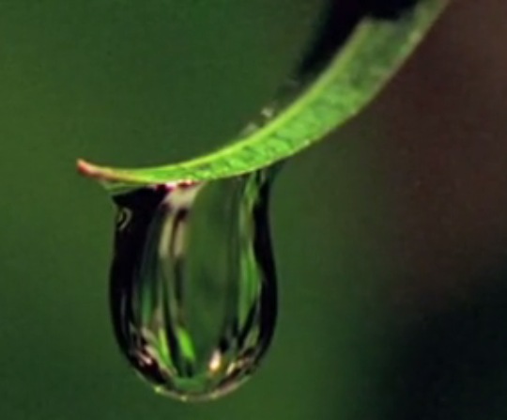
What do plants need to grow?

Slide 4
Planet | Structure | Surface Description | Geological Features
Mercury | Liquid Iron core, mantle and very thin crust with cracks in it | Cliffs and valleys with lots of craters with some filling with lava | Impact Craters and Tidal Bulges
Venus | Iron core, mantle of hot rock, and thin crust of rock on top | Mountains, valleys and lots of volcanoes. Two highland areas located at north polar and at the equator | 90 % of surface covered by Volcanoes
Mars | Core, mantle, and crust | Iron in soil and rocks make it look red. Soil and rock show oxygen, silicon, iron, magnesium, calcium, and sodium. | Largest Volcano, lots of dormant volcanoes, Valles Marineris (series of canyons) and an old impact crater
Jupiter | Liquid metal that surrounds a very hot inner core made up of mostly iron and silicate | Sea of liquid hydrogen and lots of gases | Powerful magnetic field
Saturn | Center is core of rock, ice, and water surrounded by liquid metallic hydrogen | Swirling gases and liquids like liquid hydrogen
Uranus | Small rocky core that is surrounded by hot dense fluid of “icy” materials | Swirling gases with a layer of fluid, icelike mixture- ammonia, hydrogen sulphide, methane, and water.
Neptune | Mixture of hydrogen , helium, and methane gas over a layer of melted ice over an Earth-size melted rock core | Gases and Melted ice

Slide 5
Planet | Structure | Surface Description | Geological Features
Titan | Rocky core surrounded by a surface of ice | Surface of ice with layer of liquid water beneath it.
Europa | Rocky core surrounded by a surface of ice | Entire surface is ice with craters fill with water from below | Gravity of Jupiter and moons causes flexing from tidal force which creates heat to melt ice.
TRAPPIST-1f | Core, thick mantle, and crust that holds both land and ocean | Canals filled with water. The surface is covered with craters, volcanoes, and plains. Soil shows oxygen, silicon, iron, magnesium, calcium, and sodium | Volcanoes-mostly under the ocean
Proxima Cen B | Core, mantle, and crust | Liquid Ocean covering surface and stretching 124 miles deep
Kepler-22b | Core, mantle, and crust | World-wide ocean

