Slide 1
Section 5.1
The Characteristics and Classification of Skill

Slide 2
IB
Sports, exercise and health science
Skill in sport
Topic 5
Skill in sport
5.1.1 Define the term skill
Sub-topics
Skill is the learned ability to bring about predetermined results with the maximum certainty, often with the minimum outlay of time, energy or both. (Knapp, 1967)
Skill involves learning via practice. (Wesson et.al 1998)
1. The characteristics and classification of skill
2. Information processing
3. Principles of skill learning

Slide 3
IB
Sports, exercise and health science
Skill in sport
Topic 5
Skill in sport
5.1.1 Define the term skill
Sub-topics
Specific action/level of performance of an individual
Movement that has been learnt and has a predetermined goal
It is not an action a person can do naturally
1. The characteristics and classification of skill
2. Information processing
3. Principles of skill learning

Slide 4
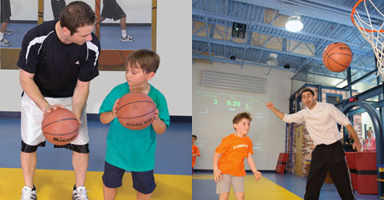
Main Characteristics of a Skill
Goal Oriented
  Skill has an End Result
    Putting a golf ball in the hole
    Making a save in football
Meeting the performance goal with maximum certainty
  Maintain balance whily riding a bike
  Making 90% of shots in a basketball game.

Slide 5
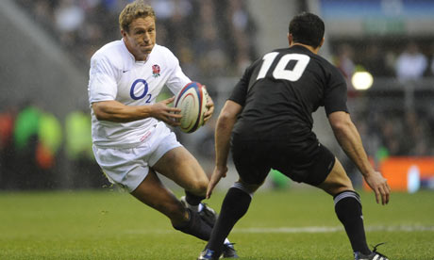
Main Characteristics of a Skill
meet performance goals with minimal outlay of energy – skill is economic and efficient in movement
  staying streamline in the water during freestyle
  Skiing parallel down a slope
Learned through practice
  requires experience, repetition, or feedback from teacher or coach

Slide 6
IB
Sports, exercise and health science
Skill in sport
Topic 5
Skill in sport
5.1.1 Define the term skill
Sub-topics
A skilled performer learns to be effective and efficient in:
  Achieving a well-defined objective (goal directed)
  Maximising – maintaining the physical and mental energy demands of performance at an optimal level (aesthetically pleasing, coordinated, precise, decisions)
  Minimising – taking only the minimum time required (well timed)
  Wesson et.al (1998)
1. The characteristics and classification of skill
2. Information processing
3. Principles of skill learning

Slide 7
IB
Sports, exercise and health science
Skill in sport
Topic 5
Skill in sport
5.1.1 Define the term skill
Sub-topics
Thus a skilful performer has gone through some form of “learning process”.
There is intention in the performance i.e. it is not just luck. It is not enough just to stay they are accurate and have good technique, the key is that they are “consistent”. The performance is also carried out “efficiently” i.e. not wasting time or energy.
  Wesson et.al (1998)
1. The characteristics and classification of skill
2. Information processing
3. Principles of skill learning

Slide 8
IB
Sports, exercise and health science
Skill in sport
Topic 5
Skill in sport
5.1.2 Describe the different types of skill
Psychologists have considered different types of skill, trying to differentiate for instance between motor and verbal skills.
Wesson et.al (1998)
Sub-topics
1. The characteristics and classification of skill
2. Information processing
3. Principles of skill learning

Slide 9
IB
Sports, exercise and health science
Skill in sport
Topic 5
Skill in sport
5.1.2 Describe the different types of skill
Examples of three different types of skill are:
    Intellectual skills or cognitive skills: Skills which involve the use of a person’s mental powers, e.g. problem solving, verbal reasoning (verbal skill).
    Perceptive skills: Interpreting and making sense of information coming in via the senses.
    Motor skills: Smoothly executing physical movements and responses.
Wesson et.al (1998)
Sub-topics
1. The characteristics and classification of skill
2. Information processing
3. Principles of skill learning

Slide 10
IB
Sports, exercise and health science
Skill in sport
Topic 5
Skill in sport
5.1.2 Describe the different types of skill
When a NBA basketballer is driving to the basket this involves a whole host of both cognitive skills and perceptual skills, as only after having taken into account all the various information (cues, signals, stimuli) being received from around them can a basketballer then carry out the necessary motor skill with any degree of proficiency.
Therefore, although many psychologists have tried to define the ways in which motor, cognitive and perceptual skills are independent of one another, from a sports science perspective when we talk of skill it is usually a combination of all three areas.
Wesson et.al (1998)
Sub-topics
1. The characteristics and classification of skill
2. Information processing
3. Principles of skill learning

Slide 11
IB
Sports, exercise and health science
Skill in sport
Topic 5
Skill in sport
5.1.2 Describe the different types of skill
Perceptual motor skills are sometimes referred to simply as motor skills. In this instance the perceptual or cognitive involvement is usually implied.
Wesson et.al (1998)
Sub-topics
1. The characteristics and classification of skill
2. Information processing
3. Principles of skill learning

Slide 12
IB
Sports, exercise and health science
Skill in sport
Topic 5
Skill in sport
5.1.3 Outline the different approaches to classifying skill.
Grouping motor skills is difficult because sports involve a huge range of skills; groupings are based on shared characteristics, while also considering the environment in which the skill is performed and the nature of relationships between the movements, the performer and environment.
Smythe et.al (1999)
Sub-topics
1. The characteristics and classification of skill
2. Information processing
3. Principles of skill learning

Slide 13
IB
Sports, exercise and health science
Skill in sport
Topic 5
Skill in sport
5.1.3 Outline the different approaches to classifying skill.
Motor skills can be classified to help determine how specific skills can be learned, as well as providing coaches with information about how to teach that particular skill. Classification is based on:
  The environment in which the skill is to be performed.
  The amount of physical effort required to perform the skill successfully.
  The type of movement required to execute skill.
    Smyth et.al (1999)
Sub-topics
1. The characteristics and classification of skill
2. Information processing
3. Principles of skill learning

Slide 14
IB
Sports, exercise and health science
Skill in sport
Topic 5
Skill in sport
5.1.3 Outline the different approaches to classifying skill.
Gross and Fine Motor Skills: Skills can be classified according to the number of muscles or muscle groups involved in the activity.
Gross motor skills involve a combination of large muscle actions that results in a coordinated movement. E.g. throwing, catching, hitting, kicking, catching and tumbling in gymnastics.
  Smyth et.al (1999)
Sub-topics
1. The characteristics and classification of skill
2. Information processing
3. Principles of skill learning

Slide 15
IB
Sports, exercise and health science
Skill in sport
Topic 5
Skill in sport
5.1.3 Outline the different approaches to classifying skill.
Fine motor skills involve the cooperative use of small muscle groups and the senses of sight and touch (visual motor tracking). The performer must also balance the use of force and fine touch control. E.g. writing, typing, archery, putting in golf.
  Smyth et.al (1999)
Sub-topics
1. The characteristics and classification of skill
2. Information processing
3. Principles of skill learning

Slide 16
IB
Sports, exercise and health science
Skill in sport
Topic 5
Skill in sport
5.1.3 Outline the different approaches to classifying skill.
Open and closed motor skills
Open Motor Skills: are performed in an environment that is constantly changing and is externally paced, for example the changing proximity of an opponent, the changing speed and height of a wave in surfing or the varying speed of a ball in cricket.
  Smyth et.al (1999)
Sub-topics
1. The characteristics and classification of skill
2. Information processing
3. Principles of skill learning

Slide 17
IB
Sports, exercise and health science
Skill in sport
Topic 5
Skill in sport
5.1.3 Outline the different approaches to classifying skill.
Closed Motor Skills: are performed in a predictable environment where there are no interruptions or changes in the surroundings, for example ten pin bowling. The athlete often tries to replicate the exact movement each time in a closed skill, for example, a golfer with his or her swing when teeing off.
  Smyth et.al (1999)
Sub-topics
1. The characteristics and classification of skill
2. Information processing
3. Principles of skill learning

Slide 18
IB
Sports, exercise and health science
Skill in sport
Topic 5
Skill in sport
5.1.3 Outline the different approaches to classifying skill.
Discrete/Continuous/Serial Skills:
  Discrete Skills: involve movements of brief duration, and are defined by a distinct beginning and end, for example a throw, kick or catch.
  Serial Skills: are a series or group of discrete skills strung together to create a more complicated, skilled action. E.g. performing a gymnastics routine.
  Continuous skills: have no distinct beginning and end point. May continue for several minutes, often involving tracking movements e.g. swimming, running.
  Smyth et.al (1999)
Sub-topics
1. The characteristics and classification of skill
2. Information processing
3. Principles of skill learning

Slide 19
IB
Sports, exercise and health science
Skill in sport
Topic 5
Skill in sport
External and Internal Paced Skills:
External Paced: Action is determined by external sources and involves the performer in reaction.
  Is a more open skill e.g. white water canoeing, receiving a serve in tennis.
Internal Paced: Performer controls the rate at which the activity is carried out and decides when to initiate movement.
  Is a more closed skill e.g. shot put, forward roll.
  Wesson et.al (1998)
5.1.3 Outline the different approaches to classifying skill.
Sub-topics
1. The characteristics and classification of skill
2. Information processing
3. Principles of skill learning

Slide 20
IB
Sports, exercise and health science
Skill in sport
Interaction Continuum (Individual/Coactive/Interactive)
A method of describing groups of skills is to group them according to whether the skill is performed without reference to another player (individual skill), whether there are others involved (called coactors) ( this is a coactive skill) or whether the skill is dependent upon interaction with the environment (interactive skill).
http://www.megaessays.com/viewpaper/26561.html
Topic 5
Skill in sport
5.1.3 Outline the different approaches to classifying skill.
Sub-topics
1. The characteristics and classification of skill
2. Information processing
3. Principles of skill learning

Slide 21
IB
Sports, exercise and health science
Skill in sport
Interaction Continuum (Individual/Coactive/Interactive)
For example, throwing the shot putt is an individual skill, a smash in badminton is coactive skill and running with the ball in rugby is an interactive skill. However, with any of classification, it is very difficult to put skills into one a particular box. Skills can be in the middle of two types. The process of analysis is very important because it gives us clues to how we should be practising a skill.
http://www.megaessays.com/viewpaper/26561.html
Topic 5
Skill in sport
5.1.3 Outline the different approaches to classifying skill.
Sub-topics
1. The characteristics and classification of skill
2. Information processing
3. Principles of skill learning

Slide 22
IB
Sports, exercise and health science
Skill in sport
Topic 5
Skill in sport
5.1.4 Compare skill profiles for contrasting sports.
Sub-topics
Class Activity: Draw a continuum for each of the five classifications and place a series of relevant examples along the appropriate places along the continuum.
1. The characteristics and classification of skill
2. Information processing
3. Principles of skill learning

Slide 23
Ability Introduction
Johnny was good at all of the team games he played in his physical education lessons, a natural footballer, basketball player, rugby player, and field hockey player, It was obvious that he had strong natural abilities that ‘fit’ those sports
  What natural abilities (motor and perceptual-motor) do you think Johnny possesses to excel in these sports?
  What are the abilities you have that enable you to be successful in your chosen sport?
                From Course Companion pg. 112

Slide 24
IB
Sports, exercise and health science
Skill in sport
Topic 5
Skill in sport
5.1.5 Define the term ability.
Sub-topics
Ability is a stable, enduring characteristic, that is genetically determined and may be wholly perceptual, wholly motor or a combination i.e. psychomotor.
It should be appreciated that abilities underpin specific skills.
IBO. Feb 2007
1. The characteristics and classification of skill
2. Information processing
3. Principles of skill learning

Slide 25
Characteristics of Ability
Ability is
  A mainly stable trait
  Genetically determined
  Developed through maturation; modified by experience

Slide 26
Perceptual-Motor Ability
Abilities that allow individual performers to make take-in and process information and decide how and when to move.
  Almost all sports skills will be a combination of both perception and motor ability
Commonly discussed motor abilities are strength, speed and coordination but there is no definitive list of psychomotor abilities
    Fleishman’s Taxonomy of Abilities
    Stallings’ Motor and Perceptual Abilities.

Slide 27
IB
Sports, exercise and health science
Skill in sport
Topic 5
Skill in sport
5.1.6 Outline Fleishman’s taxonomy of motor abilities.
Sub-topics
The work of Fleishman (1972), which is one of the better-known pieces of research, developed a taxonomy of human perceptual motor abilities. He carried out extensive testing of over 200 tasks, the results of which led him to propose that there seemed to be 11 identifiable and measurable perceptual motor abilities.
Wesson et.al (1998)
1. The characteristics and classification of skill
2. Information processing
3. Principles of skill learning

Slide 28
IB
Sports, exercise and health science
Skill in sport
Topic 5
Skill in sport
5.1.6 Outline Fleishman’s taxonomy of motor abilities.
Sub-topics
Human Perceptual Motor Abilities:
1. Limb coordination: the ability to coordinate the movement of a number of limbs simultaneously.
2. Control precision: the ability to make highly controlled and precise muscular adjustments where large muscle groups are involved.
3. Response orientation: the ability to select rapidly where a response should be made, as in a choice reaction time situation.
4. Reaction time: the ability to respond rapidly to a stimulus when it appears.
Wesson et.al (1998)
1. The characteristics and classification of skill
2. Information processing
3. Principles of skill learning

Slide 29
IB
Sports, exercise and health science
Skill in sport
Topic 5
Skill in sport
5.1.6 Outline Fleishman’s taxonomy of motor abilities.
Sub-topics
Human Perceptual Motor Abilities:
5. Speed of arm movement: the ability to make a gross, rapid arm movement.
6. Rate control: the ability to change speed and direction of response with precise timing, as in following a continuously moving target.
7. Manual dexterity: the ability to make skilful, well-directed arm hand movements, when manipulating objects under speed conditions.
8. Finger dexterity: the ability to perform skilful controlled manipulations of tiny objects involving primarily the fingers.
Wesson et.al (1998)
1. The characteristics and classification of skill
2. Information processing
3. Principles of skill learning

Slide 30
IB
Sports, exercise and health science
Skill in sport
Topic 5
Skill in sport
5.1.6 Outline Fleishman’s taxonomy of motor abilities.
Sub-topics
Human Perceptual Motor Abilities:
9. Arm hand steadiness: the ability to make precise arm, hand positioning movements where strength and speed are minimally involved.
10. Wrist finger speed: the ability to move the wrist and fingers rapidly, as in a tapping task.
11. Aiming: the ability to aim precisely at a small object in space.
Wesson et.al (1998)
1. The characteristics and classification of skill
2. Information processing
3. Principles of skill learning

Slide 31
IB
Sports, exercise and health science
Skill in sport
Topic 5
Skill in sport
5.1.6 Outline Fleishman’s taxonomy of motor abilities.
Sub-topics
In addition Fleishman identified nine physical proficiency abilities. These differed from perceptual motor abilities in that they are more generally related to gross physical performance.
Wesson et.al (1998)
1. The characteristics and classification of skill
2. Information processing
3. Principles of skill learning

Slide 32
IB
Sports, exercise and health science
Skill in sport
Topic 5
Skill in sport
5.1.6 Outline Fleishman’s taxonomy of motor abilities.
Sub-topics
Typically these more general athletic abilities
could be considered physical fitness abilities.
Physical Proficiency abilities:
1. Static strength: maximum force exerted against an external object.
2. Dynamic strength: muscular endurance in exerting force repeatedly. E.g. pull ups
Wesson et.al (1998)
1. The characteristics and classification of skill
2. Information processing
3. Principles of skill learning

Slide 33
IB
Sports, exercise and health science
Skill in sport
Topic 5
Skill in sport
5.1.6 Outline Fleishman’s taxonomy of motor abilities.
Sub-topics
3. Explosive strength: the ability to mobilize energy effectively for bursts of muscular effort, e.g. high jump
4. Trunk strength: strength of the trunk muscles.
5. Extent flexibility: the ability to flex or stretch the trunk and back muscles.
6. Dynamic flexibility: the ability to make repeated, rapid trunk flexing movements as in a series of stand and touch toes stretch and touch toes.
Wesson et.al (1998)
1. The characteristics and classification of skill
2. Information processing
3. Principles of skill learning

Slide 34
IB
Sports, exercise and health science
Skill in sport
Topic 5
Skill in sport
5.1.6 Outline Fleishman’s taxonomy of motor abilities.
Sub-topics
7. Gross body coordination: the ability to coordinate the action of several parts of the body while the body is in motion.
8. Gross body equilibrium: the ability to maintain balance without visual cues.
9. Stamina: the capacity to sustain maximum effort requiring cardiovascular effort, e.g. a long distance run.
Wesson et.al (1998)
1. The characteristics and classification of skill
2. Information processing
3. Principles of skill learning

Slide 35
IB
Sports, exercise and health science
Skill in sport
Topic 5
Skill in sport
5.1.7 Define the term technique.
Sub-topics
Technique = is a single movement action.
IBO February 2007
Techniques are the basic movements of any sport or event e.g. a block start in a 100 metre race is a technique. We combine a number of techniques into a pattern of movement e.g. triple jump - running and then the hop, skip and jump phases.
http://www.brianmac.co.uk/skills.htm
1. The characteristics and classification of skill
2. Information processing
3. Principles of skill learning

Slide 36
Technique
Technique in general terms is a “way of doing”.
In the performance of a specific sports skill it is defined as the “way in which that sports skill is performed”.

Slide 37
IB
Sports, exercise and health science
Skill in sport
Topic 5
Skill in sport
5.1.8 State the relationship between ability, skill and technique.
Sub-topics
Written task: Using the weblink below, together with your own research “ State the relationship between ability, skill and technique ”
http://www.brianmac.co.uk/skills.htm
1. The characteristics and classification of skill
2. Information processing
3. Principles of skill learning

Slide 38
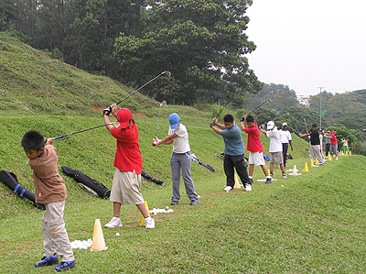
IB
Sports, exercise and health science
Skill in sport
Topic 5
Skill in sport
5.1.9 Discuss the differences between a skilled and a novice performer.
Sub-topics
The main aim of the analysis of human performance is to improve performance.
1. The characteristics and classification of skill
2. Information processing
3. Principles of skill learning

Slide 39
IB
Sports, exercise and health science
Skill in sport
Topic 5
Skill in sport
5.1.9 Discuss the differences between a skilled and a novice performer.
Sub-topics
A skilled performer has learnt how to achieve a particular performance goal at almost every attempt – with minimal waste of physical and mental energy, or time. A number of perceptual abilities and physical attributes has been identified by sports scientists to explain differences between skilled and novice performers.
Browne et.al 2000
1. The characteristics and classification of skill
2. Information processing
3. Principles of skill learning

Slide 40
IB
Sports, exercise and health science
Skill in sport
Topic 5
Skill in sport
5.1.9 Discuss the differences between a skilled and a novice performer.
Sub-topics
A skilled performer develops special attributes (such as anticipation and relevant cue recognition) through experience and practice.
Browne et.al 2000
1. The characteristics and classification of skill
2. Information processing
3. Principles of skill learning

Slide 41
IB
Sports, exercise and health science
Skill in sport
Topic 5
Skill in sport
5.1.9 Discuss the differences between a skilled and a novice performer.
These are some of the factors which distinguish the skilled performer from the novice:
    Consistency of performance.
    Accuracy
    Control
    Learned
    Efficiency
    Certainty
    Goal directed
    Fluency
Sub-topics
1. The characteristics and classification of skill
2. Information processing
3. Principles of skill learning

Slide 42
Section 5.2
Information Processing

Slide 43
IB
Sports, exercise and health science
Skill in sport
Topic 5
Skill in sport
5.2.1 Describe model of information processing.
Information processing is the system by which we take information from our surrounding environment, use it to make a decision and then produce a response:
[input-decision making-output]
IBO February 2007
Sub-topics
1. The characteristics and classification of skill
2. Information processing
3. Principles of skill learning

Slide 44
IB
Sports, exercise and health science
Skill in sport
Topic 5
Skill in sport
Black Box Model
Sub-topics
Input Output
Central Nervous System
Feedback
All the approaches are only models. Input and output are assessable/observable, but the decision-making process can only be speculation
1. The characteristics and classification of skill
2. Information processing
3. Principles of skill learning

Slide 45
IB
Sports, exercise and health science
Skill in sport
Topic 5
Skill in sport
Black Box Model – Main Stages
Sub-topics
Although many different information processing models exist, most have three main stages
  1. taking in and analyzing information about what is happening
  2. making decisions about what to do on the basis of the information
  3. programming the muscles to produce the movement required
INPUT
  The environment the performer can see, hear, & feel
  Sometimes called the stimuli
  What the performer did/does
OUTPUT – The response
1. The characteristics and classification of skill
2. Information processing
3. Principles of skill learning

Slide 46

Schmidt’s Model
Stimulus Identification
  receive and make sense of info
  From environment
  Ex. whether ball is spinning
Response Selection
  take interpreted information and decide what to do
Response Programming
  muscles need to carry out movement need to be stimulated
  Can become almost automatic in skilled players

Slide 47
IB
Sports, exercise and health science
Skill in sport
Topic 5
Skill in sport
5.2.1 Describe a simple model of information processing.
Sub-topics
Various psychologists have put forward graphical representations (models) of how they see the various parts of the cognitive process relating together.
These models are intended to aid understanding by helping teachers/coaches in their task analysis.
The learning process is, however, a changing, complex, multi-dimensional process and such models must be seen as hypothetical and flexible.
Wesson et.al 1998
1. The characteristics and classification of skill
2. Information processing
3. Principles of skill learning

Slide 48
IB
Sports, exercise and health science
Skill in sport
Topic 5
Skill in sport
5.2.1 Describe model of information processing.
Sub-topics
Two of the better known models which are generally referred to are Welford’s (1976) and Whiting’s (1970)
Wesson et.al 1998
1. The characteristics and classification of skill
2. Information processing
3. Principles of skill learning

Slide 49
IB
Sports, exercise and health science
Skill in sport
Topic 5
Skill in sport
5.2.1 Describe model of information processing.
Sub-topics
Both model’s reflect basically the same process:
    Stimulus identification stage/input stage.
    Response identification/selection stage/central stage
    Response programming stage/the output stage
although they use slightly different terminology.
Wesson et.al 1998
1. The characteristics and classification of skill
2. Information processing
3. Principles of skill learning

Slide 50
IB
Sports, exercise and health science
Skill in sport
Topic 5
Skill in sport
5.2.1 Describe model of information processing.
Sub-topics
All the approaches are only models. Input and output are assessable/observable, but the decision-making process can only be speculation.
IBO February 2007
1. The characteristics and classification of skill
2. Information processing
3. Principles of skill learning

Slide 51
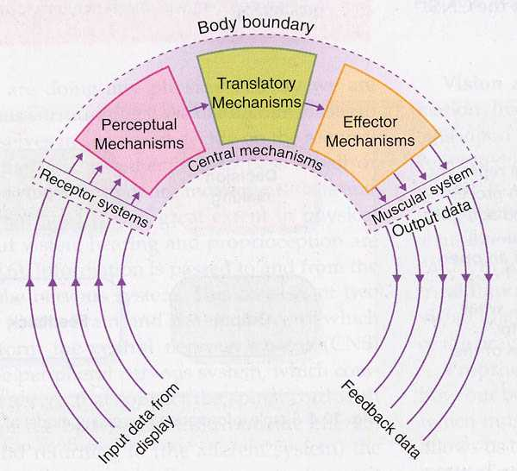
Whiting’s Model

Slide 52
IB
Sports, exercise and health science
Skill in sport
Topic 5
Skill in sport
5.2.2 Describe Welford’s model of information processing.
Welford (1960) saw the processing elements within the brain, called central mechanisms, as three sub-processors: perceptual mechanisms, translatory mechanisms and effector mechanisms.
The perceptual mechanisms interpret the information
The translatory mechanism makes decisions
The effector mechanism transfers those decisions to the muscles to produce a movement response.
Honeybourne et.al 2004
Sub-topics
1. The characteristics and classification of skill
2. Information processing
3. Principles of skill learning
Notes:
52

Slide 53
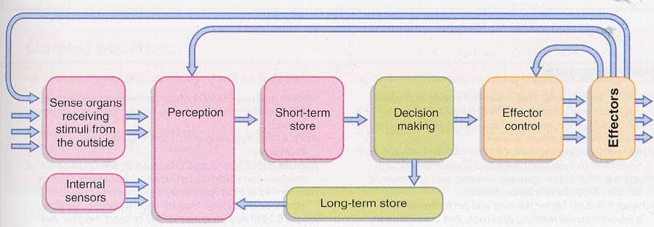
Welford’s Model

Slide 54
IB
Sports, exercise and health science
Skill in sport
5.2.2 Describe Welford’s model of information processing.
Topic 5
Skill in sport
Sense Organs – organ that responds to external stimuli by sending impulses to sensory nervous system
Perception – the ability to see, hear, or become aware through the senses
Short-Term Memory (STM) – holding small amount of information in mind
Long-Term Memory (LTM) – holding large amounts of information in mind
Decision Making – action or process of making decisions
Feedback – information about reactions to a product, a person’s performance of a task
Sub-topics
1. The characteristics and classification of skill
2. Information processing
3. Principles of skill learning
Notes:
54

Slide 55
IB
Sports, exercise and health science
Skill in sport
Topic 5
Skill in sport
5.2.3 Outline the components associated with sensory input.
This stage is mainly a sensory stage where the stimulus (e.g. a ball) is detected along with speed, size, colour, direction of movement from the display. The display (input) is the physical environment in which the learner is performing.-
Wesson et.al (1999)
Sub-topics
1. The characteristics and classification of skill
2. Information processing
3. Principles of skill learning

Slide 56
IB
Sports, exercise and health science
Skill in sport
5.2.3 Outline the components associated with sensory input.
Topic 5
Skill in sport
Sense organs, sensory systems and receptors take in the sensory information.
PROPRIOCEPTORS
nerve receptors within the body in muscles, joints, etc. providing intrinsic information regarding what class of movement is occurring.
Kinaesthetic information is also provided about the feel or sense of movement.
The inner ear also provides proprioceptive information eg. Are you balanced? Wesson et.al (1999)
Receptor responsible for telling us where we are oriented in space. Also tells us which muscle are contracted and which joints extended
Three components of proprioception are touch, equilibrium, and kinesthesis
Sub-topics
1. The characteristics and classification of skill
2. Information processing
3. Principles of skill learning

Slide 57
Components of Proprioception
Touch- enables us to feel pain, pressure, and temperature
Equilibrium- tells us if body is balanced or if it is tipping, turning or inverting; Controlled by vestibular apparatus in the middle ear
Kinesthesis- sends message about movement, or contraction state of the muscles, joints and tendons

Slide 58
IB
Sports, exercise and health science
Skill in sport
5.2.3 Outline the components associated with sensory input.
Topic 5
Skill in sport
EXTEROCEPTORS
receive extrinsic information from outside the body (from the display):
  Visual
  Audition
  Touch
  Smell
  Taste
Wesson et.al (1999)
Vison and Hearing are most important exteroceptors with regard to sport
Sub-topics
1. The characteristics and classification of skill
2. Information processing
3. Principles of skill learning

Slide 59
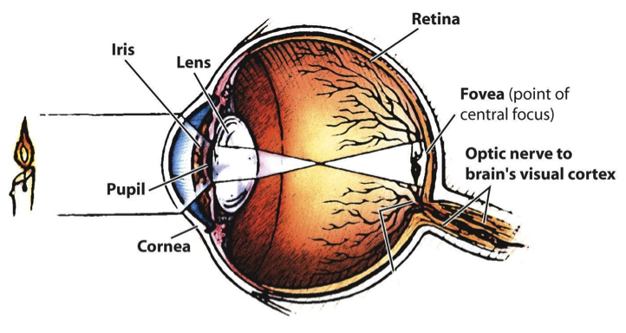
Vision

Slide 60
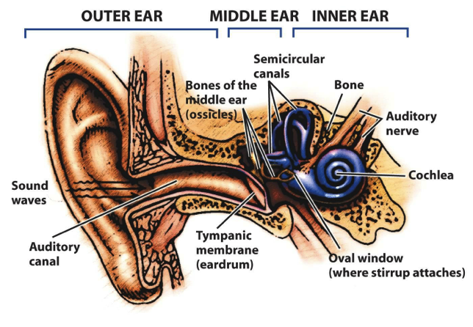
Hearing

Slide 61
IB
Sports, exercise and health science
Skill in sport
5.2.3 Outline the components associated with sensory input.
Topic 5
Skill in sport
INTEROCEPTORS
information from the internal organs of the body, heart, lungs, digestive system, etc.
This information is passed to the central mechanism of the brain via the body’s sensory nervous system, e.g. how fast the heart is beating, register fatigue, etc.
Wesson et.al (1999)
Sub-topics
1. The characteristics and classification of skill
2. Information processing
3. Principles of skill learning

Slide 62
IB
Sports, exercise and health science
Skill in sport
Topic 5
Skill in sport
5.2.4 Explain the signal detection process.
The signal detection process is often referred to as the detection – comparison –recognition process (D-C-R)
Sub-topics
1. The characteristics and classification of skill
2. Information processing
3. Principles of skill learning
Notes:
62

Slide 63
IB
Sports, exercise and health science
Skill in sport
Topic 5
Skill in sport
5.2.4 Explain the signal detection process.
PERCEPTION
Imagine you are playing in a game. You are waiting to receive a pass.
What are the things that your senses have to detect, in order for you to be able to perform the skill of receiving the pass? Make a list:
Sub-topics
1. The characteristics and classification of skill
2. Information processing
3. Principles of skill learning
Notes:
63

Slide 64
IB
Sports, exercise and health science
Skill in sport
Topic 5
Skill in sport
5.2.4 Explain the signal detection process.
These factors are all stimuli. A stimulus is any item of information which stands out from the background (the noise).
Stimuli in a game situation include things like the ball, but also includes opponents, conditions, team-mates, etc.
It is usually easier to sense and identify things if they are loud, bright, large, contrasting, fast-moving, or unusual.
Sub-topics
1. The characteristics and classification of skill
2. Information processing
3. Principles of skill learning
Notes:
64

Slide 65
IB
Sports, exercise and health science
Skill in sport
Topic 5
Skill in sport
5.2.4 Explain the signal detection process.
Hence, your team-mates wear the same uniform as you, not to look good, but to make identification easier.
In what other ways are the stimuli involved in sport made easier to detect?
Sub-topics
1. The characteristics and classification of skill
2. Information processing
3. Principles of skill learning
Notes:
65

Slide 66
IB
Sports, exercise and health science
Skill in sport
5.2.4 Explain the signal detection process.
Topic 5
Skill in sport
During the perception stage identification of a stimulus occurs, this involves three elements:
Detection, Comparison and Recognition .....the D C R process.
· Detection is the process of the registering of the stimulus, by the sense organ.
· Comparison is the process of referring the stimulus to the memory, to compare it to previously stored stimuli.
· Recognition is the process of finding a corresponding stimuli in the memory.
Sub-topics
1. The characteristics and classification of skill
2. Information processing
3. Principles of skill learning
Notes:
66

Slide 67
IB
Sports, exercise and health science
Skill in sport
Topic 5
Skill in sport
5.2.4 Explain the signal detection process.
During a sporting activity, we will be receiving a tremendous amount of information (detection) the vast majority of which is largely ignored.
For example, during a game, such as basketball, we tend to be unaware of many stimuli, such as the temperature, the touch of our clothes on our skin, the noise of the crowd, buses passing outside the hall, the firmness of the ground beneath our feet, etc.
In basketball what important stimuli might be detected when defending the ball carrier?
Sub-topics
1. The characteristics and classification of skill
2. Information processing
3. Principles of skill learning
Notes:
67

Slide 68
IB
Sports, exercise and health science
Skill in sport
Topic 5
Skill in sport
5.2.4 Explain the signal detection process.
We try to be solely concerned with the activity in question, and more importantly, those aspects of the game that are directly our concern.
In the basketball game what comparison might be looked for when defending the ball carrier?
What can be done once you have recognise the stimuli that indicate the ball carrier is about to fake a shot and dribble to the basket?
Sub-topics
1. The characteristics and classification of skill
2. Information processing
3. Principles of skill learning
Notes:
68

Slide 69
IB
Sports, exercise and health science
Skill in sport
Topic 5
Skill in sport
5.2.4 Explain the signal detection process.
REMEMBER DCR OCCURS within PERCEPTION: Exactly where we will find out later.
The vast amount of information received during a basketball game demands that we have to learn to concentrate on the stimuli that are important.
This is called SELECTIVE ATTENTION.
http://www.cix.co.uk/~dkeegan/PE/psychology/information%20processing/information%20processing.htm
Sub-topics
1. The characteristics and classification of skill
2. Information processing
3. Principles of skill learning
Notes:
69

Slide 70
IB
Sports, exercise and health science
Skill in sport
Topic 5
Skill in sport
5.2.5 Distinguish between the characteristics of short-term sensory store, short-term memory and long-term memory.
The memory is seen as a critical part of the
overall learning process.
It is central to our ability to receive the relevant
information, interpret it, use it to make decisions
and then pass out the appropriate information via
the body’s effector systems.
wesson et.al (1998)
Sub-topics
1. The characteristics and classification of skill
2. Information processing
3. Principles of skill learning

Slide 71
IB
Sports, exercise and health science
Skill in sport
Topic 5
Skill in sport
5.2.5 Distinguish between the characteristics of short-term sensory store, short-term memory and long-term memory.
There has been much debate about the structure, organization and capacity of the memory process with many modifications being suggested to the basic “two dimensional process” or “multi-store” model of memory as described by Atkinson and Shiffrin (1968).
wesson et.al (1998)
Sub-topics
1. The characteristics and classification of skill
2. Information processing
3. Principles of skill learning
Notes:
71

Slide 72
IB
Sports, exercise and health science
Skill in sport
Topic 5
Skill in sport
5.2.5 Distinguish between the characteristics of short-term sensory store, short-term memory and long-term memory.
Sub-topics
It is generally suggested, however, that there are two main aspects of memory: short term memory (STM) and long term memory (LTM).
These two parts are in some way preceded by a third area known as the sensory system or short-term sensory store (STSS) which involves a selection and attention process.
wesson et.al (1998)
1. The characteristics and classification of skill
2. Information processing
3. Principles of skill learning
Notes:
72

Slide 73
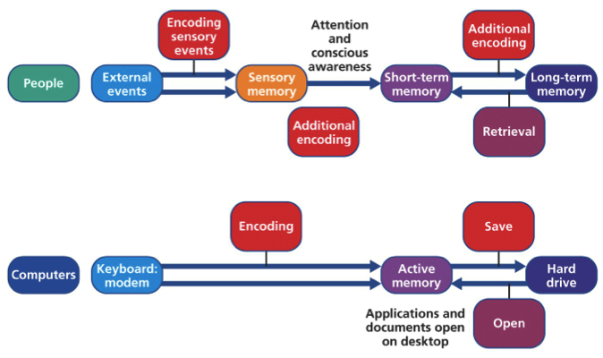
Memory Systems

Slide 74
Short Term Sensory Store
All the information that is received from the senses and held for a very brief time
    Capacity- Unlimited
    Duration- Less than a second
      Just enough time to make a decision on its importance
Job is to filter out relevant information
Much of the work of sensory memory is done before we are consciously aware of it.

Slide 75
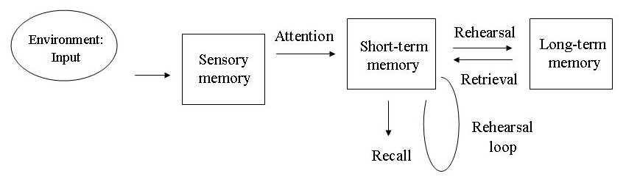
IB
Sports, exercise and health science
Skill in sport
Topic 5
Skill in sport
5.2.5 Distinguish between the characteristics of short-term sensory store, short-term memory and long-term memory.
Sub-topics
1. The characteristics and classification of skill
2. Information processing
3. Principles of skill learning
Notes:
75

Slide 76
IB
Sports, exercise and health science
Skill in sport
Topic 5
Skill in sport
5.2.6 Discuss the relationship between selective attention and memory.
Sub-topics
Owing to the apparent limited neurological capacity of the short term memory suggested by many single channel models (e.g. Broadbent 1958, Norman 1969, 1976) it is acknowledged that there is some form of selection system in order to prioritise information, although there are disagreements about the positioning of the filtering system. http://juni.osfc.ac.uk/Extension/level_3_extension/physical_education/lesson_3/welfords_model.asp
Wesson et.al 2005
1. The characteristics and classification of skill
2. Information processing
3. Principles of skill learning
Notes:
76

Slide 77
IB
Sports, exercise and health science
Skill in sport
Topic 5
Skill in sport
5.2.6 Discuss the relationship between selective attention and memory.
Sub-topics
The process of selective attention is responsible for selecting relevant from irrelevant information from the display. This allows the tennis player, for example, to focus on specific cues being presented by their opponent when receiving serve (the grip, throw up of the ball, angle of raquet, position in relation to service court etc) and ignore other aspects of the environment (display) which may distract them (eg crowd, noise from the next court, ball boys etc) thus preventing a potential information overload.
Wesson et.al 2005
1. The characteristics and classification of skill
2. Information processing
3. Principles of skill learning
Notes:
77

Slide 78
Selective Attention
Selective attention (SA) operates in the short-term sensory store (STSS). Only the relevant information is passed to the short-term memory (STM) where it is held for several seconds.
SA ensures that information overload does not occur and prevents confusion as the brain would not be able to cope with streams of information.

Slide 79
Selective Attention and Sport
A filtering mechanism operates, which separates the relevant information from the irrelevant (noise) information so that athletes concentrate on one cue or stimulus (for example, the ball, position of player in a game of tennis) to the exclusion of others.
SA is very important when accuracy or fast responses are required and can be improved by learning through past experience and interaction with long-term memory.

Slide 80
IB
Sports, exercise and health science
Skill in sport
Topic 5
Skill in sport
5.2.6 Discuss the relationship between selective attention and memory.
Sub-topics
As well as increasing the time that a stimulus can remain in the STM, effective selective attention can help to reduce reaction time.
Wesson et.al 2005
Read the following website for detailed link between selective attention and memory.
Information processing
1. The characteristics and classification of skill
2. Information processing
3. Principles of skill learning
Notes:
80

Slide 81
IB
Sports, exercise and health science
Skill in sport
Topic 5
Skill in sport
5.2.6 Discuss the relationship between selective attention and memory.
Certain stimuli attract our attention better, e.g., loud, bright, fast, contrasting, unusual but so do stimuli which we are interested in.
A demonstration of an overhead clear in badminton would present much more information to somebody who had never seen it performed before, than it presents to an expert.
Thus the amount of information, as used in this context, is directly proportional to the amount of uncertainty an event holds for a given individual.
If the situation presented to you is novel, then there is considerable information to be taken in, and you can easily suffer from information overload.
Sub-topics
1. The characteristics and classification of skill
2. Information processing
3. Principles of skill learning
Notes:
81

Slide 82
IB
Sports, exercise and health science
Skill in sport
Topic 5
Skill in sport
5.2.6 Discuss the relationship between selective attention and memory.
If however, you are an expert, then there is less information to be concerned about. You filter out the unnecessary junk that is part of the environment
Selective attention allows us to focus on just a few of the millions of stimuli arriving. This is helpful in a game situation, why?
Information is invariably detected by the senses. All information being received by the senses is stored in the....
Sub-topics
1. The characteristics and classification of skill
2. Information processing
3. Principles of skill learning
Notes:
82

Slide 83
IB
Sports, exercise and health science
Skill in sport
Topic 5
Skill in sport
5.2.6 Discuss the relationship between selective attention and memory.
MEMORY
In sport, perceiving the flight path of a ball, or knowing which muscle commands to use to be able to perform a somersault, require that remembered information be used, in the execution of the action.
There are three aspects to memory:
  SHORT-TERM SENSORY STORAGE (STSS)
  SHORT-TERM MEMORY (STM)
  LONG-TERM MEMORY (LTM)
Sub-topics
1. The characteristics and classification of skill
2. Information processing
3. Principles of skill learning
Notes:
83

Slide 84
IB
Sports, exercise and health science
Skill in sport
Topic 5
Skill in sport
5.2.6 Discuss the relationship between selective attention and memory.
STSS - all the information coming in from the environment can be stored in the STSS. This lasts about half a second or less. It is the first 'compartment' of memory. Separate STSS compartments are thought to operate for each form of sensory information. It is sub-conscious, and if not immediately attended to, is lost.
STM - Only information that is attended to, is moved from
STSS to STM. It is important in sport, that attention is maintained whilst performing a skill, e.g., keep your eye on the ball until you have caught it before attending to the next skill of moving
Sub-topics
1. The characteristics and classification of skill
2. Information processing
3. Principles of skill learning
Notes:
84

Slide 85
IB
Sports, exercise and health science
Skill in sport
Topic 5
Skill in sport
5.2.6 Discuss the relationship between selective attention and memory.
The capacity of the STM is limited. Information can be retained for up to 60 sec's, but the capacity is limited to 5-9 items. "Chunking" helps.
Information remains in the STM only as long as it is attended to, e.g., by rehearsal. If attention is directed elsewhere, information is lost within 30 sec's.
STM is important in learning motor skills. You need to recall information about a performance, to compare it to previous performances.
Hence, all the information involved in the learning and performing of skills is compared to existing information via the STM, and for this reason it is sometimes called the "working memory".
Sub-topics
1. The characteristics and classification of skill
2. Information processing
3. Principles of skill learning
Notes:
85

Slide 86
IB
Sports, exercise and health science
Skill in sport
Topic 5
Skill in sport
5.2.6 Discuss the relationship between selective attention and memory.
DCR occurs within the short term memory.
STM is also important for the coach. The limited capacity of the STM, means that instructions should be:
  Brief
  Succinct
  Given when learner is paying attention.
Otherwise the information will be lost from the STM before the learner can use it.
Selective attention lengthens the time that a stimulus remains in short term memory.
STM Capacity – 5-9 items (7+2)
STM Duration - 10-20 seconds unless rehearsed
Sub-topics
1. The characteristics and classification of skill
2. Information processing
3. Principles of skill learning
Notes:
86

Slide 87
IB
Sports, exercise and health science
Skill in sport
Topic 5
Skill in sport
5.2.6 Discuss the relationship between selective attention and memory.
LTM is where all information that enters the STM that is rehearsed, is stored.
All information in the STM is either stored in the LTM or lost.
LTM Capacity – unlimited
LTM Duration - ~ 1 Century
As a basketball player may have played against a defender on a number of occasions, what information might be stored in the LTM and how might it effect their response? Alternately give an analogy of this nature applicable to your sport.
Sub-topics
1. The characteristics and classification of skill
2. Information processing
3. Principles of skill learning
Notes:
87

Slide 88
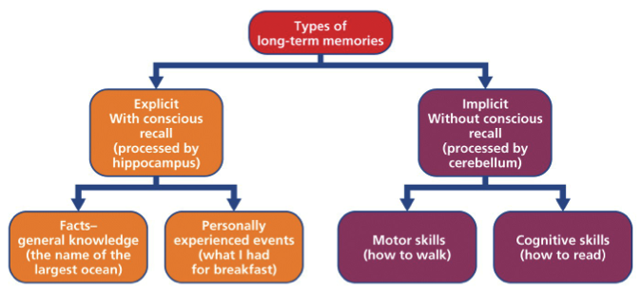
IB
Sports, exercise and health science
Skill in sport
Topic 5
Skill in sport
5.2.6 Discuss the relationship between selective attention and memory.
The LTM is therefore a store of well-learned past experiences.
The information held in the LTM is used to compare against new experiences.
It also stores responses used in these different situations.
Sub-topics
1. The characteristics and classification of skill
2. Information processing
3. Principles of skill learning
Notes:
88

Slide 89
IB
Sports, exercise and health science
Skill in sport
Topic 5
Skill in sport
5.2.6 Discuss the relationship between selective attention and memory.
Retention and retrieval of information from LTM is influenced by:
rehearsal - the more a memory is rehearsed, the more likely it is that it will be remembered
meaningfulness - the more meaningful a memory is, the more likely it is to be remembered
speed of learning - the quicker a process is learned, the more likely it is to be remembered
Sub-topics
1. The characteristics and classification of skill
2. Information processing
3. Principles of skill learning
Notes:
89

Slide 90
IB
Sports, exercise and health science
Skill in sport
Topic 5
Skill in sport
5.2.6 Discuss the relationship between selective attention and memory.
over-learning - the more a skill is practised, even when perfected, the better it will be remembered
All of the processes discussed so far involve information, that appears to be stored in some way within the Central Nervous System.
Sub-topics
1. The characteristics and classification of skill
2. Information processing
3. Principles of skill learning
Notes:
90

Slide 91
IB
Sports, exercise and health science
Skill in sport
Topic 5
Skill in sport
5.2.6 Discuss the relationship between selective attention and memory.
The efficiency of short term sensory store and the selective attention process is influenced by several factors.
    Experience: know what to look for – an experienced tennis player will no what to look for when facing an opponent.
    Arousal: the more alert you are the more likely you are to chose appropriate cues. In cricket, a batsman who is alert is able to pick up on spin, speed and direction of the ball.
Wesson et.al 2005
Sub-topics
1. The characteristics and classification of skill
2. Information processing
3. Principles of skill learning
Notes:
91

Slide 92
IB
Sports, exercise and health science
Skill in sport
Topic 5
Skill in sport
5.2.6 Discuss the relationship between selective attention and memory.
    Quality of instruction: as a beginner you don’t always know what to respond to. The coach or teacher can direct your attention verbally, visually, mechanically
    Intensity of stimulus: the effectiveness of the senses (e.g. short sighted, poor hearing) when detecting, e.g. Speed, noise, size/shape and colour.
Wesson et.al 2005
Sub-topics
1. The characteristics and classification of skill
2. Information processing
3. Principles of skill learning
Notes:
92

Slide 93
IB
Sports, exercise and health science
Skill in sport
Topic 5
Skill in sport
5.2.6 Discuss the relationship between selective attention and memory.
Selective attention can be improved by:
    Lots of relevant practice
    Increasing intensity of stimulus
    Use of language associated with or appropriate to the performer in order to motivate and arouse
    Use of past experience/transfer to help explanations
    Direct attention
Wesson et.al 2005
Sub-topics
1. The characteristics and classification of skill
2. Information processing
3. Principles of skill learning
Notes:
93

Slide 94
IB
Sports, exercise and health science
Skill in sport
Topic 5
Skill in sport
5.2.6 Discuss the relationship between selective attention and memory.
Research task:
Discuss the following terms:
    Filtering
    Channel capacity (single channel hypothesis/series or parallel.
Sub-topics
1. The characteristics and classification of skill
2. Information processing
3. Principles of skill learning
Notes:
94

Slide 95
IB
Sports, exercise and health science
Skill in sport
Topic 5
Skill in sport
5.2.6 Discuss the relationship between selective attention and memory.
Serial and parallel processing
Some of the processes within the information processing model involve decisions that are sequential - one decision follows on from another and affects the next one. Some decisions, however, are simultaneous or parallel in nature, in other words, processes are occurring independently from one another. It is generally recognised that if information processing is to be applied to the learning of motor skills there is mixture of serial and parallel processing.
Hneybourne et.al 2004
Sub-topics
1. The characteristics and classification of skill
2. Information processing
3. Principles of skill learning
Notes:
95

Slide 96
IB
Sports, exercise and health science
Skill in sport
Topic 5
Skill in sport
5.2.6 Discuss the relationship between selective attention and memory.
Single Channel Hypothesis
This states that when handling stimuli from the environment the brain can deal with only one stimulus at a time. This is because the brain is thought of as a single channel organ, it can only deal with one piece of information at a time, which has to be processed before the next stimulus can be dealt with. This is often referred to as the “bottleneck”.
Honeybourne et.al 2004
Sub-topics
1. The characteristics and classification of skill
2. Information processing
3. Principles of skill learning
Notes:
96

Slide 97
IB
Sports, exercise and health science
Skill in sport
Topic 5
Skill in sport
5.2.7 Compare different methods of memory improvement.
Improving Memory Techniques
Rehearsal
  go over information again and again to ensure relevant information is passed into our long term memory
  Needs to be stored if it is to be remembered
  Rehearsal and repetition of information helps to ensure encoding and enhanced memory.
  How does it work? - It is the process whereby material is presented over and over until it is encoded.
http://www.usq.edu.au/studentservices/counselling/issues/memory/rehearsal.htm
Sub-topics
1. The characteristics and classification of skill
2. Information processing
3. Principles of skill learning
Notes:
97

Slide 98
IB
Sports, exercise and health science
Skill in sport
Topic 5
Skill in sport
5.2.7 Compare different methods of memory improvement.
It can occur in any sensory modality, for example:
verbal - repeating information over and over either aloud or silently
motor - drawing or writing information or performing a sequence of actions repeatedly
visual - looking at information over and over.
The more sensory modalities used in the repetition of information, the more likely that information will be remembered.
http://www.usq.edu.au/studentservices/counselling/issues/memory/rehearsal.htm
Sub-topics
1. The characteristics and classification of skill
2. Information processing
3. Principles of skill learning
Notes:
98

Slide 99
Improving Memory Techniques
Brevity- Only able to process a little at a time.
  “three coaching points, then practice”
Clarity- Keep it simple to start and add complexity later. Introducing similar topics at the same time can cause ‘interference’
  Ex.- Tennis to badminton transfer

Slide 100
Improving Memory Techniques
Association- link new knowledge to that you already know; Teach individual components that will be linked into one fluid movement
Organization- organize the information we are to learn and make it meaningful; Coaches sometimes use imagery to accomplish this

Slide 101
IB
Sports, exercise and health science
Skill in sport
Topic 5
Skill in sport
5.2.7 Compare different methods of memory improvement.
Chunking
Can hold more information in our short term memory if we ‘chunk’ it into meaningful units.
Different pieces of information can be grouped (or chunked) together then remembered as one piece of information.
For example, instead of trying to remember each separate move made by each player in a line-out in Rugby or a penalty corner in Hockey, a player might remember the whole drill as a single number.
Honeybourne et.al 2004
Sub-topics
1. The characteristics and classification of skill
2. Information processing
3. Principles of skill learning
Notes:
101

Slide 102
Improving Memory Techniques
Practice- related to rehearsal
  practicing new things shuttles information between short and long term memory
  Improves ‘memory trace’ making information more readily available.

Slide 103
IB
Sports, exercise and health science
Skill in sport
Topic 5
Skill in sport
5.2.8 Define the term response time
Response time = reaction time + movement time.
IBO February 2007
Sub-topics
1. The characteristics and classification of skill
2. Information processing
3. Principles of skill learning
Notes:
103

Slide 104
IB
Sports, exercise and health science
Skill in sport
Topic 5
Skill in sport
5.2.9 Outline factors that determine response time
Response time is defined as the time from the initiation of movement to the completion of that movement. Wesson et.al 2005
Response time is an ability, having individual and group variance (for example gender and age)
IBO February 2007
Made up of reaction time + movement time
Sub-topics
1. The characteristics and classification of skill
2. Information processing
3. Principles of skill learning
Notes:
104

Slide 105
IB
Sports, exercise and health science
Skill in sport
Topic 5
Skill in sport
5.2.9 Outline factors that determine response time
Reaction Time is defined as :
“the time between the onset of a signal to respond (stimulus) and the initiation of that response”
R. A Magill
Sub-topics
1. The characteristics and classification of skill
2. Information processing
3. Principles of skill learning
Notes:
105

Slide 106
IB
Sports, exercise and health science
Skill in sport
Topic 5
Skill in sport
5.2.9 Outline factors that determine response time
Movement time is defined as the time from the
initiation of the first movement to the completion of
that movement. Wesson et.al2005
In other words……it is the time it takes to carry out the motor aspect of the movement
Sub-topics
1. The characteristics and classification of skill
2. Information processing
3. Principles of skill learning
Notes:
106

Slide 107
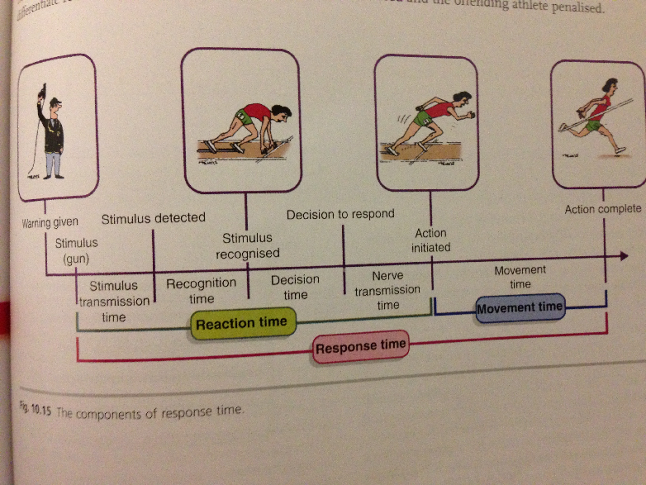

Slide 108
IB
Sports, exercise and health science
Skill in sport
Topic 5
Skill in sport
5.2.9 Outline factors that determine response time
Several factors affect response time:
  Gender: Males generally have quicker reactions than females, but the reaction times of females deteriorate less quickly than males.
  Age: Your reaction time gets quicker up to an optimum age and then deteriorates.
  Number of choices:
    Simple reaction time – no choices
    Choice reaction time – more than 1 choice – slower reaction
  Hoenybourne et.al 2004
Sub-topics
1. The characteristics and classification of skill
2. Information processing
3. Principles of skill learning
Notes:
108

Slide 109
IB
Sports, exercise and health science
Skill in sport
Topic 5
Skill in sport
5.2.9 Outline factors that determine response time
Reaction time includes:
  Stimulus transmission
  Detection
  Recognition
  Decision to respond
  Nerve transmission
  Initiation of action
  IBO February 2007
Sub-topics
1. The characteristics and classification of skill
2. Information processing
3. Principles of skill learning
Notes:
109

Slide 110
Factors affecting Reaction Time
Reaction Time is an ability
Can be affected by:
  Age and sex
  Health
  Body Temperature (the colder the slower the reaction
  Personality- extroverts faster than introverts
  Length of Neural Pathways
  State of alertness, arousal, and motivation

Slide 111
Conditions Affecting
Reaction Time
The type of task and nature of stimulus can also effect reaction time
  Intensity of the stimulus
  The probability of the stimulus occurring
  The existence of warning signals and the extent to which stimulus is expected
  The sense being used for detection

Slide 112
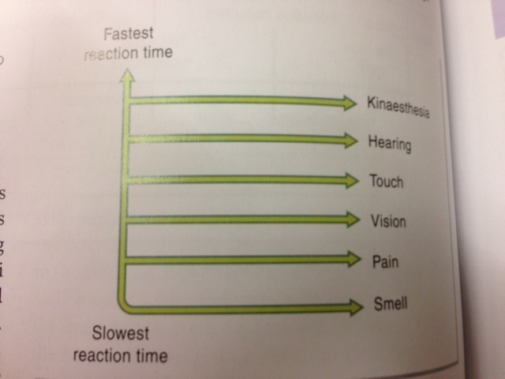
Sense and Reaction Time

Slide 113
IB
Sports, exercise and health science
Skill in sport
Topic 5
Skill in sport
5.2.9 Outline factors that determine response time
Choice reaction time
This is when there are a number of alternatives: either a performer has to respond correctly when faced with several stimuli all requiring a different response or a performer has to respond correctly to a specific stimulus with a choice of stimuli. Generally, the more choices a performer has to face with regard to the number of stimuli or more importantly the number of optional responses, the more information they have to process and the longer or slower the reaction time is.
Wesson et.al 2005
Sub-topics
1. The characteristics and classification of skill
2. Information processing
3. Principles of skill learning
Notes:
113

Slide 114
SRT vs. CRT
Simple Reaction Time- Reaction time hen there is only on possible response
Choice Reaction Time- Reaction time when there is more than once choice
Hicks Law- the more choices that are available to us (the greater the number of stimulus-response alternatives), the longer we take to react

Slide 115
IB
Sports, exercise and health science
Skill in sport
Topic 5
Skill in sport
5.2.9 Outline factors that determine response time
This rule of thumb is based on Hick’s Law (1952).
Hick’s Law states that: “Reaction time will increase logarithmically as the number of stimulus response choices increase.”
The linear relationship implies that reaction time increases at a constant rate every time the number of response choices is doubled.
Wesson et.al 2005
Sub-topics
1. The characteristics and classification of skill
2. Information processing
3. Principles of skill learning
Notes:
115

Slide 116
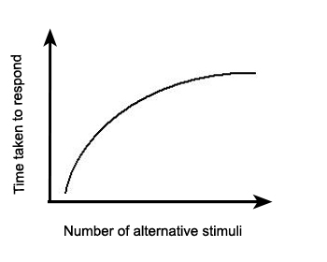
Hick’s Law
Reaction time increases by 150 milliseconds every time the stimulus-response alternatives doubles

Slide 117
IB
Sports, exercise and health science
Skill in sport
Topic 5
Skill in sport
5.2.9 Outline factors that determine response time
This has obvious implications for a performer when trying to outwit an opponent.
e.g. a bowler in cricket is better placed to dismiss a batsman if they have more types of delivery at there disposal and can use them at various times to create uncertainty in the batsman’s mind. In this instance reaction time can be increased by over 50%.
Wesson et.al 2005
Sub-topics
1. The characteristics and classification of skill
2. Information processing
3. Principles of skill learning
Notes:
117

Slide 118
ACTIVITY
Reaction Time and Choices
Work in pairs.
You will need a stopwatch and a set of playing cards. The task is to sort the shuffled pack.
Your partner will give you a start signal, time you to the completion of the sort and note the time
Tasks to be done w/low & high lighting in room
  Separate red cards from black (two groups)
  Separate the four suits (four groups)
  Separate four suits of court cards and four suits of non-court cards (eight groups)

Slide 119
Reaction Time
&
Choice Discussion
What do your results tell you about the relationship between response time and the number of stimulus response alternatives available?
Choose a sport/activity in which choice response time is important. Explain why?
List some sports in which short reaction time is not particularly important and explain why or why not.

Slide 120
IB
Sports, exercise and health science
Skill in sport
Topic 5
Skill in sport
5.2.10 Evaluate the concept of psychological refractory period (PRP)
A performer using previous experience in order to help them anticipate certain moves or actions depends heavily on making the correct predictions in order to reduce the time to make a response.
One way a performer can try to increase the reaction time of their opponent is by presenting certain false information, a certain stance or movement of a racket in tennis implies to the opponent that a certain shot or movement will occur (predicting).
Wesson et.al 2005
Sub-topics
1. The characteristics and classification of skill
2. Information processing
3. Principles of skill learning
Notes:
120

Slide 121
IB
Sports, exercise and health science
Skill in sport
Topic 5
Skill in sport
5.2.10 Evaluate the concept of psychological refractory period (PRP)
The opponent then processes this information in order to prepare and initiate a response. As the opponent’s response to the first “dummy” or fake action is initiated, the player changes the move or shot causing the opponent to re-evaluate the situation and react to the second set of stimuli.
The processing of the new information, for instance a drop shot in badminton rather than the anticipated overhead shot, takes time, creating a slight time delay.
Wesson et.al 2005
Sub-topics
1. The characteristics and classification of skill
2. Information processing
3. Principles of skill learning
Notes:
121

Slide 122
IB
Sports, exercise and health science
Skill in sport
Topic 5
Skill in sport
5.2.10 Evaluate the concept of psychological refractory period (PRP)
This delay in being able to respond to the second of two closely spaced stimuli is termed the psychological refractory period (PRP).
In game situations, defenders are made to look foolish as by the time they have reorganised their movement to deal with the second stimulus, the point has been won or they have been beaten by the attack.
Wesson et.al 2005
Sub-topics
1. The characteristics and classification of skill
2. Information processing
3. Principles of skill learning
Notes:
122

Slide 123
IB
Sports, exercise and health science
Skill in sport
Topic 5
Skill in sport
5.2.10 Evaluate the concept of psychological refractory period (PRP)
Theoretically the delay is created by the increased processing time caused by a hold up or “bottleneck effect” within the response programming stage.
Within this stage it is suggested that the brain can only deal with the initiation of one action or response when presented with two closely following stimuli. This is known as the single channel hypothesis.
Wesson et.al 2005
Sub-topics
1. The characteristics and classification of skill
2. Information processing
3. Principles of skill learning
Notes:
123

Slide 124
IB
Sports, exercise and health science
Skill in sport
Topic 5
Skill in sport
5.2.10 Evaluate the concept of psychological refractory period (PRP)
A PRP will only occur, however, if the “fake” or “dummy” move or action is significant enough to cause the opponent to think it is actually going to happen.
There must be no lengthy delay in carrying out the stimulus or “real” action as this may negate the whole significance of the PRP>
Wesson et.al 2005
Sub-topics
1. The characteristics and classification of skill
2. Information processing
3. Principles of skill learning
Notes:
124

Slide 125
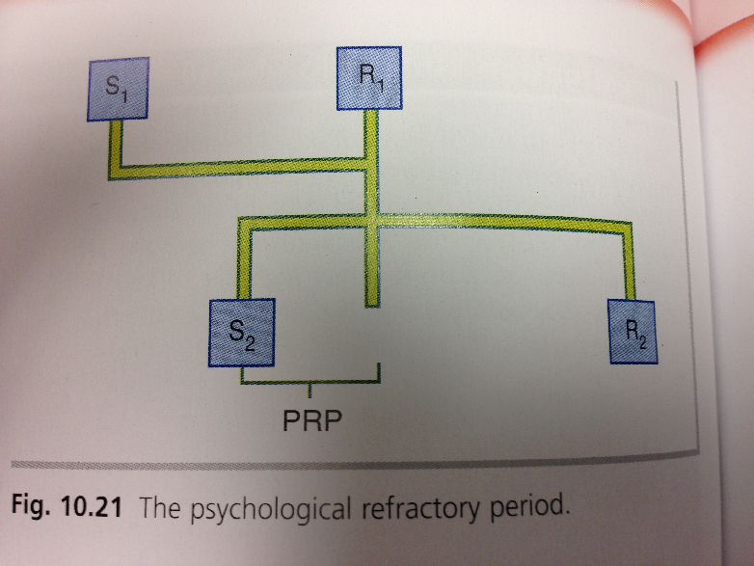
Psychological Refractory Period

Slide 126
Improving Reaction Time
Detecting the Cue
Detecting Relevant Cue
Decision Making
Changes in Attentional Focus
Controlling Anxiety
Creating Optimum Levels of Motivation
Warm-Up

Slide 127
Anticipation
Strategy used to reduce response to a stimulus
  Ex anticipating the starting gun in a race (temporal anticipation
  Anticipating what type of serve your opponent will hit in your tennis match (spatial or event anticipation)
Can be improved through practice

Slide 128
IB
Sports, exercise and health science
Skill in sport
Topic 5
Skill in sport
5.2.10 Evaluate the concept of psychological refractory period (PRP)
Sub-topics
Welford (1968) - Experiment with 2 stimuli
When a 2nd stimuli is introduced shortly after the 1st stimuli, the reaction time is slower
The time gap between the 2 stimuli is called psychological refractory period (PRP)
1. The characteristics and classification of skill
2. Information processing
3. Principles of skill learning
Notes:
128

Slide 129
IB
Sports, exercise and health science
Skill in sport
Topic 5
Skill in sport
5.2.11Define a motor programme
Defined as a set of movements stored as a whole in the memory regardless of whether feedback is used in their execution.
IBO February 2007
An abstract code or structure, representing one or more skilled movements, stored in the central nervous system. The motor programme resembles a computer programme because it appears to consist of a series of neural commands, which when initiated result in the production of a particular sequence of coordinated movement.
http://www.answers.com/topic/motor-programme
Sub-topics
1. The characteristics and classification of skill
2. Information processing
3. Principles of skill learning
Notes:
129

Slide 130
IB
Sports, exercise and health science
Skill in sport
Topic 5
Skill in sport
5.2.11Define a motor programme
What ever the skill, when we learn it we must develop the particular movement pattern for that skill. The movement pattern or executive/motor programme is made up of different components or (subroutines) that have to be controlled and performed in the correct time.
Galligan et.al 2000
Sub-topics
1. The characteristics and classification of skill
2. Information processing
3. Principles of skill learning
Notes:
130

Slide 131
IB
Sports, exercise and health science
Skill in sport
Topic 5
Skill in sport
5.2.11 Define a motor programme
The skills in a game of badminton require a number of “executive programmes” – one of which is the smash. Each of these programmes is broken down into a series of subroutines – “mini skills” – which may also be subroutines of other executive programmes. Our motor memory is the storage of how to perform a particular skill and is accessed in long term memory whenever we want to perform.
Galligan et.al 2000
Sub-topics
1. The characteristics and classification of skill
2. Information processing
3. Principles of skill learning
Notes:
131

Slide 132
IB
Sports, exercise and health science
Skill in sport
Topic 5
Skill in sport
5.2.11 Define a motor programme
Defined as a set of movements stored as a whole in the memory regardless of whether feedback is used in their execution.
Includes what movements occur for what skill and in what order
Consist of executive programs (whole skill) and subroutines (movements making up skill)
Sub-topics
1. The characteristics and classification of skill
2. Information processing
3. Principles of skill learning
Tennis
Serve
Stance
Throw
Swing
Weight Transfer
Strike
Notes:
132

Slide 133
Activity
Identifying Motor Programs
Work in pairs
Identify a skill both partners are familiar with and identify a sport, executive program and subroutines for your skill
Draw a hierarchy identifying one skill (executive program) and 5-7 subroutines making up that skill

Slide 134
IB
Sports, exercise and health science
Skill in sport
Topic 5
Skill in sport
5.2.12 Compare motor programmes from both open and closed loop perspectives
Open loop
Motor programmes are generalised series of movements stored in the long-term memory and each is retrieved by a single decision. They usually explain how we perform very quick actions in sport, especially closed skills. Some almost automatic movements do not seem to be under conscious control i.e. if a decision had to be made about every single muscle action to catch a ball the information processing would take far too long. This kind of control over actions is know as open loop control.
Honeybourne et.al 2004
Sub-topics
1. The characteristics and classification of skill
2. Information processing
3. Principles of skill learning
Notes:
134

Slide 135
IB
Sports, exercise and health science
Skill in sport
Topic 5
Skill in sport
5.2.12 Compare motor programmes from both open and closed loop perspectives
There is no feedback with open loop control. If the environment remains constant and predictable then a motor programme can be used or “run” effectively.
The more a performer practices a series of movements, the more likely it is that a motor programme will be formed.
Honeybourne et.al 2004
Knowledge of result provides feedback after the movement is completed
Ballistic Skills- limb swing is fast and move under their own momentum
    Ex. Golf Swing- Not controllable once it is started
Sub-topics
1. The characteristics and classification of skill
2. Information processing
3. Principles of skill learning
Notes:
135

Slide 136
IB
Sports, exercise and health science
Skill in sport
Topic 5
Skill in sport
5.2.12 Compare motor programmes from both open and closed loop perspectives
Closed loop
This involves the process of feedback. The feedback for this type of control is internal – information received from the proprioceptors which detect and correct errors in movement.
Programs which occur at a pace that allow for kinaesthetic feedback to make adjustments & correct errors
Honeybourne et.al 2004
Sub-topics
1. The characteristics and classification of skill
2. Information processing
3. Principles of skill learning
Notes:
136

Slide 137
IB
Sports, exercise and health science
Skill in sport
Topic 5
Skill in sport
5.2.12 Compare motor programmes from both open and closed loop perspectives
This theory provided by Jack Adams (1971). He states that movements are initiated by a memory trace. This triggers an appropriate response that has been stored in the long term memory.
The perceptual trace is then initiated which controls the movement once it has been triggered by the memory trace. The perceptual trace is developed from experiences. When a motor skill is practised, the performer is continuously matching the perceptual trace with feedback.
Honeybourne et.al 2004
Sub-topics
1. The characteristics and classification of skill
2. Information processing
3. Principles of skill learning
Notes:
137

Slide 138
If the feedback tells the performer that there is something wrong because the movement does not match the perceptual trace, then the action is corrected. This process can happen throughout the movement and errors are continuously monitored and movements corrected.
Memory Trace- Executive Programs stored in our long term memory
Perceptual Trace- Executive program in our short term memory during skill
    Perceptual trace compared to memory trace and if they do not match adjustments can be made

Slide 139
IB
Sports, exercise and health science
Skill in sport
Topic 5
Skill in sport
5.2.13 Explain Schmidt’s schema theory
Some people feel that the open loop and closed loop theories do not fully explain how we perform so many actions in sport with relatively little conscious control – there simply can not be enough storage space for so many motor programmes. Under the schema theory a motor programme is seen only as a generalised series of movements that can be modified by taking in information as a skill is performed.
Honeybourne et.al 2004
Sub-topics
1. The characteristics and classification of skill
2. Information processing
3. Principles of skill learning
Notes:
139

Slide 140
IB
Sports, exercise and health science
Skill in sport
Topic 5
Skill in sport
5.2.13 Explain Schmidt’s schema theory
The theory usefully explains how we can immediately learn a new skill, and also solves the storage problem. When a movement takes place we perceive information about where we are (knowledge of the environment), what we have to do to perform successfully (response specifications), what the movement feels like (sensory consequences) and what happens when we respond (response outcomes). These items of information, called “schemas”, are then stored and then used update the motor programme when we next want to use it.
Honeybourne et.al 2004
Sub-topics
1. The characteristics and classification of skill
2. Information processing
3. Principles of skill learning
Notes:
140

Slide 141
IB
Sports, exercise and health science
Skill in sport
Topic 5
Skill in sport
5.2.13 Explain Schmidt’s schema theory
Schmidt suggested that we learn and control movements by developing generalised patterns of movement around certain types of movement experience. e.g. throwing.
A performer does not store all the many specific but different types of catching and throwing; rather they collate various items of information every time they experience catching or throwing in general. Performers thus construct schemas which enable them at some future time to successfully carry out a variety of movements.
Wesson et.al 2005
Sub-topics
1. The characteristics and classification of skill
2. Information processing
3. Principles of skill learning
Notes:
141

Slide 142
IB
Sports, exercise and health science
Skill in sport
Topic 5
Skill in sport
5.2.13 Explain Schmidt’s schema theory
A schema for throwing can be adapted:
  returning a cricket ball to wicket keeper
  a long pass in basketball/netball
  a goalkeeper in football setting up an attack
  throwing a javelin
  playing darts
  By collating as much movement information as possible with regard to throwing we can adapt to new situations because we know the general rules associated with throwing long, high, low etc.
Wesson et.al 2005
Sub-topics
1. The characteristics and classification of skill
2. Information processing
3. Principles of skill learning
Notes:
142

Slide 143
IB
Sports, exercise and health science
Skill in sport
Topic 5
Skill in sport
5.2.13 Explain Schmidt’s schema theory
Recall schemas
Recall schemas are the information stored about the production of movement – the environment and the response specifications. The recall schemas start the appropriate movement.
Wesson et.al 2005
Sub-topics
1. The characteristics and classification of skill
2. Information processing
3. Principles of skill learning
Notes:
143

Slide 144
IB
Sports, exercise and health science
Skill in sport
Topic 5
Skill in sport
5.2.13 Explain Schmidt’s schema theory
Recognition schemas
Recognition schemas include information stored about evaluating the response – the sensory consequences and response outcomes. The recognition schemas control the movement.
Wesson et.al 2005
Sub-topics
1. The characteristics and classification of skill
2. Information processing
3. Principles of skill learning
Notes:
144

Slide 145
Open/Closed vs. Schema
Two theories offer a number of similarities
  In schema theory before developing a schema you first have to practice to develop a set of rules for that movement. Schema is adapted for variety of the task
  When two similar skills are performed schema’s can be adjusted to meet the new demand
    Learning to throw a ball to learning to throw a javelin

Slide 146
IB
Sports, exercise and health science
Skill in sport
Topic 5
Skill in sport
5.2.13 Explain Schmidt’s schema theory
Research Assignment
Outline the role of short-term and long-term memory in schema theory.
Sub-topics
1. The characteristics and classification of skill
2. Information processing
3. Principles of skill learning
Notes:
146

Slide 147
IB
Sports, exercise and health science
Skill in sport
Topic 5
Skill in sport
5.2.14 Outline the role of feedback in information processing models
Feedback is the final part in the information processing system.
Feedback is generally referred to as all the information in it’s various forms that a performer receives as a result of movement (response produced information). When a performer is taking part in physical activity in any shape or form information is fed back into the system either during the activity or after the activity.
This information is used to either detect and correct errors during the activity or to make changes/ improvements next time the skill is performed.
Wesson et.al 2005
Sub-topics
1. The characteristics and classification of skill
2. Information processing
3. Principles of skill learning
Notes:
147

Slide 148
IB
Sports, exercise and health science
Skill in sport
Topic 5
Skill in sport
5.2.14 Outline the role of feedback in information processing models
As well as changing performance, feedback can also be used to reinforce learning in motivate the performer. It has been argued that without Feedback learning can not occur.
Wesson et.al 2005
Sub-topics
1. The characteristics and classification of skill
2. Information processing
3. Principles of skill learning
Notes:
148

Slide 149
IB
Sports, exercise and health science
Skill in sport
Intrinsic feedback
Sometimes referred to as internal, this feedback comes from within the performer from the proprioceptors.
  e.g. when a golfer swings at the ball they can feel the timing of the arm movement and the hip movement in conjunction with the strike of the ball.
  This is also referred to as kinaesthetic feedback. The more skilled the performer the more effective the use of kinaesthetic feedback.
Wesson et.al 2005
Information received from ourselves
Overall feel of the movement
Topic 5
Skill in sport
5.2.14 Outline the role of feedback in information processing models
Sub-topics
1. The characteristics and classification of skill
2. Information processing
3. Principles of skill learning
Notes:
149

Slide 150
IB
Sports, exercise and health science
Skill in sport
Extrinsic feedback
Sometimes referred to as external or augmented feedback this type of feedback is information received from outside the performer and is given to enhance (augment) the already received intrinsic feedback.
Feedback given by an individual or device
This is the type of feedback most commonly referred to in teaching and coaching. It is usually provided by the coach to describe to the performer why success or failure took place.
Wesson et.al 2005
Topic 5
Skill in sport
5.2.14 Outline the role of feedback in information processing models
Sub-topics
1. The characteristics and classification of skill
2. Information processing
3. Principles of skill learning
Notes:
150

Slide 151
IB
Sports, exercise and health science
Skill in sport
Knowledge of results (KR) feedback
Without knowing what the results of our actions have been we will be unable to modify them in order to produce the precise movements needed for the correct performance of a skill.
Wesson et.al 2005
It refers to the end result of a response.
Honeybourne et.al 2004
Information about the outcome of the action.
Topic 5
Skill in sport
5.2.14 Outline the role of feedback in information processing models
Sub-topics
1. The characteristics and classification of skill
2. Information processing
3. Principles of skill learning
Notes:
151

Slide 152
IB
Sports, exercise and health science
Skill in sport
Knowledge of performance (KP) feedback
The type of feedback given about the actual movement pattern is known as knowledge of performance. Wesson et.al 2005
This information is about how well the movement is being executed, rather than the end result. Honeybourne et.al 2004
Post-response information on the nature of the movement – “feel the movement”
Topic 5
Skill in sport
5.2.14 Outline the role of feedback in information processing models
Sub-topics
1. The characteristics and classification of skill
2. Information processing
3. Principles of skill learning
Notes:
152

Slide 153
IB
Sports, exercise and health science
Skill in sport
Positive feedback
This type of feedback occurs when performance of a task was correct or successful. It can be used to reinforce learning.
Wesson et.al 2005
It gives information about a successful outcome.
Honeybourne et.al 2004
Topic 5
Skill in sport
5.2.14 Outline the role of feedback in information processing models
Sub-topics
1. The characteristics and classification of skill
2. Information processing
3. Principles of skill learning
Notes:
153

Slide 154
IB
Sports, exercise and health science
Skill in sport
Negative feedback
This type of feedback occurs when performance of a task was incorrect. E.g. a basketball player missing a free throw: they see the ball missed; friends comment; they realise the shot lacked power; teacher or coach may indicate faults.
Wesson et.al 2005
Can be used to build successful strategies.
Honeybourne et.al 2004
Topic 5
Skill in sport
5.2.14 Outline the role of feedback in information processing models
Sub-topics
1. The characteristics and classification of skill
2. Information processing
3. Principles of skill learning
Notes:
154

Slide 155
IB
Sports, exercise and health science
Skill in sport
Concurrent feedback
This type of feedback is being received during the activity. It is most frequently received as proprioceptive or kinaesthetic information.
E.g. a tennis player can feel the ball hitting the “sweet spot” of the racket when playing strokes during a rally.
Wesson et.al 2005
Topic 5
Skill in sport
5.2.14 Outline the role of feedback in information processing models
Sub-topics
1. The characteristics and classification of skill
2. Information processing
3. Principles of skill learning
Notes:
155

Slide 156
IB
Sports, exercise and health science
Skill in sport
Terminal feedback
This type of feedback is received by the performer after they have completed the skill or task. It can be given immediately after the relevant performance or be delayed and given some time later.
Wesson et.al 2005
Topic 5
Skill in sport
5.2.14 Outline the role of feedback in information processing models
Sub-topics
1. The characteristics and classification of skill
2. Information processing
3. Principles of skill learning
Notes:
156

Slide 157
IB
Sports, exercise and health science
Skill in sport
Prescriptive Feedback
Feedback that tells the learner how they need to improve
Topic 5
Skill in sport
5.2.14 Outline the role of feedback in information processing models
Sub-topics
1. The characteristics and classification of skill
2. Information processing
3. Principles of skill learning
Notes:
157

Slide 158
IB
Sports, exercise and health science
Skill in sport
Topic 5
Skill in sport
5.2.15 Outline the role of feedback in learning
There are numerous studies to support the importance of feedback (KR) in the learning process.
Although skills can be learned without feedback it is generally accepted that feedback makes the learning process more efficient by improving error correction and developing better performance.
Wesson et.al 2005
Sub-topics
1. The characteristics and classification of skill
2. Information processing
3. Principles of skill learning
Notes:
158

Slide 159
IB
Sports, exercise and health science
Skill in sport
Topic 5
Skill in sport
5.2.15 Outline the role of feedback in learning
Positive feedback has a great role to play in reinforcement. Both KR and KP can be useful in motivating a performer, maintaining interest and effort (direction and intensity).
Using feedback in conjunction with goal setting has been recognised as being very effective in the learning process.
Wesson et.al 2005
Sub-topics
1. The characteristics and classification of skill
2. Information processing
3. Principles of skill learning
Notes:
159

Slide 160
IB
Sports, exercise and health science
Skill in sport
Topic 5
Skill in sport
5.2.15 Outline the role of feedback in learning
Feedback from the coach can allow the performer to adapt previously learnt skills to novel situations.
Wesson et.al 2005
Sub-topics
1. The characteristics and classification of skill
2. Information processing
3. Principles of skill learning
Notes:
160

Slide 161
IB
Sports, exercise and health science
Skill in sport
Topic 5
Skill in sport
5.2.15 Outline the role of feedback in learning
Research task: In your own words outline the role of feedback with the learning process.
Consider the cyclic process of learning.
Sub-topics
1. The characteristics and classification of skill
2. Information processing
3. Principles of skill learning
Notes:
161

