Slide 1
Topic 11 Skill acquisition and analysis
SEHS HL

Slide 2
11.1.1 Distinguish between traditional and nonlinear pedagogy in sport
Pedagogy is the art or craft of teaching. When learning a new skill you are often taught by a coach. We have two methods of pedagogy when coaching in sport; Traditional or Nonlinear
Discuss and come up with a definition and example of each method.

Slide 3
11.1.1 Distinguish between traditional and nonlinear pedagogy in sport
Traditional
Transmission of fixed knowledge from coach to athlete
Content focused learning
Coach led learning
Coach has full responsibility for what, how and when learning takes place
Nonlinear
Occurs in a nonlinear/unpredictable manner with coach and athlete working on the learning together
High level of collaboration with athlete and coach
Process-orientated learning
Development of creativity in athletes

Slide 4
11.1.2 Discuss Newell’s (1986) constraints led approach to teaching motor skills in physical education
When learning motor skills we are going through an ongoing process that is dynamic and nonlinear. While trying to learn these motor skills we have constraints that limit our ability to perform the skill.We can categorise these constraints into
Athlete constraints Environmental constraints Task constraints

Slide 5
11.1.2 Discuss Newell’s (1986) constraints led approach to teaching motor skills in physical education
How can a coach manipulate the constraints to help increase learning?

Slide 6
11.1.3 Suggest how a constraint led approach to learning a given sport can influence motivation
Using a specific sport suggest ways in which you can use the constraint approach to increase learning.
Here are some examples
-Athlete; adapt the rules for rugby so that you can pass the ball forward
-Environment; lower the net in volleyball to help increase success
-Task; reduce the complexity of the task for example can not be tackled in football

Slide 7
11.1.3 Suggest how a constraint led approach to learning a given sport can influence motivation
What are some of the downfalls of using a constraint approach for too long with an athlete?

Slide 8
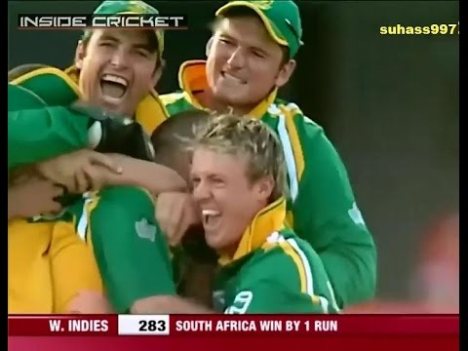
11.2.1 Outline the reasons for using notational analysis in physical education and sports
It is used during the coaching process to improve athletic performance
Using the video clip develop some notational analysis that a coach may find useful

Slide 9
11.2.1 Outline the reasons for using notational analysis in physical education and sports
How can notational analysis improve athletic performance?
Providing recorded objective feedback
Quantifying performance in a reliable manner
Facilitating quantitative and qualitative feedback

Slide 10
11.2.2 List five applications of notation in physical education and sporting contexts
Tactical evaluation
Technical evaluation
Analysis of movement
Development of database/models
Educational use with teacher/coach and athlete
What did you use in the cricket example?

Slide 11
11.2.3 Distinguish between a phase analysis model and performance outcome model of qualitative biomechanical analysis for an individual sport technique.
Phase analysis model
Preparation
Retraction/backlift
Action
Follow-through
Performance outcome model
Specific factors affecting performance
Speed principles
Force principles
Coordination principles
Specific performance principles

Slide 12
11.2.4 Explain how a flow chart system can be used for match analysis in a team invasion game
Flowcharts should include
Player in possession
Location for change of possession
Player who gains possession
The method for change of possession
Was the pass successful
PASS
Do you have possessions
Pass, run or kick
RUN
Was the gain line made
YES
KICK
NO
Did the kick find the intended space
Are you in defensive position
NO
YES
Get into the defensive line
Call out a defender

Slide 13
11.2.4 Explain how a flow chart system can be used for match analysis in a team invasion game
Create a flow chart that could be used for match analysis of an invasion game of your choice.

Slide 14
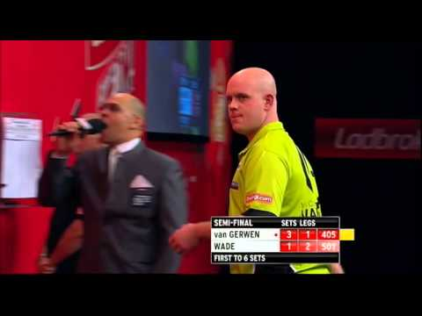
11.2.5 Suggest how to develop a simple notation system for team games
Playing a game of darts develop a notation system that could be used to help gain feedback for an athlete/coach.

Slide 15
11.2.5 Suggest how to develop a simple notation system for team games
What system did you develop? Why is it not appropriate for 11.2.5?
Using football as the sport, develop a simple notation system using the following,
Scattergram
Frequency table
Sequential system

Slide 16
11.2.6 Outline three examples of the use of digital technology in sports analysis
Select one of the following technologies used in sport analysis;
-Motion tracking (e.g.Hawk eye)
-Performance analysis (e.g.Prozone)
-Nutrition, fitness and training analysis (My fitness pal)
Answer the following
What is does?
Who benefits from its data?
Has it improved sport/health? Why or Why not?
Find a video online to share with the class to show it working

Slide 17
11.2.7 Evaluate the use of information technologies in sport analysis for different sports contexts
Pros
Cons

Slide 18
11.2.7 Evaluate the use of information technologies in sport analysis for different sports contexts
Provides data that is not available through traditional analysis techniques
Provides data over shorter/longer timescales
Data is objective and accurate
Allows comparison between images
Feedback is immediate
Feedback information is manageable and specifically adjusted for athletes
Many technologies are inexpensive
Coaches need training to make most effective use of interpreting data
Limited availability in many regions
Limited use in all situations and locations
May lead to over reliance on objective data

