Slide 1
How are societies transformed by the trade around the world? Is the change intentional or unintentional? Describe how another culture has impacted American culture.
Warm Up

Slide 2
Age of Empires as the first Age of “Globalization”
Globalization is a process of interaction and integration among the people, companies, and governments of different nations, a process driven by international trade and investment and aided by information technology.
In other words, CULTURAL DIFFUSION on a GLOBAL scale!

Slide 3
In the Age of Empires,
  what trade networks do we know existed?
  what forms of “information technology” would have been used?

Slide 4
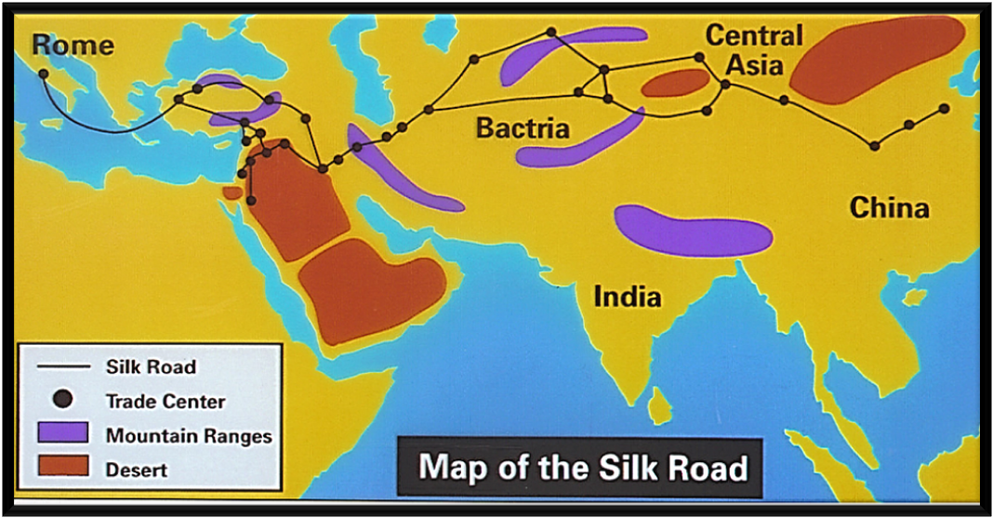
Silk Road

Slide 5
Silk Road Foldable
Create a foldable with 6 “doors” and label as seen below:
1. Silk Road
2. Geographic Barriers
3. Foods Exchanged
4. Products Exchanged
5. Ideas Exchanged
6. Religions Exchanged

Slide 6
Silk Road
Take notes as you watch the video!
a vast network of trading routes that spanned from Rome to China beginning in the fourth to first centuries BCE.

Slide 7
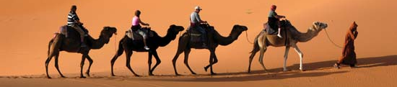
The Silk “Road”
Merchants did not travel from one end to the other but goods traded from town to town eventually went all the way
The farther goods traveled, the more expensive they became
Most trade done by caravans- groups of travelers journeying together, often through desert with camels

Slide 8
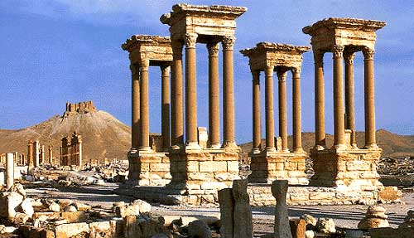
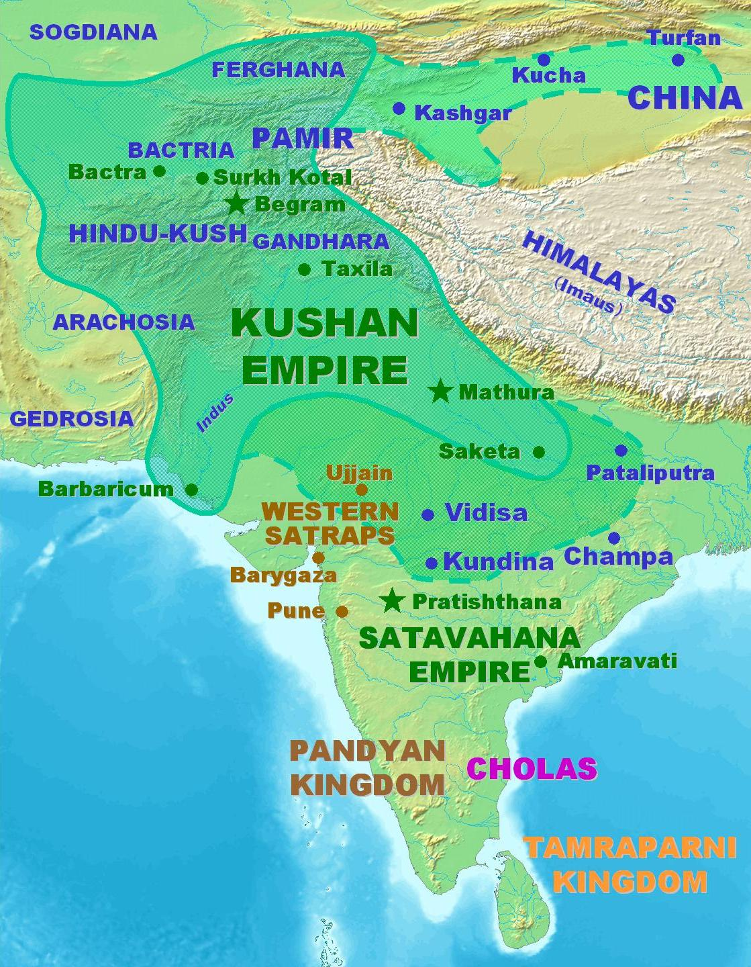
Influence of the Trade
Helped spread Buddhism to Asia
Central Asian Nomads excelled as traders because they already had experience traveling those areas
Cities established along trade routes, such as Palmyra in Syria and Samarkand in Central Asia, became wealthy centers of trade
30-375: Kushan Empire founded by Central Asian nomads ruled from Central Asia and Afghanistan to Northern India before the Gupta Empire took over in the 300s

Slide 9
Silk Road Role- Play
Select a Silk Road job from those available from Mrs. Pleasants.
Read the documents provided and answer its accompanying questions.
Use the supplies provided to create a “Travel Log”.
Write a ONE paragraph journal entry as prompted by each document into your “Travel Log.” Remember you must stay in character!
Anything not finished in class will become homework.
Travel Logs will be due Wednesday!

