Slide 1
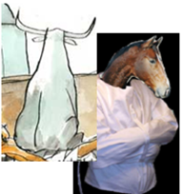

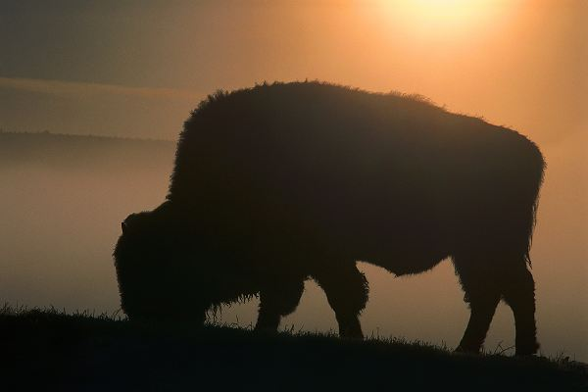
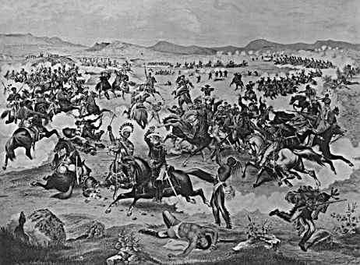
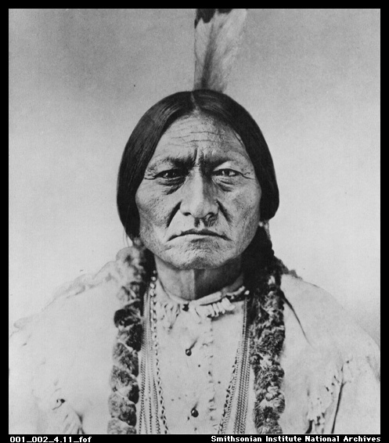

Settling The West

Slide 2
Who Lived There First?
What Impact will Westward migration have on these “Native” groups?

Slide 3
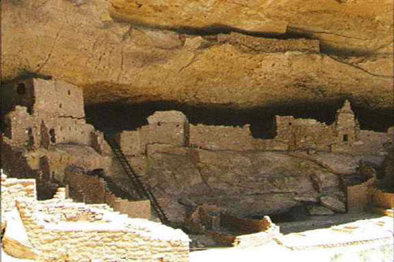
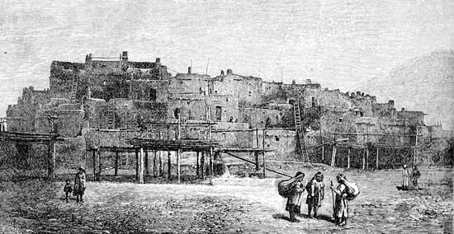
Native Americans
Western Tribes
  300,000 before Spanish arrival
    Fishing, Foraging, Small Farming
    Pueblos – Established permanent cities in SW

Slide 4
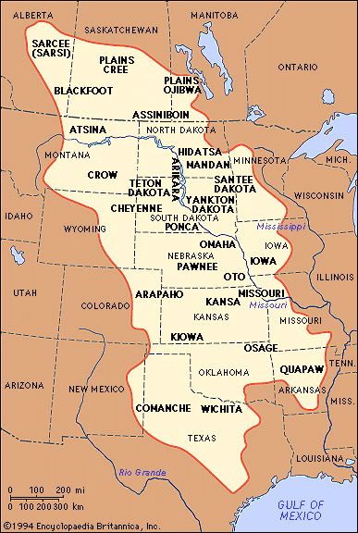
Native Americans
Plains Indians
  Had Developed way of life
    Leaders chosen by tribe
    Land could not be owned
  Depended on Horse and Buffalo
  Lived with extended families
    Men-hunters/warriors
    Women- cooked and prepared hides
  Most refuse to unite
  Sioux, Cheyenne, Arapahoe
    Form alliance

Slide 5
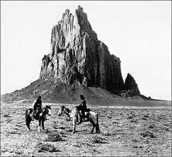
Hispanic Population
New Mexico
  1840s
    White Settlers struggle to establish government
    Outnumbered 1000 to 50,000
    Apache, Navajo, Taos Indians
  1850s
    Defeat of Natives
    Allows Hispanics to spread
  1870s-1890s - Effects of Railroads
    Increasing Anglo population
    Begin to restrict Mexican Immigration
    Fear of job loss

Slide 6
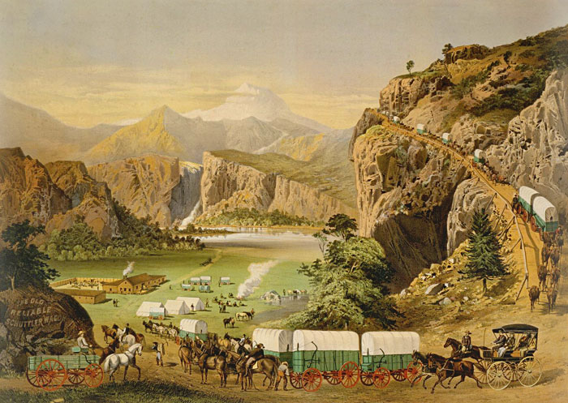
Hispanic Population
California
  1700^{s}
    Catholics establish Missions
    Force Hispanics to gather into coastal communities
  Early 1800’s
    Missions Collapse
    Controlled by Mexican Aristocrats
  1849 - Gold Rush
    Californos cannot resist incoming Anglo population
Texas
  Hispanic farmers cannot compete with Large Ranches

Slide 7
Recap
What Impact did migration have on the “Native” groups?
Is this fair?

Slide 8
Chinese Immigration
What events led to Chinese Immigration?
What role did these immigrants play in the West?
What was the American response to the influx of Immigrants?

Slide 9
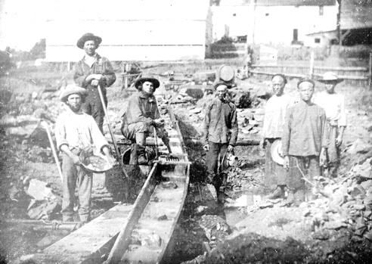
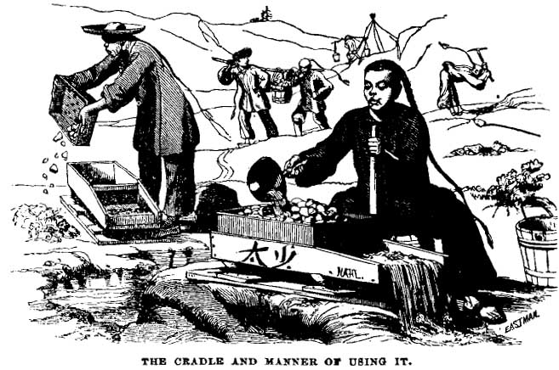
Chinese Immigration
1. Gold Rush
  Pre 1849
    Migrated to Hawaii, Caribbean, Latin America
    Many were indentured servants
  Post 1849
    200,000 by 1880
    Seen as competition
    1853 – “Foreign Miners Tax”
      $20 license fee ($500 today)
      Forces many out of prospecting

Slide 10
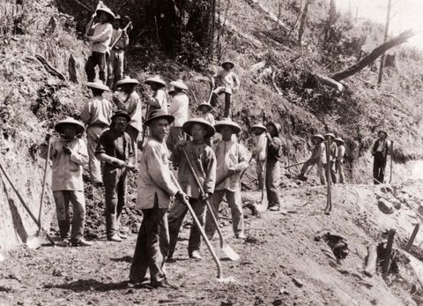
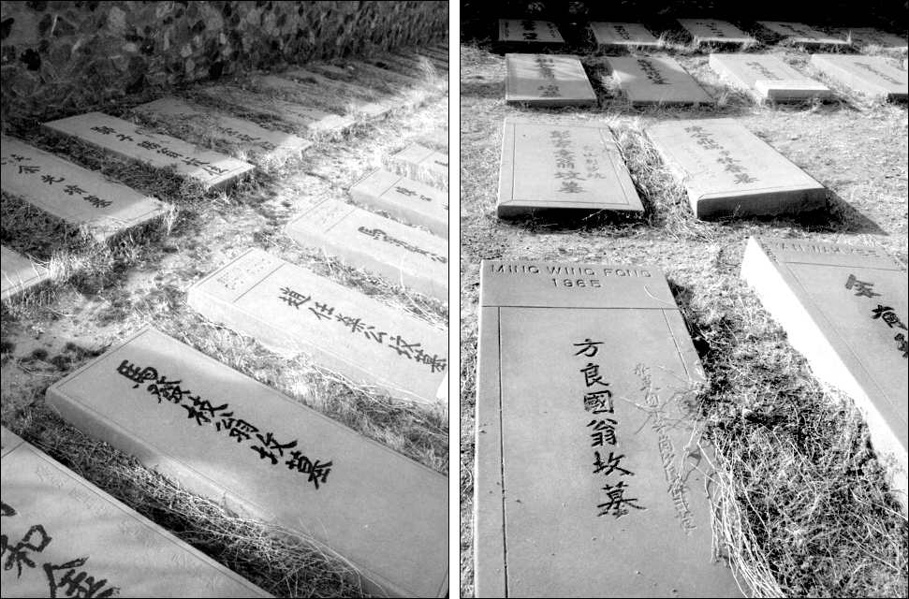
Chinese Immigration
2. Transcontinental Railroad
  Chinese provide 90% of Labor of the western portion
    Accepted lower wages
    Harder working
    Extremely Dangerous
  Attempted Strike of 1866
    Starved into submission

Slide 11
Pacific RR Act

Slide 12
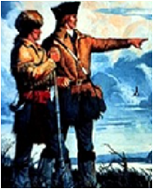
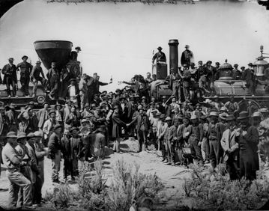
Railroads Open South
Lewis & Clark
The first Transcontinental Railroad-1869
Trip that once took 6 months now took 6 days
Jerks!
Chinese
Irish

Slide 13
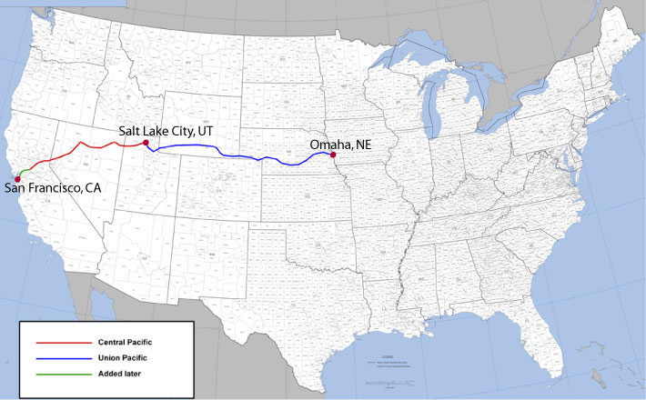
http://www.history.com/videos/transcontinental-railroad#transcontinental-railroad
1869

Slide 14
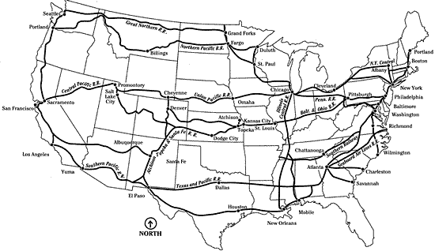
1900

Slide 15
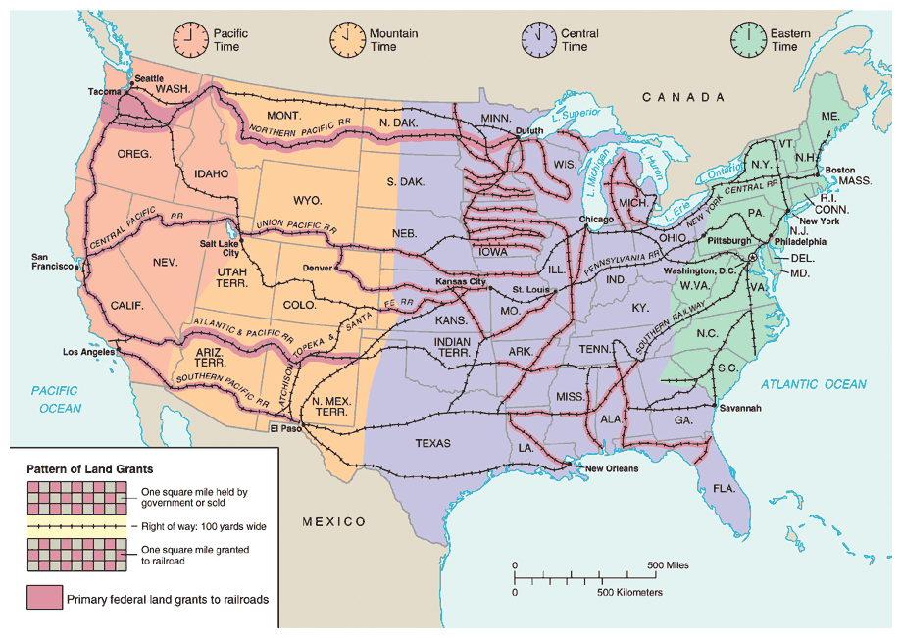

Slide 16
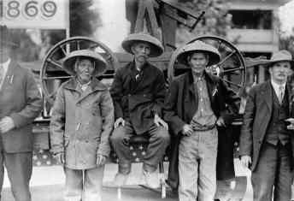
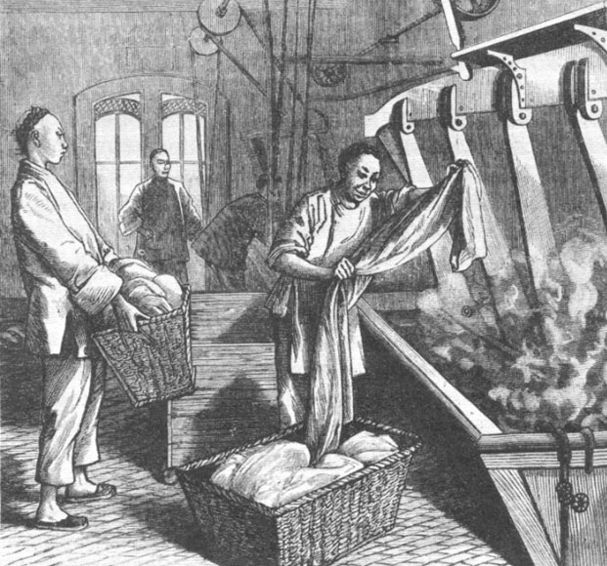
Chinese Immigration
Post Railroad Completion
  Most lost jobs
    Moved into Cities
  “China Towns”
    Laundry Industry
      Controlled 2/3
    Tongs – Chinese Gangs
      Prostitution
      Drug trading
  Women
    Initially, few women made trip
    1880 ½ Chinese women immigrants were prostitutes

Slide 17
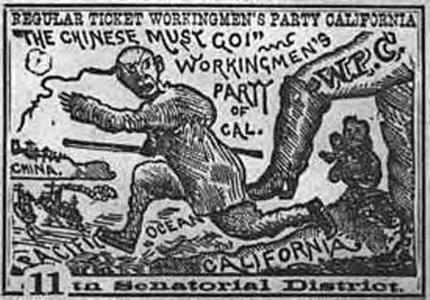
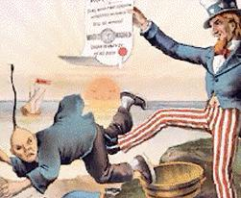
Western Nativism
Anti Chinese Sentiment
  Democrats Party and “Working Man’s Party”
  Chinese Exclusion Act - 1882
    Banned immigration for 10 years
    Renewed in 1892
    Made Permanent in 1902
    40% Decrease in Population
    * Not repealed until WWII (1943)

Slide 18
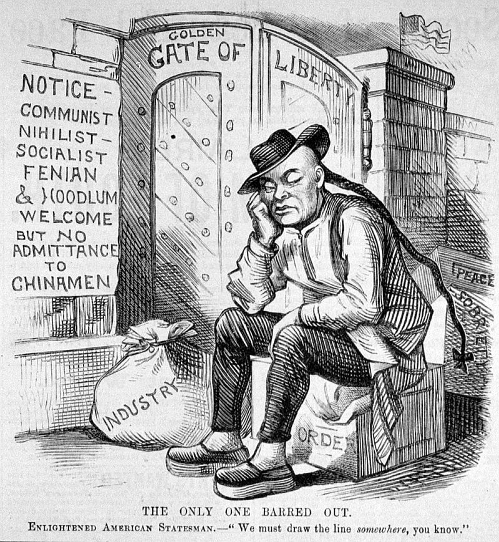

Slide 19
Recap
What events led to Chinese Immigration?
What role did these immigrants play in the West?
What was the American response to the influx of Immigrants?

Slide 20
American Migration
What events led to increased Westward Migration?
After the migration, what professions were common in the west?

Slide 21
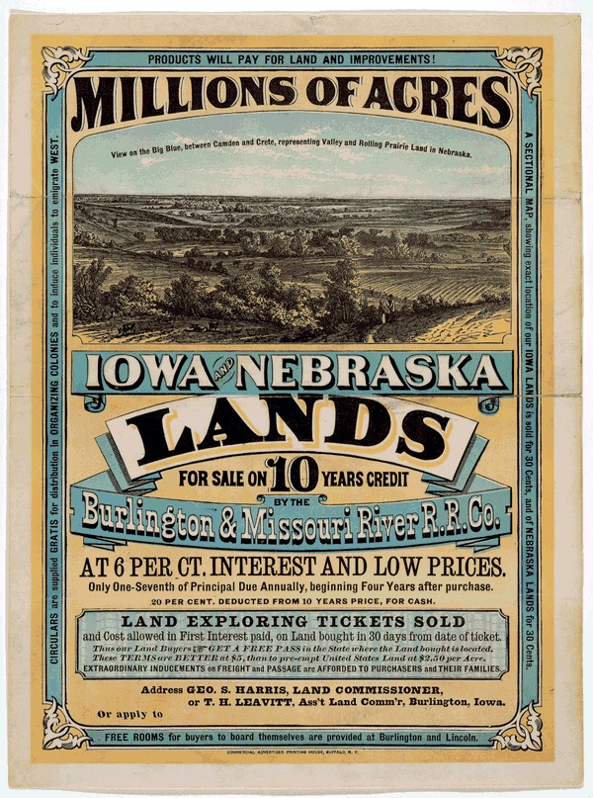
American Migration
Homestead Act – 1862
  160 acres of land to any head of household
    Requirements
      21 and older
      Never fought for the South
      Must Improve the Land
      Must keep for 5 years
  600,000 families took advantage
  Several thousand were freed African Americans - Exodusters

Slide 22
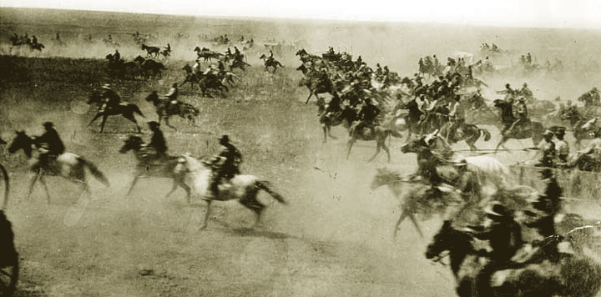
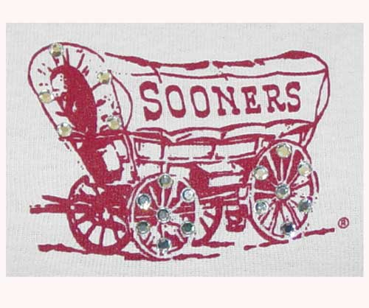
American Migration
Sooners
  1889 - Government opens up remaining Oklahoma
    2 million acres claimed in one day
    Several settlers jumped the gun (Sooners)

Slide 23
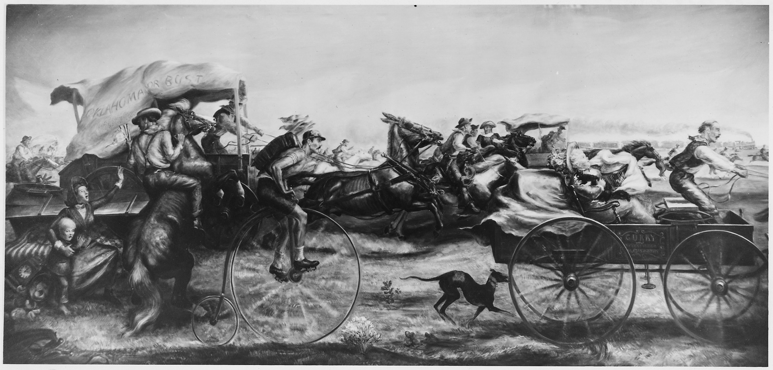

Slide 24

Agricultural Education
Morrill Land Grant Act - 1862
  Federal Government provides funding and land for agricultural colleges
  Attempt to encourage farming
Auburn - LSU
Arizona - Michigan State
Connecticut - Nebraska
Florida -Rutgers
Texas A&M -Tennessee
Hawaii -NC State
Purdue -NC A&T
Iowa State -Ohio State
Kansas State -Oregon State
- Clemson -West Virginia

Slide 25
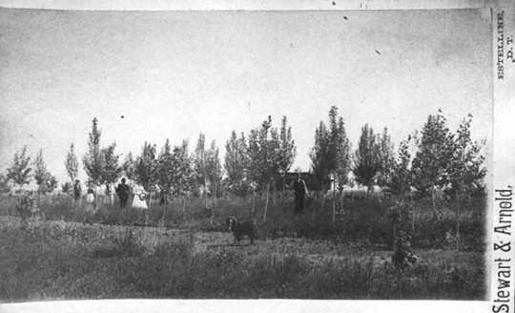
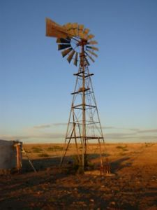
American Migration
Extensions of Homestead Act
  Timber Culture Act – 1873
    160 Acres (if owner planted trees on 40 acres)
  Desert Land Act – 1877
    640 Acres/$1.25 per (If owner irrigated property)
  Effects
    Rapid Migration
    Development of New States
    By 1900, AZ, NM, and OK only territories that remain

Slide 26
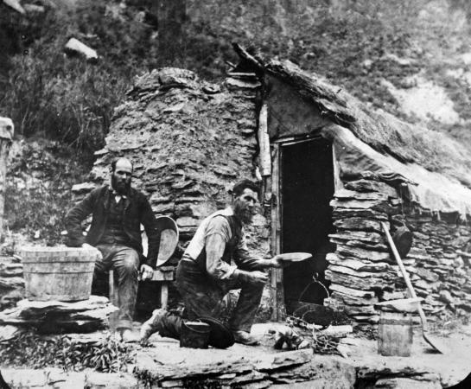
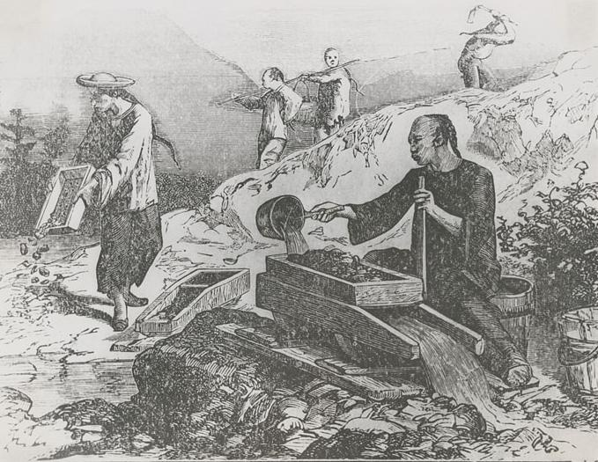
Arrival of Miners
Silver and Gold
  1858 - Colorado-Pikes Peak
    Denver
  1859 - Nevada- Comstock Lode
    $300,000,000 worth
  1874 - Dakotas -Black Hills
  1881 - Montana
Effects
    Brought all races and nationalities
    Creation of boomtowns

Slide 27
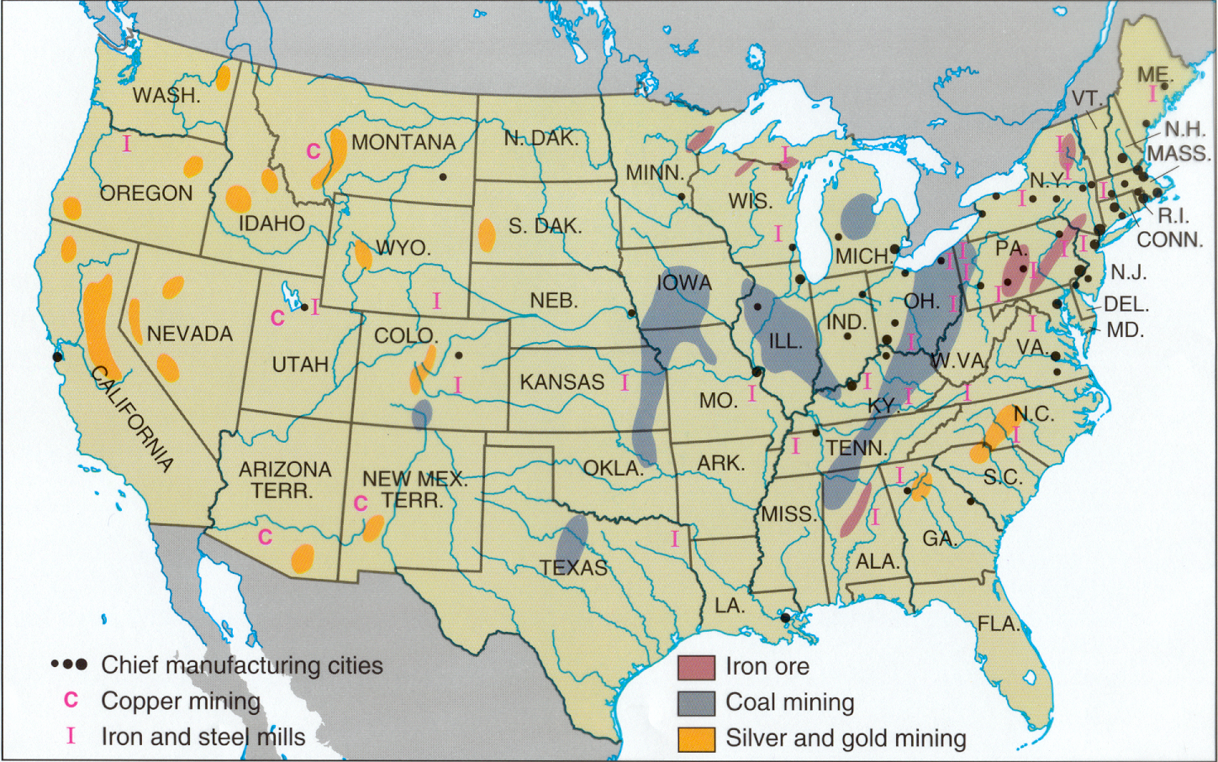

Slide 28
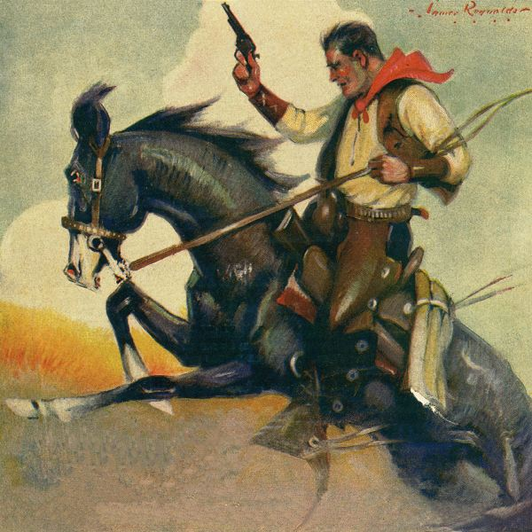
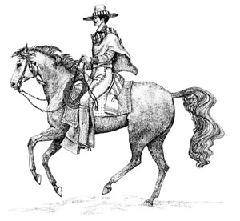
Cowboys
Buffalo = Cattle
Settlers learn from Mexicans
Adopt clothing, food and vocabulary
  Spurs, stirrups, Chaps, Jerky
  Mustang, Bronco, Corral, Rodeo
  25% African American
  15% Mexican
Herded cattle to railroads
  Led to growing demand for beef
  Open Ranging

Slide 29
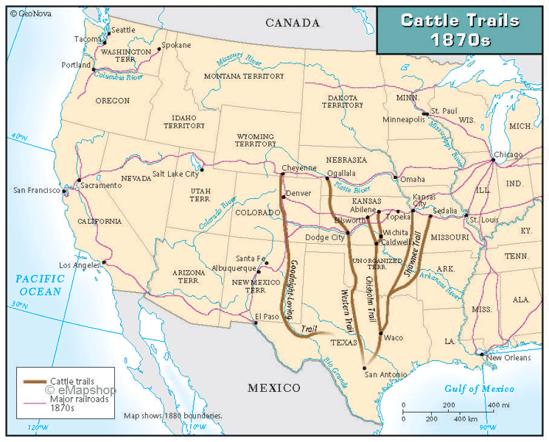

Slide 30
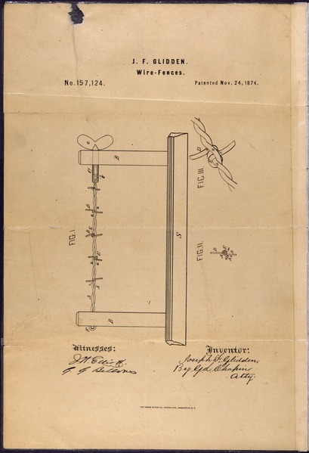
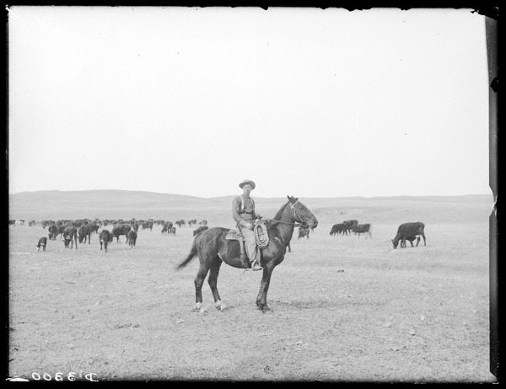
End of Open Range
Over Grazing
  “Range Wars”
Barbed Wire
  1874
  Joseph Glidden
Bad Weather
  1885 - 1887
Wild West slowly comes to an end

Slide 31
Recap
What events led to increased Westward Migration?
After the migration, what professions were common in the west?

Slide 32
Life on the Frontier
What was life like for those who chose to make the move?

Slide 33
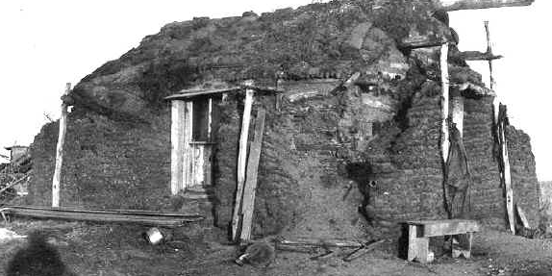
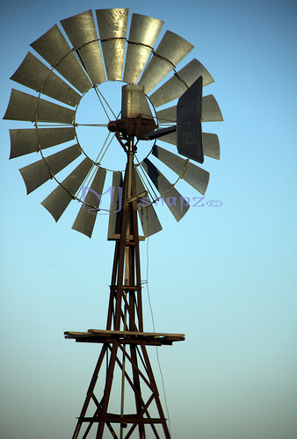
Life on the Frontier
Soddies
  Due to lack of wood, houses were
  built out of sod
  Warm in winter, cool in summer
Women
  Women forced to work beside the men in order to make ends meet
  Led to women gaining political rights sooner in West
Technology
  Riding Steel Plows
  McCormick Reaper
  Windmills- Bring up water from underground

Slide 34
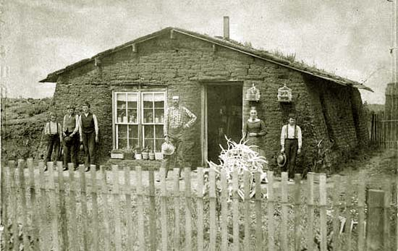
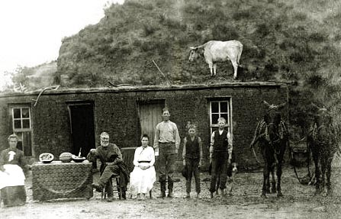

Slide 35
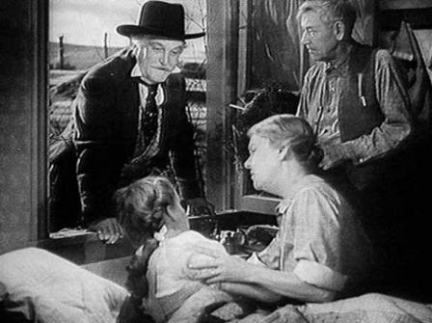
The Fall of Farmers
I wonder if she’ll still be this happy when we tell her that Toto was crushed by a flying cow in the storm
1880’s changing trends
  Railroads
    High transportation/storage rates
  Credit
    Banks charge outrageous interest rates
  Crop Prices
    Rise in commercial farming forces reduction in crop prices

Slide 36
Recap
What was life like for those who chose to make the move?

Slide 37
The “Romantic” West
How was the west portrayed in literature and art?

Slide 38
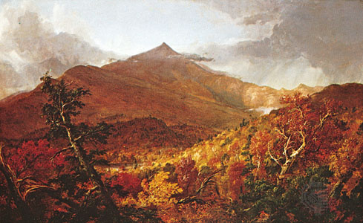
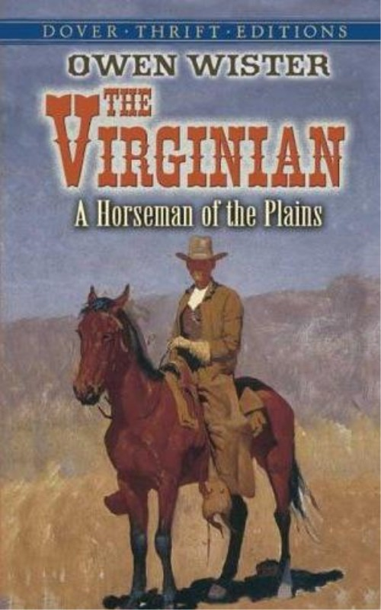
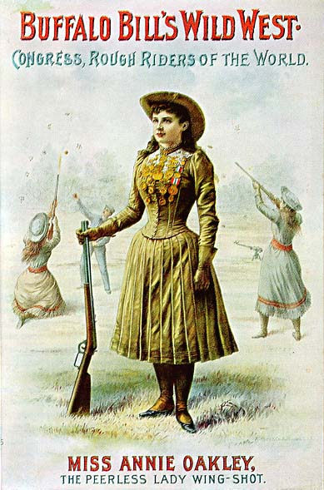
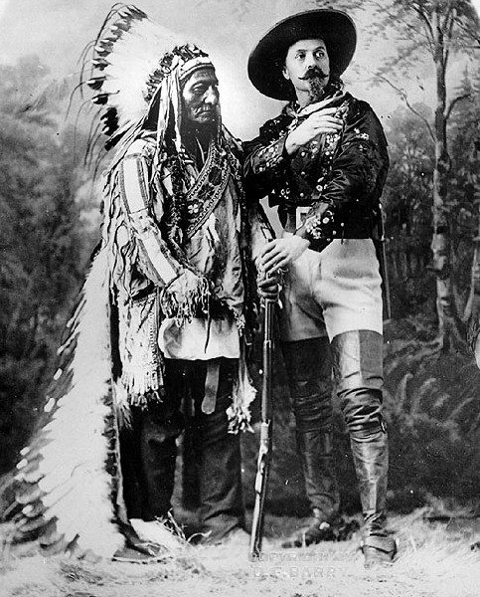
“Romantic” West
Art
  “Rocky Mountain School”
    Sparks 1880s Tourism
Cowboys
  The Virginian 1902
    Owen Wister
    Givens romantic view of Cowboys
    Sparks idea of pop fiction
“Wild West” shows
  Buffalo Bill’s Wild West
    Indian War reenactments
    Sitting Bull, Annie Oakley

Slide 39
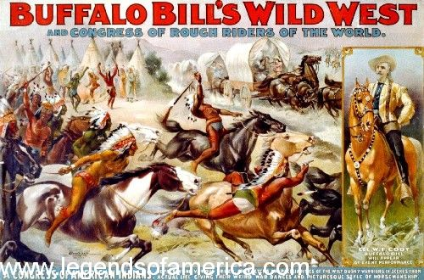

Slide 40
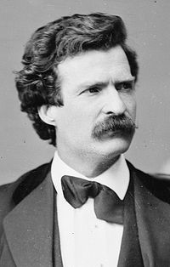
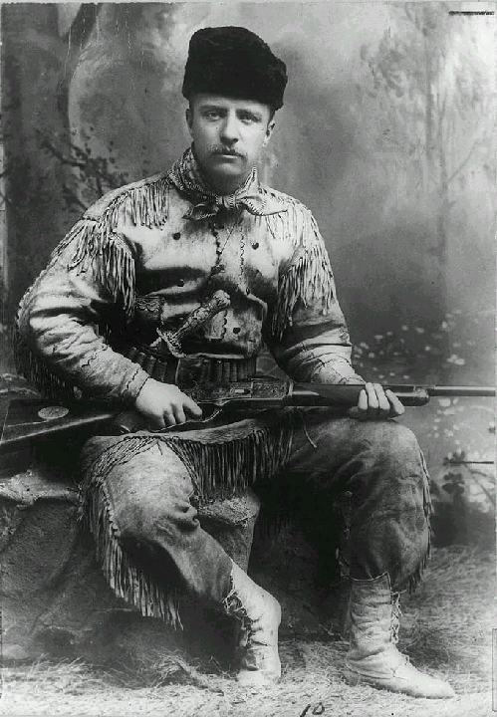
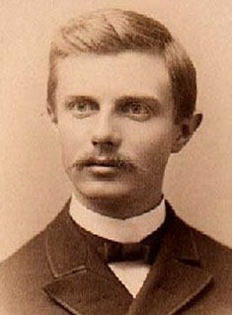
“Romantic” Frontier
Mark Twain
  Adventures of Tom Sawyer - 1876
  Adventures of Huckleberry - 1885
Teddy Roosevelt
  Moves to Dakota “Badlands” after wife’s death
  Writes The Winning of the West
    Heroic History of Expansion
Frederick Jackson Turner
  “ The Significance of the Frontier in American History”
    Later claims that frontier is “Closed”
    Effects?

Slide 41
The “Romantic” West
How was the west portrayed in literature and art?
To what degree was this depiction Accurate?

Slide 42


Dispersal of Native Americans
“Concentration” Policy
  Creation of reservation system
  Govt forces treaties
Indian Peace Commission
  1867 - Established 2 large reservations
    Dakotas and Oklahoma
Some Indians Ignore Treaties
  Result – “Indian Wars”
    1850s-1880s

Slide 43


Destruction of the Buffalo
Reasons
  Profit
    Leather
    Bones used in sugar, fertilizer, and china (dishes)
  Damaged or Delayed Trains
  Reduce competition with cattle
  Weaken Native Americans
1800-65,000,000
1890-1,000
1900- one herd

Slide 44


Slide 45


Slide 46


Slide 47


Slide 48

Background of Indian Wars
Treaty of Fort Laramie - 1851
  Signed by US government & 7 Tribes
    Cheyenne, Sioux, Arapaho, Crow, Mandan, Assiniboine

Slide 49

Background of Indian Wars
Promises Made…
  US Government –
    Natives can keep land
    US would pay “annuity”
    $50k Per year for 50 Years
  Natives
    Allow safe passage to migrants on the Oregon Trail
    Allow Roads and Forts to be built in exchange for $

Slide 50


Native American Conflict
Sand Creek Massacre -1864
  Background
    Gold Rush in Colorado in 1858
    A small group of the Cheyenne were bribed to sign away 90% of land
    Many Natives oppose the treaty and continued to hunt in this land
    “Colorado Wars” begin
1850
1860
1870
1880
1890
Sand Creek

Slide 51


Native American Conflict
Sand Creek Massacre - 1864
  Background
    Word spread that “Rouge” group of Natives were attacking settlements and stage coaches
    Governor promises safety for peaceful natives located on designated bases
Cheyenne “Dog Soldiers”
1850
1860
1870
1880
1890
Sand Creek

Slide 52


Native American Conflict
Sand Creek Massacre - 1864
  The “Battle”
    John Chivington ignores promise
    Launches an attack on natives who were flying a white flag
    70-170 natives were killed/mutilated
    24 US soldiers killed
    No charges were brought on soldiers
John Chivington
1850
1860
1870
1880
1890
Sand Creek

Slide 53


Slide 54
I saw the bodies of those lying there cut all to pieces, worse mutilated than any I ever saw before; the women cut all to pieces ... With knives; scalped; their brains knocked out; children two or three months old; all ages lying there, from sucking infants up to warriors ... By whom were they mutilated? By the United States troops ...
- John S. Smith, Congressional Testimony of Mr. John S. Smith, 1865
Fingers and ears were cut off the bodies for the jewelry they carried. The body of White Antelope, lying solitarily in the creek bed, was a prime target. Besides scalping him the soldiers cut off his nose, ears, and testicles-the last for a tobacco pouch ...
- Stan Hoig

Slide 55
There was one little child, probably three years old, just big enough to walk through the sand. The Indians had gone ahead, and this little child was behind, following after them. The little fellow was perfectly naked, travelling in the sand. I saw one man get off his horse at a distance of about seventy-five yards and draw up his rifle and fire. He missed the child. Another man came up and said, 'let me try the son of a b-. I can hit him.' He got down off his horse, kneeled down, and fired at the little child, but he missed him. A third man came up, and made a similar remark, and fired, and the little fellow dropped.
— Major Anthony, New York Tribune, 1879

Slide 56

Native American Conflict
1876-Custer’s Last Stand/
Battle of Little Big Horn
  Group of Sioux flee Dakota Reservation
    Led by Sitting Bull and Crazy Horse
  George Custer sent to force return
  Custer orders regiment (300) to attack Indians (3000 warriors) .
  Custer’s regiment completely destroyed.
  Leads to increase in violence
Sand Creek
1850
1860
1870
Little Big Horn
1880
1890

Slide 57


Custer’s Last Stand

Slide 58


Slide 59



Slide 60


Slide 61


Slide 62


Native American Conflicts
Nez Perce
  Forced from land in Northwest
  Attempt to flee reservation to Canada
  Pursued by American
Nez Perce War - 1877
  Led by Chief Joseph
    “Red Napoleon”
  Fought for 3 months across 5 states
  Eventually forced to surrender

Slide 63


Slide 64
Surrender of Chief Joseph
“Tell General Howard I know his heart. What he told me before, I have it in my heart. I am tired of fighting. Our chiefs are killed; Looking Glass is dead, Too-hul-hul-sote is dead. The old men are all dead. It is the young men who say yes or no. He who led on the young men is dead. It is cold, and we have no blankets; the little children are freezing to death. My people, some of them, have run away to the hills, and have no blankets, no food. No one knows where they are—perhaps freezing to death. I want to have time to look for my children, and see how many of them I can find. Maybe I shall find them among the dead. Hear me, my chiefs! I am tired; my heart is sick and sad. From where the sun now stands, I will fight no more forever.”

Slide 65


Native American Conflict
Apache (Arizona/Mexican Border)
  Some of the last remaining Independent Natives
    Led by Geronimo
  Carried out numerous attacks on outposts
  Escaped Reservations 3 Times
    Doesn’t surrender until outnumbered 30 to 10,000 in 1886

Slide 66


Worlds Fair - 1904

Slide 67

Native American Conflict
Death of Sitting Bull- 1890
  25,000 Sioux hold a “Ghost Dance”
    Inspired vision of white retreat and return of Buffalo
  American Military fears attack
  Sitting Bull shot after military ordered his arrest
  Devastates Remaining Natives
Death of Sitting Bull
Little Big Horn
1850
1860
Sand Creek
1870
1880
1890

Slide 68

Sitting Bull’s Death Mask

Slide 69

Native American Conflict
Wounded Knee-1890
  350 Sioux/Lakota Remain in Dakotas
    starving and freezing
  Seventh Cavalry is sent in to Relocate
  Someone fires a shot causing the soldiers to open fire
  300 mostly unarmed natives killed
  Unofficially marks the end of the Indian Wars
http://www.history.com/shows/america-the-story-of-us/videos/the-last-of-the-sioux#the-last-of-the-sioux
Death of Sitting Bull
1850
1860
Sand Creek
1870
Little Big Horn
1880
1890
Wounded Knee

Slide 70



Slide 71


Slide 72


Slide 73

Assimilation
Assimilation
  transition into white society by abandoning old way of life
Dawes Severalty Act - 1887
  Attempt to “assimilate” Natives
  Broke up Reservations
  Provided with land
    160 Acres
  Natives granted citizenship
    Not officially given property ownership until after 25 years
  Largely unsuccessful

Slide 74


Slide 75



Slide 76

Carlisle Indian Industrial School

Slide 77


Slide 78
Native Americans
Prior to European arrival?
10,000,000
By 1890?
250,000

Slide 79

Timeline of American Expansion into Native Lands

Slide 80


Slide 81

A Century of Dishonor - 1881
Helen Hunt Jackson
  Condemned the governments treatment of Natives
  Focused on broken treaties
  A copy was sent to every congressman in D.C.

