Slide 1
Current Events
CNN

Slide 2
Quote of the Day
“The roots of education are bitter, but the fruit is sweet.”
-Aristotle

Slide 3
“I cannot remember the books I've read any more than the meals I have eaten; even so, they have made me.”
― Ralph Waldo Emerson

Slide 4
Mars One
What would it take for you to join this expedition? Would you go for money? Would you go for glory? Would you go for religious freedom?

Slide 5
The Settlement of New England

Slide 6
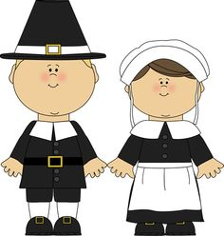

Slide 7
What do you know about the Pilgrims?

Slide 8
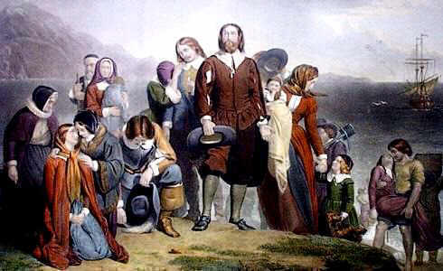

Slide 9
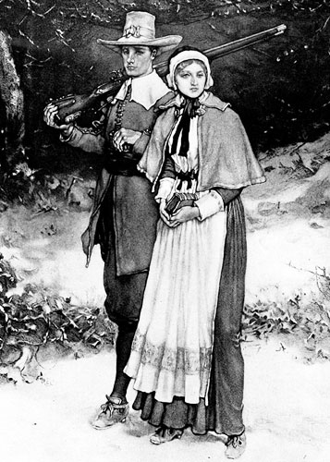
Separatist Puritans
Religious dissenters who fled England for Holland in 1608
Once there, they worried that they were losing their English way of life
1617: decided to sail for America
Today, we call them the Pilgrims

Slide 10
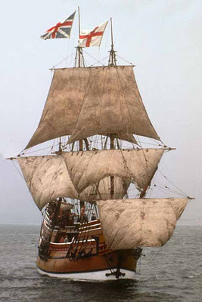
The Mayflower
September, 1620: 102 passengers set sail for Virginia
Hardships: blown off course, food ran out, much illness, 1 death
Arrived off Cape Cod in November and landed at Plymouth

Slide 11
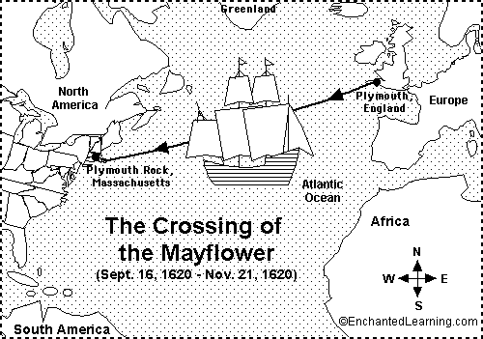

Slide 12
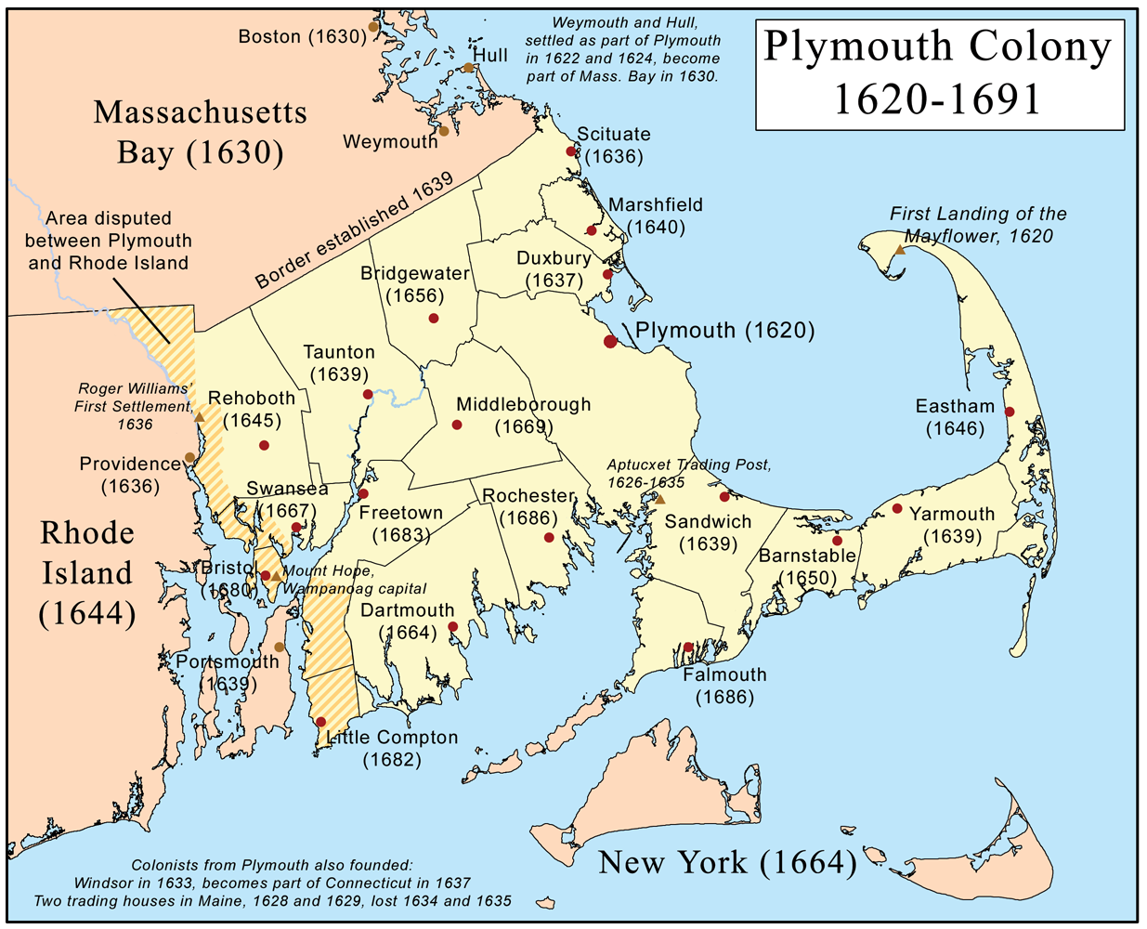

Slide 13
Another example of American Autonomy….

Slide 14
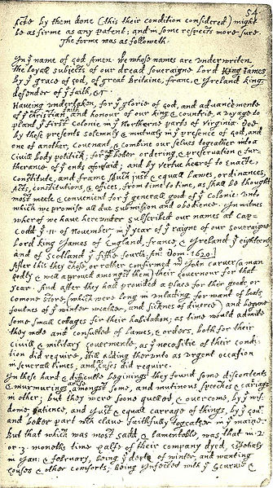
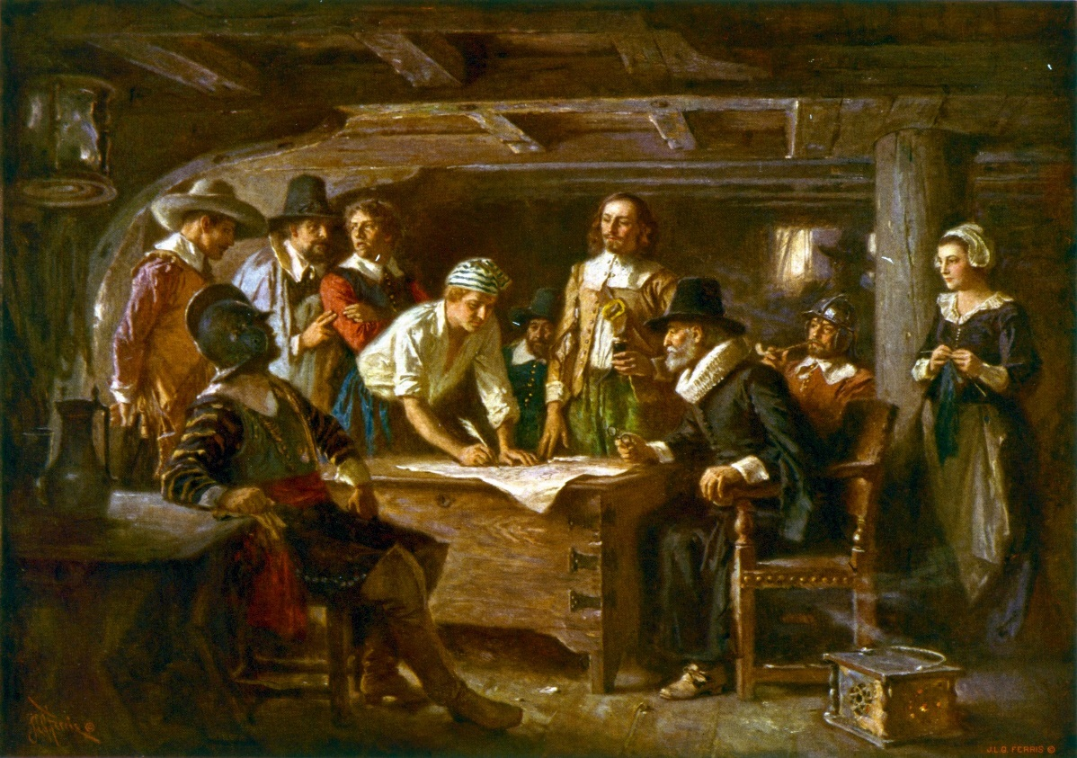
The Mayflower Compact
The settlers, understanding that they were now outside of English law, on land that they knew little about, agreed to “solemnly and mutually in the presence of God and of one another” create a new government and to obey its laws
Based on Majority rule (Autonomy)
The first evidence of self government in New England

Slide 15
What advantages did Plymouth settlers have over Jamestown?

Slide 16
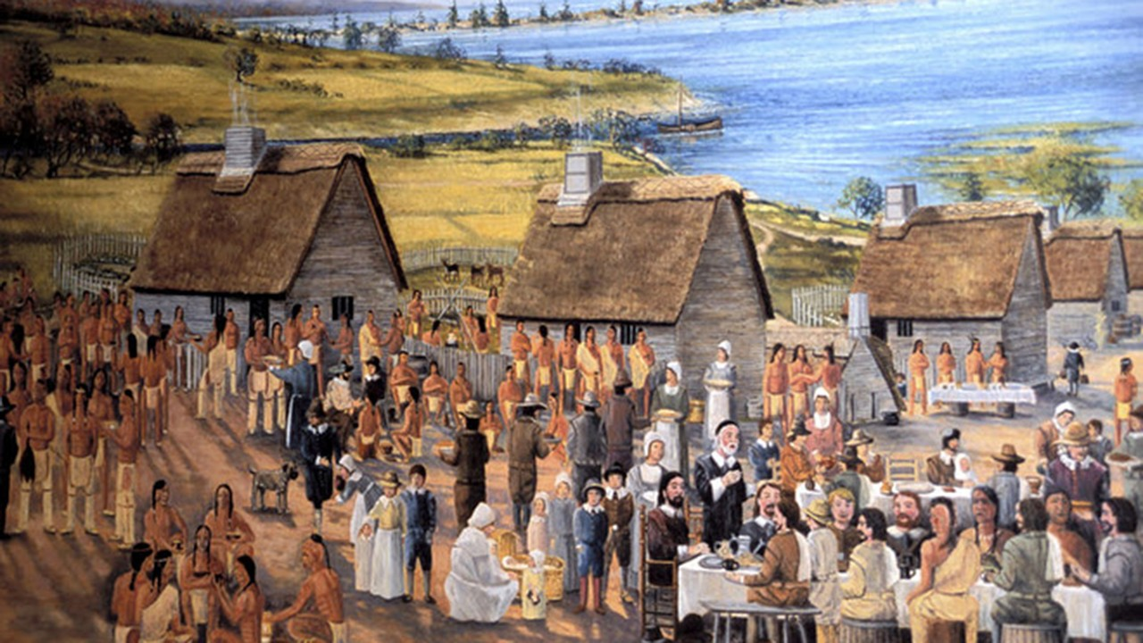
Plymouth Colony
The Pilgrims were industrious and planned on staying, unlike the Jamestown settlers who were just looking for wealth
Began building a village, but disease killed off half the settlers within the first few months

Slide 17
The Plymouth Colony needs help!!!!

Slide 18
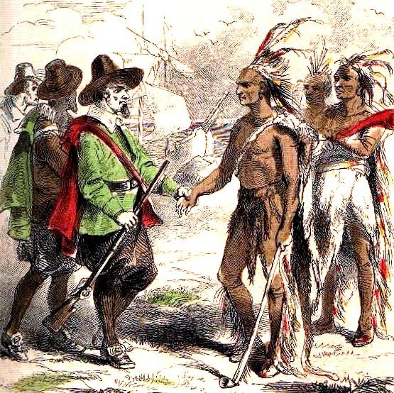

Slide 19
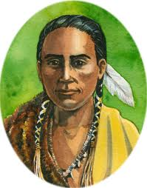
Squanto
A friendly Native American took pity on the settlers and instructed them in farming corn and how to locate good fishing grounds
Squanto had once been captured by English traders and had lived in England, so he spoke English
Squanto also negotiated a peace agreement between the settlers and the local tribes

Slide 20
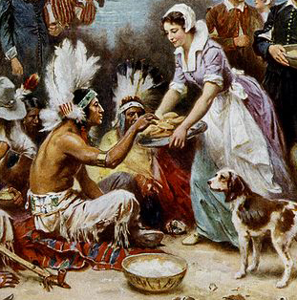
First Thanksgiving?
The Pilgrims celebrated their one-year anniversary of survival and their alliance with the local Natives by holding a “Thanksgiving” festival, sometime in autumn 1621
Virginia settlers, however, had begun recognizing a “thanksgiving” holiday as early as 1619, and Spanish settlers in Florida had celebrated as early as the 1540s

Slide 21
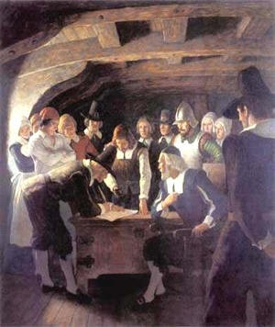
More Settlers Arrive
After 1625, religious persecution of Puritans in England increased, driving more of these dissenters to flee to America
Economic problems in England’s industries at this same time also increased the number of settlers

Slide 22
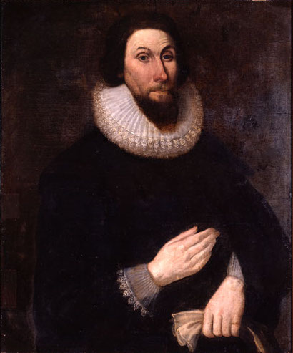
John Winthrop
John Winthrop, an investor in the Massachusetts Bay Company (a joint-stock company which held a royal charter to create a colony in New England), led 900 Puritan settlers to New England in March 1630

Slide 23
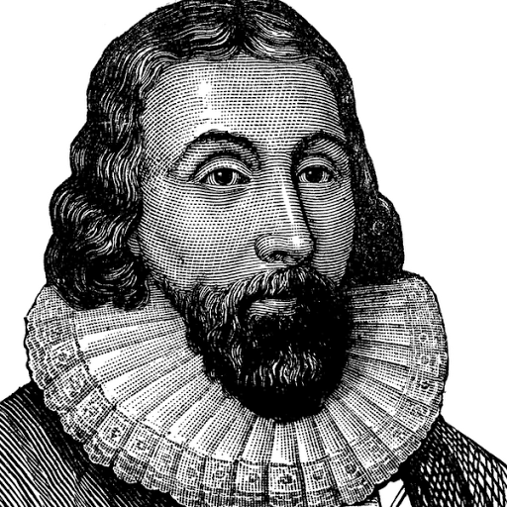
“A City on a Hill”
Winthrop delivered a rousing sermon, A Model of Christian Charity: “The Lord will make our name a praise and glory, so that men shall say of succeeding plantations: The Lord make it like that of New England. For we must consider that we shall be like a City upon a Hill; the eyes of all people are upon us.”
America rooted in majority rule and morality

Slide 24
Reagan and Kennedy

Slide 25
End Pt. 1
What is a PRIMARY SOURCE?

Slide 26
A City Upon A Hill
Part 1: Read and annotate John Winthrop’s speech, “A Model of Christian Charity.”
Part 2: Complete SOAPSTONE analysis of speech.
Staple both the annotated primary source and soapstone analysis sheet before turning in.

Slide 27
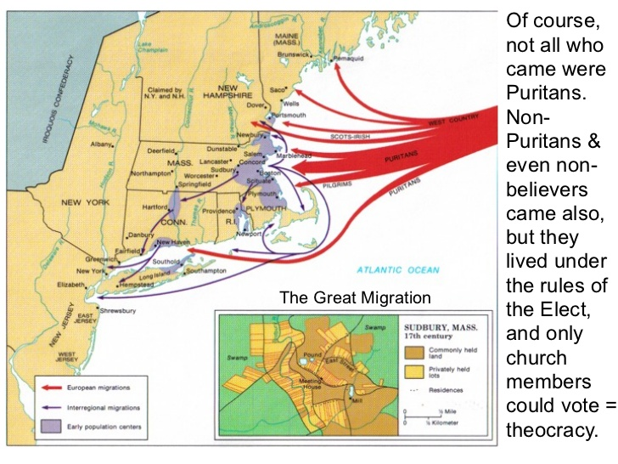
The Great Migration
As conditions in England grew worse, thousands more Puritans left for the New England colony, mostly for its new capital of Boston.
By 1643, New England had an estimated 20,000 settlers

Slide 28
How will Massachusetts Bay be governed?

Slide 29
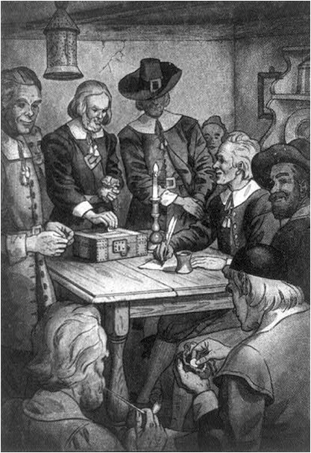
Governance
Only those settlers who owned stock in the Massachusetts Bay Company could participate in elections and in making the law
Winthrop, as the first governor, briefly tried to run the colony as a dictatorship, but after only four years was forced to share power with a representative assembly

Slide 30
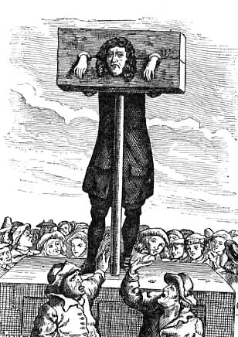
Church and State
Winthrop did manage to tie the government of the colony to the Puritan church
Church attendance was required by law; taxes were used to support the church; gambling, blasphemy, adultery, and drunkenness were all severely punished
Heretics (those who disagreed with the church) were banished from the colony

Slide 31
At this point, does religious freedom exist in the New World? Democracy?

Slide 32
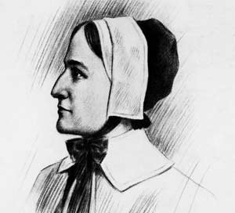
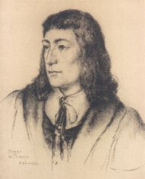
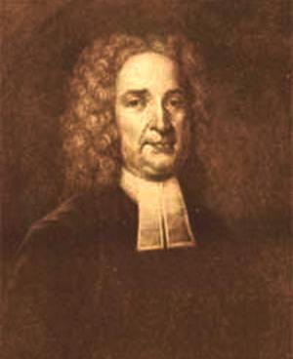
These“HERETICS” will help found new colonies…

Slide 33
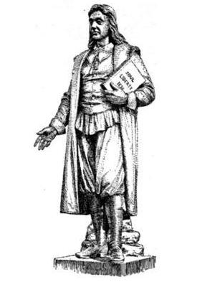
Roger Williams
1631: Roger Williams began ministering in Salem, Mass., but was critical of the church, of the King, and of John Winthrop
Winthrop, fearful of losing his royal charter if word got back to the king of Williams’ criticism, had Williams banished
Williams went south and founded the colony of Providence, a settlement of greater religious tolerance

Slide 34
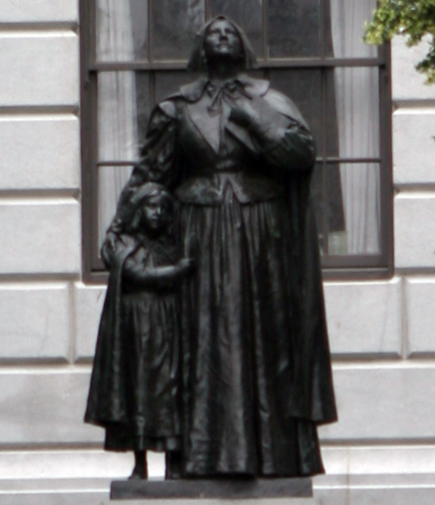
Anne Hutchinson
Devout Puritan who also began to criticize certain leaders of the church and was thus charged with heresy
Claimed that God spoke to her and revealed to her which ministers were correct and which wrong
Puritans believed that God only spoke through the Bible; Hutchinson was convicted of heresy and banished
Hutchinson headed south with her followers and founded the town of Portsmouth
Had 15 kids

Slide 35
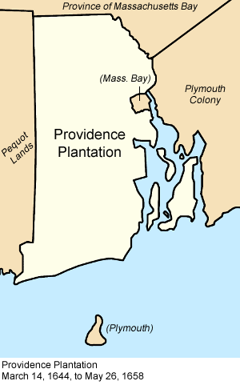
Rhode Island
More “heretics” joined Williams and Hutchinson, founding the towns of Newport and Warwick
In 1644, the four settlements came together as the new colony of Rhode Island
Rhode Island’s charter specifically created a separation between church and state

Slide 36
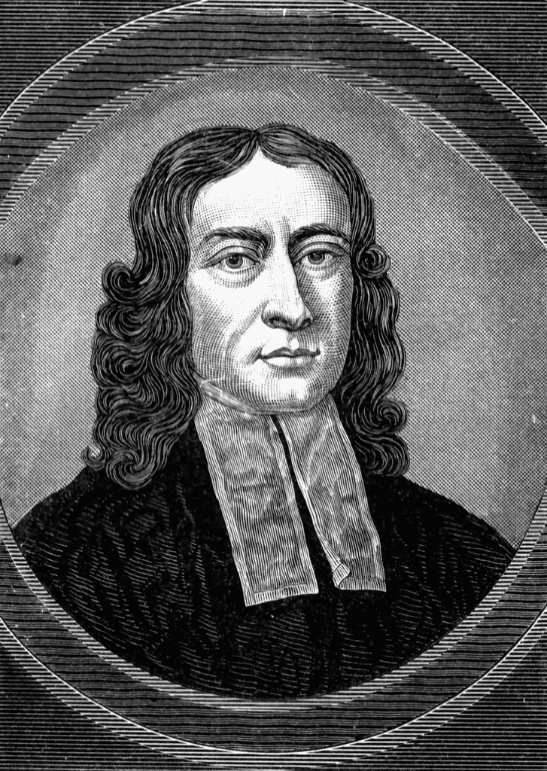
Thomas Hooker
Puritan minister who led his congregation to settle on the Connecticut River
Hooker and his followers were frustrated with their inability to find good land in Massachusetts and by the requirement that one must hold stock in the Bay Company in order to vote

Slide 37
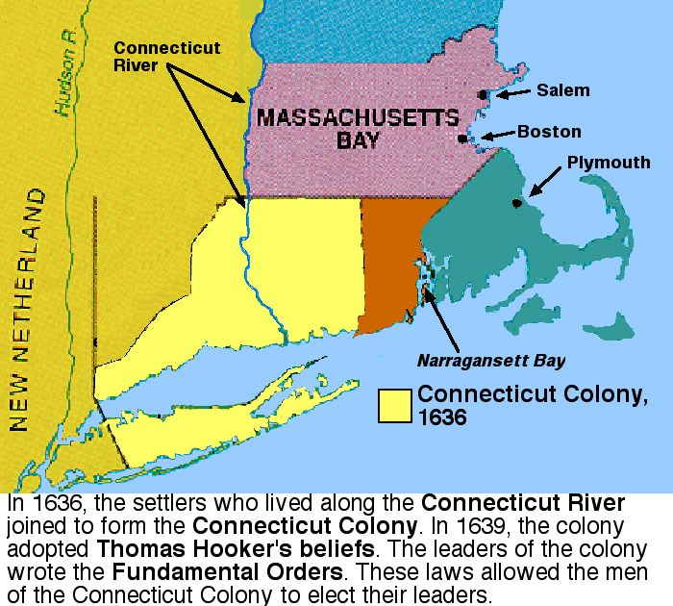
Connecticut
In 1639, Hooker’s settlement, along with others in the valley, adopted the Fundamental Orders of Connecticut, the first written constitution in the American colonies
Biggest difference: all adult men were allowed to vote for Governor and the General Court (legislature)

Slide 38
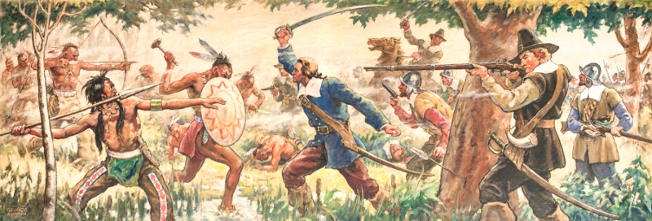
Essential Question
What problems arise out of EXPANSION?

Slide 39
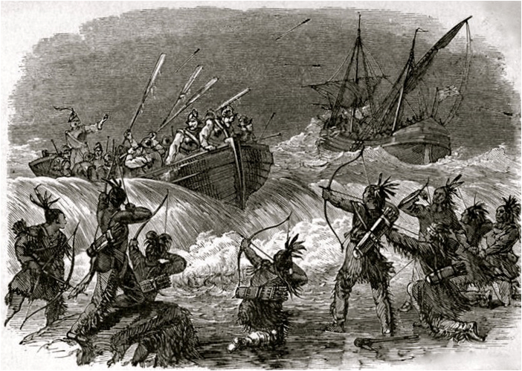
The Pequot War
After the Pequot tribe was blamed for the death of 2 Massachusetts traders in 1637, white-native tensions began to rise
Massachusetts sent a military force to retaliate against the natives, prompting an uprising
The first example of large scale violence towards Natives in New England

Slide 40
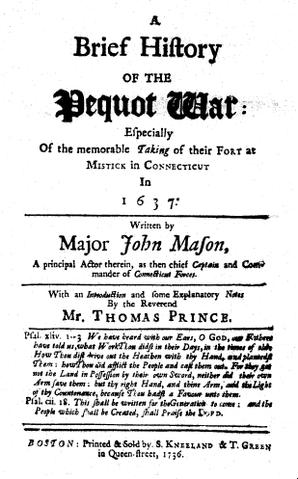
The Pequot War
The white settlers, allied with other Native American groups who were enemies of the Pequot, carried out a brutal extermination of the Pequot
Over 400 of the tribe were massacred, despite trying to surrender, and the survivors were sold into slavery

Slide 41
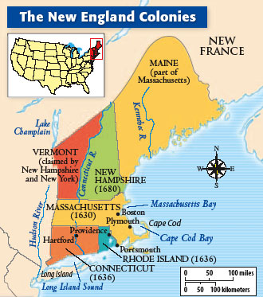
New Hampshire & Maine
Settlers also left Massachusetts heading north.
In 1679, New Hampshire was granted the status of a royal colony and broke away from Massachusetts
Maine, despite having a distinct population, remained part of Massachusetts until 1820

Slide 42
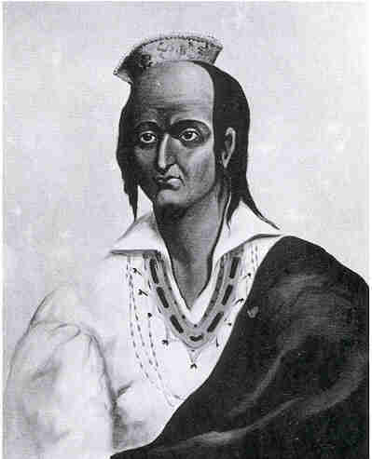
Tensions Build
Generally, New England native tribes and their white neighbors lived together peacefully, engaging in trade
As time passed, however, white settlers increasingly encroached on native lands and the colonial governments began to demand that natives obey their laws

Slide 43
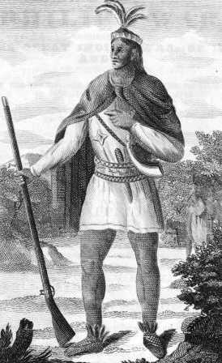
King Philip’s War
In 1675, Plymouth colony arrested, tried, and executed 3 Wampanoags for murder, leading to an attack by the natives
This led to a brutal war between whites and natives, known as King Philip’s War (King Philip was the name given by settlers to the Indian chief Metacomet)
By 1678, New England’s native population had been defeated and driven west, leaving the region in the hands of the settlers

Slide 44
John Winthrop Needs A Translator
“A City Upon A Hill”
Read the excerpt from John Winthrop’s “A Model of Christian Charity.” It is written in Old English.
Translate the excerpt and its message into 2016 language.
Speak like you normally do, use modern language and phrases but please be appropriate.
½ Page minimum

Slide 45
Short Response – 150 Words
In essay format, respond to the following questions:
1. What degree of religious freedom was achieved in the early New England Colonies? Explain!? (Factual)
2. What does “True” religious freedom mean to you? (Opinion)
3. If you could construct a society, how much religious freedom would you allow? (Opinion)
Your responses and opinions MUST contain specific evidence from your notes. Do not make a claim without backing it up!!!!!!! Points will be taken for responses that do not corroborate opinions.

