Slide 1
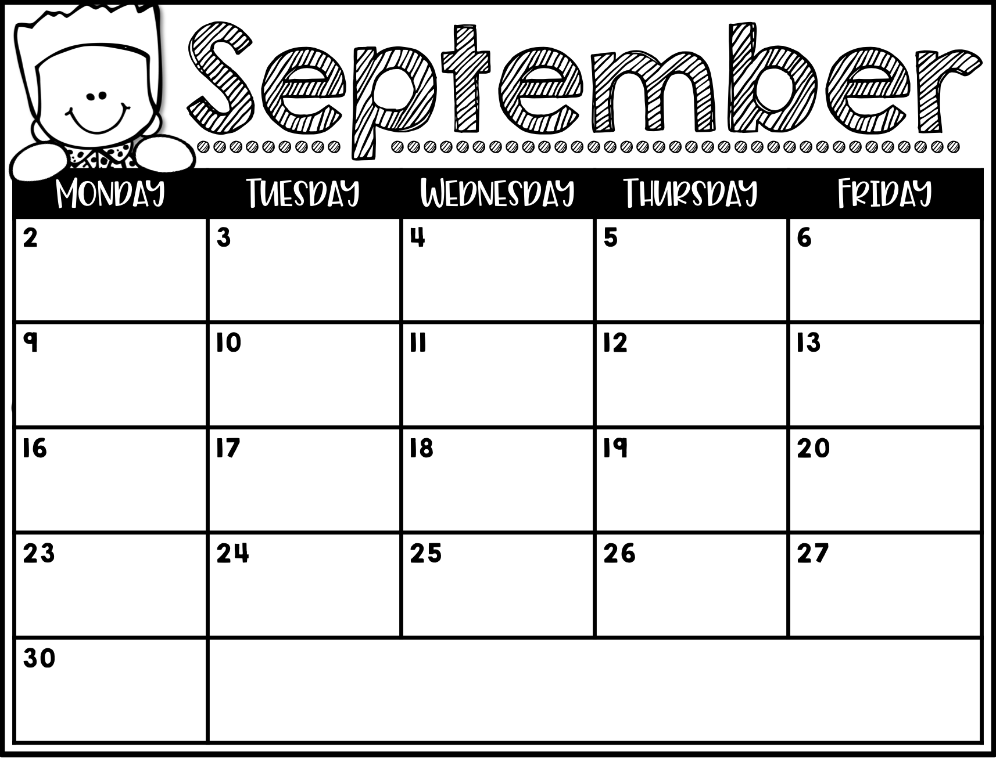
No School
Makerspace
Chinese
Media
PE
Art
PE
Music
Chinese
Media
Curriculum Night
6:oopm
Art
PE
Fit Lab
Maker Space
Chinese
Media
PE
Art
PE
No School
Sept. 10th – School Spirit Night Chick Fila Night
Sept. 17th Curriculum Night 6:00pm
Sept. 26th- Spirit Night @ Abbots Frozen Custard
Music

