Slide 1

Seed Planning

Slide 2
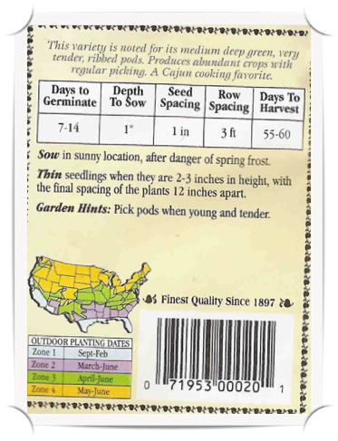
Read Seed Packets Carefully

Slide 3
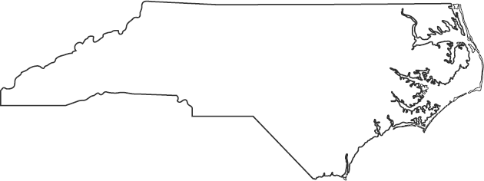
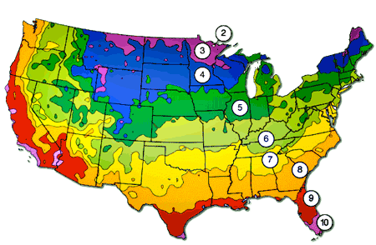
Know Your Zone
Zones 7 & 8

Slide 4
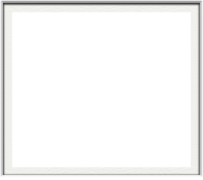
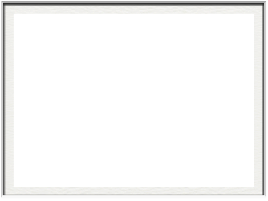
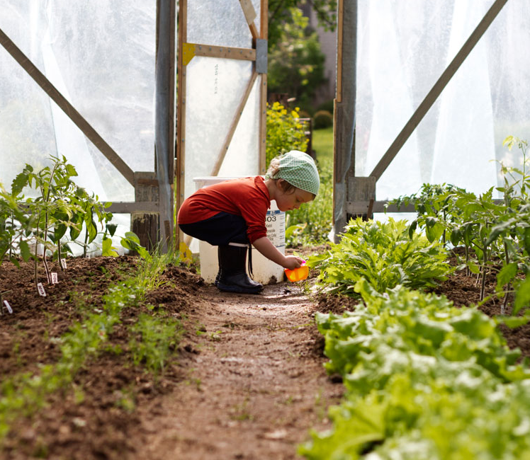
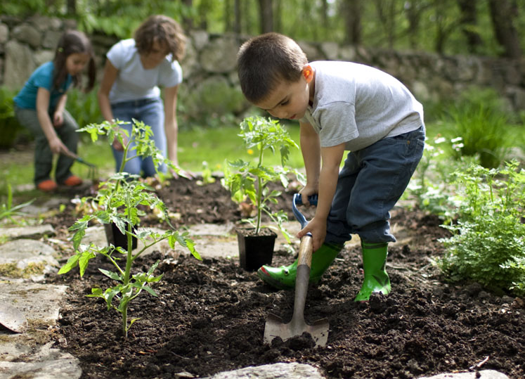
Seed
Sow
seed started indoors
in small containers
extends growing season
start in mid-February or early March for Zone 7& 8
seed started outdoors
directly in the ground
shortens growing season
start in mid-April or early May for Zone 7& 8

Slide 5
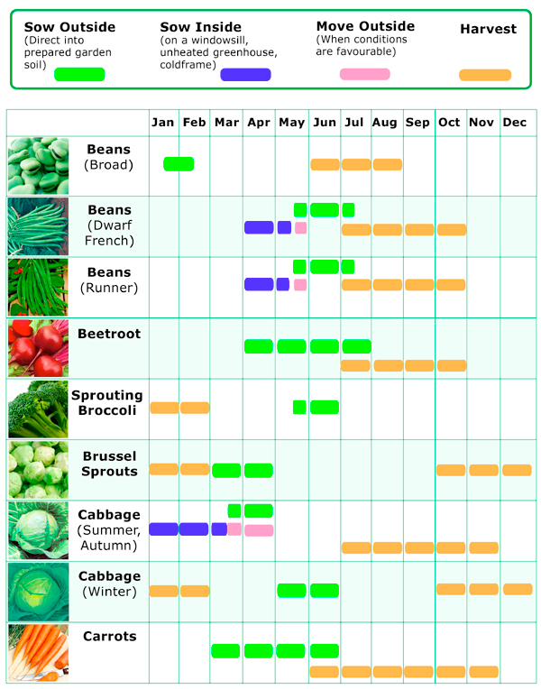
Plan Your Timeline

Slide 6
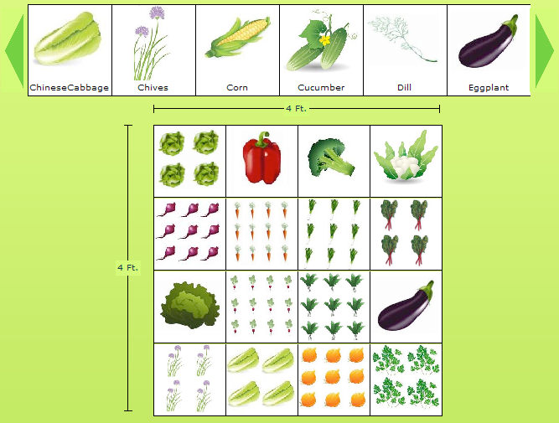
Plan Square Foot Garden

Slide 7

Partner Activities
Examine seeds & read seed packets
Create a Planting Timeline
Plan an Online Square Foot Garden

