Slide 1

SPACE-AGE SPIN OFFS

Slide 2

SPACE-AGE SPIN OFFS
What are Space – Age Spin Offs?
They are technologies that were developed for the space programs but are now used in everyday life.
There are hundreds of items that we use every day that were developed for the space program.

Slide 3

SPACE-AGE SPIN OFFS
Spin 2
Spin 1
How It Happens:
NASA needs to find a new way to study space or solve a problem.
Their scientists study the problem and come up with a new technology that solves it.
People at NASA’s Technology Transfer Program get a patent for the new technology and study it to find ways it could be used in everyday life.
Then they find companies or other organizations that are interested in licensing the technology.
Those companies use the new technology to make a new product or to make existing products better.

Slide 4
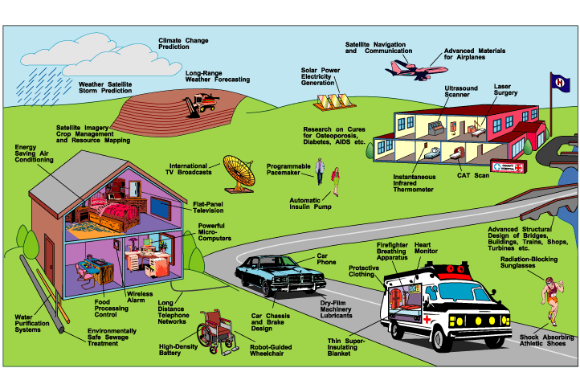
SPACE-AGE SPIN OFFS

