Slide 1
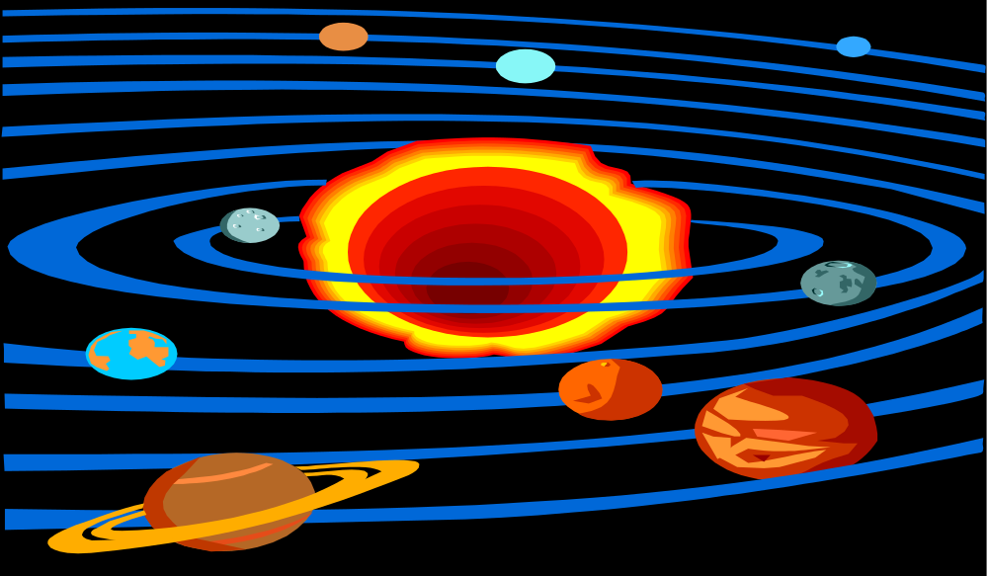
SOLAR SYSTEM
NOTES

Slide 2

Solar System
Where Does Space Begin?
Space begins where the Earth’s atmosphere is too thin to affect objects moving through it (an atmosphere is a mass of gases that surround a planet or star).
This is at about 100 miles above the Earth.

Slide 3
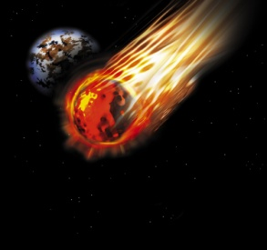
Solar System
We measure large distances in space by LIGHT -YEARS. A LIGHT -YEAR is the distance that light travels in a year (6 trillion miles)
Light travels at 670 million miles per hour.
It would take you 1 second to circle the Earth 8 times.
Our solar system, in which we live, includes the sun, the planets, moons and asteroids.

Slide 4
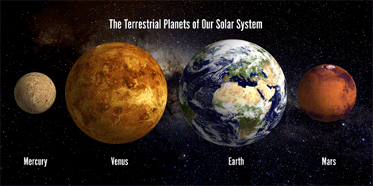
Solar System
The sun (our star) is 93,000,000 miles away, which is also called an Astronomical Unit.
In our solar system, there are 8 planets and their moons.
The first 4 planets closest to the sun are called the Inner Planets. These planets are also called terrestrial planets because they are dense and rocky.
The 4 Inner Planets are: Mercury, Venus, Earth, and Mars.

Slide 5
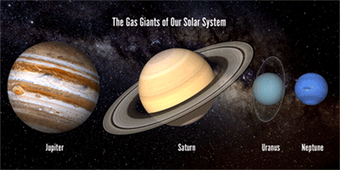
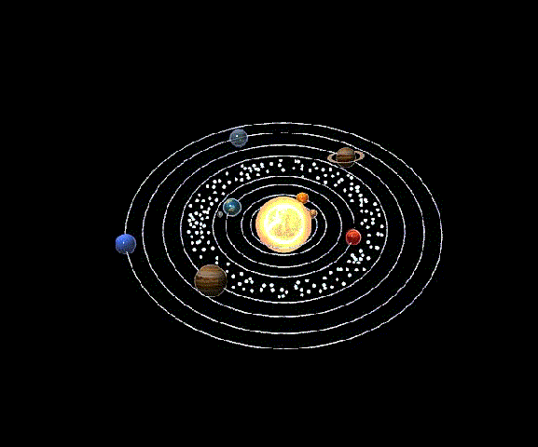
Solar System
The next 4 planets are the Outer Planets, or Gas Giants (they have deep, massive atmospheres).
The 4 Outer Planets are: Jupiter, Saturn, Uranus, and Neptune.
The Inner and Outer Planets are separated by an asteroid belt.

Slide 6
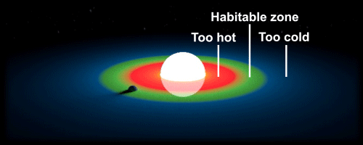
Solar System
Of all the planets, Earth is the only planet that is habitable (capable of maintaining life).
What Makes Earth Habitable?
Liquid water
Right distance from the sun
Breathable atmosphere
Protective magnetic field
“Friendly” moon
The perfect size

Slide 7
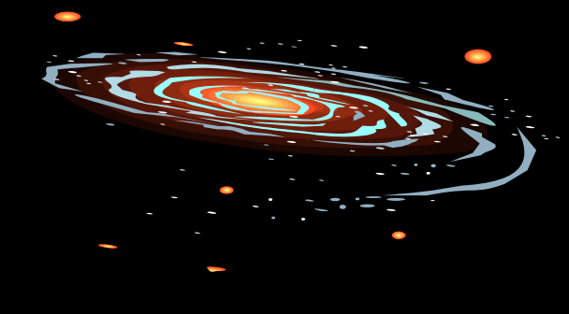
Solar System
Our solar system lies inside a GALAXY.
A GALAXY is a collection of stars, dust , and gas bound together by gravity.
We live in a SPIRAL GALAXY, called the MILKY WAY.

Slide 8

Solar System
A GALAXY can have more than 1 TRILLION STARS!
Our Galaxy, The MILKY WAY, has about 200 BILLION STARS.
Our SUN is a star.
There are HUNDREDS of BILLIONS of galaxies in our universe.

Slide 9

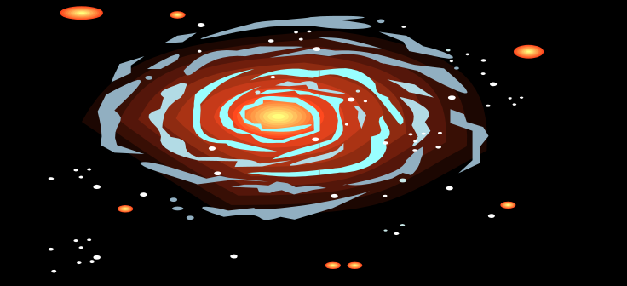
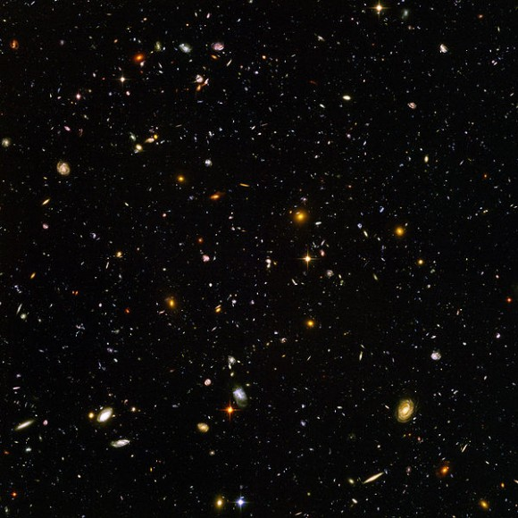
The Earth is part of the Solar System,
Which is part of a Galaxy,
Which is part of the Universe.
Video
SJ
Size

