Slide 1
Decision Making

Slide 2
Steps to decision making
I. Identify your goal
2. Identify your options
3. Consider the consequences for each option
4. Choose the option with the best results (but keep your back ups in mind)
5. Evaluate your decision

Slide 3
ReactiNG VS. RESPONDING
Acting without thinking
Thinking first before acting

Slide 4
Emotional reactions
https://www.youtube.com/watch?v=kv6HkipQcfA&t=2s

Slide 5
Survival instincts
CAVEMAN MIND | MODERN MIND

Slide 6
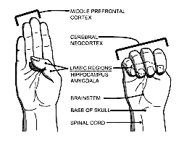

Slide 7
Rapid Reset

Slide 8
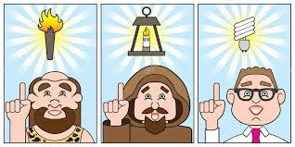
The caveman mind’s biggest advantage over the modern mind is that everything it did was of value-made for a better life. Our life has evolved and so has our mind. We no longer work merely from a place of survival. The modern mind has also developed logic/higher level thinking but we must bypass our emotional/survival brain in order to access it to better ourselves.

Slide 9
Thinking Strategies:
Anything you have ever tried to make yourself feel better when painful thoughts or feelings show up.
Worrying
Dwelling on the past
Dreaming about the future
Imagining revenge scenarios
Thinking ”it’s not fair”…. ” if only….”
Blaming yourself
Blaming others/ the world
Talking positively to yourself
Talking negatively to yourself
Analyzing yourself (trying to figure out why you’re like this)
Analyzing the situation (trying to figure out why this happened)
Analyzing others (trying to figure out why they are like this)

Slide 10
Ask yourself…
Did this get rid of my painful thoughts and feelings in the long term?
Did this bring me closer to a rich, full life?
If the answer is ”no”, what did this cost me in terms of time, energy, health, relationships?

