Slide 1
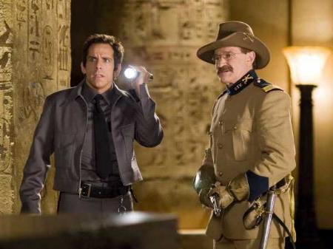
Theodore “Teddy” Roosevelt

Slide 2
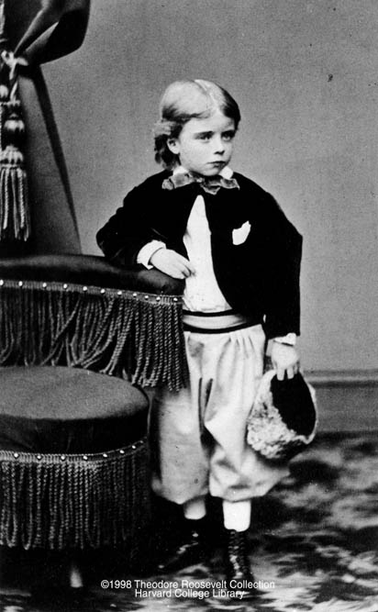
Young Teddy
Grew up in NYC
Nicknamed “Teedie”
Amateur Taxidermist
Suffered from Asthma
  Home remedies of the time…
    Coffee
    Tobacco
    Whiskey

Slide 3
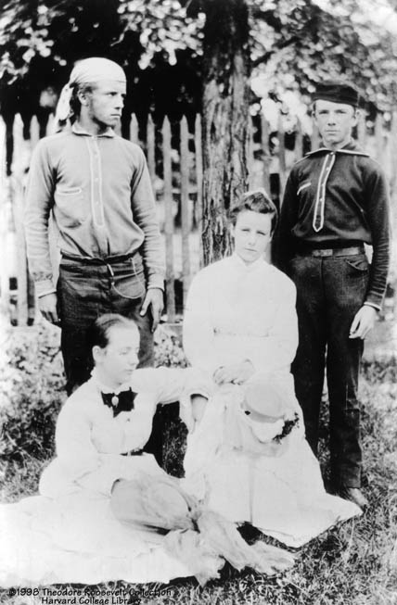
Teenager Teddy
Works hard in his father’s home gym to overcome illness
    Weightlifting
    Gymnastics
    Horseback Riding
    Swimming
    Hiking
    Wrestling
    Boxing
    Judo

Slide 4
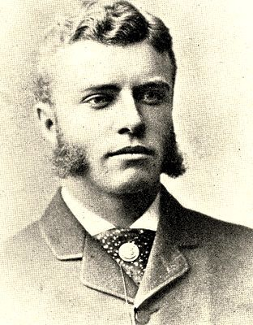
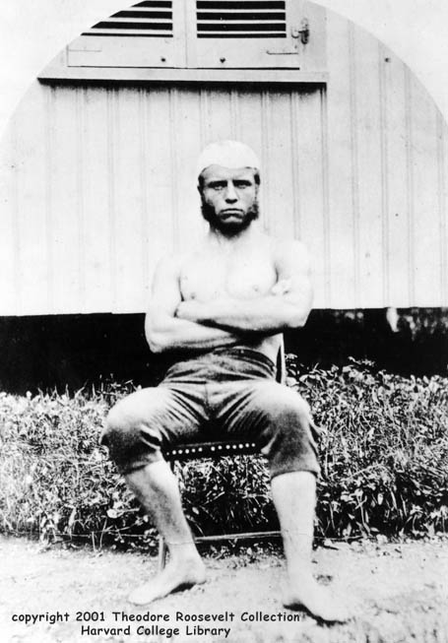
Harvard Years
Graduated with Bachelor of Arts
  Photographic Memory
  22 of 177
  4.0 GPA
  Boxing – Runner up in championship
  Rowing
  Editor of Student Magazine
Entered into Columbia Law School
  Dropped out to pursue politics

Slide 5
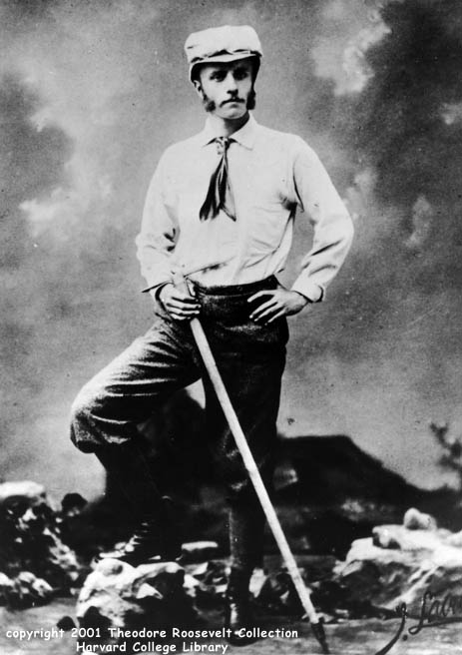
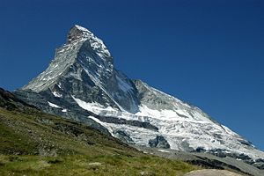
Early Adult Years
1881 – Climbing the Matterhorn (Switzerland-Italy)

Slide 6
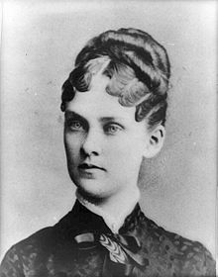
First Marriage
Alice Hathaway Lee
Died at 23 of kidney disease 2 days after having daughter
Mother died later that day of Typhoid Fever

Slide 7
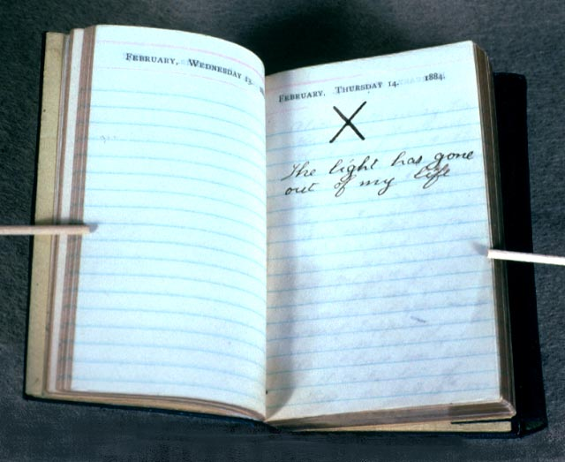

Slide 8
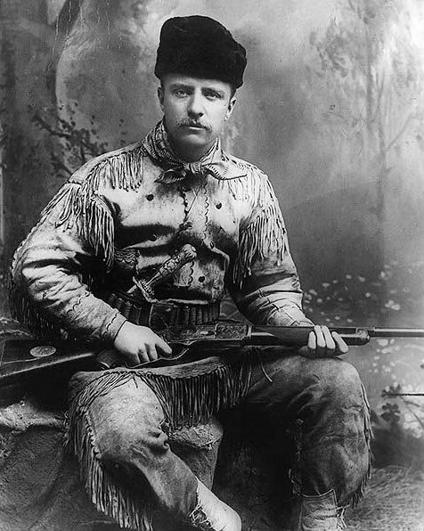
Life in the Badlands
Purchased Ranch in Dakota Territory while Buffalo Hunting
Developed love for outdoors
Served as Deputy Sheriff
  Once hunted down 3 outlaws who stole his riverboat
  Marched thieves back 40 hours for trial without sleeping
Returned back east after winter wiped out $60k worth of cattle

Slide 9
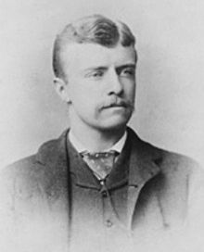
Early Career
NY Assemblyman
Ran for mayor of NY as “Cowboy of the Dakotas”
  Finished 3rd
Civil Service Commission under B. Harrison
  Fought against Spoils System

Slide 10
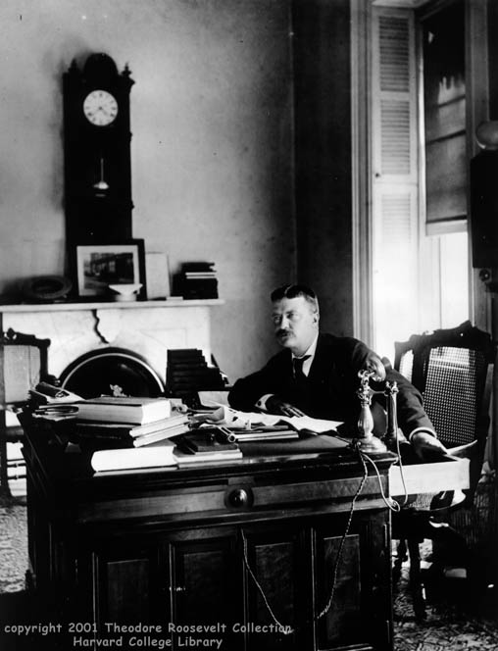
Early Career
Pres. Of NYC Police Commissioners
  Reformed Corrupt police force
Assistant Secretary of the Navy
  Often acted as Secretary
  Left to fight in Spanish American War

Slide 11
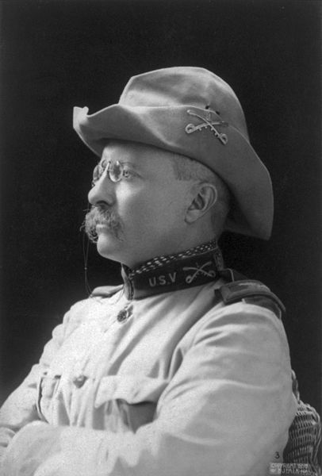
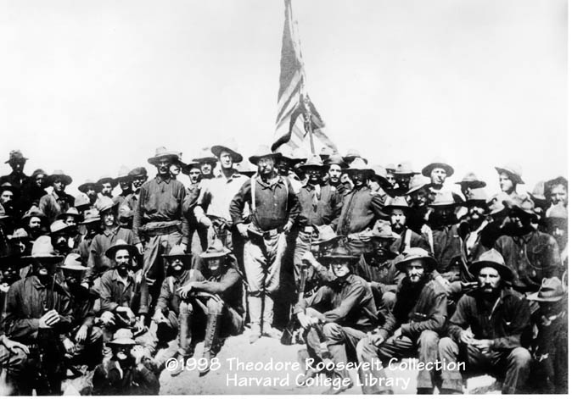
Rough Riders
Volunteer cavalry brigade
Victory at San Juan Hill
Recommended for Medal of Honor
  Disapproved after war
  Awarded posthumously in 2001 by Bill Clinton

Slide 12
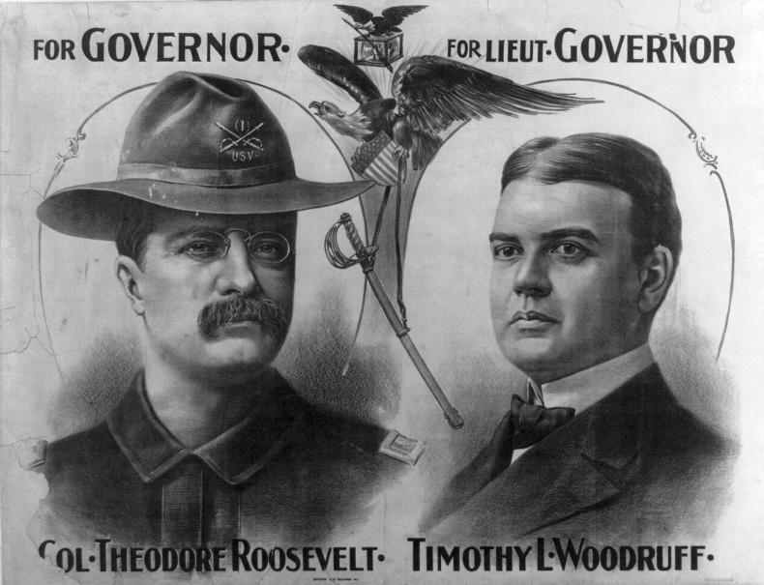
McKinley/Roosevelt Ticket
Roosevelt served as governor of NY for 3 years
  Waged war on political machines
  Won admiration of “Progressives”

Slide 13
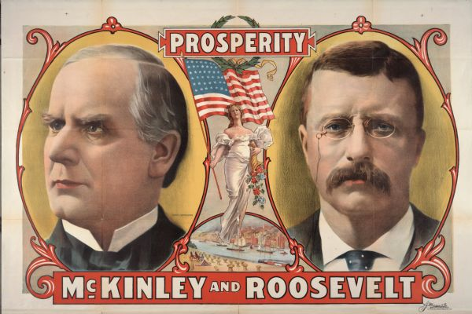
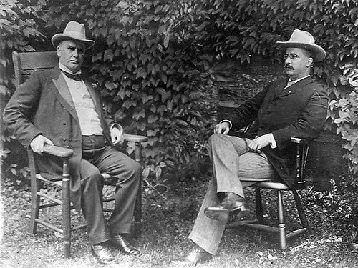
McKinley/Roosevelt Ticket
“Forced” into running with McKinley in 1900
Known as a great campaigner
Republican’s hoped he would win over “Progressive” voters
  "Don't any of you realize that there's only one life between that madman and the Presidency?“
  - Conservative Sen., Mark Hanna

Slide 14
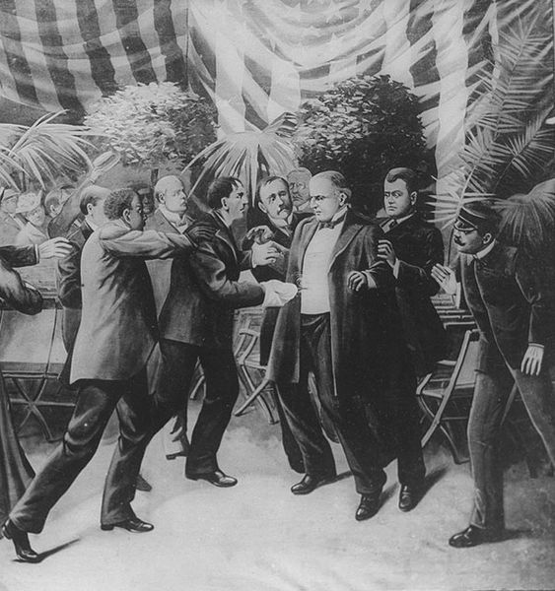
Roosevelt Becomes President
Assassination of McKinley in 1901
Youngest Pres.
  age 42
"Now look, that damned cowboy is President of the United States!"
- Mark Hanna

Slide 16
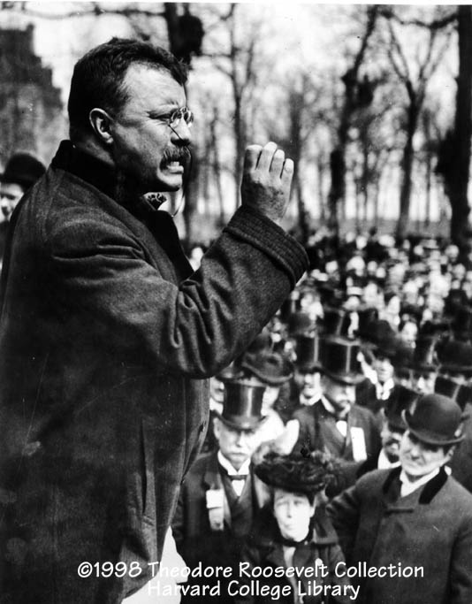
The Bully Pulpit
Uses speeches to influence media and shape legislation

Slide 17
Philosophy
Internationally—he was a Social Darwinist
Domestically—believed that government should actively balance the needs of competing groups in American society

Slide 18
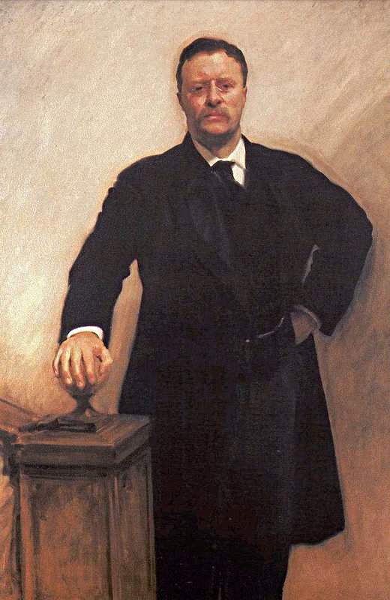
Roosevelt’s Square Deal
More Federal Power
Take up for the common man
Progressive reforms
Provide a “square” fair deal for everyone
Notes:
Became President after McKinley assassinated
Believed federal government should take control where states proved incapable

Slide 19
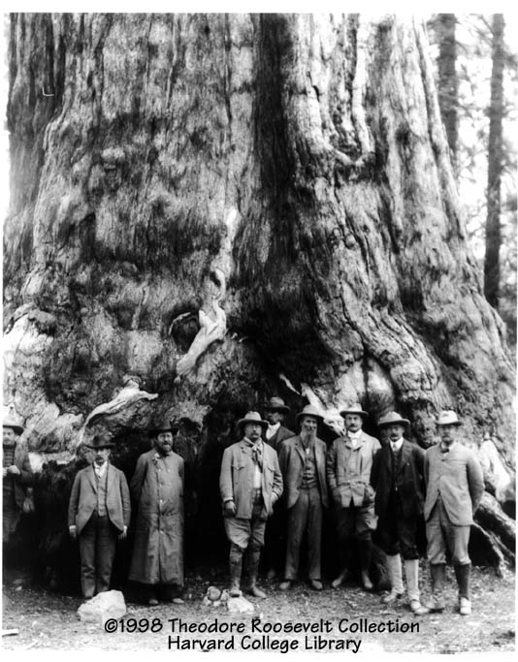
Roosevelt as Conservationist
National Parks, National Forests, game and bird preserves, and other federal reservations
230,000,000 acres protected for land and animals
Teddy Bear
President Theodore Roosevelt at Yosemite in 1903.

Slide 20
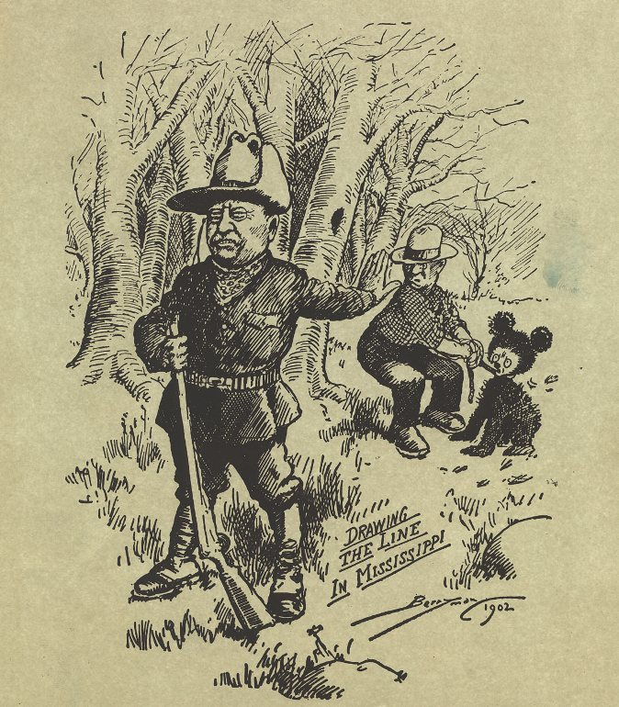

Slide 21
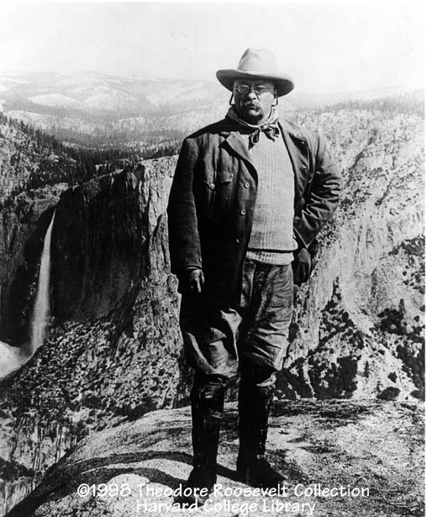
Roosevelt and National Parks
"Leave it as it is. You can not improve on it. The ages have been at work on it, and man can only mar it."

Slide 22
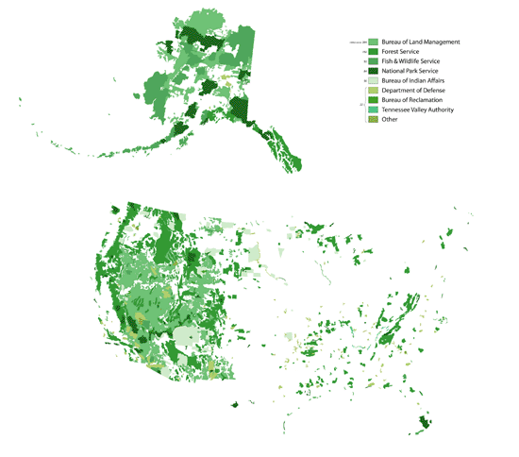
Federal Lands

Slide 23
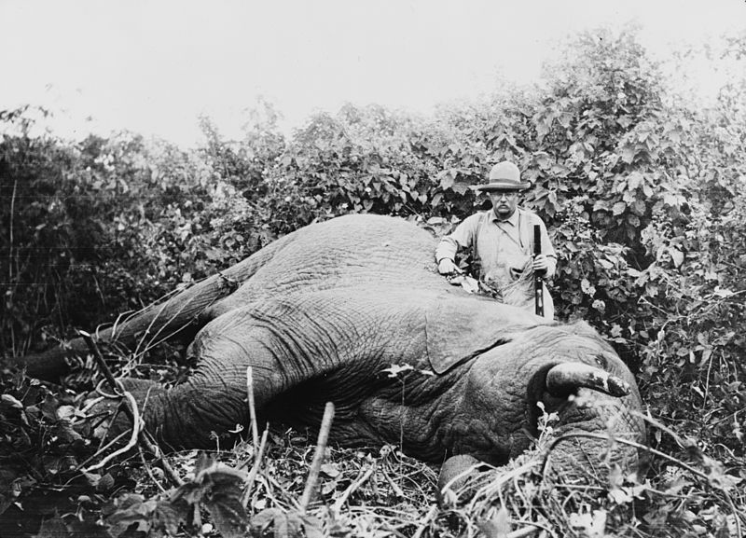

Slide 24
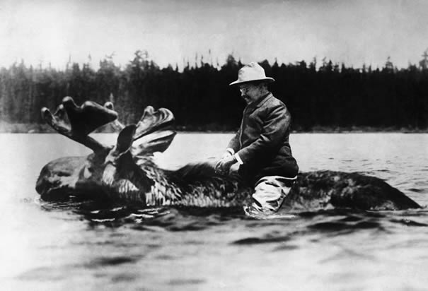

Slide 25
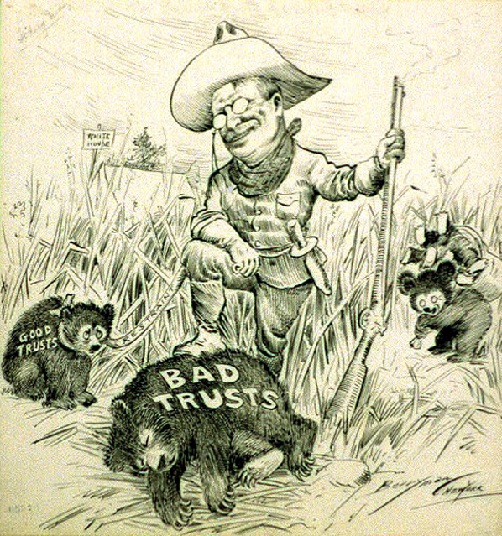
Attack on Laissez Faire
Work to curb the power of trusts "within reasonable limits"
Roosevelt the “Trust Buster”

Slide 26
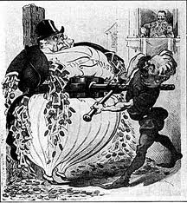
TRUSTBUSTER!
1904: Federal Govt. sues Northern Securities Company
  Owned by JP Morgan
  Teddy urges Supreme Court to declare this a violation of the Anti-Trust Act.
  Roosevelt’s popularity soared
Awesome Cartoon

Slide 27
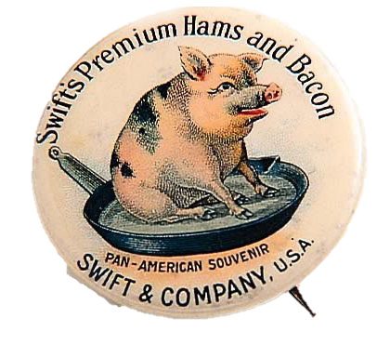
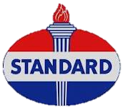
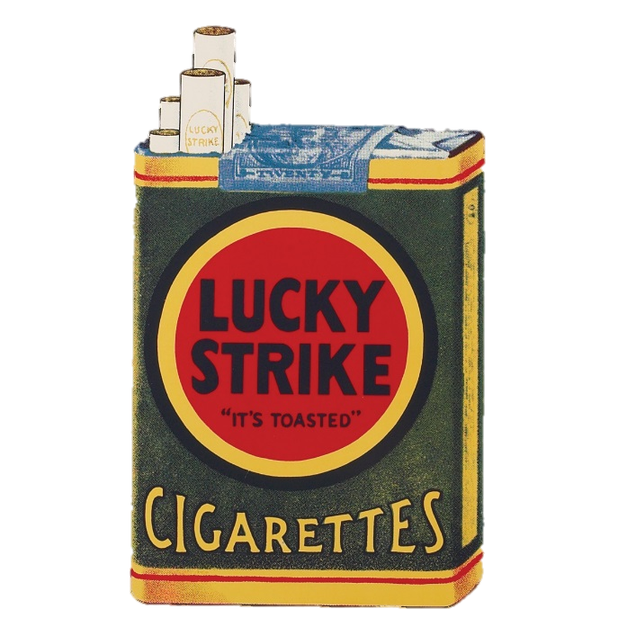
Other “Broken” Trusts
Swift & Company v. U.S. (1905)
Standard Oil Company v. U.S. (1911)
  Created 30+ new companies
  Exxon, Amoco, Mobil, Chevron, Etc
US v. American Tobacco Company (1911)

Slide 28
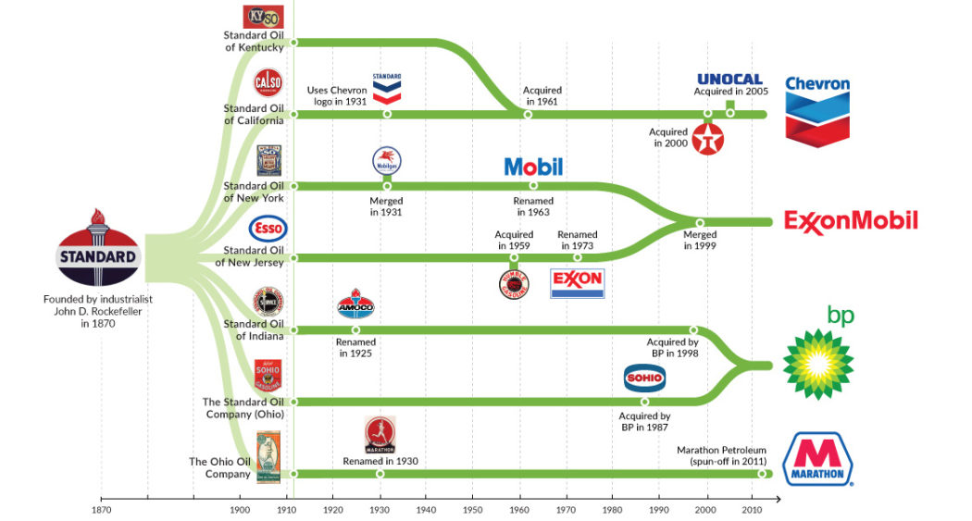

Slide 29
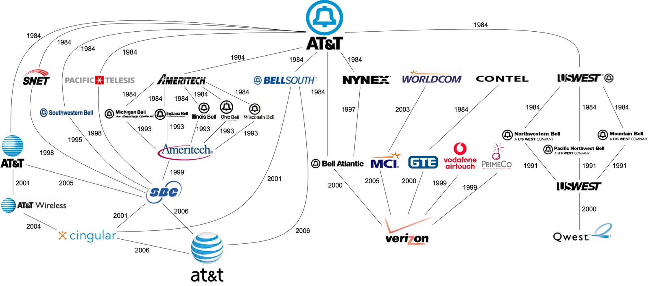
Modern “Trust Busting”

Slide 30
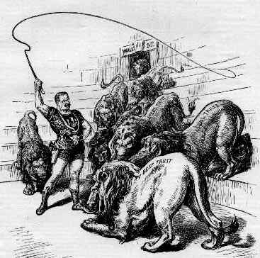
The Lion Tamer

Slide 31
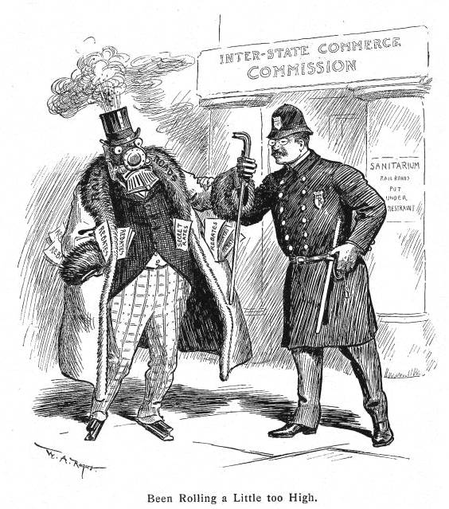
Regulate Interstate Commerce
Interstate Commerce Act (1887)
  Attempt to regulate railroads.
Roosevelt Amendments to ICA
  Elkins Act- Illegal to give/receive rebates
  Hepburn Act- let ICC set maximum rates
Notes:
Sherman Anti-Trust Act too vague to enforce
Roosevelt brought 44 suits against trusts, though had some wins it could not stop the merger movement of business
ICC est to enforce the new law but had little power

Slide 32
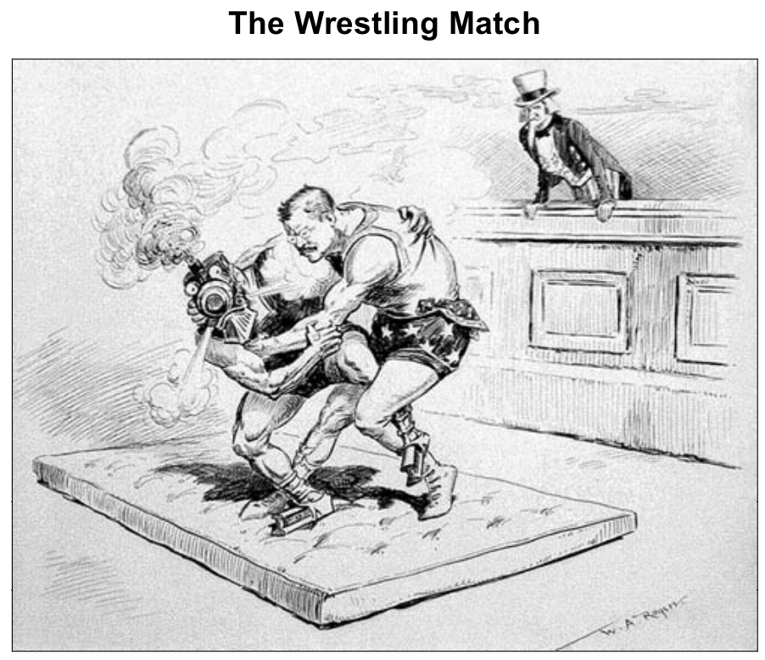

Slide 33
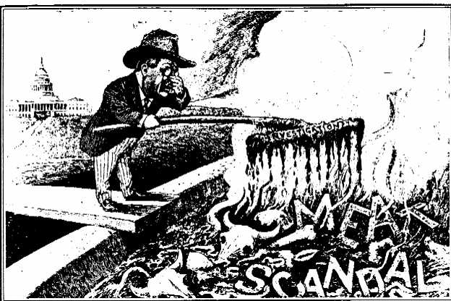
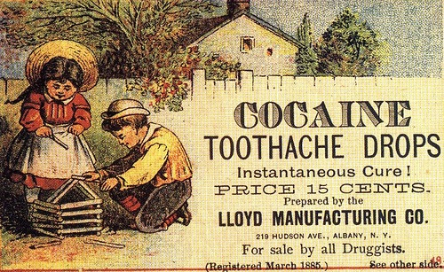
Food and Drugs
Meat Inspection Act (1906)- established federal food inspection program
Pure Food and Drug Act (1906)- stopped sale of contaminated food and drugs; ensure truth labeling
  Early for of the FDA

Slide 34
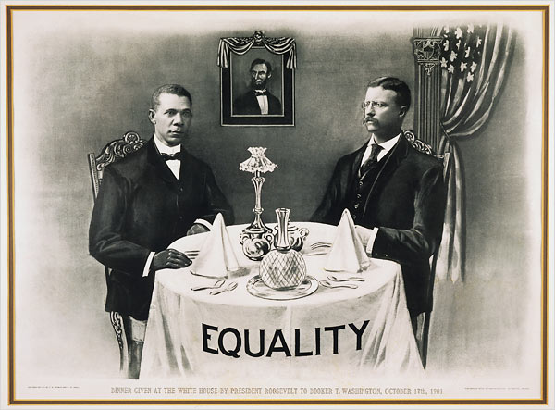
Roosevelt and Civil Rights
Did not fully support civil rights
Invited Booker T. Washington to the White House
  Praised by some
  Infuriated Southerners
“I shall have Washington to dine just as often as I please.“
      - Theodore Roosevelt
Notes:
Did very little to advance civil rights
Some whites in Mississippi refused to accept the black postmisstress he had appointed, he chose to close the station down then give in
1906 angered many Af-Am when dismissed an entire regiment of Af-Am soldiers accused of conspiracy in protecting others charged with murder in Brownsville, TX

Slide 35
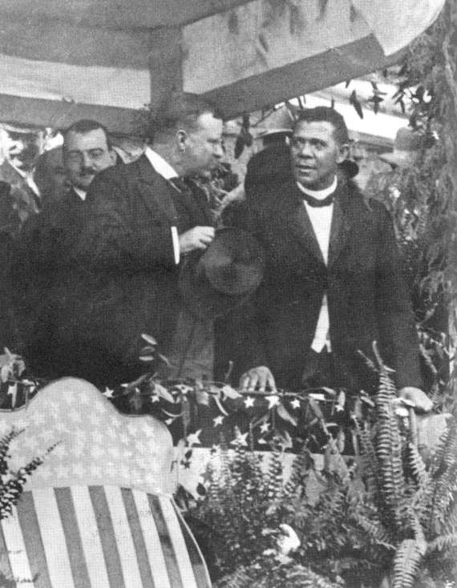

Slide 36
Presidential Firsts
First to invite an African American to a White House dinner
First to have Secret Service protection
First to win Nobel Peace Prize for his work towards ending the Russo-Japanese War
First to take trip outside the United States

Slide 37
More Presidential Firsts
First to give an open invitation to the press
First to be submerged in a submarine, to own a car, and to be allowed to operate the light switches in the White House

Slide 38
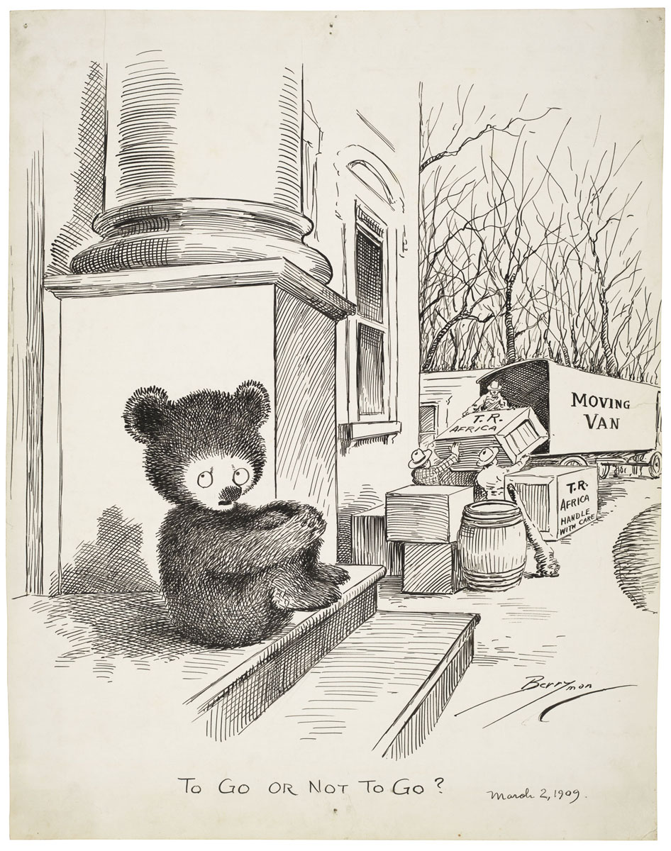

Slide 39
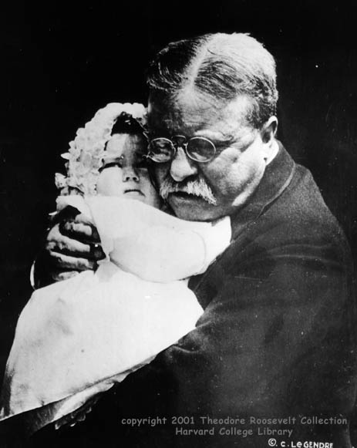
An Older Theodore Roosevelt
Youngest son killed in WWI in World War I
"Grandfather" Roosevelt hugs baby granddaughter Edith Roosevelt Derby, 1918.

Slide 40
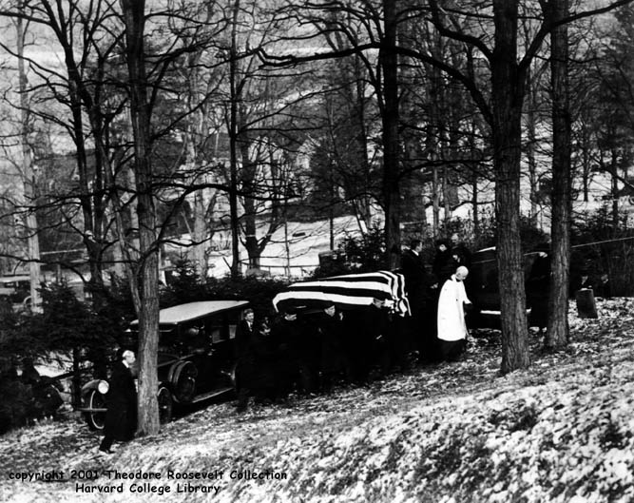
Roosevelt’s Death
Died in 1919 of a heart attack
Photo shows the burial of Theodore Roosevelt, January 1919 in Young’s Memorial Cemetery, Oyster Bay, NY.
"Death had to take Roosevelt sleeping, for if he had been awake, there would have been a fight.”

Slide 41
Works Cited
- "Theodore Roosevelt Collection." 1998.
Harvard College Library. 4 Dec 2006
<http://hcl.harvard.edu/houghton/dep artment /roosevelt.html. >.
- Melissa Johnson: Honors US History, Hickory
Ridge High School. NC
- Chris Balga: Hickory Ridge HS. NC

