Slide 1
Rise and Fall of Populism
Chapter 13
Section 3

Slide 2
Post Reconstruction Politics
Party system becomes fairly stable
  Republicans
    Northerners
    Middle Class
    Protestant
    Anti Immigration
Avg 78% Voter turnout
Federal Government remains weak
  Controlled by “Machine Politics” and Bosses
  - Democrats
    Southerners
    Poorer Class
    Catholics

Slide 3
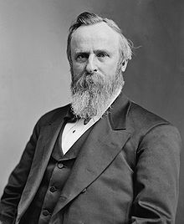
Gilded Age Presidents
Rutherford B Hayes - 1876
  Known for Compromise of 1877
    Nicknamed “His Fraudulency”
  Promises to serve only 1 term

Slide 4
Fun Facts
5’ 8”
Other Nicknames
  Dark Horse President and Rud
Teetotaler
Wounded 5 times in Combat
Important stuff that happened during presidency
  Compromise of 1877
  Great RR Strike of 1877

Slide 5
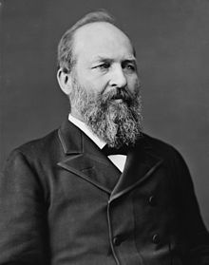
Gilded Age Presidents
James Garfield
  1880 Election decided by 2 Republican “Factions”
Stalwart's
  Traditional Republicans
  Supported Chester Arthur
Half Breeds
  Called for Civil Service Reform
  Supported James Garfield

Slide 6
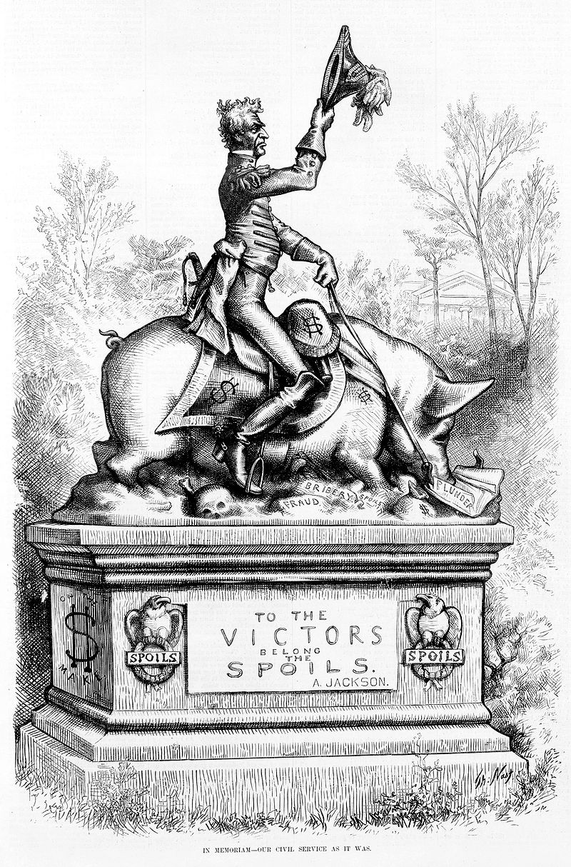

Slide 7
Gilded Age Presidents
Garfield Wins Election - 1880
  Assassinated soon after by pro-Stalwart’s assassin
Pendleton Civil Service Act
  Passed by Arthur soon after assassination
  Requires Examinations for civil service jobs.
  *** Meant to end Spoils System

Slide 8
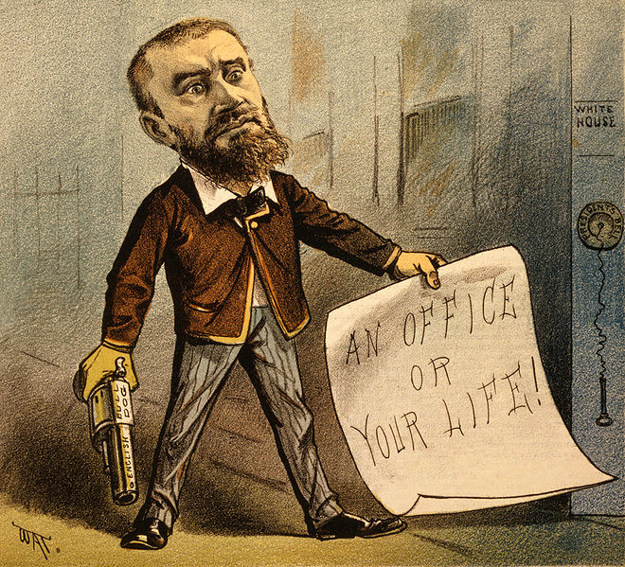
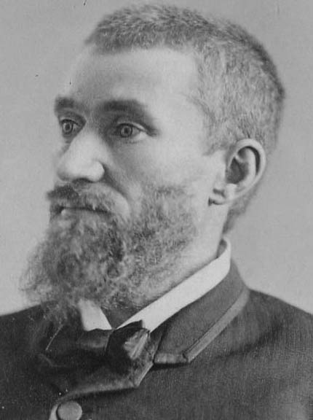
Fun Facts
Assassinated 100 days after inauguration
Died of infection… Not bullet wounds
Shot by Charles Julius Guiteau
Implemented in Credit Mobilier Scandal

Slide 9
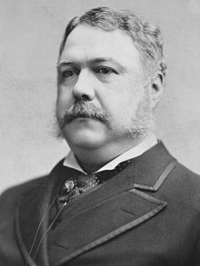
Gilded Age Presidents
Chester Arthur – Takes office in 1881
  6’ 2”
  Nickname – The Gentleman Boss
  Supported Chinese Exclusion Act
Important Stuff that Happened during Presidency
  Pendleton Act

Slide 10
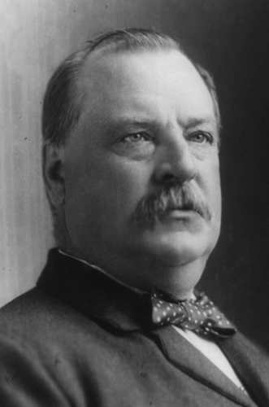
Gilded Age Presidents
Grover Cleveland – 1884 & 1892
  Elected thanks to “Mugwumps”
    Republicans who promised to vote for an “Honest Democrat”
  Anti…
    Politician
    Graft (Bribery)
    Political Machine
    Tariff
  Election of 1888
    Tariff’s and economy are major concerns
    Cleveland wins Pop vote but not electoral vote

Slide 11
Fun Facts
5’11, 250lbs
Nicknames – Big Steve and Uncle Jumbo
At the age of 47, married his 21 yr old “God Child”
Only President elected for two non consecutive terms
Accused in sex scandal
President when Statue of Liberty Finished
Vetoed more bills than first 21 presidents
Important events that happened during presidency
  Dawes Act - Interstate Commerce Act
  Panic of 1893 -Pullman Strike

Slide 12
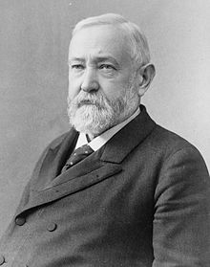
Post Reconstruction Presidents
Benjamin Harrison - 1888
  Grandson of William H. Harrison
    Presidency was just as productive

Slide 13
Fun Facts
5’ 6”
Nickname – The Human Iceberg
2nd wife was 30 years younger than him
Supported 2 bills keeping African Americans from voting
Appointed Frederick Douglass as minister to Haiti
Important stuff that happened during presidency
  Sherman Anti Trust Act
  Sherman Silver Purchase Act
  Wounded Knee Massacre

Slide 14
Possible LEQ Prompt
Explain the origins of the Populist Party (1890s) and its effects on US politics and national policies through the year 1920.

Slide 15
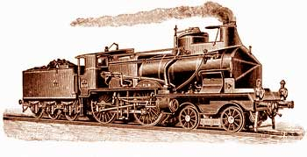


Gilded Age Issues
Railroads
  Problem:
    RRs had a virtual monopoly
    Could charge whatever they wanted for transportation of people/goods
  Attempted Solution
    Interstate Commerce Act - 1887
    All Rates must be “Reasonable and Just”
    Not effective for 20 years (Teddy R)
      Elkins Act & Hepburn Act
Vocab Word!!

Slide 16
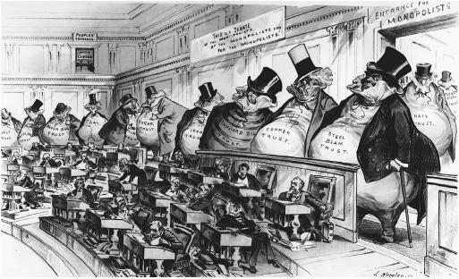
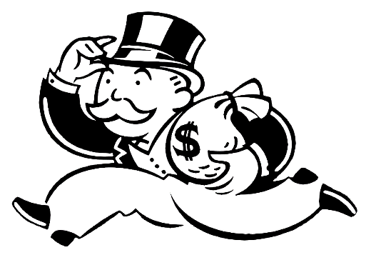
Gilded Age Issues
Trusts
  Problem
    Many “Trusts” had become Monopolies
    Lack of competition = Bad for consumers
  Attempted Solution
    Sherman Anti Trust Act - 1890
      “Every combination… in the form of trust or otherwise… in restraint of trade or commerce… is declared to be illegal”
    Not effective for 10+ years (Teddy R)
Vocab Word!!
Does this include Unions?

Slide 17
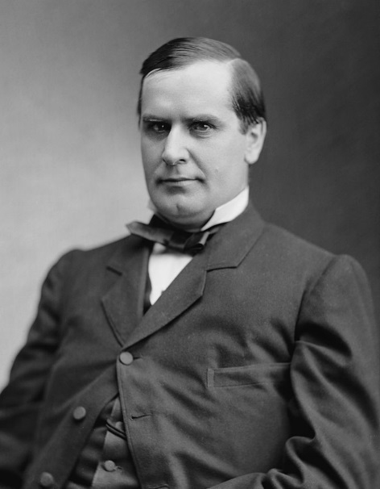
Gilded Age Issues
Tariffs
  Issue:
    Tariffs “protect” American Businesses
    Provided Income for the Fed Govt
  Attempted Solution
    McKinley Tariff - 1890
    Highest ever proposed (from 38 to 50%)
  Effect:
    Angers Lower Class. Why?
    Democrats win House and Presidency in 1892
    Tariff Reduced in 1894

Slide 18
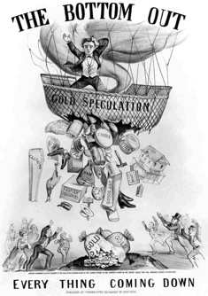
Economic Distress
Panic of 1893
  Causes
    Failure of Reading and Philadelphia RRs
    Crash in Wheat Prices
  Effects
    8000 Businesses close
    150 RRs out of business
    400 Banks close
    20% Unemployment
    US Govt borrowed $60 Million from JP Morgan

Slide 19
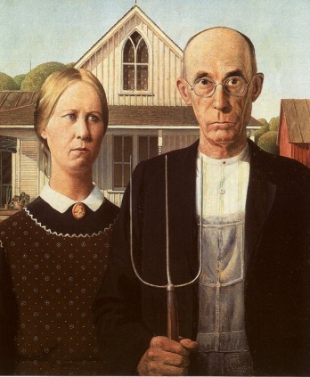
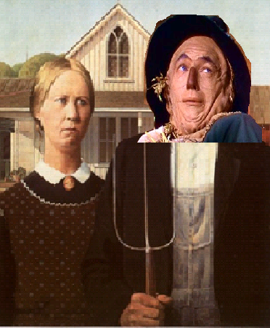
Economic Distress
Farmers in Midwest are caught in a vicious cycle
If Farmers could not pay their mortgage, they would face foreclosure
Buy land on loans
Wheat Prices drop
Wheat Prices drop
Buy land on loans

Slide 20
Railroad: Good or Evil?
Railroads were great for transportation and shipping produce around the country
Unfortunately, they were charging outrageous prices making it difficult for farmers to make a profit
Jerks

Slide 21
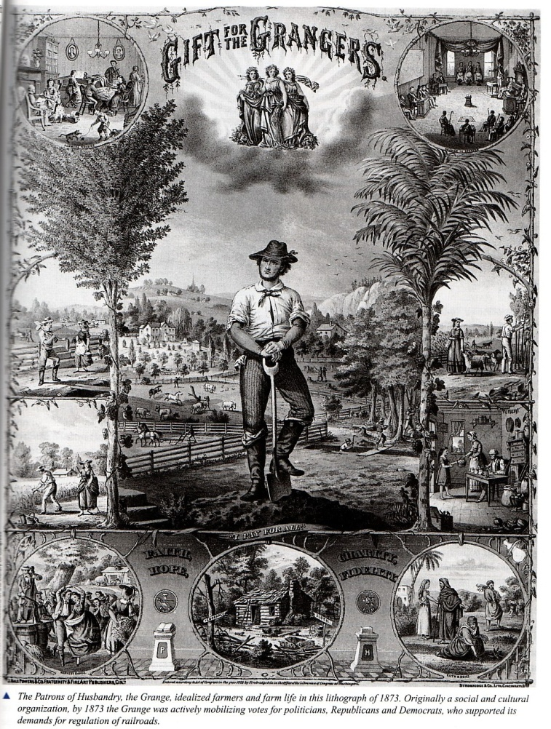
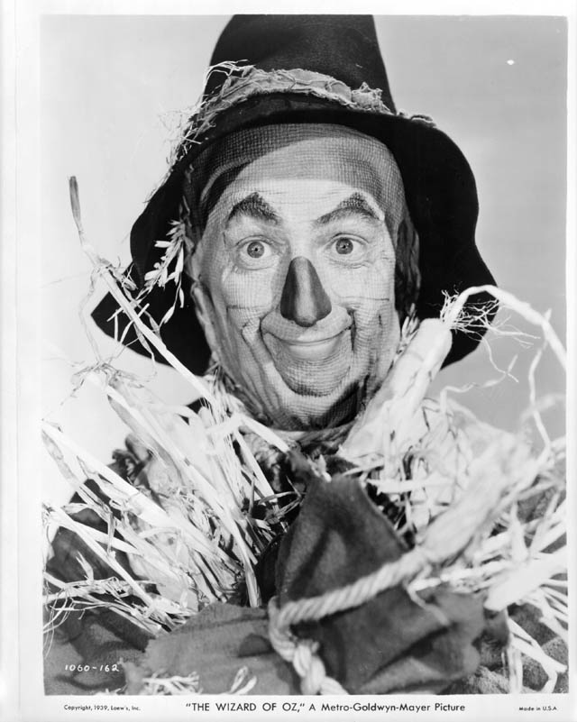
Farmers Alliances
The Grange – 1867
  National Organization of farmers
Farmers Alliances
  Southern – 1875
  Northern – 1877
  Colored – 1886
    Formed after banned from Southern Alliance
Focused on…
  Fighting the railroad/storage rates
  Influencing Politics

Slide 22
“Wimin is Everywhere”
Both men and women participated
Mary Elizabeth Lease
  Made 160 speeches in the summer of 1890
  “Raise less corn and more hell”
  “It is no longer a government of the people, by the people, and for the people, but a government of Wall Street, by Wall Street, and for Wall Street.”

Slide 23
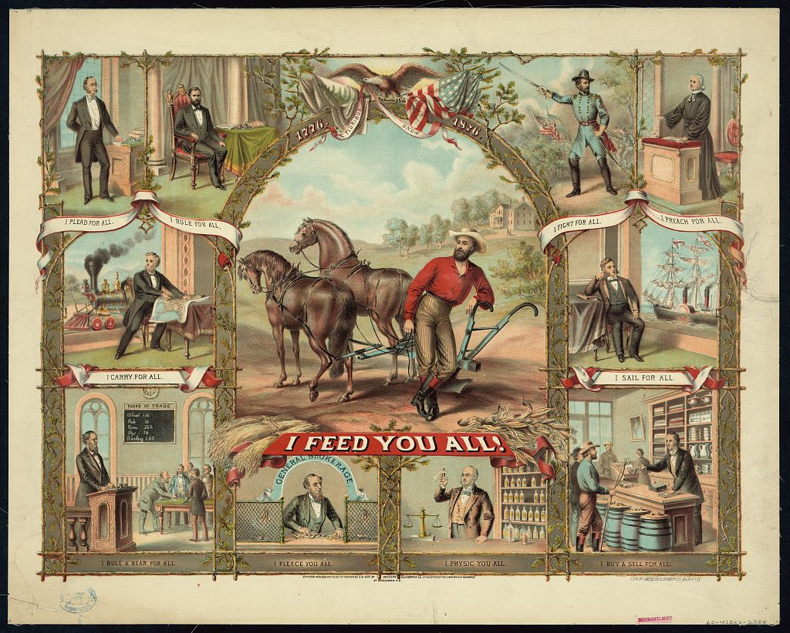

Slide 24
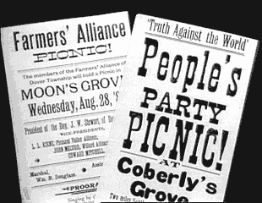
The People’s Party (Populists)
Farmers see the need to unify under a single party
Omaha Platform
  Political Change
    Direct election of senators
    Secret ballot
    Initiatives and Referendums
  Economic Change
    Bimetallism
    Govt Control of RR’s, Telegraph and Telephone companies
    Government Assistance for Farmers
    Graduated Income Tax
    8 Hour Workday

Slide 25
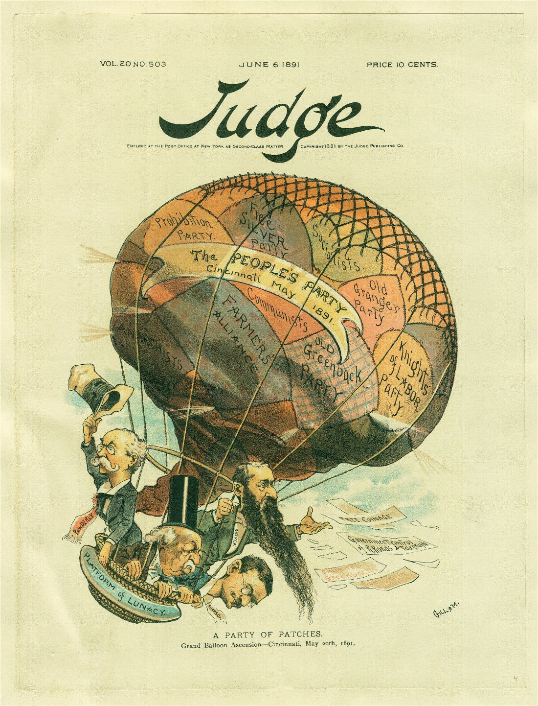

Slide 26
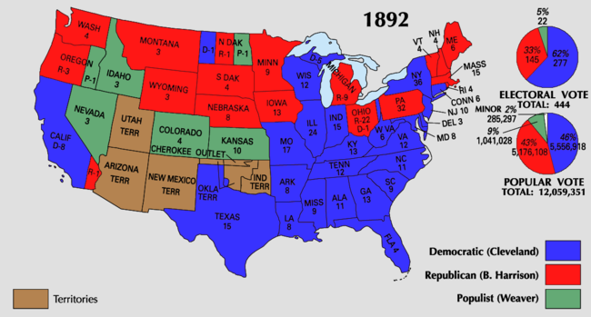
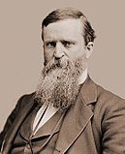
Election of 1892
James Weaver

Slide 27
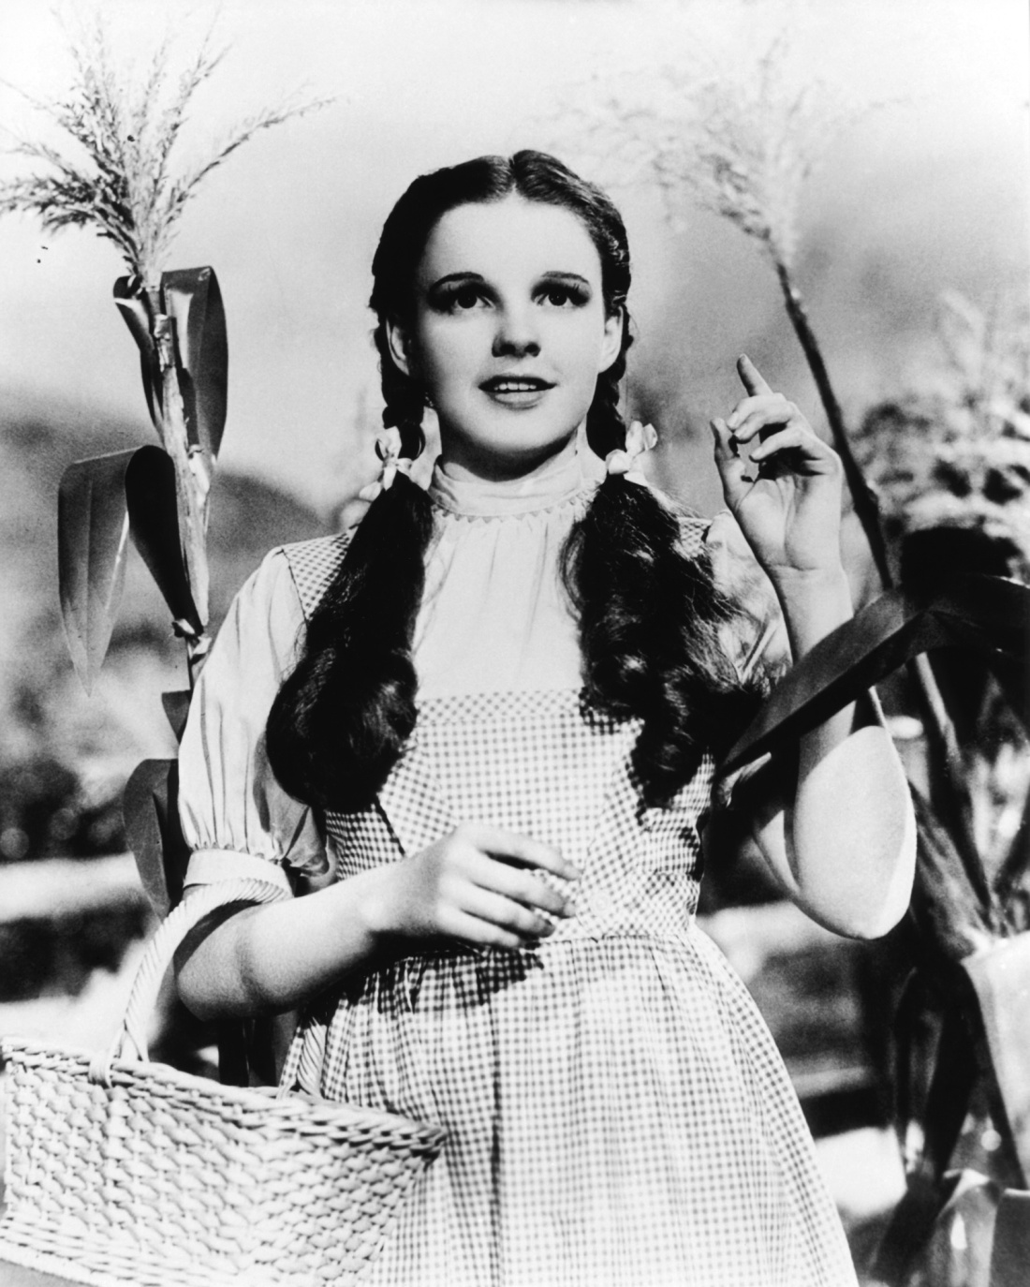
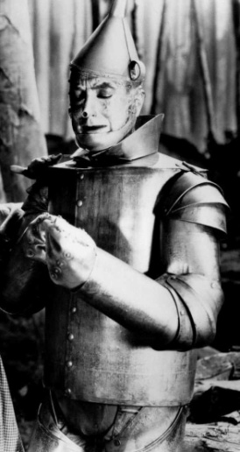
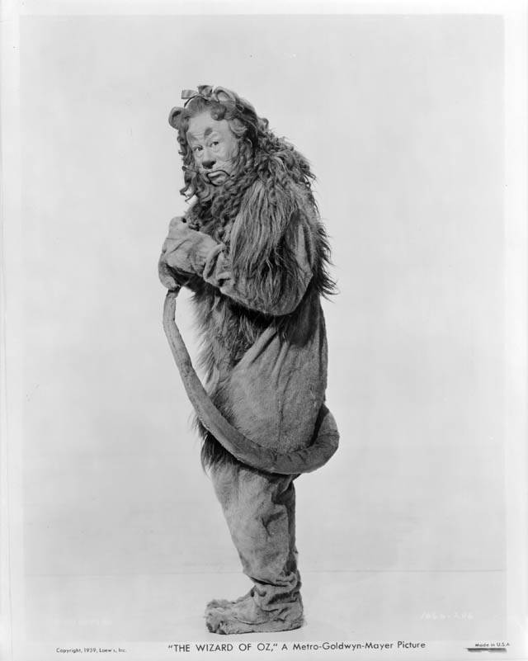

Populist Party
In order to get more votes, farmers join..
Prohibitionists and Knights of Labor
Select William Jennings Bryan as Candidate

Slide 28
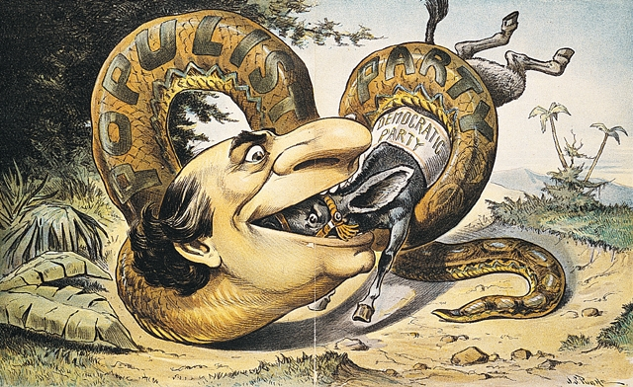
Party “Fusion”

Slide 29
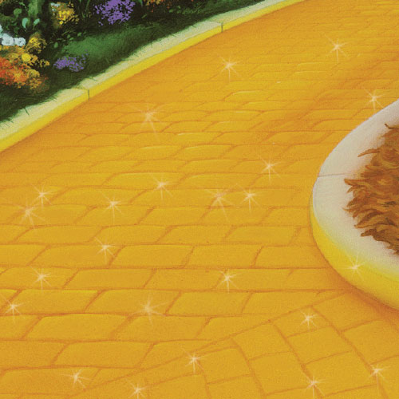
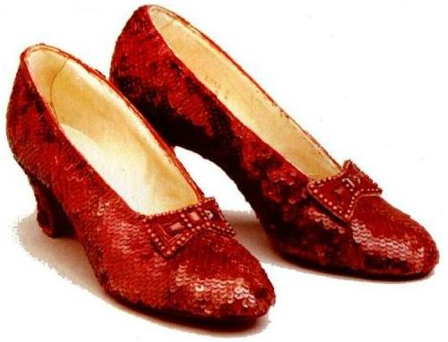
The Gold Issue
A major issue at the forefront of politics was the money system.
 | “Gold Bugs” | “Silverites”
Who were they? | Bankers and Businessmen | Farmers and Laborers
What did they want? | Gold Standard= Less $ in circulation | Bimetallism= More $ in circulation
Why ? | Loans would be repaid in stable money | Products sold at higher prices
Effects | Deflation: -Prices fall -Fewer people have money -Value of money increases | Inflation: -Prices rise More people have money Value of $decreases

Slide 30
Cross of Gold Speech
In hopes of getting into the white house, Populist joined sided with the Democrats and chose William Jennings Bryan as their candidate in the 96’ election
Made a famous “Cross of Gold Speech” in which he showed his disdain for the gold standard.
“If they dare to come out in the open field and defend the gold standard as a good thing, we shall fight them to the uttermost, Having behind us the producing masses of this nations and the world, supported by the commercial interests, the laboring interests, and the toiling everywhere, we will answer the demand for the gold standard by saying to them: You shall not press down upon the brow of labor this crown of thorns, you shall not crucify mankind upon a cross of gold.”
-Democratic National Convention speech, Chicago, July 8, 1896

Slide 31
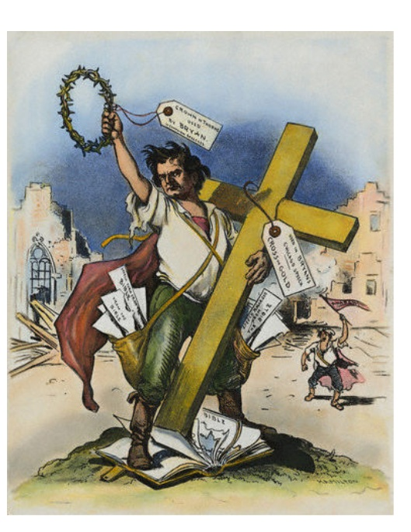
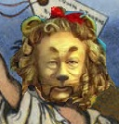

Slide 32
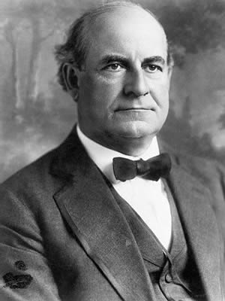
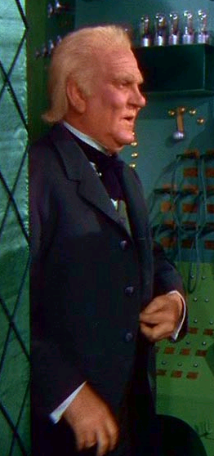
Election of 1896
Bryan vs. McKinley
  McKinley's Campaign - $3,000,000
  Bryans Campaign - $300,000
Bryan won the West, McKinley the East
  McKinley : 7,000,000 votes
  Bryan: 6,500,000 votes
  With Bryan’s loss, the Populist Party gradually lost
  support and eventually disappeared.

Slide 33
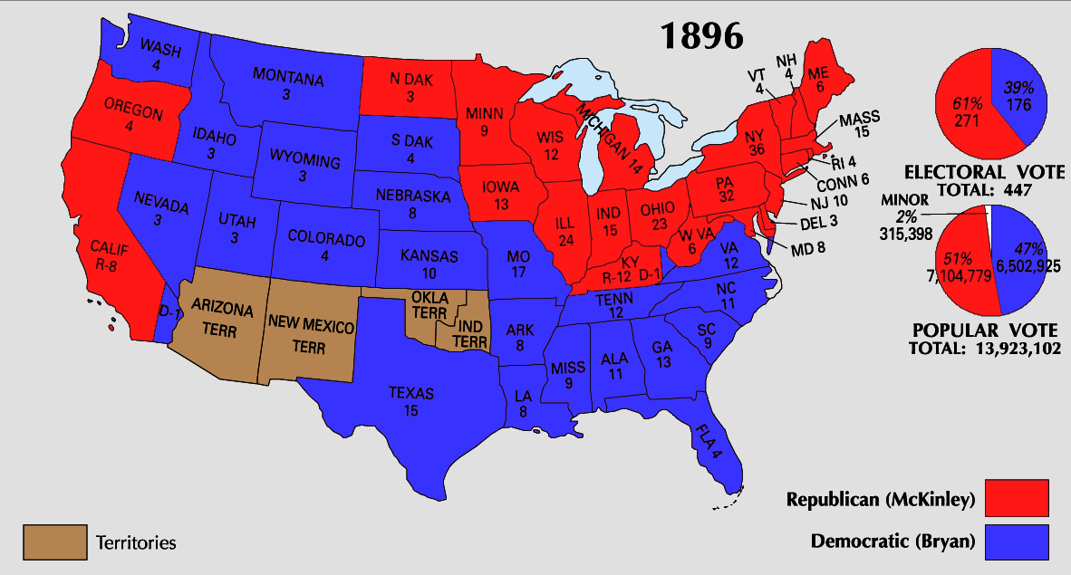

Slide 34
So who cares?
Despite not winning the presidency…
…Populists won numerous Local, State, and National Elections
    22 House of Reps Members in 1896 (45 Total)
    5 Senators in 1896 (6 Total)
    11 State Governors (Including NC) between 1890 &1900
… Many of the “Populist” planks were adopted by politicians during the Progressive Era

Slide 35
The People’s Party (Populists)
Omaha Platform
  Political Change
    Direct election of senators
    Secret ballot
    Initiatives and Referendums
  Economic Change
    Bimetallism
    Govt Control of RR’s, Telegraph and Telephone companies
    Government Assistance for Farmers
    Graduated Income Tax
    8 Hour Workday
17th Amendment - 1913
Universal by 1892
25+ States have in some form
Partially Adopted
Interstate Commerce Act actually enforced in early 1900’s
Not significantly implemented until after depression
16th Amendment 1913
Gradually becomes common practice in early 1900s

