Slide 1
Renaissance Literature and Art
1350-1550

Slide 2

Humanism
Intellectual Movement of the Renaissance
Reaction to Scholasticism
Based on the study of classic literary works of Greece and Rome to learn what they reveal about human nature, leading a moral life, etc.
  They studied grammar, rhetoric, poetry, philosophy, & history. Today these subjects are called the LIBERAL ARTS.
  It was considered one’s duty to use one’s education in service to the state (i.e. civic duties)

Slide 3
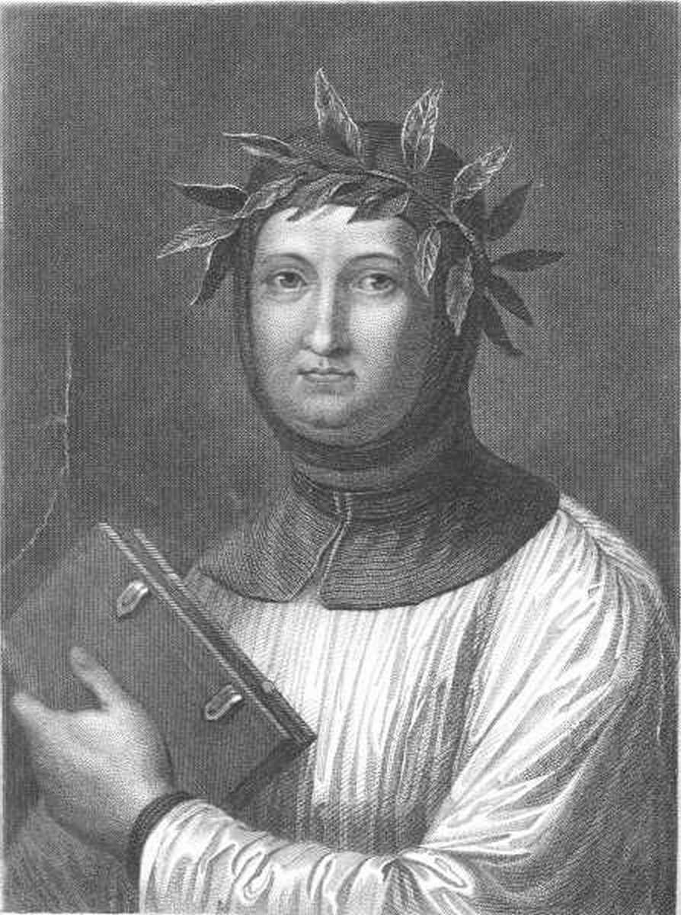
Petrarch
Father of Italian Renaissance Humanism
Poet, historian, & scholar
Introduced the Latin Classics to his contemporaries
Used classical Latin in his own writing

Slide 4
Vernacular Literature
Many scholars, lawyers, and theologians used classical Latin
  Some writers wrote in the VERNACULAR, the language of their own region.

Slide 5
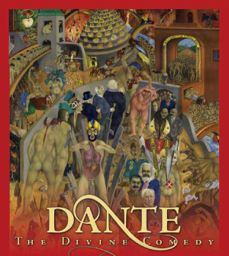
Italian author Dante wrote the DIVINE COMEDY about the soul’s journey
  The poem is divided into 3 sections: HELL, Purgatory, and HEAVEN (or Paradise)
  Dante goes through a journey until he reaches Paradise and meets God.

Slide 6
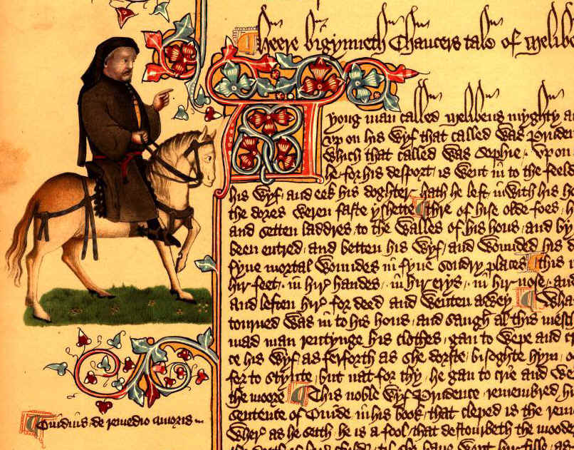
English author Geoffrey Chaucer wrote THE CANTERBURY TALES
  A collection of stories by 29 pilgrims journeying to the tomb of Saint Thomas a Becket at Canterbury, England.
Click the image to watch some college students “rap” the intro to the Canterbury Tales!

Slide 7
Humanist Education in the Renaissance
Humanists believed at the core of schools should be the Liberal Arts.
  The purpose was to follow a path of VIRTUE and WISDOM.
Humanists also stressed PHYSICAL education – javelin throwing, archery, dancing, running, wrestling, hunting, etc.
Women were told not to learn math or rhetoric.
  They mostly learned religion and morals so they could be good mothers and wives.

Slide 8
THE ARTISTIC RENAISSANCE IN ITALY
  PAINTING
    A FRESCOE is a painting done on fresh, wet plaster with water-based paints – it makes the picture come alive – by using perspective, he developed a new, REALISTIC style of painting
    They focused on understanding the laws of PERSPECTIVE and the organization of outdoor space and light through geometry
    They also investigated movement and the HUMAN BODY

Slide 9
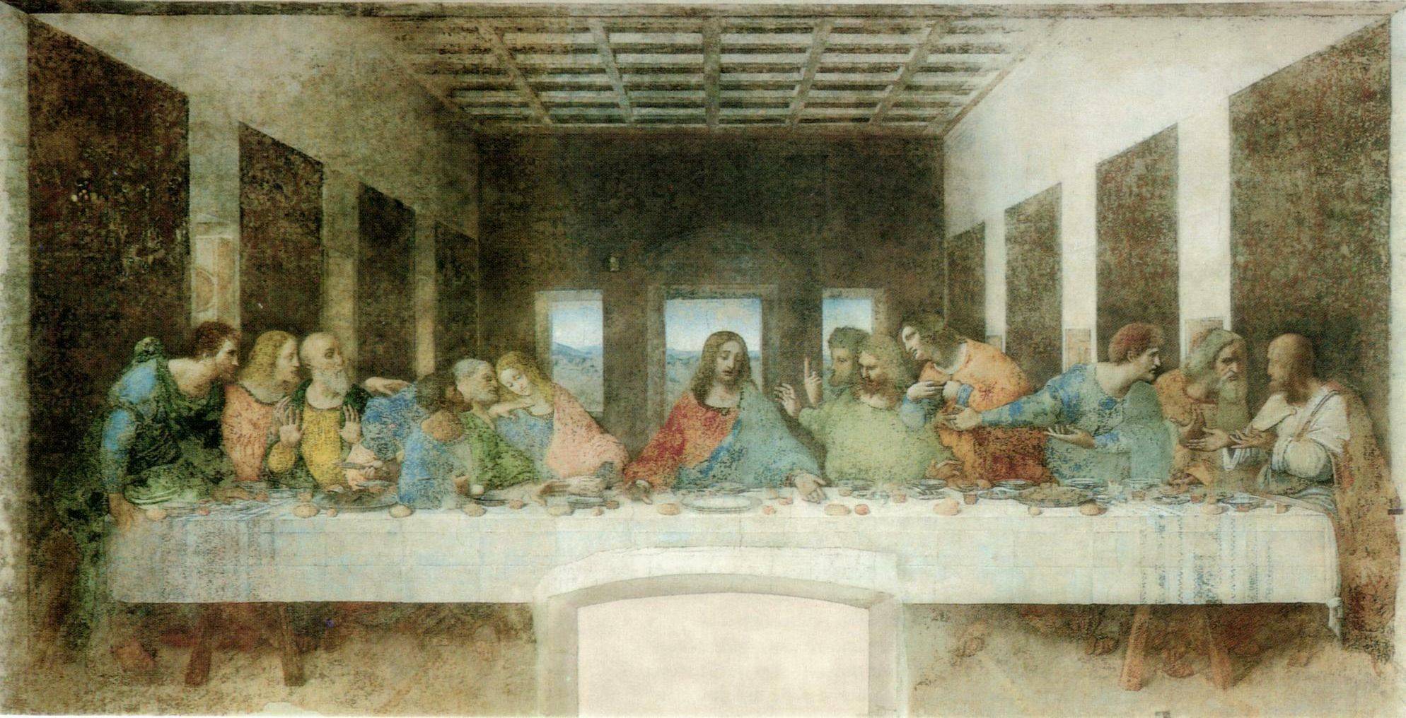

Slide 10
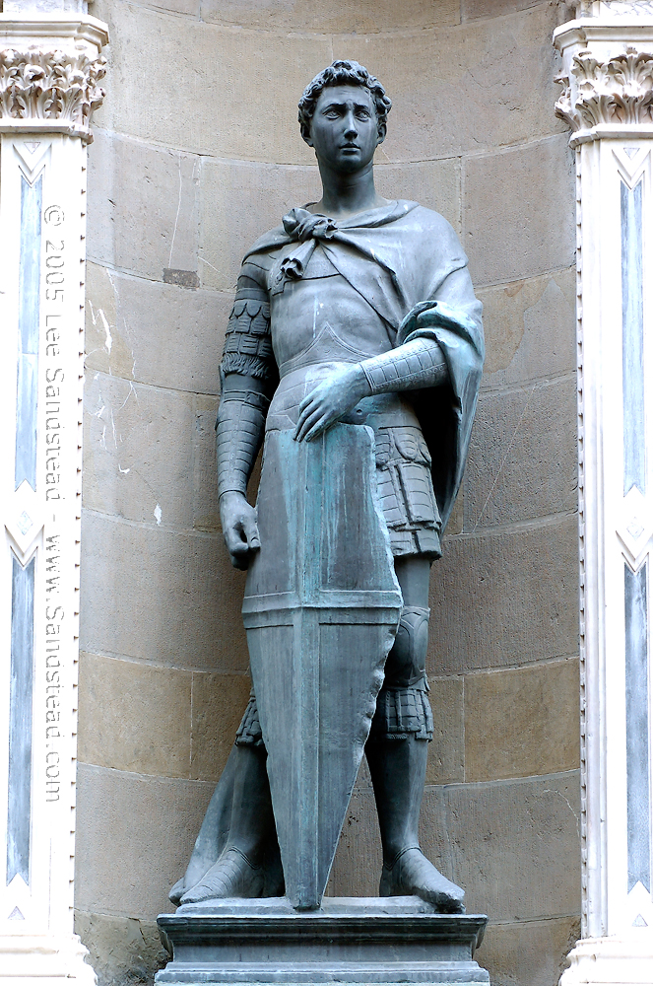
  SCULPTURE AND ARCHITECTURE
    DONATELLO - statue of Saint George

Slide 11
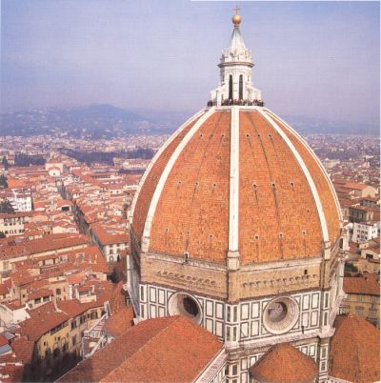
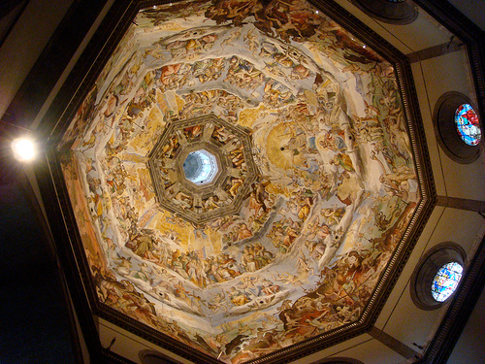
    FILIPPO BRUNELLESCHI - hired by Medici family to design the church of San Lorenzo

Slide 12
  MASTERS OF THE HIGH RENAISSANCE
LEONARDO DA VINCI had a goal to capture the perfection of nature and the individual
RAPHAEL painted many pictures of the Virgin Mary – he is well known for frescoes in the VATICAN (where the pope lives)
MICHELANGELO - painted the ceiling of the SISTINE CHAPEL in Rome – shows that human is supposed to be the reflection of divine beauty – the more beautiful the body, the more godlike

Slide 13
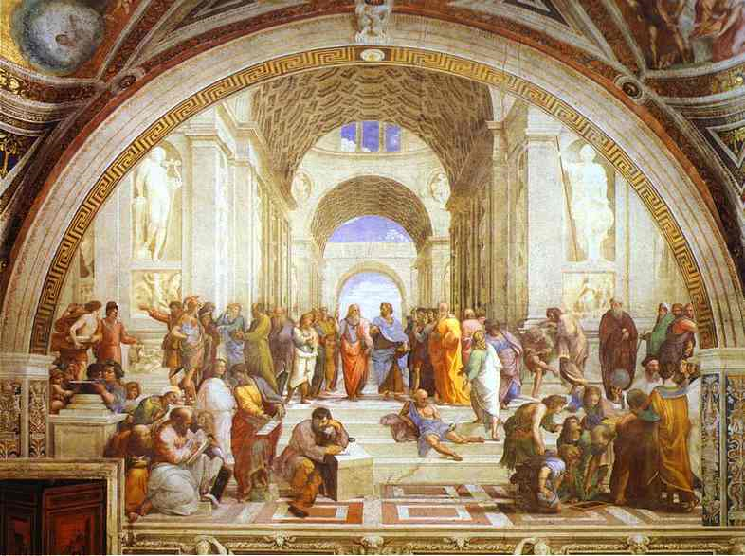
Raphael – The School of Athens

Slide 14
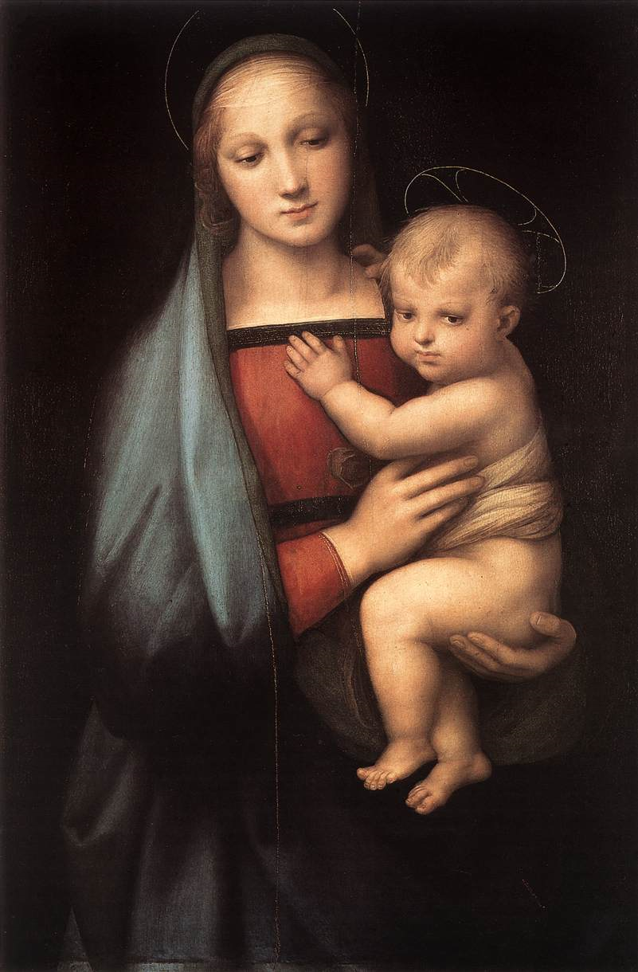
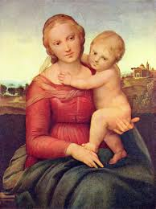
Raphael – Virgin Mary and Baby Jesus

Slide 15
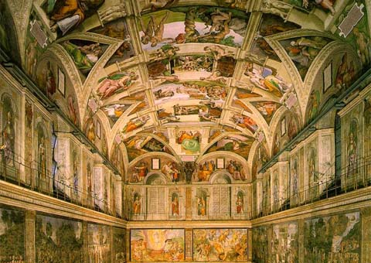
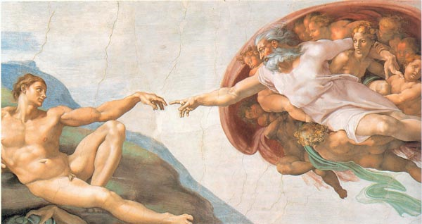
Ceiling of the Sistine Chapel
Michelangelo
Moment of Man’s Creation

Slide 16
THE NORTHERN ARTISTIC RENAISSANCE

Slide 17
Renaissance Art in Northern Europe
Should not be considered an appendage to Italian art.
But, Italian influence was strong.
  Painting in OIL, developed in Flanders, was widely adopted in Italy.
The differences between the two cultures:
  Italy → change was inspired by humanism with its emphasis on the revival of the values of classical antiquity.
  No. Europe → change was driven by religious reform, the return to Christian values, and the revolt against the authority of the Church.
More princes & kings were patrons of artists.

Slide 18
Characteristics of Northern Renaissance Art
The continuation of late medieval attention to details.
Tendency toward realism & naturalism [less emphasis on the “classical ideal”].
Interest in landscapes.
More emphasis on middle-class and peasant life.
Details of domestic interiors.
Great skill in portraiture.

Slide 19
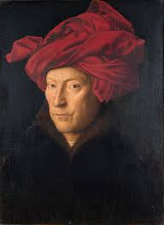
  Jan van Eyck used OIL PAINT, which allowed him a use of variety of colors and fine details

Slide 20
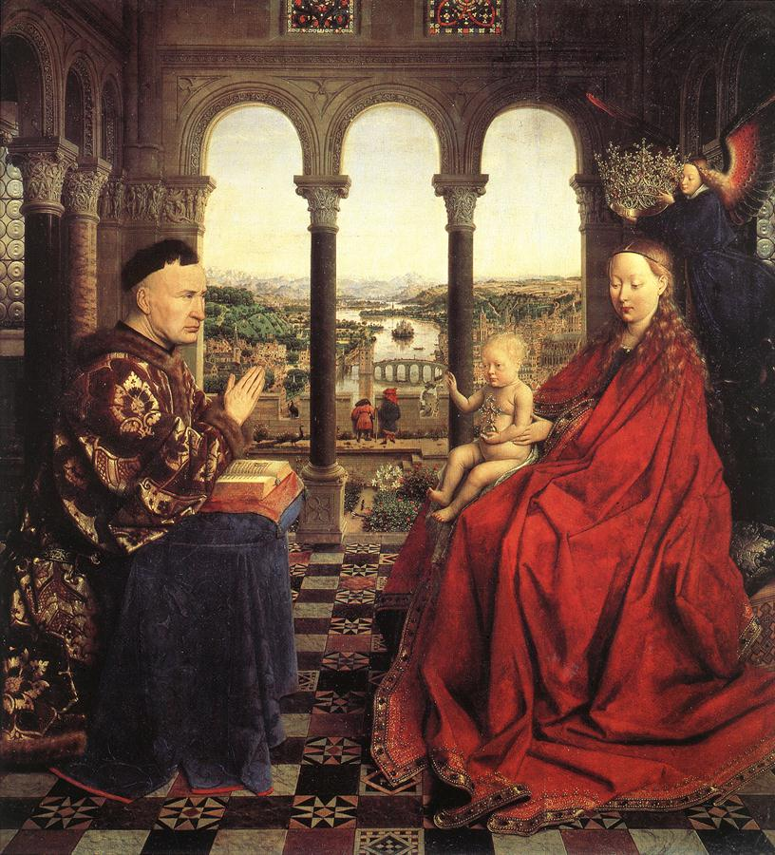
Jan van Eyck (1395 – 1441)
More courtly and aristocratic work.
  Court painter to the Duke of Burgundy, Philip the Good.
←The Virgin and Chancellor Rolin, 1435.

Slide 21
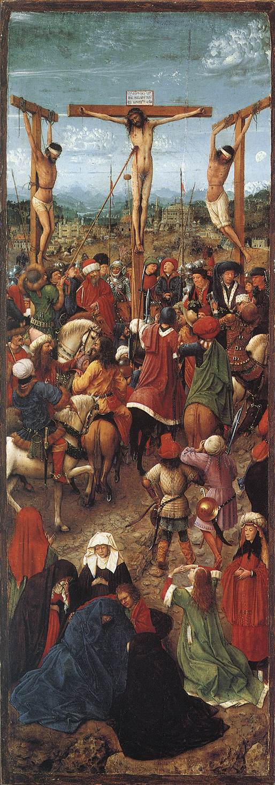
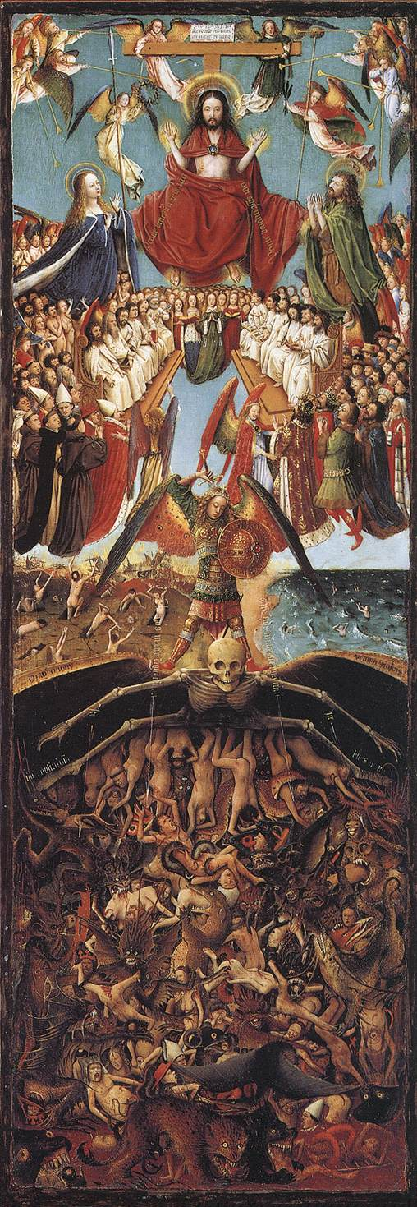
Van Eyck:
← The Crucifixion
&
The Last Judgment →
1420-1425

Slide 22
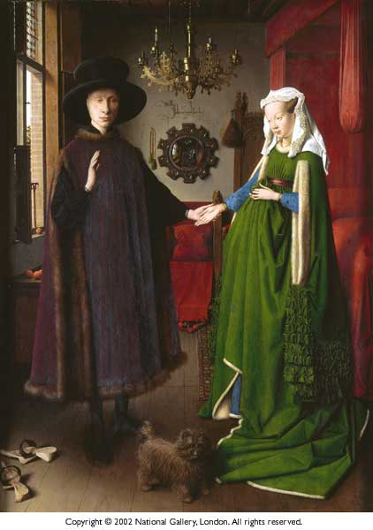
Giovanni Arnolfini and His Wife
(Wedding Portrait)
Jan Van Eyck
1434

Slide 23
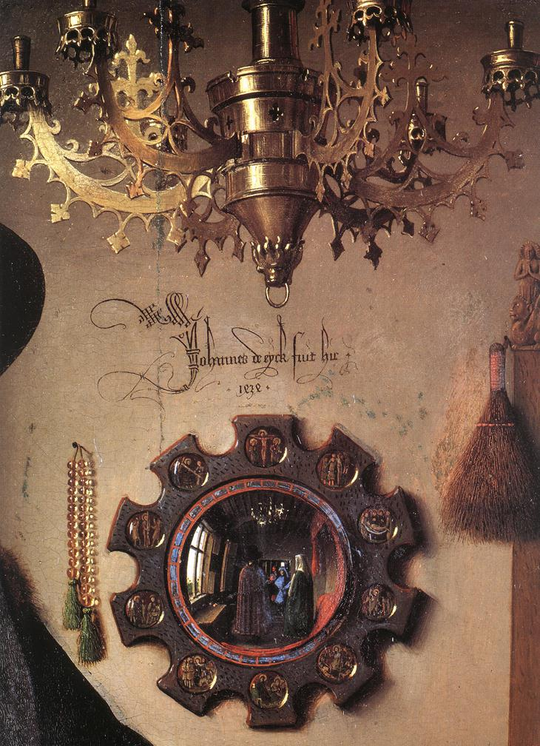
Jan van Eyck - Giovanni Arnolfini & His Wife
(details)

Slide 24
Other Northern Renaissance Artists:

Slide 25
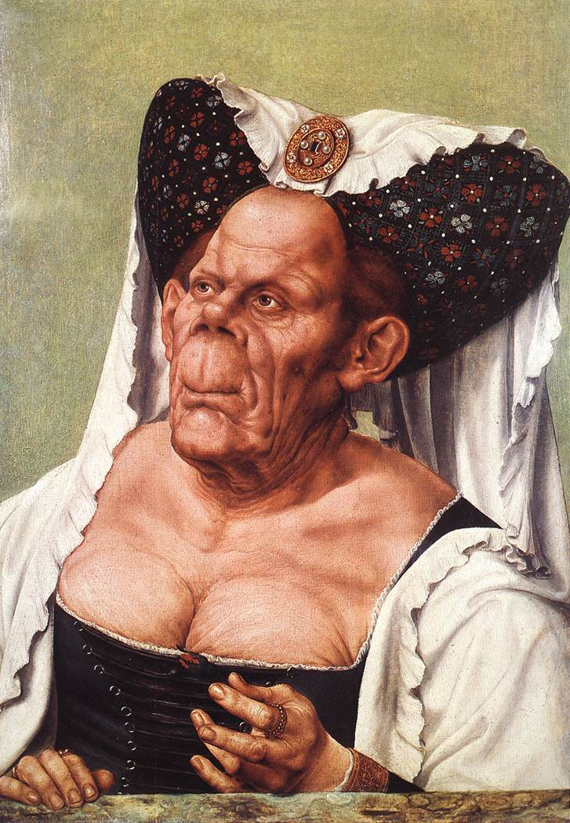
Quentin Massys (1465-1530)
Belonged to the humanist circle in Antwerp that included Erasmus.
Influenced by
da Vinci.
Thomas More called him “the renovator of the old art.”
The Ugly Dutchess, 1525-1530 →

Slide 26
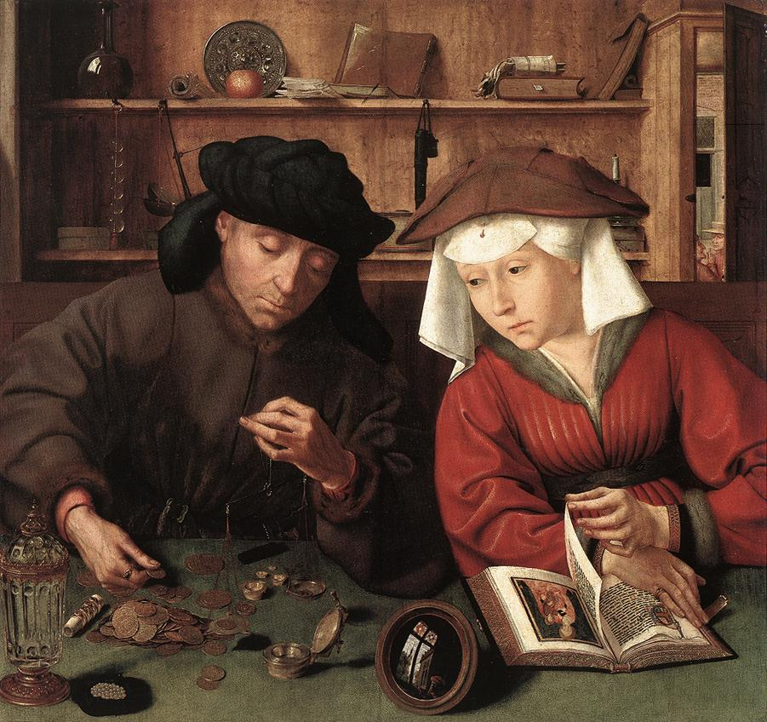
Massys’ The Moneylender & His Wife, 1514

Slide 27
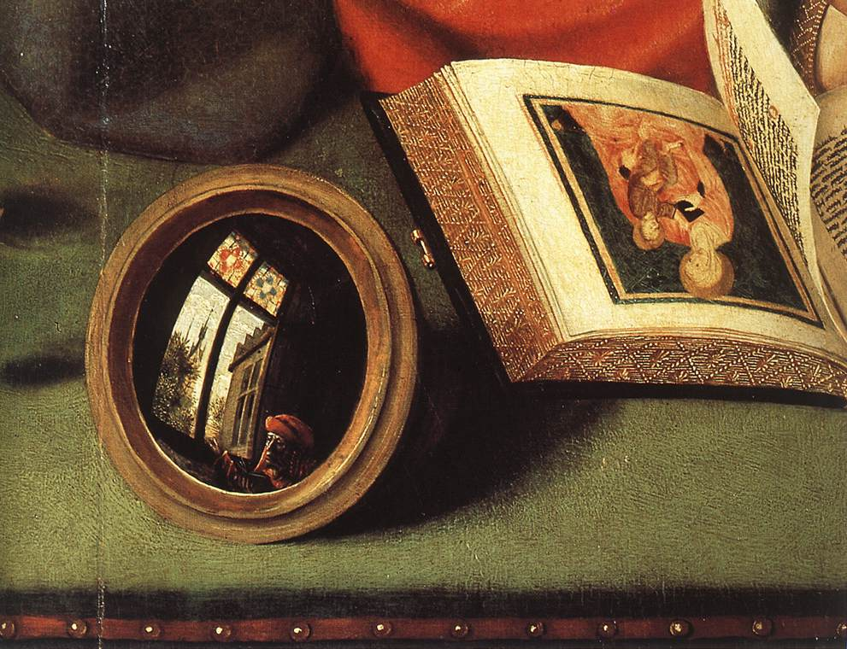

Slide 28
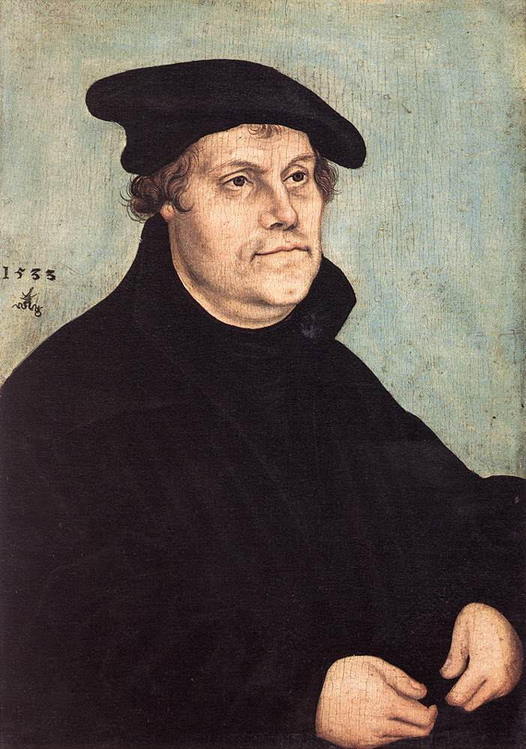
Lucas Cranach the Elder (1472-1553)
Court painter at Wittenberg from 1505-1553.
His best portraits were of Martin Luther (to the left).

Slide 29
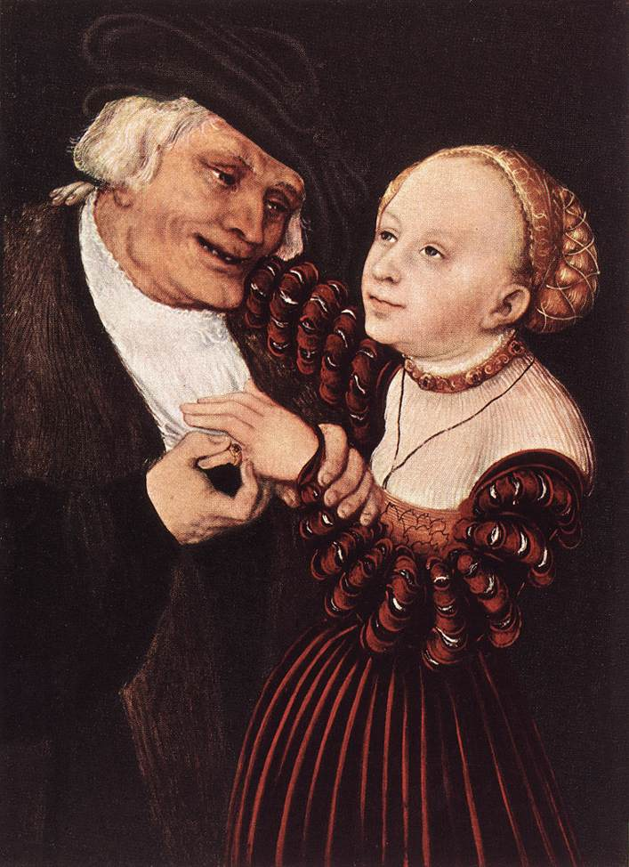
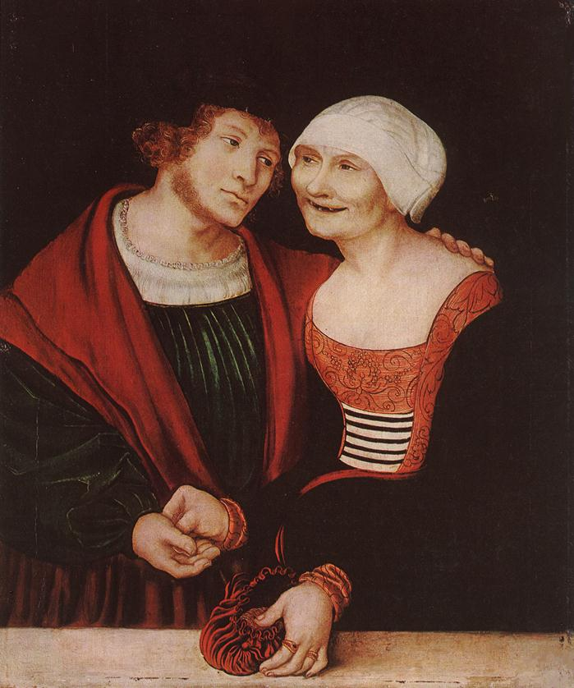
Lucas Cranach the Elder
Old Man with a Young Woman
Amorous Old Woman with a Young Man

Slide 30
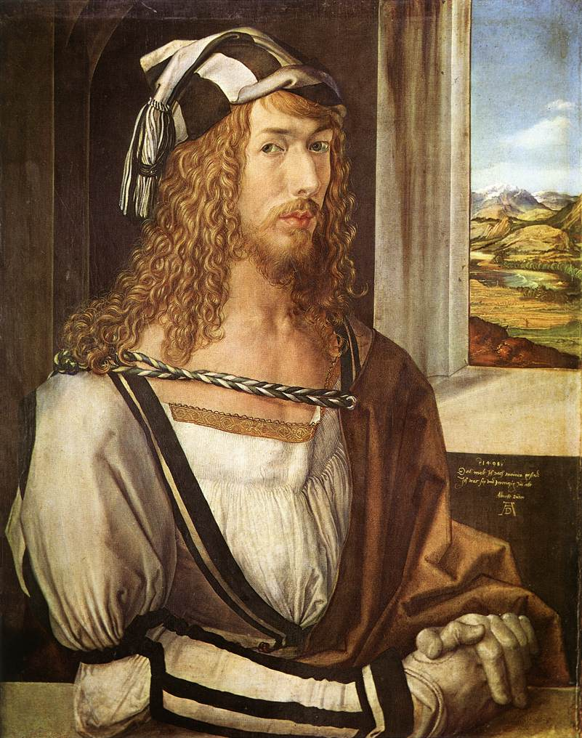
Albrecht Dürer (1471-1528)
The greatest of German artists.
A scholar as well as an artist.
His patron was the Emperor Maximilian I.
Also a scientist
  Wrote books on geometry, fortifications, and human proportions.
Self-conscious individualism of the Renaissance is seen in his portraits.
← Self-Portrait at 26, 1498.

Slide 31
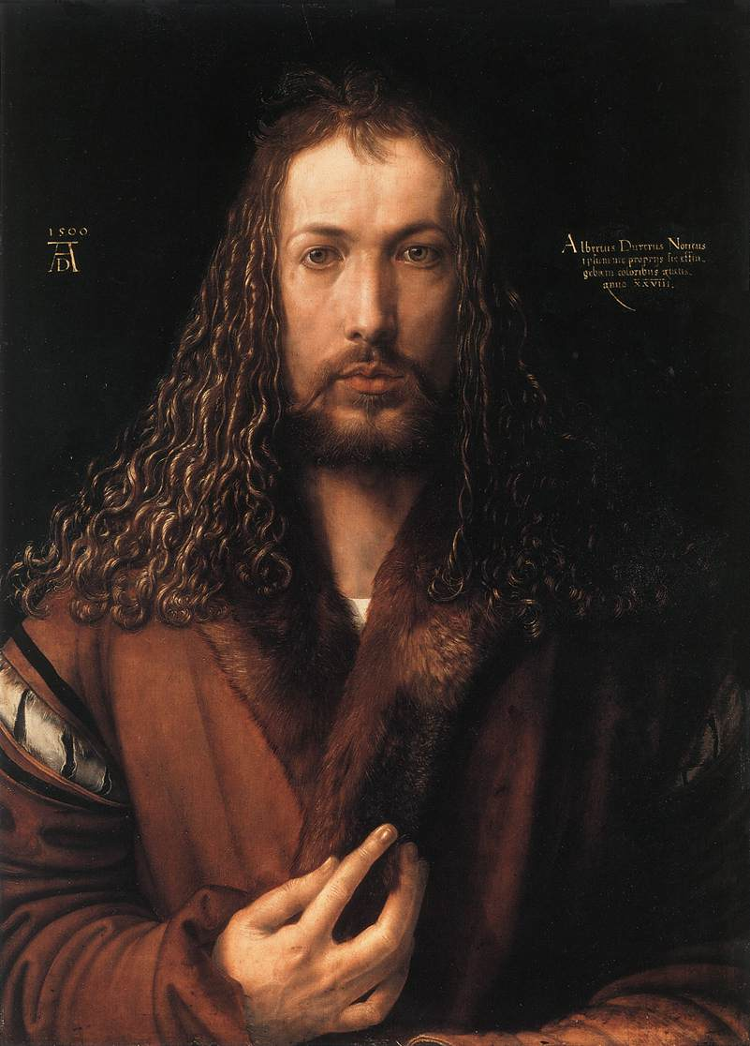
Dürer – Self-Portrait in Fur-Collared Robe, 1500

Slide 32
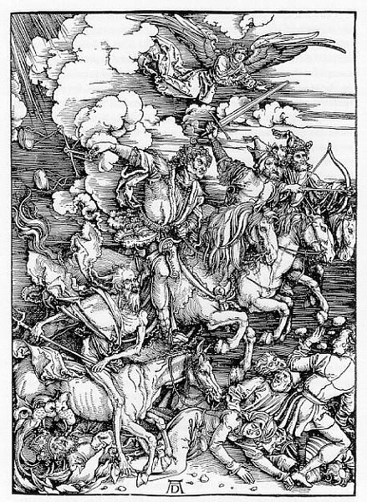
Dürer
Four
Horsemen of the
Apocalypse woodcut, 1498

Slide 33
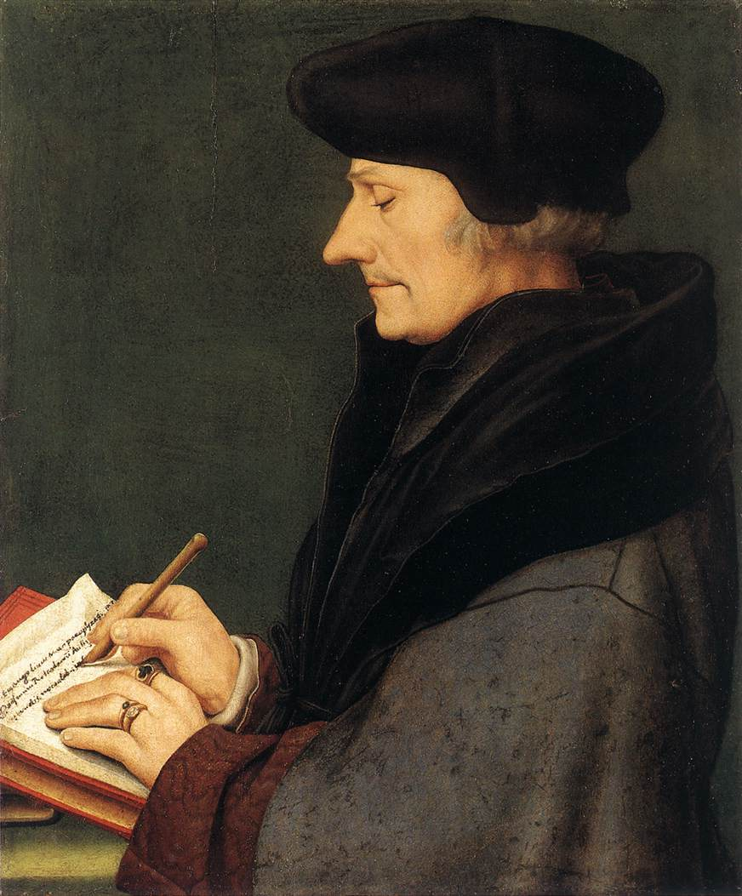
Hans Holbein, the Younger (1497-1543)
One of the great German artists who did most of his work in England.
While in Basel, he befriended Erasmus.
  Erasmus Writing, 1523 →
Henry VIII was his patron from 1536.
Great portraitist noted for:
  Objectivity & detachment.
  Doesn’t conceal the weaknesses of his subjects.

Slide 34
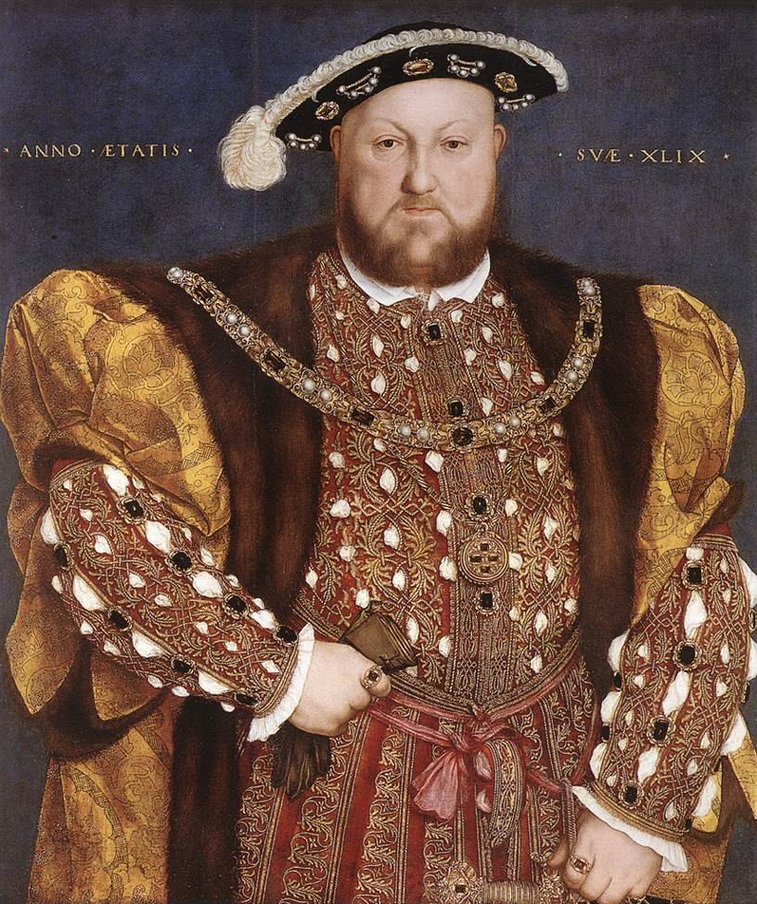
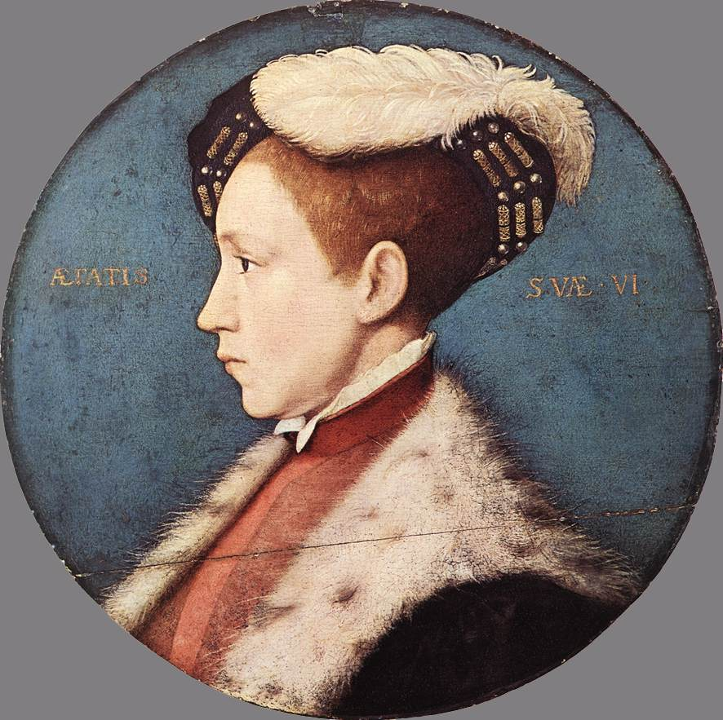
Artist to the Tudors
Henry VIII (left), 1540 and the future Edward VI (above), 1543.

Slide 35
Pieter Bruegel the Elder (1525-1569)
One of the greatest artistic geniuses of his age.
Worked in Antwerp and then moved to Brussels.
In touch with a circle of Erasmian humanists.
Was deeply concerned with human vice and follies.
A master of landscapes; not a portraitist.
  People in his works often have round, blank, heavy faces.
  They are expressionless, mindless, and sometimes malicious.
  They are types, rather than individuals.
  Their purpose is to convey a message.

Slide 36
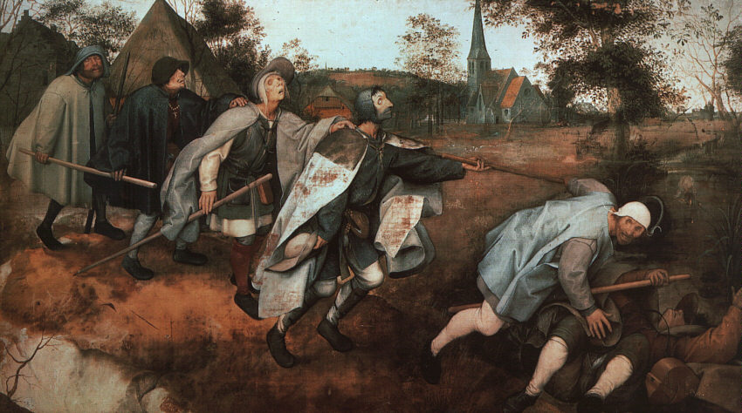
Bruegel’s, Parable of the Blind Leading the Blind, 1568

Slide 37
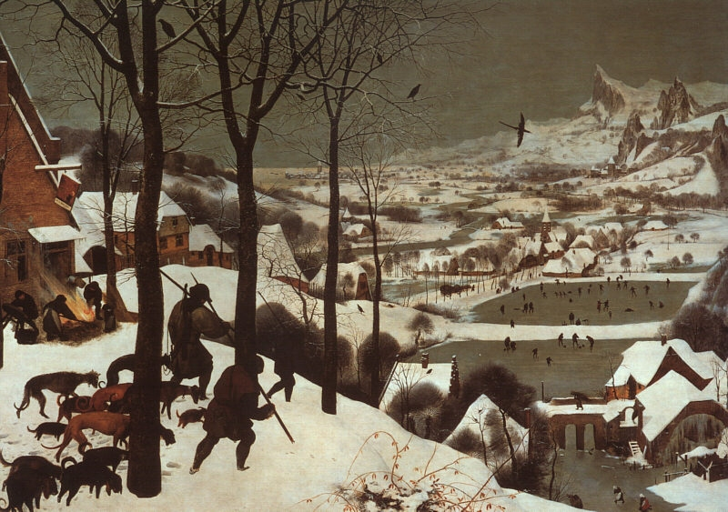
Bruegel’s, Hunters in the Snow, 1565

Slide 38
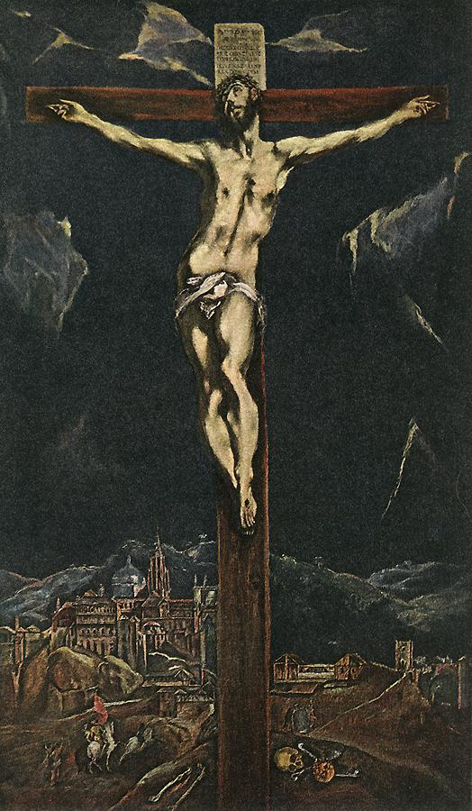
El Greco
Christ in Agony on the Cross
1600s

Slide 39
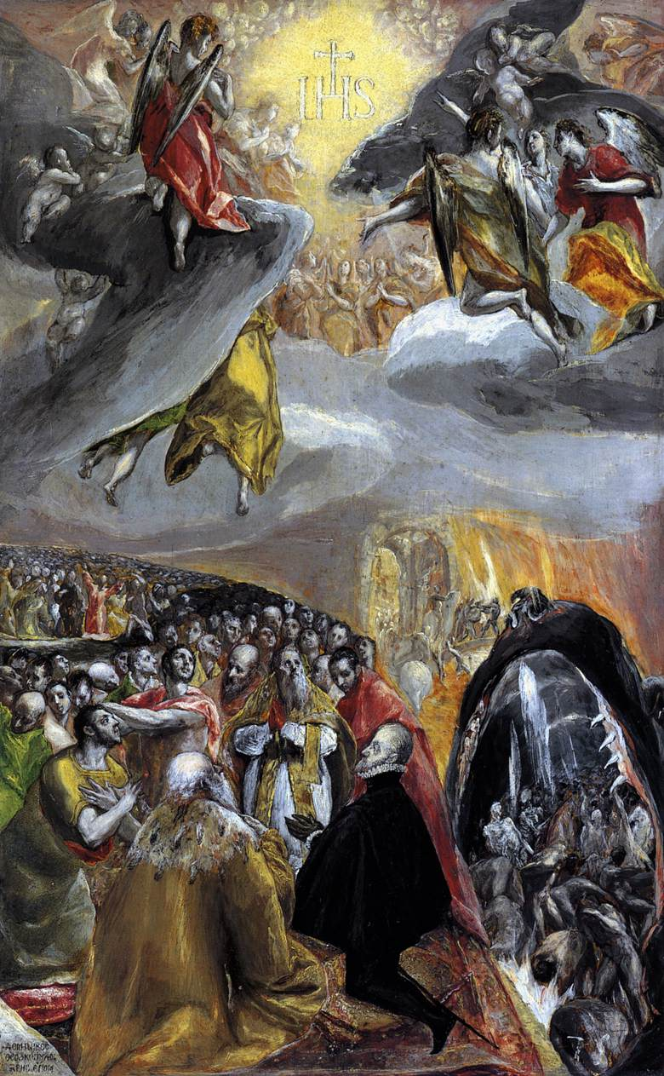
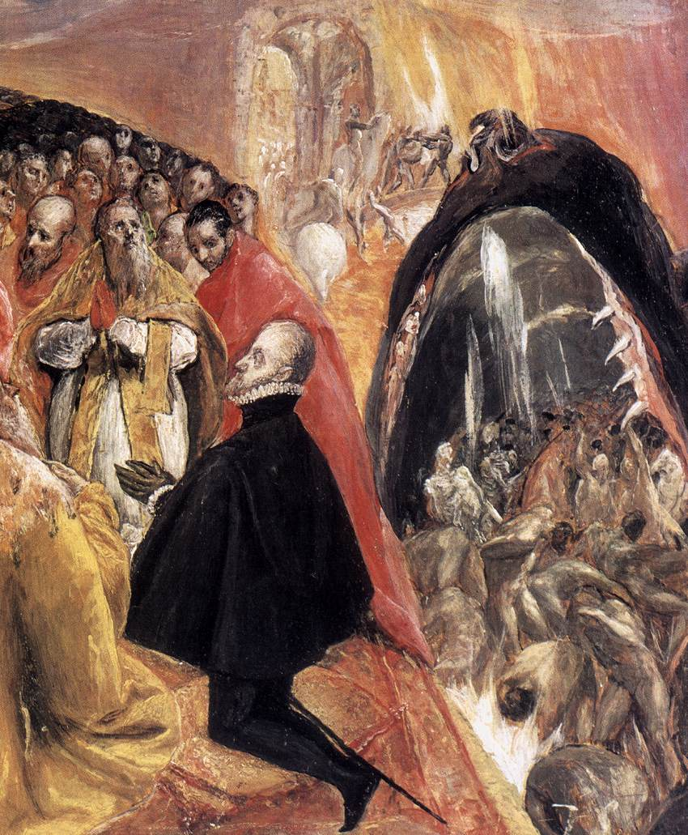
El Greco’s, The Burial of Count Orgaz, 1578-1580

Slide 40
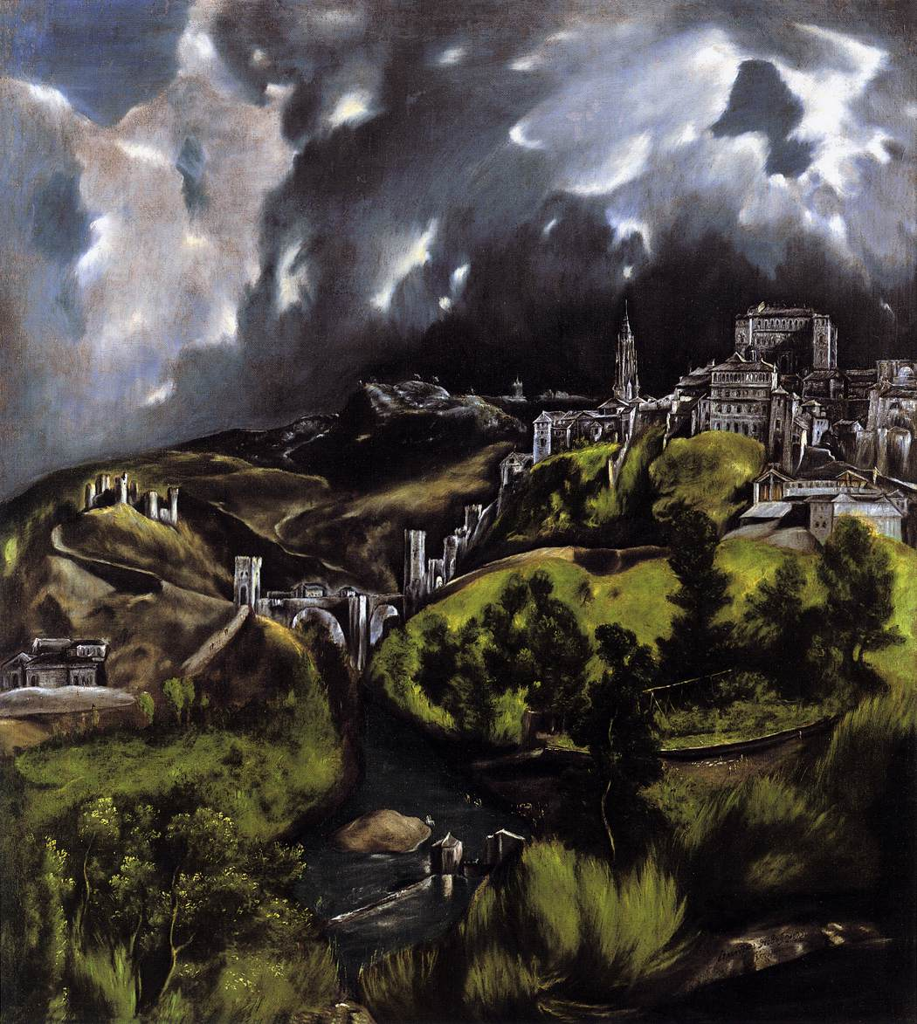
El Greco
The View of Toledo
1597-1599

Slide 41
Conclusions
The artistic production of Northern Europe in the 16c was vast, rich, and complex.
The Northern Renaissance ended with a Mannerist phase, which lasted a generation longer in the North than it did in Italy, where it was outmoded by 1600.

