Slide 1
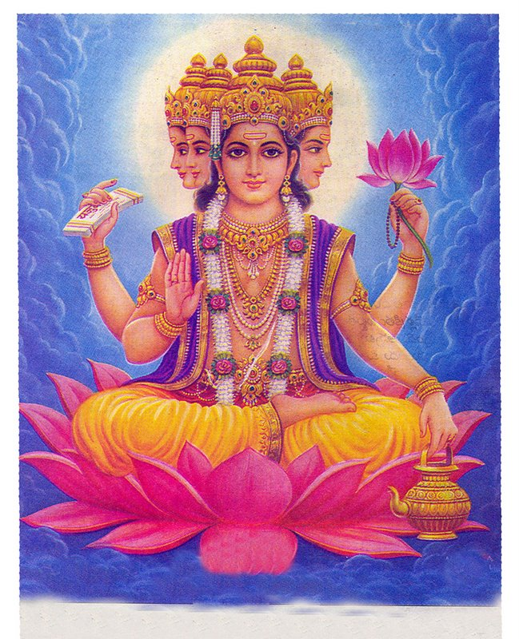
Warm Up
Based on the image, what might you assume about the religious beliefs of the culture who created this piece of art?

Slide 2
Religions That Shaped Asia
Hinduism and Buddhism

Slide 3
Hinduism
nearly 4,000 years old - one of the oldest living religions on Earth
no identified founder
no formal doctrine

Slide 4
The History of the Faith
Aryans- are considered to be the founders of Hinduism. They passed their beliefs from generation to generation by memorizing long hymns and poems
Vedas- are a collection of hymns and poems. This is the oldest set of scriptures still in use today. (1500 BC)
Upanishads- are a collection of essays used to interpret the Vedas

Slide 5
Gods
Brahma:
  A mighty spirit that created the universe; Brahma is one and yet expresses itself as many! Brahma is viewed as the unifying and all powerful spirit… respect for all life.

Slide 6
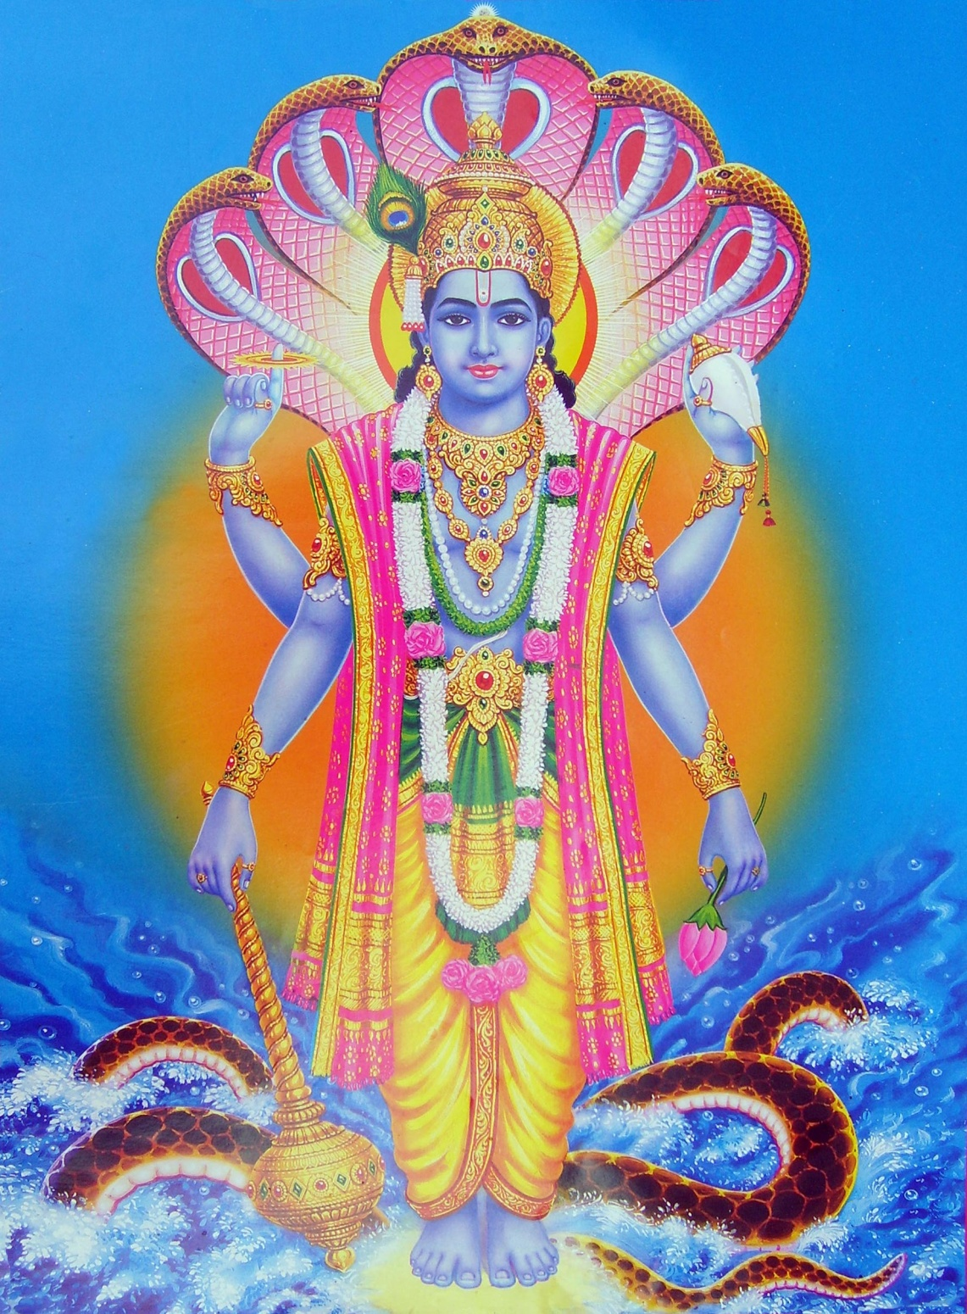
Vishnu: The preserver and protector of the universe

Slide 7
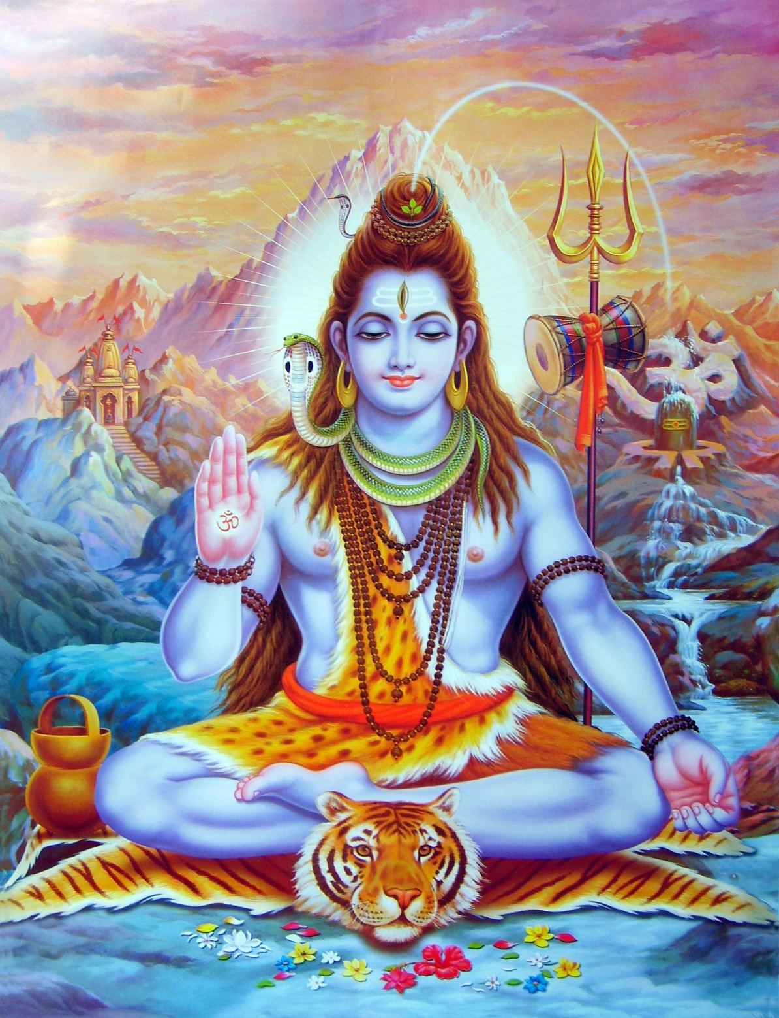
Shiva: The destroyer who symbolizes the cycle of creation, death, and rebirth.

Slide 8
Journal: Rig Veda
Read the provided excerpt of the Rig Veda. Answer following questions:
1. What did Aryans ask of each goddess?
2. Which lines best convey the traits and qualities possessed by each goddess?
3. What values do these hymns reflect?

Slide 9
Key Terms
Reincarnation
  Rebirth in a new body or form of life
  Key principle of Hinduism
Karma
  Ethical law of cause and effect
  “just as he behaves, so he becomes”
Dharma
  Duty

Slide 10
Ahimsa
  Practice of nonviolence toward all living things
Moksha
  Release from pain and suffering of reincarnation
Ganges River
  India’s most sacred river
  Bathing here will purify you

Slide 11

Yoga
Dates back to 3000 B.C.
Evidence of it is found in the Rig Veda and the Bhagavad-Gita where it is mentioned as a practice of meditation as a discipline.
Archaeological evidence suggests it was originally used during the Stone Age by religious leaders to heal community members.
It is now practiced by followers of most world religions across the globe as a discipline of exercise and meditation.

Slide 12
Buddhism
a religion whose followers seek spiritual enlightenment and emphasizes the teachings of the Buddha including Dharma (duty) and the Four Noble Truths

Slide 13
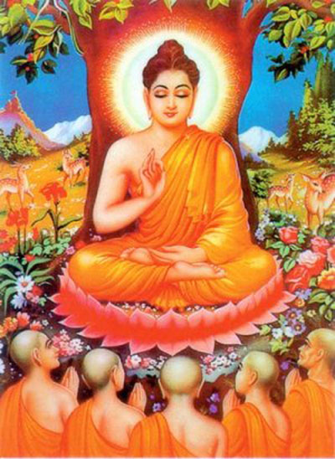
Siddhartha Guatama
Founder of Buddhism. Known as Buddha or “Enlightened One”

Slide 14
Four Noble Truths
Suffering is a part of life.
Suffering is caused by people’s greed and cravings for things (selfishness).
Suffering will stop is selfishness is overcome.
The way to bring an end to suffering is to follow the Eightfold path.

Slide 15
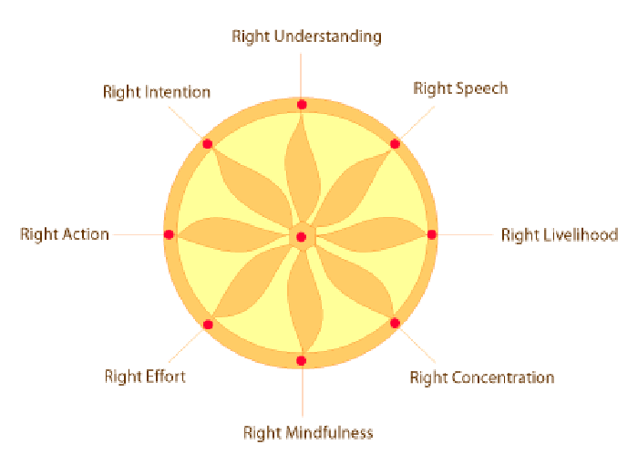

Slide 16
Eightfold Path
Accept the four noble truths. (awareness)
Think in the right way which leads you to help others. (thought)
Be kind in speech; avoid boasting, gossip, and lies. (speech)
Do what is right. (action)

Slide 17
5. Earn your living in a way which is good. (livelihood)
6. Avoid evil thoughts and actions. Work hard. (effort)
7. Learn to meditate. (concentration)
8. Be at peace in your mind. (understanding)

Slide 18
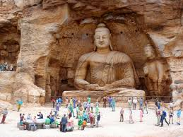
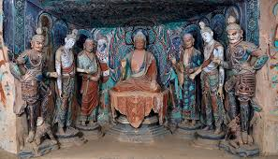
Image Analysis
Cave of Dunhuang: What do the images tell us about the concerns of people who traveled the Silk Road?

Slide 19
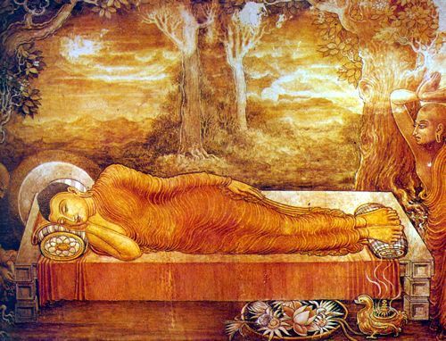
Nirvana
This leads to Nirvana: a state of freedom from the cycle of rebirth. You become one with the universe.

Slide 20
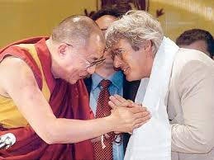
FAMOUS BUDDHISTS
Richard Gere (Actor)
Orlando Bloom (Actor)
Jackie Chan (Actor, martial artist)
Phil Jackson (Bulls B-ball Coach)
Jennifer Lopez (Singer, Actress)
Keanu Reeves (Actor)
Oliver Stone (film director)
Steven Seagal (actor)
Tina Turner (Singer)
Tiger Woods (Golfer)

Slide 21
Hinduism
Buddhism
mm
Homework Review

Slide 22
Warm Up
Which Classical Indian developments you listed on your homework do you believe to have had the most lasting impact?

