Slide 1
Reconstruction

Slide 2
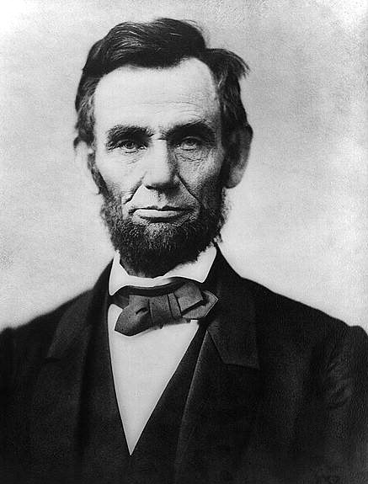
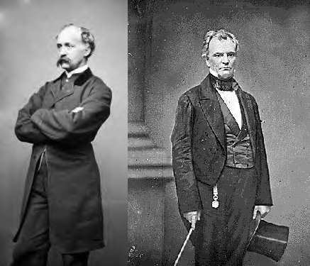
Early Plans for Reconstruction

Slide 3
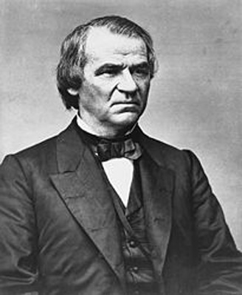
Differing Goals of Reconstruction
End Slavery. Reunite Union ASAP
Abe Lincoln
Punish the South. Extend Civil Rights to African Americans
Radical Republicans
Democrat from Tennessee. Wants whites to remain in control of the south
Andrew Johnson

Slide 4
Lincolns 10 % Plan (1864)
  Disagrees with Radicals
  Lenient on Confederacy
    Lincoln needed war to end quickly
  State’s Oath of Allegiance
    10% of Registered voters
  Voting rights for Some African Americans
    Property Owners
    Educated
  Pardoning of most Confederates

Slide 5
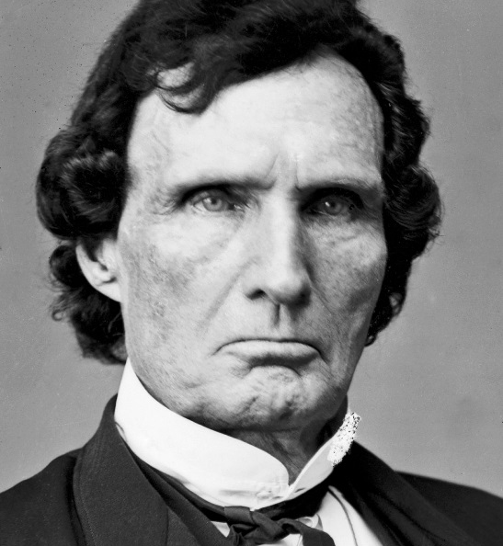
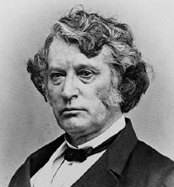
Radical Republicans
  Thaddeus Stevens and Charles Sumner
  Initially call for…
    Disenfranchisement of former Confederates
    Civil Rights for African Americans
    Confiscation/Redistribution of Confederate Lands

Slide 6
Wade-Davis Bill
Radical’s counter to 10%Plan
Confederate states placed under Union Control until…
  Oath of Allegiance
    50% of registered voters
  Accept Federally appointed State Governors
  Accept 13th Amendment
  Payment of War Debts
POCKET VETO

Slide 7
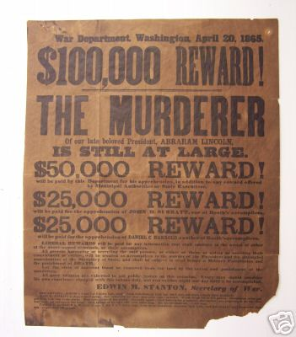
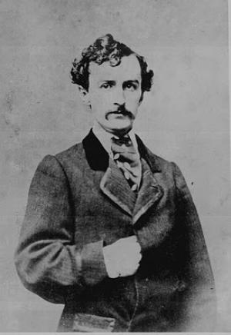
Death of Lincoln
John Wilkes Booth
Conspiracy
  Abe Lincoln
    Killed
  Andrew Johnson
    Vice Prez
    Assassin Backs Out
  William Seward
    Sec. of State
    Stabbed but not Killed
8 People convicted
4 Executed

Slide 8
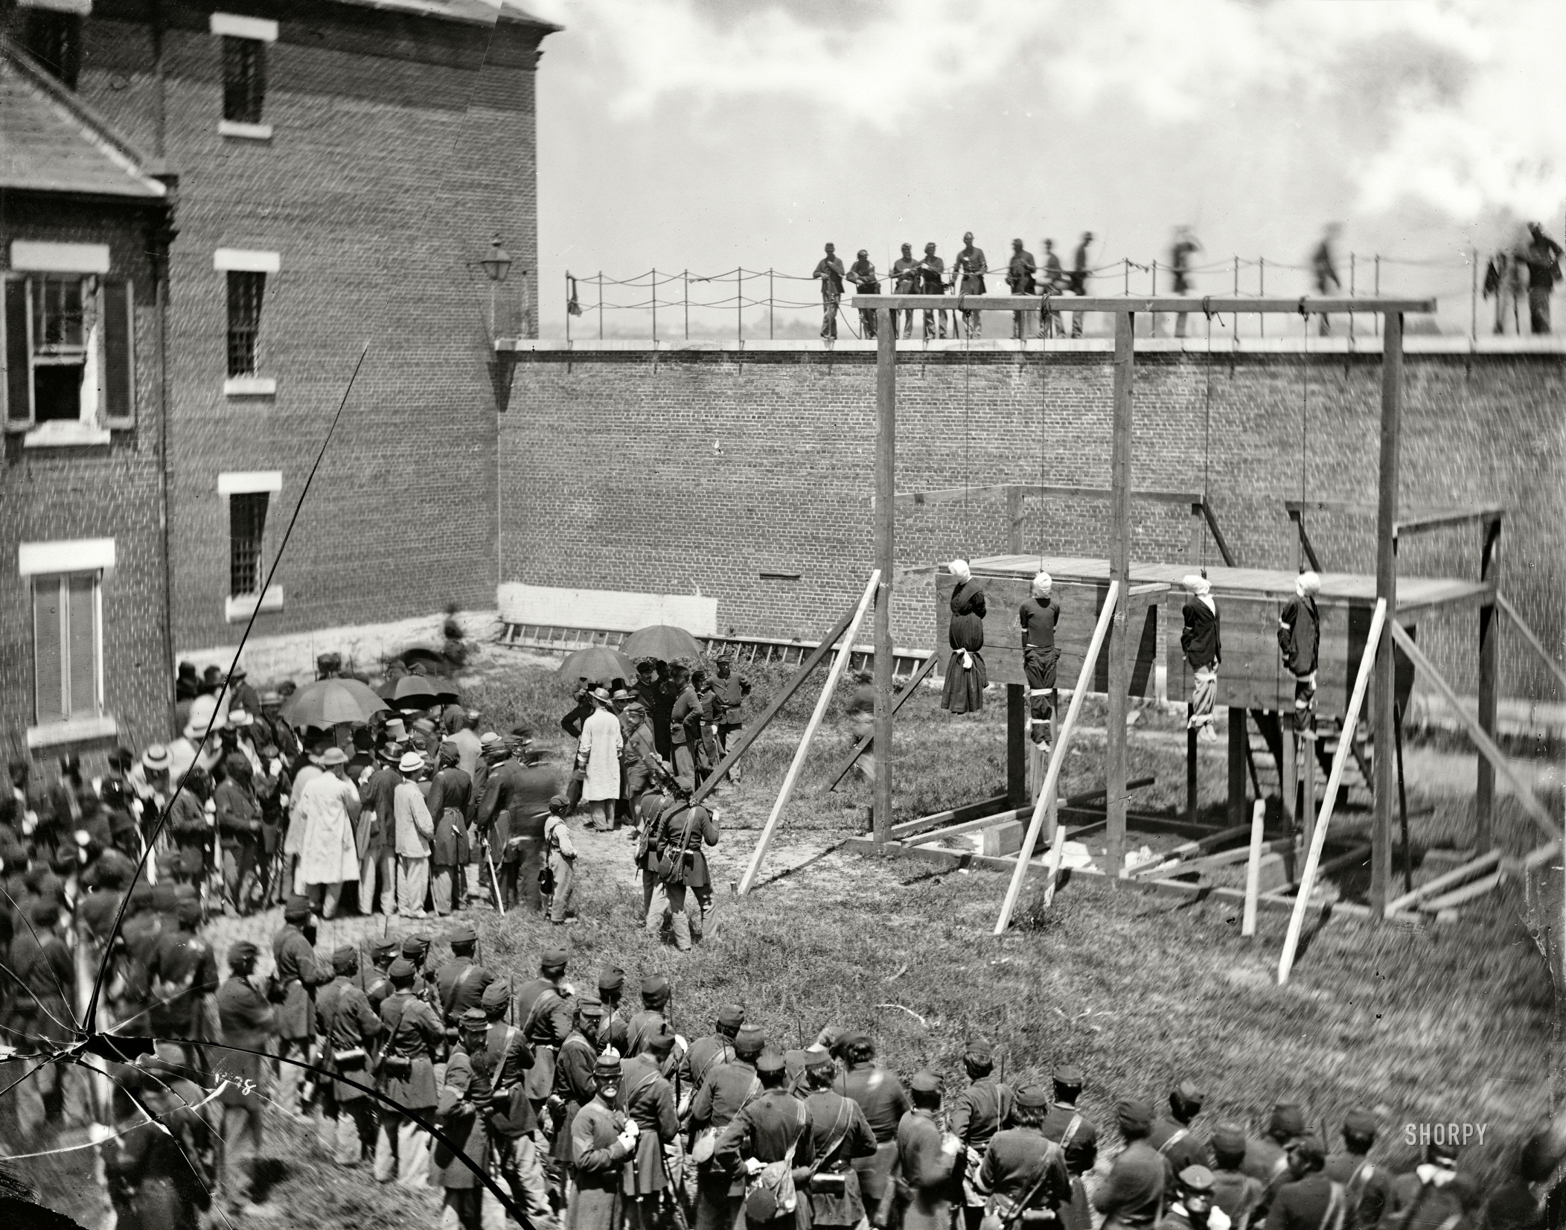

Slide 9
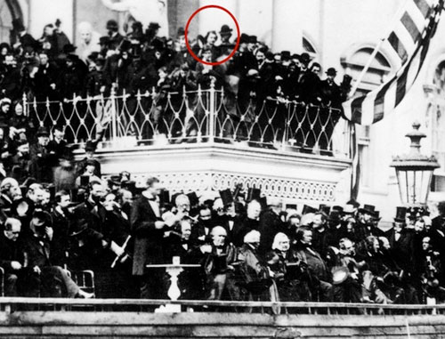
Lincoln

Slide 10
Presidential Reconstruction
Andrew Johnson
  Former Dem. From TN
Plan for “Restoration”
  Mixture of 10% and Wade Davis
  Oath of Allegiance
  High Ranking officials and wealthy “punished”
    (+$20,000)
  Paid Debts
  13th Amendment
  Fed. Appointed Gov.

Slide 11
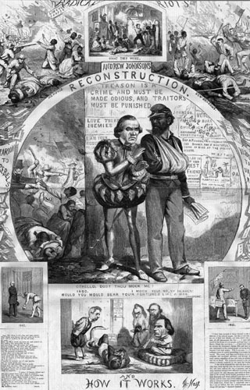
Johnson’s “Plan”
What actually happened?
  Most Confederates pardoned
    Jeff. Davis (2 years prison)
    Pardoned by Johnson
  Allows Black Codes to be passed in many states
  All states accept plan within year
  Congress (R.Reps) not Satisfied

Slide 12
Johnson’s Plan
Andrew Johnson:
“The time has come for us to heal the scars and wounds of this Great War. We must repair this Union immediately. My Plan for Reconstruction is this. Each state must withdraw its secession, swear allegiance to the Union . . . and ratify the 13th Amendment. With these conditions met, let the states of the South rejoin our great Union. I will pardon Confederate leaders that demonstrate true remorse for their actions, and I do not say that suffrage (voting) is now the right of the freed Negro. No, sir, white men alone must manage the South.”
“1865 has been a terrible year of loss of pride and the Confederacy. However, we will not lose our dignity in our own lands. . . The races must remain separated, and the Negro being inferior must not be allowed to hold power in our communities.
We have successfully drafted a measure of Black Codes. This will prevent the Negro from carrying weapons, serving on juries, testifying against Whites, marrying Whites, traveling without a permit, and most of all not owning land.”

Slide 13
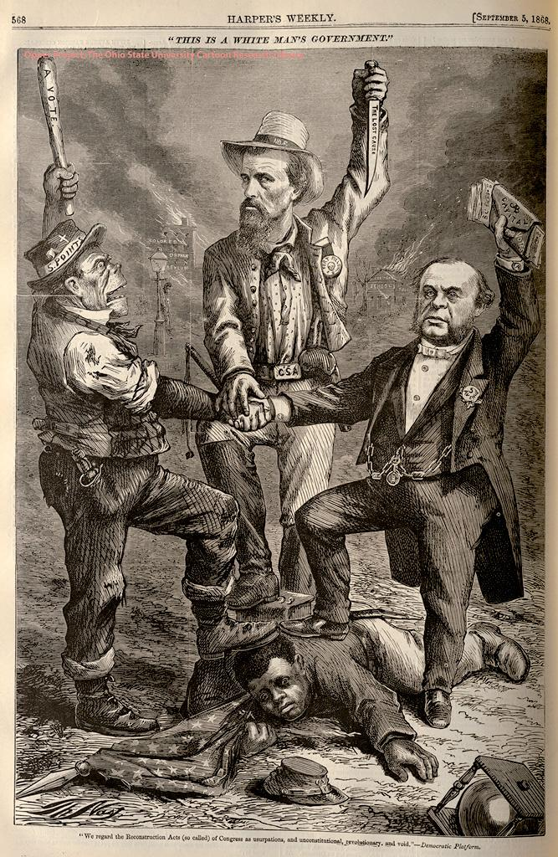
Black Codes
“This is a White Man’s Government”
Nathan B Forrest
“Freedmans School”
Passed in most southern states
Examples
  African Americans could not…
    Own Weapons
    Own Property
    Marry Whites
    Testify against whites
    Assemble in large groups
“colored orphanage”
“$ for Bribes”

Slide 14
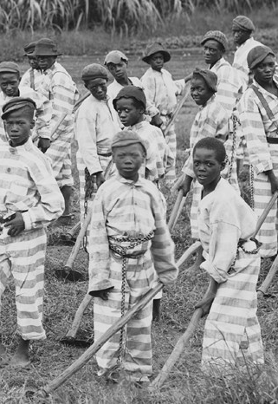
Black
Codes
  Criminalized Vagrancy
    Homeless or Jobless Men could be arrested
    These convicts were often leased to companies for manual labor
    Forced many former slaves to sign Labor Contracts

Slide 15
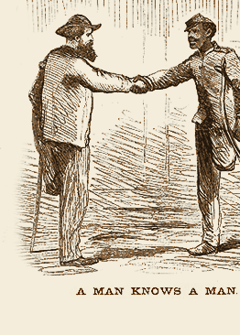
Radical Republicans Respond
Civil Rights Act (1866)
  Grants Citizenship
  Allows Fed Gov Intervention
    Vetoed by Johnson
    Overridden by Congress
      First time ever!
Freedman’s Bureau
  Government Organization meant to provide assistance for Freed Slaves
  Vetoed by Johnson
    Overridden by Congress
Propose 14th Amendment
  All men are equal under the law
  Only TN accepts

Slide 16
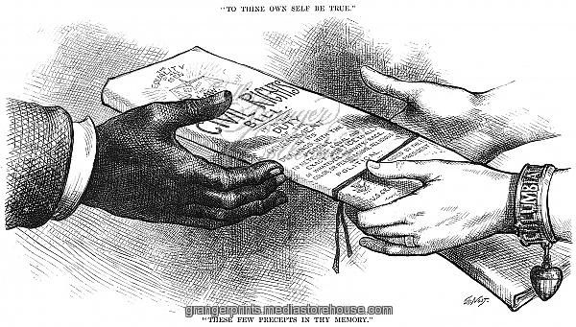
The act declared that all persons born in the United States were now citizens, without regard to race, color, or previous condition. As citizens they could make and enforce contracts, sue and be sued, give evidence in court, and inherit, purchase, lease, sell, hold, and convey real and personal property. Persons who denied these rights to former slaves were guilty of a misdemeanor and upon conviction faced a fine not exceeding $1,000, or imprisonment not exceeding one year, or both.

Slide 17
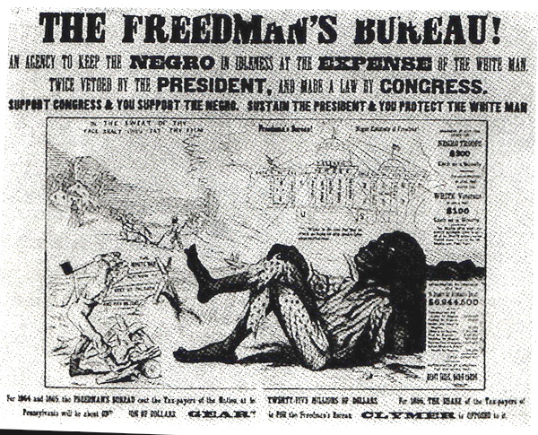

Slide 18
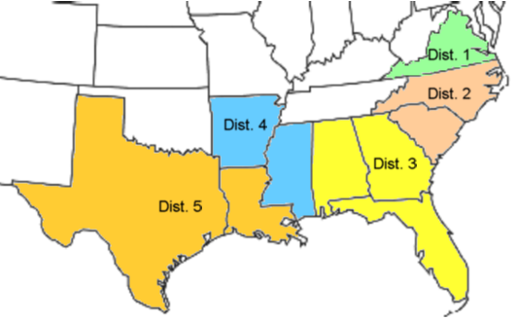
Congressional Reconstruction
Rejects all previous plans
Military Occupation
  5 Districts
  Withheld Federal Funds
Until…
  States Registration Drives
  13th, 14th, 15th Amendment

Slide 19
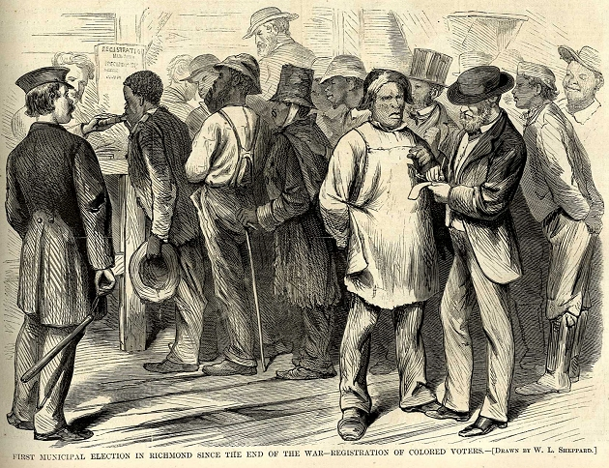

Slide 20
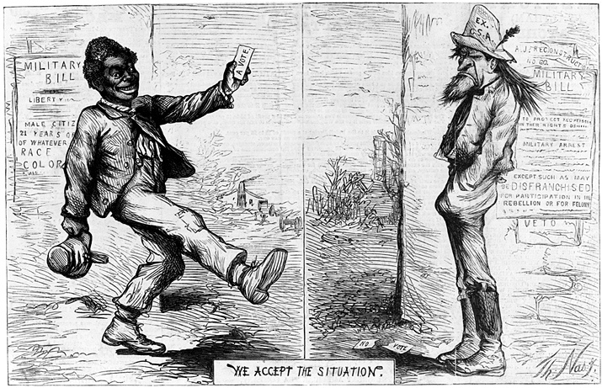

Slide 21
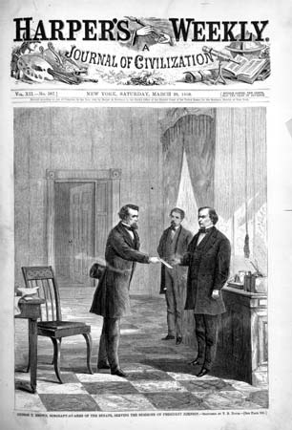
Johnson Impeached
Tenure of Office Act - 1867
  Prevents Johnson from firing political opponents
    Specifically his Secretary of War
  Johnson Breaks Law
Impeachment - 1868
  Impeached but not Removed from office
  Fails in Senate by 1 vote

Slide 22
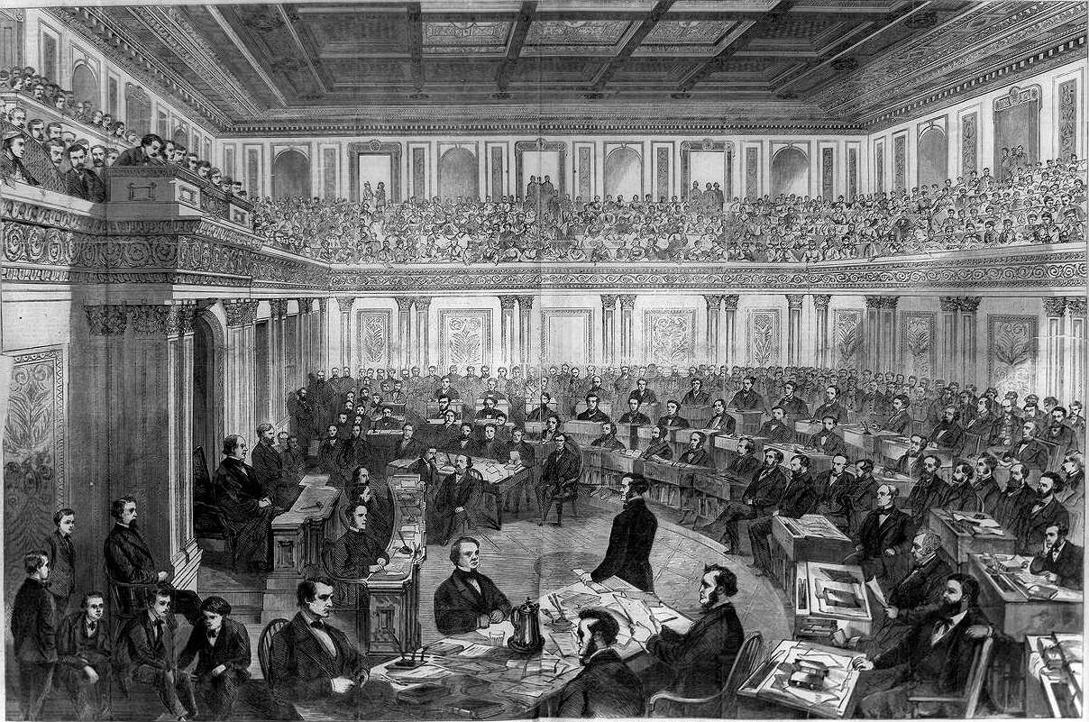

Slide 23
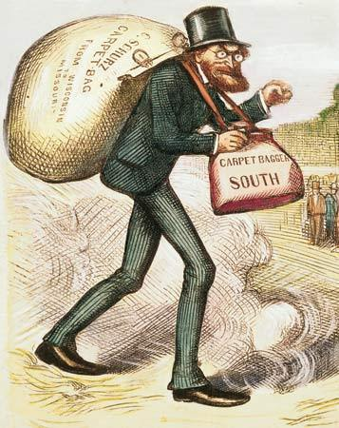
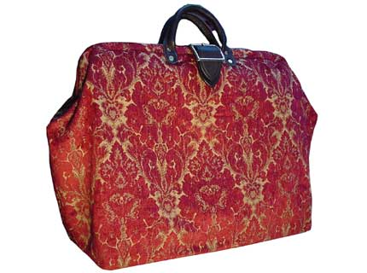
Recon. Life in the South –
Government
Scalawags
  Southerners who Support Recon.
Carpetbaggers
  Northern “opportunists”
African Americans (1869-1901)
  20 voted into House
  2 voted into Senate

Slide 24
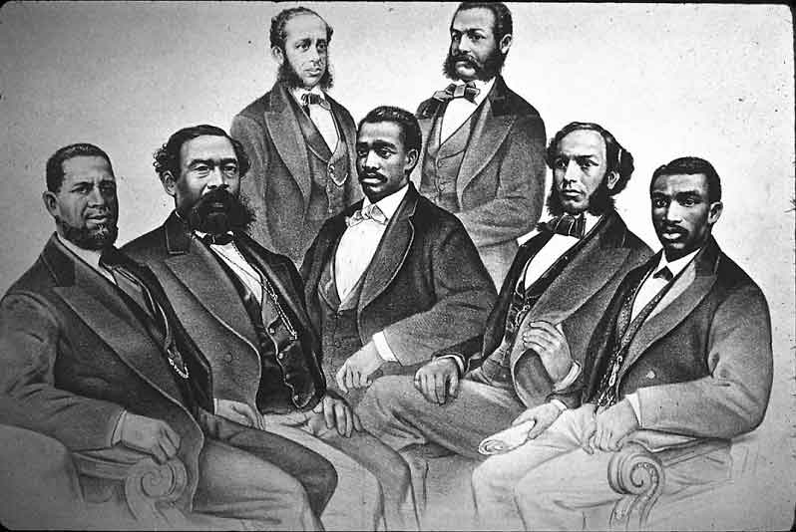
Black Senate & House Delegates

Slide 25
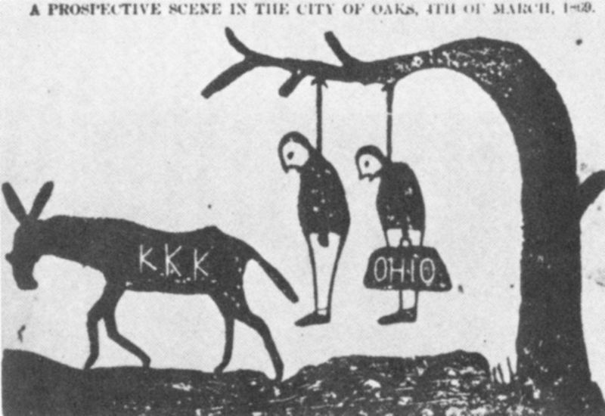

Slide 26
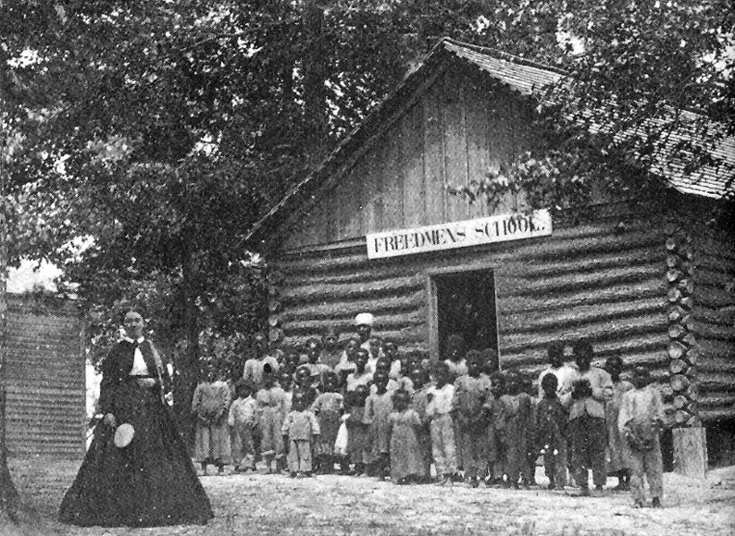
Recon. Life in the South - Education
The Numbers
  Approximately 4000 public schools by 1870
    Virtually none prior to War
  40% attended school
  25%-30% Illiterate
African American Education
  Freedman’s Bureau (1865-69)
    Established 1000 schools by 1870
  Colleges and Universities
    22 HBCU’s between 1864 and 1870

Slide 27
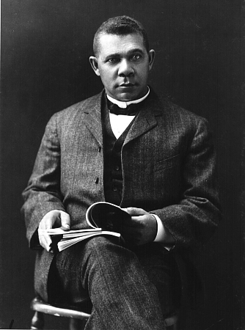
Recon Life in South - Education
Booker T Washington
  Former Slave
  Advocates African American Education
  Focus on Agriculture and Trades
  Starts the Tuskegee Institute in Alabama (1881)

Slide 28
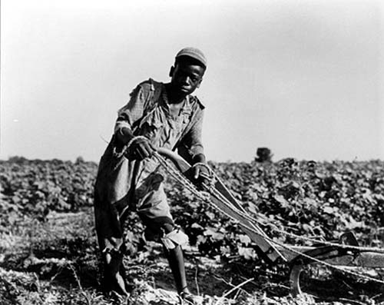
Recon. Life in the South - Wealth
Land Ownership
  Some land redistributed to Freedmen
  Most returned to Former White owners
Tennant Farming, Sharecropping, Debt Peonage
  “Legal” extension of Slavery
  Both Whites and Blacks
  70% of southerners by 1870
Income
  African Americans - 46% increase
  Whites – 35% decrease

Slide 29
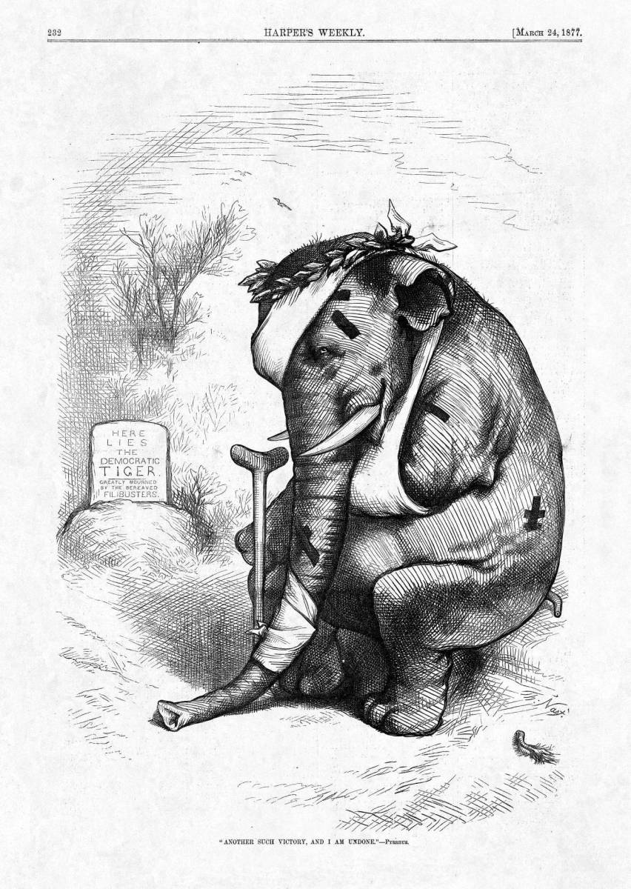
Downfall of the Republicans
What types of events/actions could harm a specific political parties?

Slide 30
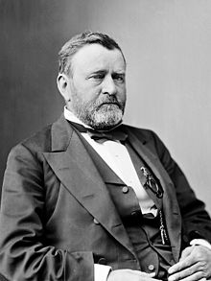
The Grant Administration
Ulysses S. Grant
  “Soldier President”
  No political experience
  Use of Spoils System
  Presidency scarred by corruption

Slide 31
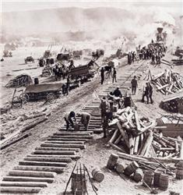
Scandals
Credit Mobilier - 1872
  Company responsible for building Transcontinental R.R.
  Charged outrages rates
  Bribed US government officials to keep quiet
  Some of those involved…
    Grants Vice President
    Secretary of Treasury
    Speaker of the House
    4 Senators

Slide 32
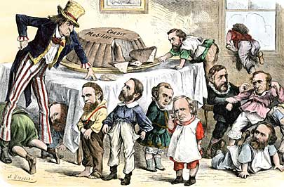

Slide 33
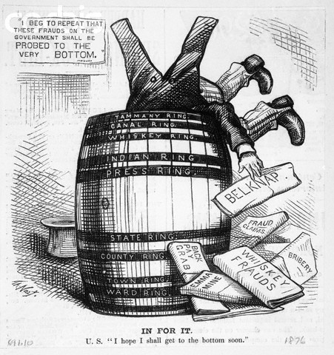
Scandals
Whiskey Ring - 1875
  Alcohol taxes raised post Civil War
  Congressmen bribed to allow Whiskey producers to keep funds from taxes.
  Grants personal secretary indicted

Slide 34
Panic of 1873
Causes
Banks finance RRs by selling bonds
Many RRs go out of business
Banks cannot pay back bonds
Banks close

Slide 35
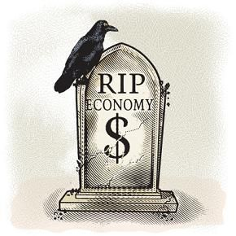
Panic of 1873
Effects
NY Stock Exchange closes for 10 days
25% of Railroads go out of business
Unemployment reaches 14%
Republican Party gets the Blame

Slide 36
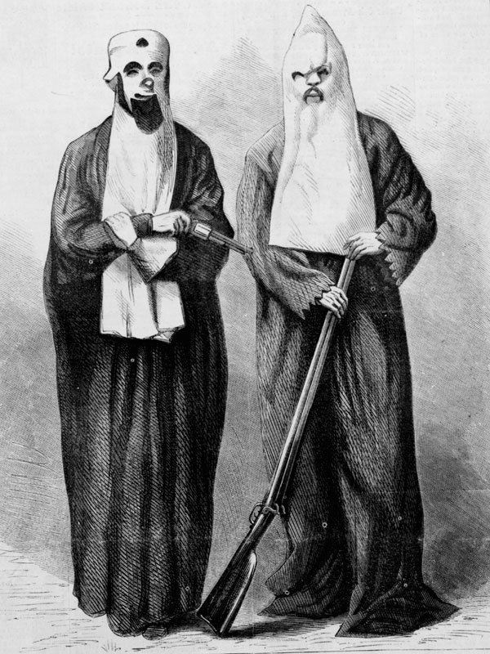
Southern “Redemption”
Disenfranchisement
  African Americans and Republicans
  Literacy Tests
  Poll taxes
  *“Grandfather Clause”
Upper South
  KKK - 1866
  Red Shirts
Lower South
  Knights of Camellia
  White League
62% decrease in African American voters

Slide 37
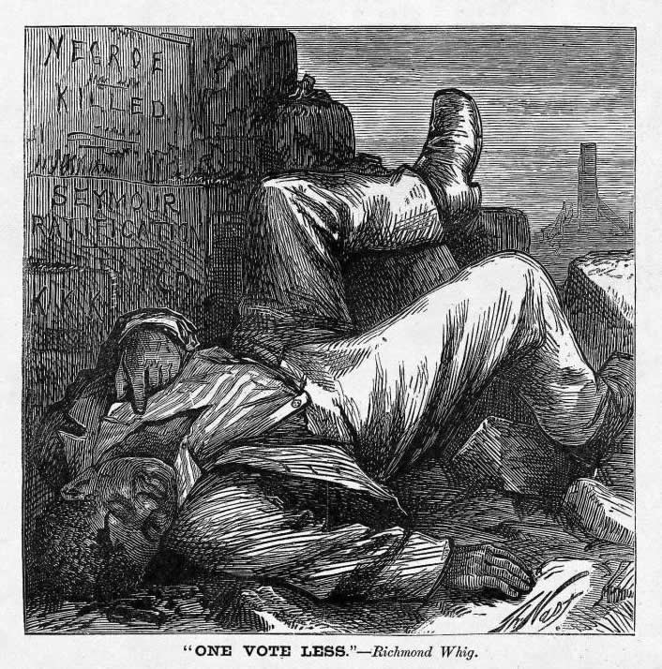

Slide 38
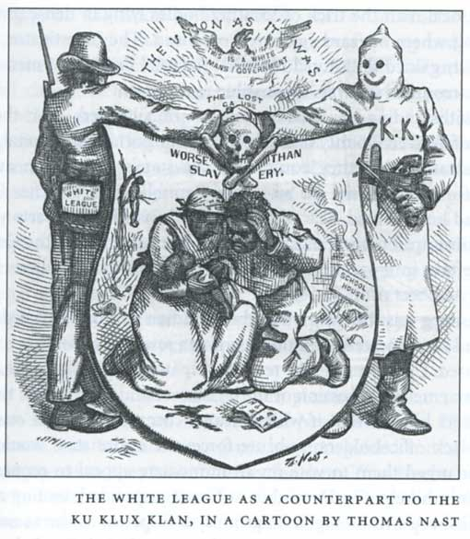

Slide 39
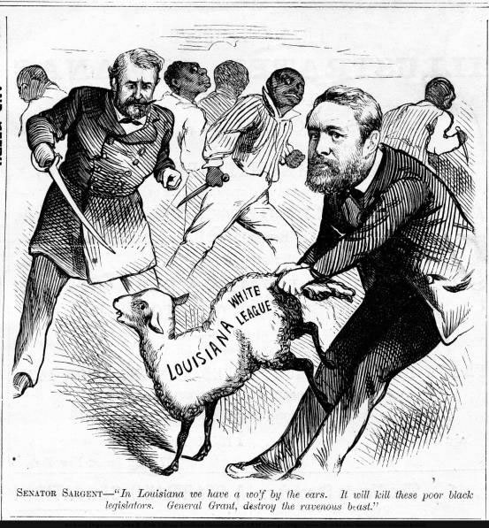
Southern “Redemption”
Enforcement Acts (1870,71)
  a.k.a. KKK Acts
  Allowed the president to use federal troops to prevent discrimination against voters
Midterm election of 1874
  Despite attempts to protect voting rights in the south, Democrats win control of House

Slide 40
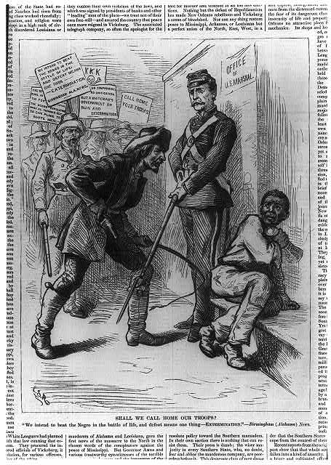

Slide 41
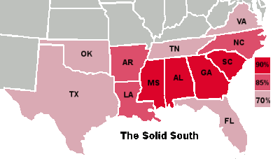
End of Reconstruction
By end of Grants Presidency..
  Republican party loses support
    Political Corruption – Grant Scandals
    Economic Failure – Panic of 1873
  Democrats have regained control of 7 states
    “Solid South”

Slide 42
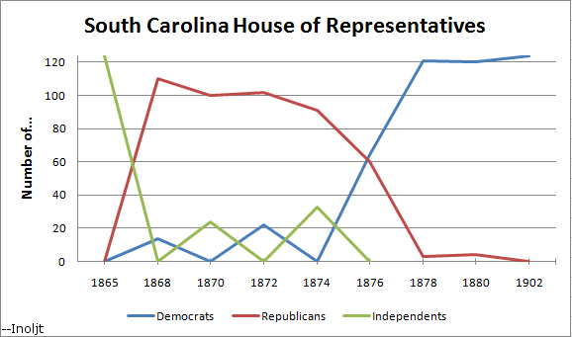

Slide 43
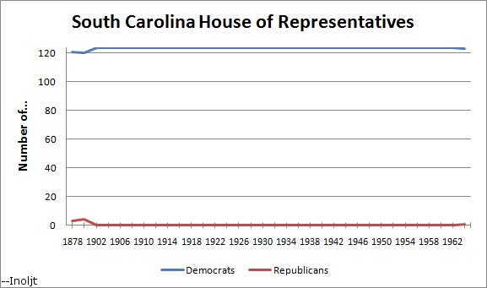

Slide 44
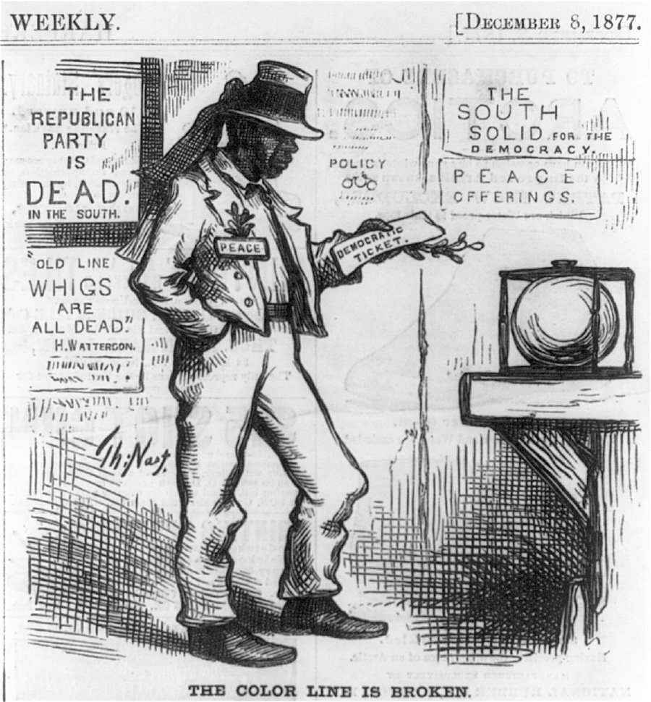

Slide 45
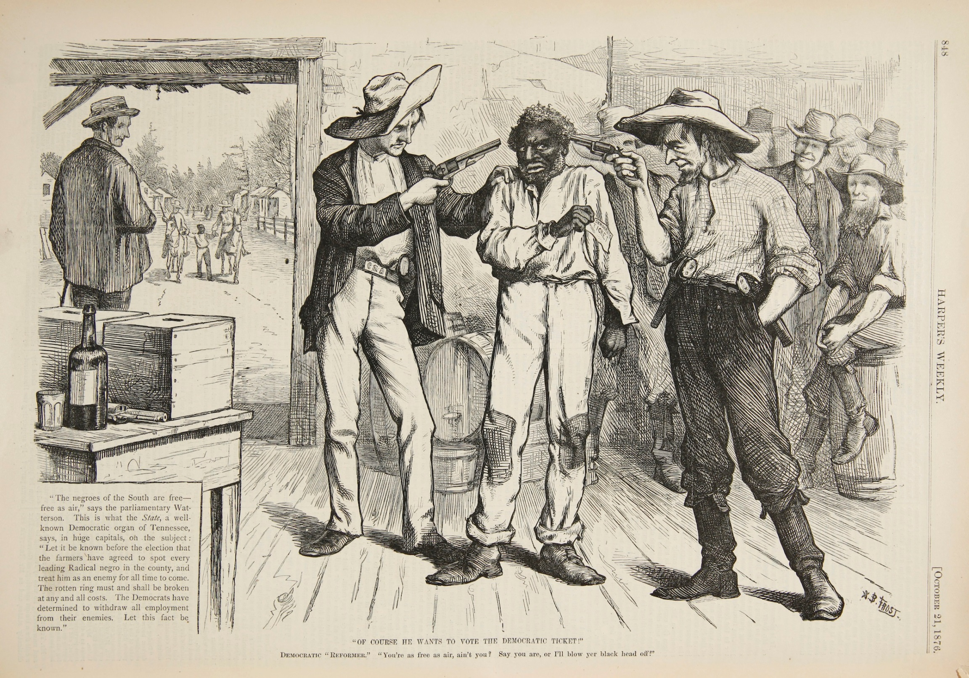

Slide 46
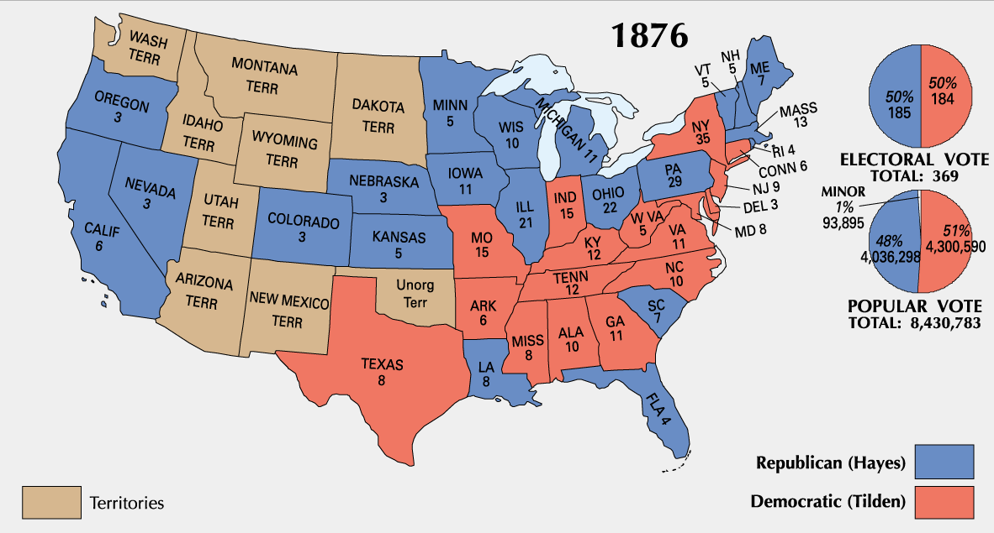
1876 Election Results

Slide 47

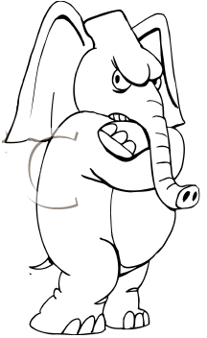

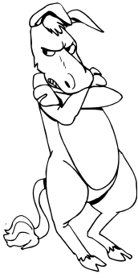

Samuel Tilden wins popular vote.
Republicans call for a recount
After “recounting” Rutherford B. Hayes is found to be the winner.
Democrats in Congress protest the election – think there was cheating
A Compromise is needed!

Slide 48
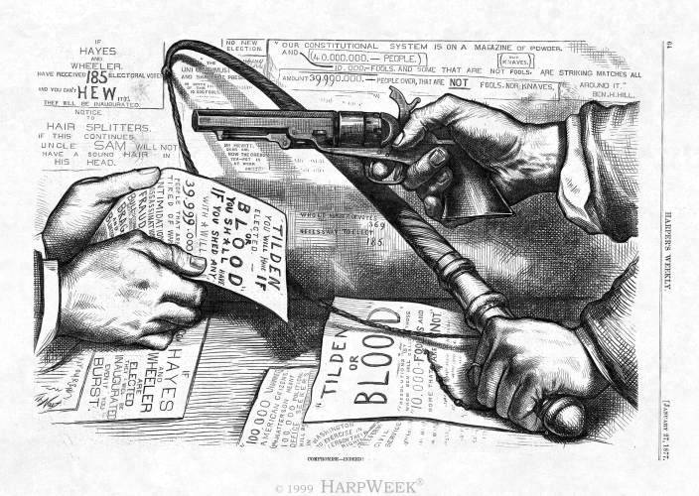

Slide 49
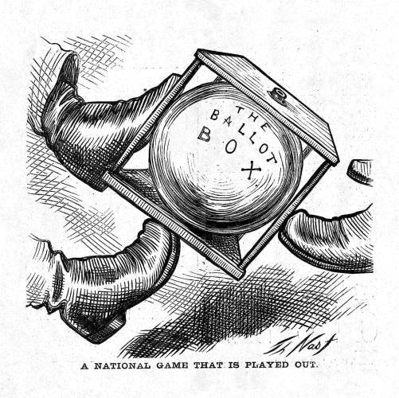
Compromise of 1877
House and Senate create Electoral Commission to determine winner
  Vote 8 to 7 in favor of Hayes
Filibuster and Compromise
  Democrats attempt to protest ruling
  Meanwhile, Dems and Reps agree on a compromise
    President must appoint Southerner to Cabinet
    Internal Improvements
    Aid for southern Transcontinental RR
    Removal of Troops from the south

Slide 51
Legacy of Reconstruction
Industrialization
  Rise in Textiles
  Shift to Tobacco
  Iron/Steel mining
  Railroad Construction
  Still only 10% of countries total manufacturing
  Lack of Labor Unions
  Workers (Women) exploitation

Slide 52
Legacy of Reconstruction
Rise of Redeemers
  Post Reconstruction ruling class
  Lower Taxes
  Cut Govt spending
    Education
Jim Crow Laws
  14th Amend only for public organizations
  Plessy v. Ferguson
    Separate but Equal

Slide 53
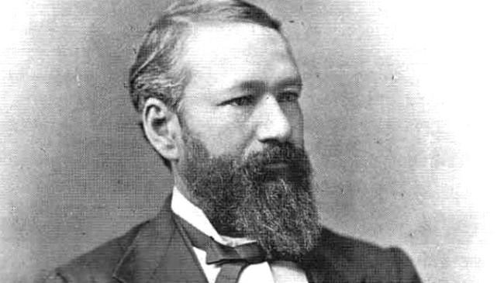
Homer Plessy - 1/8th Black

Slide 54
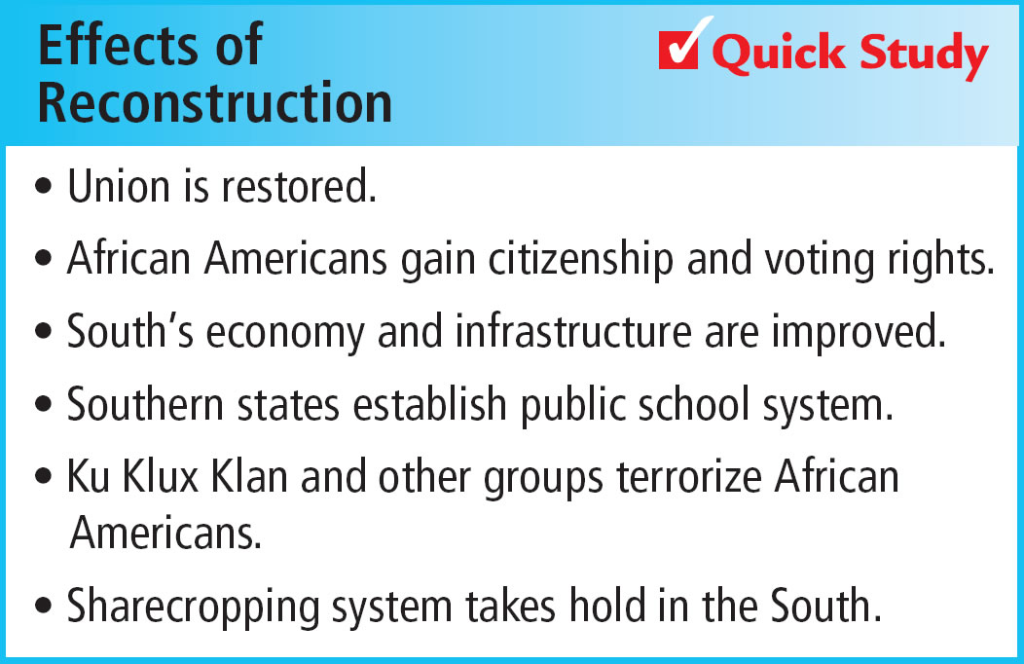

Legacy of Reconstruction

