Slide 1
Ratification of the Constitution

Slide 2
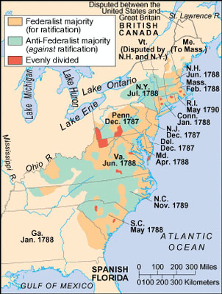
To Ratify or Not To Ratify?
Once the Constitution was written, Article VII required that 9 of the 13 states must ratify (approve) it before it could become binding
This led to much argument in the state legislatures between those who supported adoption of the new Constitution and those who thought it gave the new federal government too much authority

Slide 3
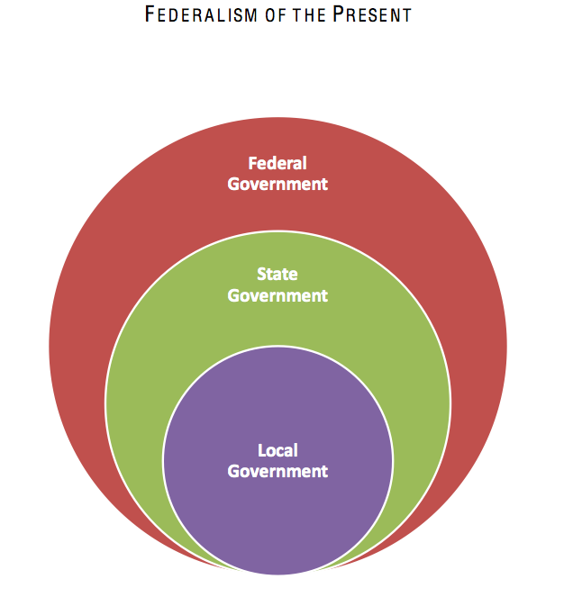
The Federalists
Supporters of ratification called themselves “Federalists”
They wanted to remind the people that what the Constitution created was a system of “federalism,” or a system where powers were clearly defined and divided between the central government and the individual states

Slide 4
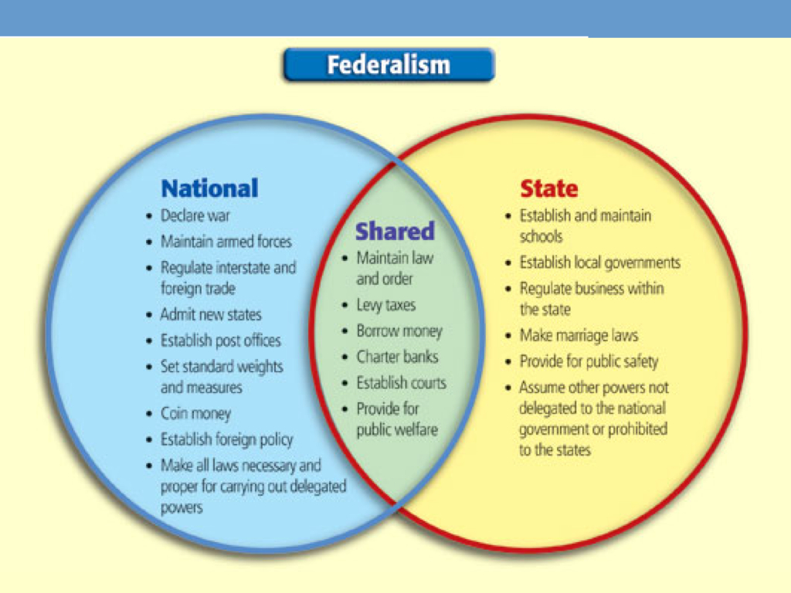

Slide 5
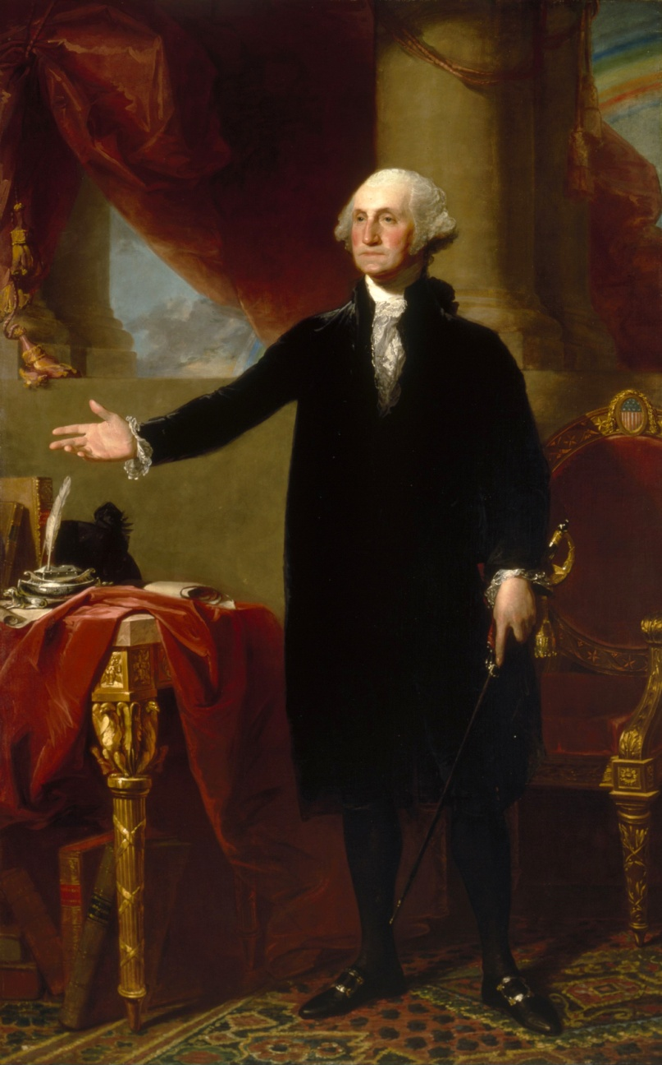
Who Were Federalists?
Federalists included large landholders who wanted a strong central government which could protect their property rights
They included merchants and artisans who wanted a central government empowered to regulate foreign trade
They included many small farmers who wanted internal trade barriers removed

Slide 6
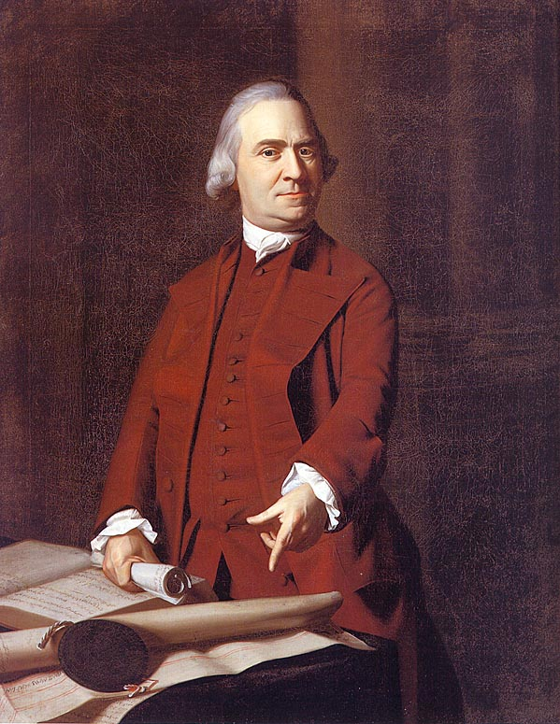
The Antifederalists
Those who opposed the Constitution came to be called Antifederalists
They primarily opposed Article VI, which made the federal government superior to the individual state governments and bound the states to follow federal law

Slide 7
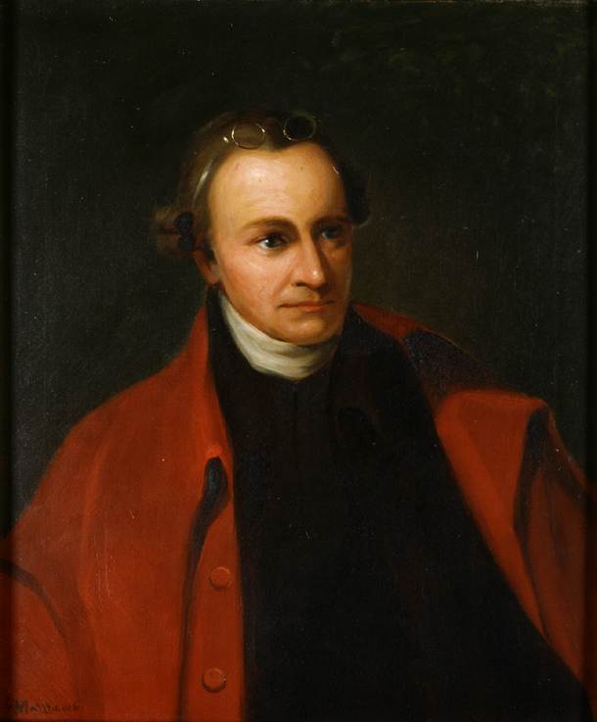
Who Were the Antifederalists?
There were many strong voices amongst the Antifederalists, including John Hancock, Sam Adams, Richard Henry Lee, and Patrick Henry
Some, like George Mason and Edmund Randolph, opposed the Constitution because they demanded the Bill of Rights be attached before ratification be considered

Slide 8

Western Opposition
Many Antifederalists were western farmers who were self-reliant and feared a powerful government; they also were afraid that the new federal government would be dominated by wealthy creditors who would try to exploit the system to make it harder for debtors (which these farmers were) to escape their debts

Slide 9
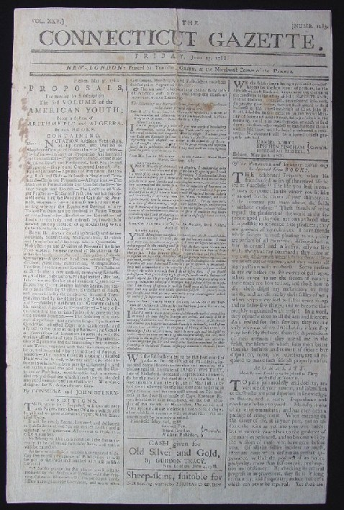
Federalists’ Advantages
Federalists were offering a definitive plan to fix the problems of the Articles of Confederation, while Antifederalists had no cohesive plan
The Federalists also tended to be excellent writers and public speakers, with good access to newspaper editors and pamphleteers

Slide 10
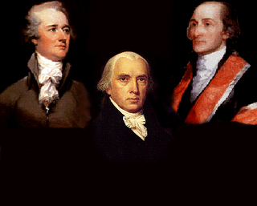
The Federalist Papers
A collection of 85 essays in favor of ratifying the Constitution
Written by James Madison, Alexander Hamilton, and John Jay under the pen name “Publius” (Latin for “the people”)
First published individually in newspapers during late 1787 and early 1788

Slide 11
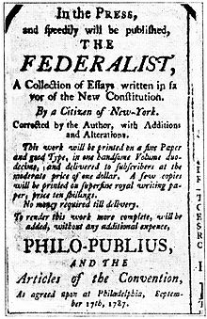
The Federalist Papers
The Federalist Papers explained the details of the Constitution, the intent behind each Article, and offered arguments for why each detail of the Constitution was needed
The Federalist Papers are still used today as a resource by Congress and the Federal Courts to determine the intent of the framers of the Constitution

Slide 12
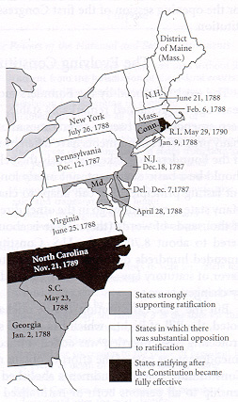
The First States Ratify
The Federalists had an advantage in several states, but the vote was going to be tight in the major states of Virginia, New York, and Massachusetts
By early 1788, Delaware, Pennsylvania, New Jersey, Georgia and Connecticut had all approved the Constitution, but 4 more states were needed for ratification

Slide 13
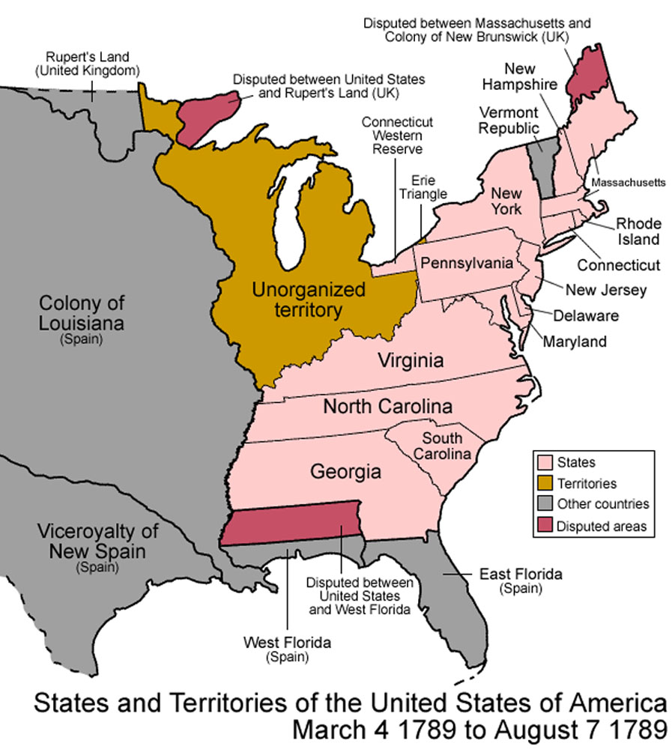
Massachusetts Ratifies
To win over voters in Massachusetts, the Federalists promised to pass a Bill of Rights (including an amendment that would reserve powers for the states that were not already given to the federal government) once the Constitution was ratified

Slide 14
Enough Come On Board
The compromises offered to Massachusetts also brought Maryland, New Hampshire, and South Carolina on board, bringing the number of states which approved the Constitution to the nine needed to fully ratify

Slide 15
What About VA & NY?
Many feared that without Virginia and New York’s support, however, the new government was doomed to fail
James Madison and George Washington targeted winning over Virginians, while Alexander Hamilton and John Jay targeted New Yorkers

Slide 16
The Big States Ratify
Washington and Madison finally won the approval of the Virginia legislature by promising a Bill of Rights
Hamilton and Jay sold the Constitution to New York by pointing out that if they did not ratify, they would be in a position of weakness, surrounded by states which had

Slide 17
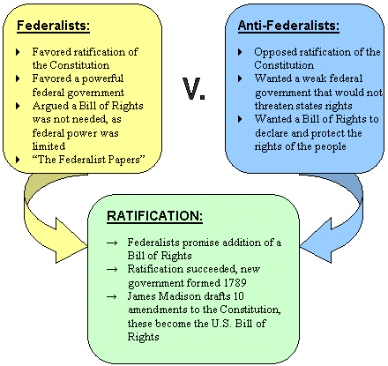
Planning a New Government
By late summer of 1788, all states but Rhode Island and North Carolina had ratified the Constitution and plans were put in place for the elections to be held and the new government to be seated in March of 1789

Slide 18
Final States to Ratify
North Carolina did not ratify until after the Bill of Rights was actually proposed in the new Congress (Nov. 1789)
Rhode Island became the last state to ratify, waiting until May 1790

Slide 19
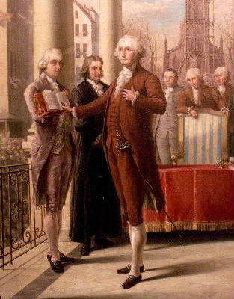
A New President
When the first elections were held in the fall of 1788, George Washington was nominated unopposed for the newly created office of Chief Executive or President of the United States of America
He won with 100% of the electoral vote, the only President to ever do so

Slide 20
Federalist vs Anti-Federalist
Part 1
Using the document on my website, read and analyze the two primary sources using the template I have provided for you. Be detailed in your answers.
Part 2
In essay format respond to the following question:
“What is the difference between a Federalist and an Anti-Federalist?”
- You must provide three specific differences.

