Slide 1
Psychology of sport
Option B
https://www.youtube.com/watch?v=d8DSzLpEru0

Slide 2
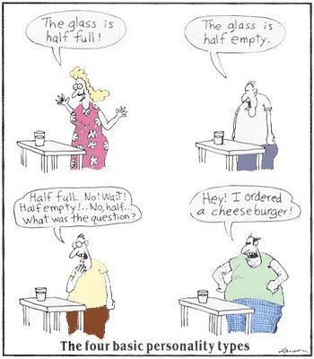
B.1.1 Define the term personality.
Those relatively stable and enduring aspects of individuals which distinguish them from other people, making them unique but at the same time permit a comparison between individuals.

Slide 3
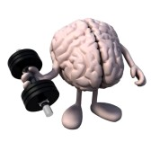
B.1.2 Discuss social learning theory and personality.
We have the capacity to learn through observation.
The personality components of the social learning theory are mainly cognitive:
Knowing
Being aware
Thinking
Learning
Judging

Slide 4
B.1.2 Discuss social learning theory and personality.
‘Personality is the sum total of an individual’s characteristics which make a human unique.’
(Hollander)
‘Personality represents those characteristics of the person that account for consistent patterns of behaviour.’
(Pervin, 1993)

Slide 5
B.1.2 Discuss social learning theory and personality.
How personality and social learning theory are related.
Competencies and skills
Beliefs and expectancies
Behavioral standards
Personal goals

Slide 6
B.1.2 Discuss social learning theory and personality.
Competencies and skills
Two implications:
Context specificity. Some psychological structures that are relevant in one situation may not be in another.
What might be an example?
Psychological change. Competencies are acquired through observation and social interaction.

Slide 7
B.1.2 Discuss social learning theory and personality.
Beliefs and expectancies
Beliefs are how thing are in our life (sport)
Expectancies are how things are going to be in the future. Also important is evaluating the worth and quality of an event.

Slide 8
B.1.2 Discuss social learning theory and personality.
For change to occur in personalities the three factors of how we see the world, what we think will happen in the future and what the world should look like, must be addressed.

Slide 9
B.1.2 Discuss social learning theory and personality.
Behavioral standards
How we judge the goodness or worth of our behavior
We evaluate our own actions and then respond in an emotionally satisfied or dissatisfied way.
An internal guidance system.

Slide 10
B.1.2 Discuss social learning theory and personality.
Personal goals
A key concept to influencing change is identification and realization of ones goals.

Slide 11
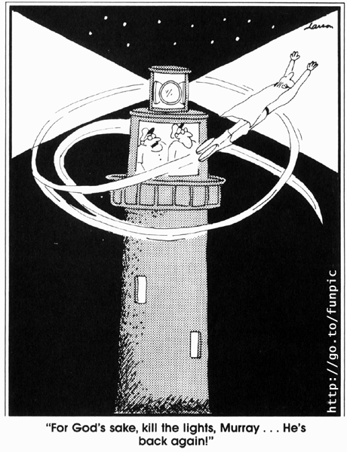
B.1.3 Discuss the interactionist approach to personality.
Behavior = Function of Personality x Environment
(B = F (P x E))
http://www.pearsonschoolsandfecolleges.co.uk/

Slide 12
B.1.3 Discuss the interactionist approach to personality.
Personality has three levels that interact to form personality
1 Psychological core
2 Typical responses
3 Role-related behaviour
http://www.pearsonschoolsandfecolleges.co.uk/

Slide 13
B.1.3 Discuss the interactionist approach to personality.
1 Psychological core
This is the most internal of the personality levels and is thought to be the true self. Inaccessibility makes it the most difficult level
to research but it is known to be stable and
remains relatively constant over time.
http://www.pearsonschoolsandfecolleges.co.uk/

Slide 14
B.1.3 Discuss the interactionist approach to personality.
2 Typical responses
Typical responses are changeable and are
learned behaviors. They become modified
as the person responds to environmental
situations. They often reflect the makeup of
the personality core.
http://www.pearsonschoolsandfecolleges.co.uk/

Slide 15
B.1.3 Discuss the interactionist approach to personality.
3 Role-related behavior
This is the most external of the personality
levels. It is therefore the level that is dynamic and changeable. An individual may have to adjust in order to fulfill many different roles in one day, for example the role of student, coach or friend. Role-related behavior is a direct consequence of the immediate environment.
http://www.pearsonschoolsandfecolleges.co.uk/

Slide 16
B.1.3 Discuss the interactionist approach to personality.
The interactionist approach is not simple. Any
behavior or response in sport can be the outcome of unlimited combinations of personality and environmental factors

Slide 17
B.1.3 Discuss the interactionist approach to personality.
The individual’s experiences cannot be understood if personal and situational factors are separated.
Even so, a fundamental part of who we are is dependent upon our genes.

Slide 18
B.1.3 Discuss the interactionist approach to personality.
Read page 218-220 “An interactionist view of personality”

Slide 19
B.1.3 Discuss the interactionist approach to personality.
Discuss in at your table what your interpretation of an interactionist view of personality is. How does it relate to sports?

Slide 20
B.2.1 Define the term motivation.
Motivation is “the internal mechanisms and external stimuli which arouse and direct our behavior” (Sage, 1974).
Direction of effort
Intensity

Slide 21
B.2.2 Outline the types of motivation.
Intrinsic motivation refers to engagement in an activity with no reason other than the enjoyment and satisfaction of engagement itself. By comparison, extrinsic motivation refers to engagement that provides means to ends that go beyond the engagement itself.

Slide 22
B.2.2 Outline the types of motivation.
What are some of the intrinsic things that motivate you? In school? Work? Sports?
What are some extrinsic things that motivate you? In school? Work? Sports?

Slide 23

B.2.2 Outline the types of motivation.
Extrinsic motivation examples would be money, bonuses, nice cars, expensive houses,
high grades in school, gold medals for athletics, etc.
http://www.academia.edu/1323999/The_Difference_Between_Extrinsic_and_Intrinsic_Motivation

Slide 24
B.2.2 Outline the types of motivation.
Intrinsic motivation is the opposite. You
get paid for doing what you truly enjoy doing, nice cars and houses don’t motivate you as much as
your joy in work, learning, and the things that truly motivate you internally
http://www.academia.edu/1323999/The_Difference_Between_Extrinsic_and_Intrinsic_Motivation

Slide 25
B.2.3 Discuss the issues associated with the use of intrinsic and extrinsic motivators in sports and exercise.
.
Extrinsic rewards influence intrinsic motivation. How?
Extrinsic rewards seen as controlling of behavior.

Slide 26
B.2.3 Discuss the issues associated with the use of intrinsic and extrinsic motivators in sports and exercise.
.
Extrinsic rewards providing information about their level of performance.
Extrinsic rewards will enhance intrinsic motivation when the reward provides positive information with regard to the performer’s level of competence.

Slide 27
B.2.3 Discuss the issues associated with the use of intrinsic and extrinsic motivators in sports and exercise.
https://www.youtube.com/watch?v=4IGjH9kQHwE

Slide 28
B.2.4 Describe Atkinson’s model of Achievement Motivation.
Motivation is a balance between the motive to achieve success and the motive to avoid failure.
In sports, athletes enter with an approach-avoidance conflict. That is, they are motivated by success but also by the fear of failure.

Slide 29
B.2.4 Describe Atkinson’s model of Achievement Motivation.
Achievement motivation =
The desire to succeed – The fear of failure

Slide 30
B.2.4 Describe Atkinson’s model of Achievement Motivation.
Some athletes the desire to succeed is greater than the fear of failure. They are said to be high in achievement motivation
Some athletes the fear of failure is greater than the desire for success. They are said to be low in achievement motivation

Slide 31
B.2.4 Describe Atkinson’s model of Achievement Motivation.
High Achievers
Select challenging tasks
Display a high level of effort
Continue to try hard in difficult situations
Focus on the pride of success

Slide 32
B.2.4 Describe Atkinson’s model of Achievement Motivation.
Low Achievers
Avoid challenging activities
Exert less effort when they take part
Exert less persistence when they take part
Focus on the shame of failure

Slide 33
B.2.4 Describe Atkinson’s model of Achievement Motivation.

Slide 34
B.2.5 Outline Goal Orientation theory.
Some studies suggest that outcome orientation is better for motivation, because an athlete is more likely to be successful. Trying to achieve ones goals. Other research suggests that task orientation makes for happier athletes, who train harder and are generally better prepared.
http://www.coe.uga.edu/epltt/motivation/con_attribution.htm

Slide 35
B.2.6 Describe Attribution Theory and its application to sport and exercise.
Why did I successfully accomplish this work?”
"Why did Jack flunk math?”
The answers to these questions reflect a person's beliefs about the causes of results.
http://www.coe.uga.edu/epltt/motivation/con_attribution.htm

Slide 36
B.2.6 Describe Attribution Theory and its application to sport and exercise.
Attribution theory is the study of how individuals explain events that take place in their lives.
Knowing learners' attributional beliefs can help the instructors to address the value of effort.
http://www.coe.uga.edu/epltt/motivation/con_attribution.htm

Slide 37
B.2.6 Describe Attribution Theory and its application to sport and exercise.
Weiner’s classification for causal attributions.
Locus of stability
Locus of causality
Locus of control
Self-serving bias
Learned helplessness
https://www.boundless.com

Slide 38
B.2.6 Describe Attribution Theory and its application to sport and exercise.
Locus of Causality: internal-external
Locus means the cause is within (internal) or outside (external) an individual. For instance, factors like mood and ability are internal causes, whereas luck and teacher bias are external causes.
http://www.coe.uga.edu/epltt/motivation/con_attribution.htm

Slide 39
B.2.6 Describe Attribution Theory and its application to sport and exercise.
Locus of Stability: stable-unstable
Stability means the cause is unchanging.
"I'm good at playing guitar since I've practiced over one year". Caused by the person (stable).
"I got an A in math this time because the test is very easy, everyone had an A." Someone performed very well just by chance, and the easy test is an inconsistent or unstable cause.
http://www.coe.uga.edu/epltt/motivation/con_attribution.htm

Slide 40
B.2.6 Describe Attribution Theory and its application to sport and exercise.
Locus of Control: controllable-uncontrollable
Control refers to the factors that we can control to influence results. Factors like skill and competence are classified as controllable, whereas luck and mood are classified as uncontrollable.
http://www.coe.uga.edu/epltt/motivation/con_attribution.htm

Slide 41
B.2.6 Describe Attribution Theory and its application to sport and exercise.
Self-serving bias
A self-serving bias is any cognitive or perceptual process that is distorted by the need to maintain and enhance self-esteem.
For example, a student who attributes earning a good grade on an exam to their own intelligence and preparation but attributes earning a poor grade to the teacher's poor teaching ability or unfair test questions is exhibiting the self-serving bias.
http://www.coe.uga.edu/epltt/motivation/con_attribution.htm

Slide 42
B.2.6 Describe Attribution Theory and its application to sport and exercise.
Learned helplessness
An individual has negative expectations and thinks failure is inevitable, despite their clear ability to change their behavior or performance. They feel “doomed” to failure.
http://www.coe.uga.edu/epltt/motivation/con_attribution.htm

Slide 43
B.2.6 Describe Attribution Theory and its application to sport and exercise.
Library
What are some issues that make measuring someone’s personality difficult?

Slide 44
B.2.6 Describe Attribution Theory and its application to sport and exercise.
TASK:
Carry out a Cattell 16 pf test
Consider whether there are links between the sport that you most enjoy and your personality profile.
http://www.similarminds.com/cattell-16-factor.html

Slide 45
B.2.6 Describe Attribution Theory and its application to sport and exercise.
TASK:
Discuss the value of personality profiling as a way of selecting a team or when advising a person as to which sport to take up.

Slide 46
B.2.6 Describe Attribution Theory and its application to sport and exercise.
Complete the TEOSQ

Slide 47
B.2.6 Describe Attribution Theory and its application to sport and exercise.
After you have completed the TEOSQ, workout a class average score for both task and ego orientation out of 5.
Scoring:
Add the task scores (questions 2, 5, 7, 8, 10, 12, 13), find the mean.
Add the ego scores (questions 1, 3, 4, 6, 9, 11), find the mean.

Slide 48
B.2.6 Describe Attribution Theory and its application to sport and exercise.
Do page 241 “ Data Based Questions”

Slide 49
Answers to page 241 data based question
  a. i. Student 1 High Task, High Ego
ii.Student 2 Low Task, High Ego
iii.Student 3 High Task, Low Ego
b. i. Mean ego = 3.67
ii. Mean task= 3.88
c. i. Student 3
ii. because of their high task orientation and low ego orientation.

Slide 50
Motivational Climate
Perceived motivational climate influences an individual’s thoughts, feelings, and achievement behavior (Ames, 1992)

Slide 51
Performance Climate
Mastery Climate
Comparision with others is most important source of information for self-evaluation
Focus on winning and improvement is of little significance
Perceptions – associated with high levels of worry, focus on competitive ability
Performance is evaluated in terms of personal mastery and improvement and not with comparison of others
Perceptions – task goal orientation, intrinsic motivation, prefer challenging tasks and beliefs of success are due to effort
Positive attitude, high satisfaction, low boredom and anxiety

Slide 52
TARGET Principles - Motivational Climate
Task
Authority
Recognition
Grouping
Evalutation
Time Structures

Slide 53
Psychology of Sports
Review of motivation
https://www.youtube.com/watch?v=SE4IpVF1soo
https://www.youtube.com/watch?v=1akg5srwmTQ
Psychology of the Obsessed Athlete
https://www.youtube.com/watch?v=A9ZaudNTSeQ

Slide 54
Visualization
http://www.youtube.com/watch?v=vD06AfbmFlY

Slide 55
B.3.1 Define the term arousal.
The continuum ranging from a very deep sleep-like state to excessive and uncontrolled activation of numerous systems that might be seen in the instance of a panic attack.

Slide 56
B.3.1 Define the term arousal.
Autonomic arousal is seen as the immediate response to a stressor.
The sympathetic nervous system closes down the non-essential physiological systems. They accelerate those fight of flight response systems.

Slide 57
B.3.2 Describe the theoretical approaches to arousal.
Drive Reduction Theory
It was developed by Clark Hull in 1943, was the first theory for motivation.
Drive reduction theory says that humans are motivated to reduce the state of tension caused when certain biological needs are not satisfied. This theory helps explain behaviors that have strong biological components.
Example might be you are driven to drink a glass of water to reduce your sensation of thirst.
https://www.boundless.com

Slide 58
B.3.2 Describe the theoretical approaches to arousal.
Drive Reduction Theory
Discuss with you table some examples of drive reduction theory
An example of Drive not being reduced
.
https://www.youtube.com/watch?v=1x9W70LJKVw
https://www.boundless.com

Slide 59
B.3.2 Describe the theoretical approaches to arousal.
Inverted-U hypothesis
For complex tasks there was an optimal level of arousal above and below which performance levels would decrease.
The theory is that as arousal is increased then performance improves but only up to a certain point (top of the inverted U). If the athlete's arousal is increased beyond this point then performance diminishes.
https://www.boundless.com

Slide 60
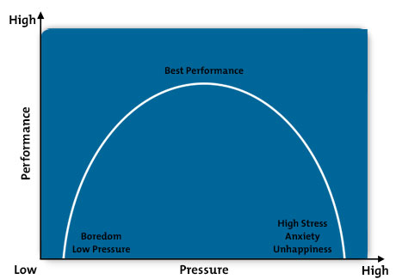
Inverted-U hypothesis
http://www.mindtools.com/pages/article/inverted-u.htm

Slide 61
B.3.2 Describe the theoretical approaches to arousal.
Catastrophe theory.
Sometimes know as choking. The pressure seems insurmountable and an athlete will fall victim to what sports psychologists call the catastrophe theory.
https://www.boundless.com

Slide 62
B.3.2 Describe the theoretical approaches to arousal.
Catastrophe theory.
The interaction between physiological arousal and cognitive anxiety.
Sudden shifts in behavior arising from small changes in circumstances.
Why the behavior occurs it not yet known.
https://www.boundless.com

Slide 63
B.3.4 Discuss the emotions that may influence an athlete’s performance or experience in a physical activity
Participation in sport and exercise influences a range of participant emotions such as depression, anxiety, and pleasure
(+) Positive and (-) Negative emotions can have +/- effect on performance
(+) Positive Emotions
  Excitement, relief, and pride
  Often lead to improved performance
(-) Negative Emotions
  Anger, guilt, shame, anxiety, and boredom
  Lead to decreased performance

Slide 64
B.3.4 Discuss the emotions that may influence an athlete’s performance or experience in a physical activity
Specific Emotions have a discrete effect on performance
  Negative mood
    Prime us to remember negative memories of past failures
    Reduce our feelings of confidence to perform
    Feeling of helplessness, impending failure, decreasing reasoning
  Positive mood
    Prime us to positive previous outcomes
    Increase our confidence to perform
    Positive self-talk, increased self-esteem, increased problem solving when faced with performance issues
Some emotions traditionally negative but for that individual, have positive effect on performance (anger)

Slide 65
B.3.5 Define the term anxiety.
Anxiety is a negative emotion of apprehension and tension (stress) which includes irrational thoughts, fear of failure, self-doubt and worry
Types
  Trait (innate) anxiety
  State (situation) anxiety

Slide 66
B.3.6 Distinguish between cognitive and somatic anxiety.
COGNITIVE ANXIETY
Characterized by thoughts and perceptions of worry/doubt and negative expectations (mind), about performance, self-evaluation, & evaluation by others
(-) effect
  Confusion/irrational thoughts
  Lack of concentration
  Nervousness
  Apprehension
(+) effect
  Faster information processing
  Increased attention
SOMATIC ANXIETY
Relates our perceptions of our bodily state (physiological arousal)
Provide signal to individual they are anxious

Slide 67
B.3.7 Distinguish between trait anxiety and state anxiety.
TRAIT ANXIETY
STATE ANXIETY
Innate
If you have the trait, you are more likely to show the state
A relative enduring disposition (innate personality dimension) causes people at the high of this continuum to view a wide range of non-dangerous circumstances as threatening
Situation specific
Drops significantly once competition begins
A temporary negative emotion of apprehensiveness and tension experienced in threatening situations and is situation specific

Slide 68
B.3.8 Evaluate how anxiety is measured.
SCAT (Sport Competition Anxiety Test) (Martens, 1977)
  Aimed to find out which competitors are likely to become too anxious in a competitive situation.
  Scoring from a sport specific situation gives an indication of that person’s level of state anxiety in competition-specific situations.
  Four factors are related to competitive anxiety:
    Individual differences in how performers interact with different situations - some events are more important than others and therefore cause more anxiety
    The different types of anxiety (state and trait) that a performer experiences
    A specific anxiety trait that only occurs in competitive situations.
    The competition itself, which involves interaction between the performer's personality traits, their own competitive trait anxiety and the specific situation involved

Slide 69
B.3.8 Evaluate how anxiety is measured.
CSAI - 2
  Measured three components: cognitive, somatic, self-efficacy.
  Given out before competition but more than once, such as a week before, a day before, and half an hour before this.
  Enables researchers to discover baseline levels of anxiety and compare it with pre-competition levels to see if they differ.
STAI (State-Trait Anxiety Inventory)
  Is a self-report questionnaire in which people rate how nervous they feel both in general and in specific situations.
  The scoring system for the questions gives an indication of both the state anxiety and the trait anxiety of the performer.

Slide 70
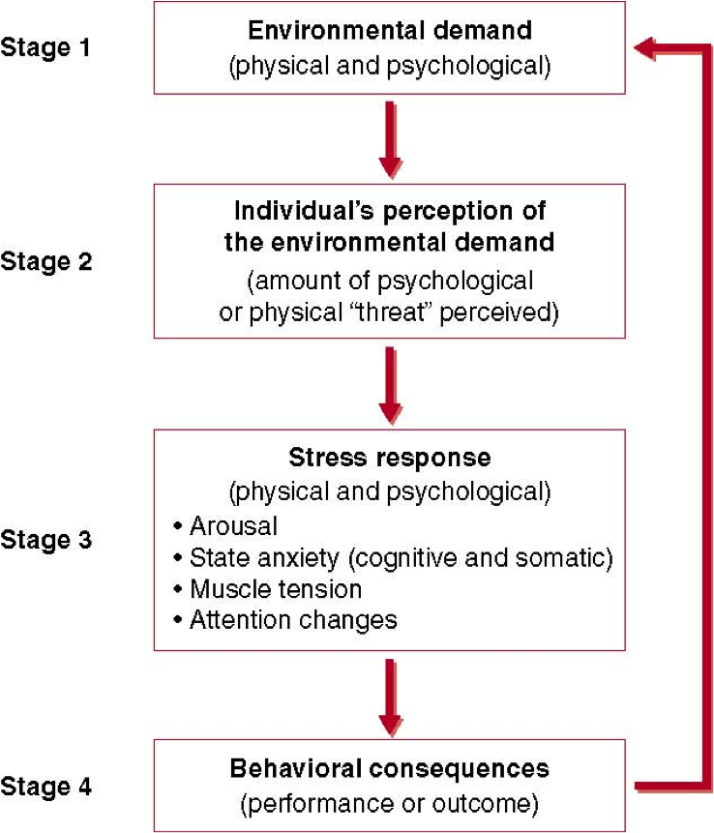
B.3.9 Describe the stress process in sport
Stress is a process that involves one’s perception of an imbalance between the demands of the environment (physical and/or psychological)and one’s response capability (response), under conditions where failure to meet the demands

Slide 71
B.4.1 Discuss psychological skills training (PST).
Psychological skills training (PST)
Refers to the systematic and consistent practice of mental or psychological skills.
Include the following issues.
https://www.boundless.com

Slide 72
B.4.1 Discuss psychological skills training (PST).
PST: (i) is not just for elite athletes
(ii) is not just for problem athletes
(iii) does not provide quick fix solutions.
https://www.boundless.com

Slide 73
B.4.1 Discuss psychological skills training (PST).
Psychological Skills Training (PST) is an individually designed combination of methods selected to attain psychological skill needs.
There is no single idyllic PST package, each program must be individualized based on the psychological state of the individual and, the sport.
http://www.brianmac.co.uk/articles/article001.htm

Slide 74
B.4.1 Discuss psychological skills training (PST).
To assemble a successful PST program it is important to distinguish between PST skills and PST methods. PST skills are the psychological qualities or attributes that need to be developed (i.e. confidence, concentration), the PST method is the tool that will be used to help improve the PST skill (Calmels et al. 2003).
http://www.brianmac.co.uk/articles/article001.htm

Slide 75
B.4.1 Discuss psychological skills training (PST).
When implementing a PST program, it is improbable that a single method will be employed by a sports psychologist. It is more effective to employ a combination of mental skills that relate to the specific sport.
http://www.brianmac.co.uk/articles/article001.htm

Slide 76
B.4.2 Outline goal setting.
Goal setting helps with motivation to the individual and also can give self confidence to the individual.
http://www.brianmac.co.uk/articles/article001.htm

Slide 77
B.4.2 Outline goal setting.
SMARTER (specific, measurable, achievable, realistic, time, evaluate, review) goals
http://www.brianmac.co.uk/articles/article001.htm

Slide 78
B.4.2 Outline goal setting.
Set a combination of outcome, performance and process goals
Process goals:
Race plan
Positive mental imagery
Quality training program
http://www.brianmac.co.uk/articles/article001.htm

Slide 79
B.4.2 Outline goal setting.
Set a combination of outcome, performance and process goals
Performance goals:
Run a race at a given time.
Keep pitch count down to 60.
Throw no interceptions
http://www.brianmac.co.uk/articles/article001.htm

Slide 80
B.4.2 Outline goal setting.
Set a combination of outcome, performance and process goals
Outcome goals
Win the game.
Beat the number one seed.
Get selected for the All-star team.
http://www.brianmac.co.uk/articles/article001.htm

Slide 81
B.4.3 Evaluate mental imagery.
SMARTER (specific, measurable, achievable, realistic, time, evaluate, review) goals
http://www.brianmac.co.uk/articles/article001.htm

Slide 82
Example of test questions
Define arousal
Draw a graphical representation of the Inverted-U hypothesis
In drive reduction theory, what is meant by drive?
https://www.boundless.com

Slide 83
What to include in your presentation
What key information do you want them to get.
Space for additional information.
Use information from the book.
Use information from the internet (be sure to check more than one site for credibility).
Give examples.
https://www.boundless.com

Slide 84
Use pictures/video or diagrams that help clarify or explain an idea.
Must include interactive component.
Come up with four quality questions about your material covered.
https://www.boundless.com

