Slide 1
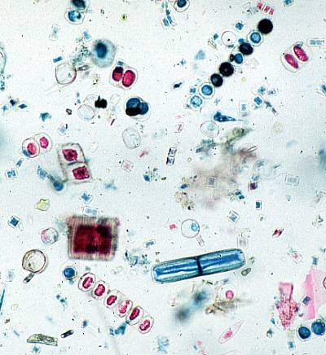
Kingdom Protista

Slide 2


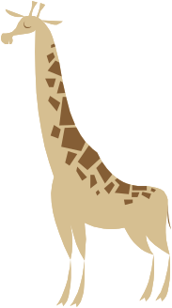
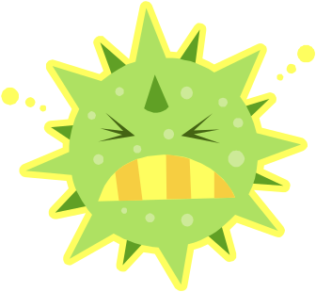

General Characteristics
Any organism not classified as a—plant, animal, fungus, or bacteria (prokaryote).
Protists are eukaryotic having a distinct nucleus and organelles.
Most protists are unicellular (one-celled) but some are multicellular.

Slide 3
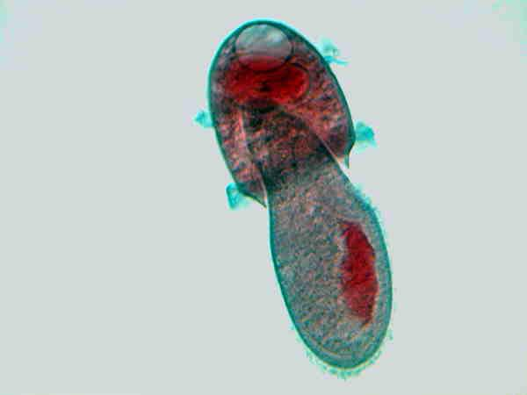
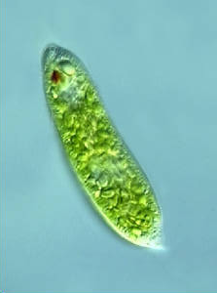
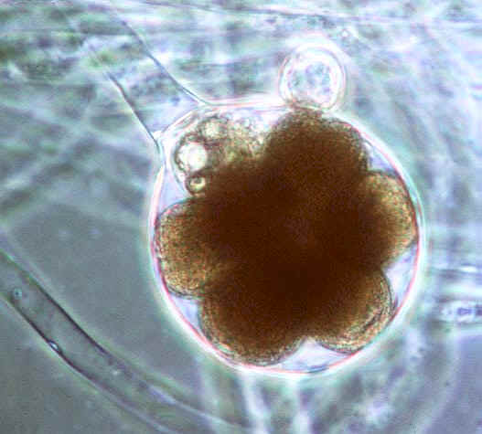
4. Protists are primarily classified according to how they obtain nutrition:
Animal-like—heterotrophs
(eat other organisms)
Plant-like—autotrophs
They contain chloroplasts
and make their own food
(photosynthesis).
Fungus-like—
Decomposers/Heterotrophs
Didinium
eating
Paramecium
Green like plants!
Water mold

Slide 4
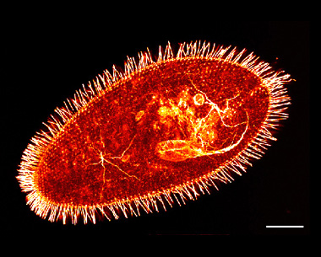
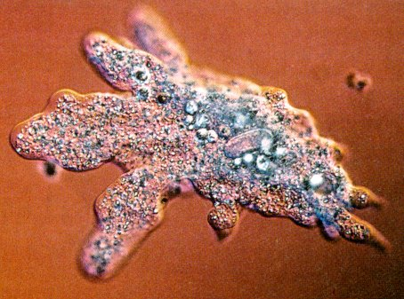
Animal-like Protists (Protozoans)
Method of Movement:
  Cilia—hair-like projections used for movement and feeding
  Cytoplasmic streaming—pseudopod (false foot) extends and cytoplasm streams into it.
Video
Video

Slide 5
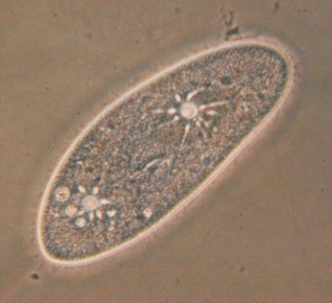
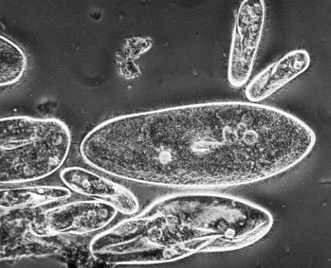
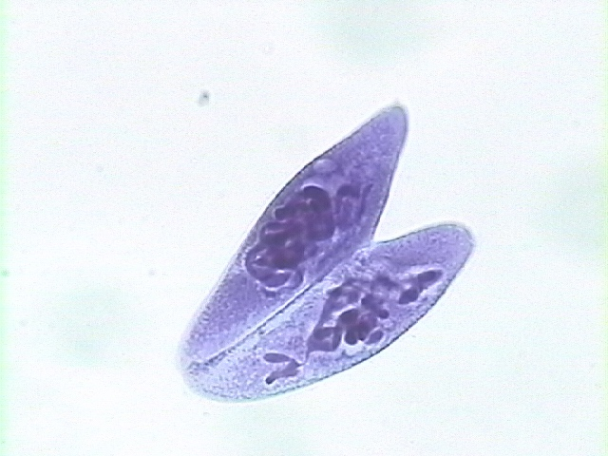
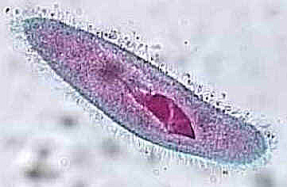
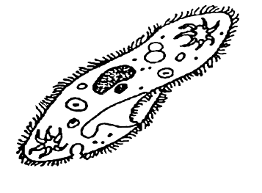
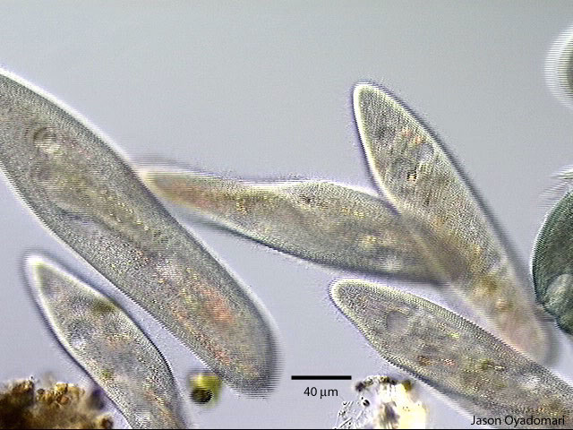
Paramecium:
Contractile Vacuole
Collects and removes excess H₂O
(Maintains homeostasis)
Nucleus
Cilia
Oral Groove
Used to collect food
Cell Membrane

Slide 6
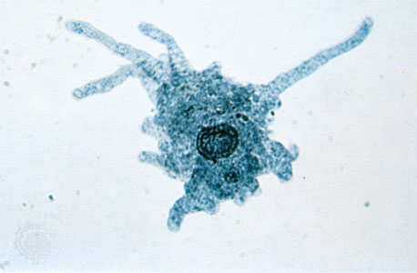
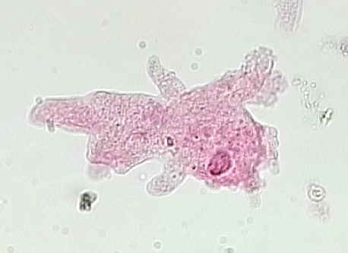
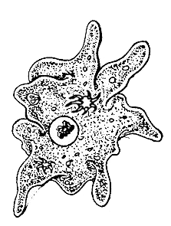
Amoeba: Engulfs its food
Nucleus
Contractile Vacuole
Pseudopod
(False foot)

Slide 7
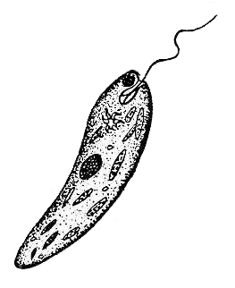
Plant-like Protists
Method of Movement:
Flagellum—whip-like structure used for movement
Euglena
Autotroph AND Heterotroph
Eyespot
For photosynthesis (light)
Nucleus
Flagella
Contractile Vacuole
Chloroplasts

Slide 8
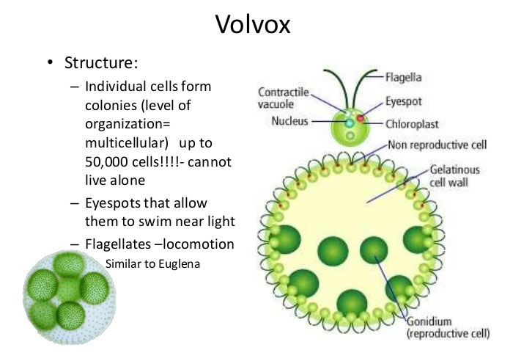

Slide 9
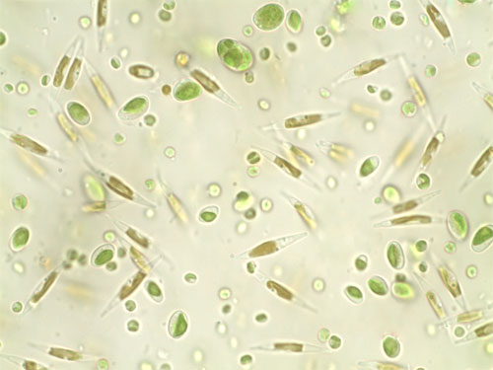
Unicellular Algae
  Phytoplankton provides a source of nourishment for other organisms

Slide 10
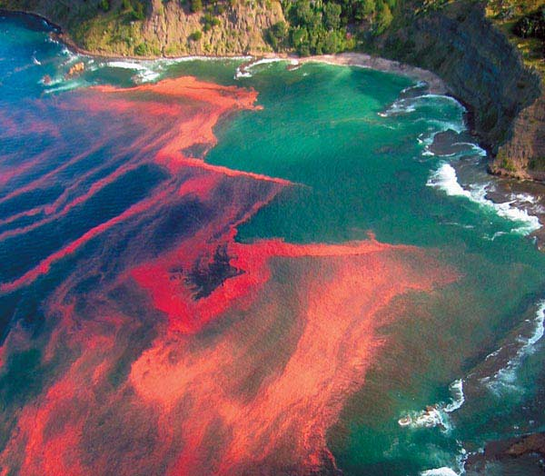
Algal blooms are harmful when overgrown—deplete water of nutrients consequently killing fish.
  Algal blooms called Red Tides cause illness, paralysis, and death of fish and even humans.

Slide 11
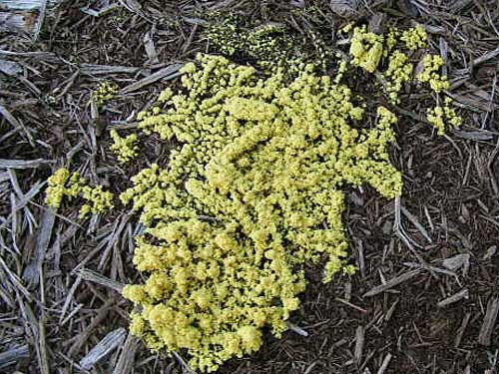
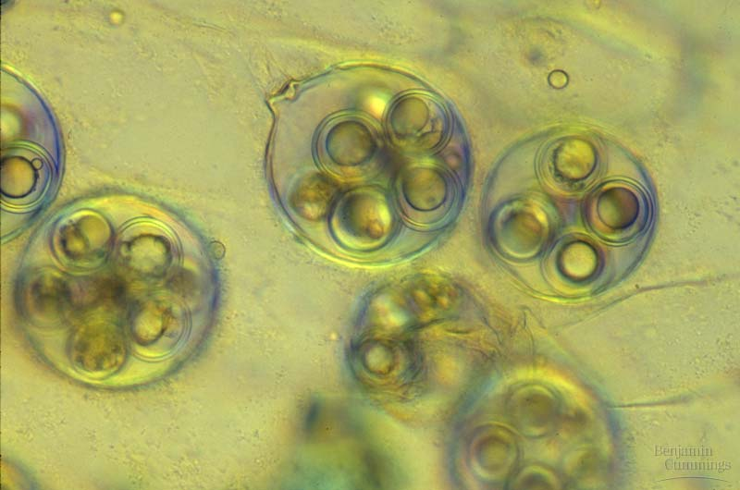
Fungus-like Protists:
Examples
  Slime molds
  Water molds

