Slide 1


Welcome to the
Early College!
Class of 2027
Please sign in while you wait!

Slide 2
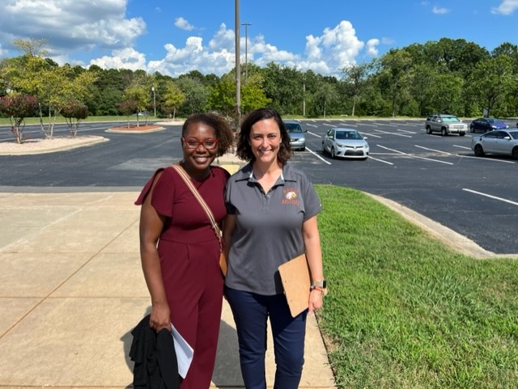
Who we are?
Meet the Eagle staff:
Dr. Brown, Principal
Mrs. Tinsley, Assistant Principal
Mrs. Crews, Guidance Counselor
Mrs. Glover, Social Worker
Mrs. Cook, College Liaison
Mr. Curtis, Student Wholeness Specialist

Slide 3
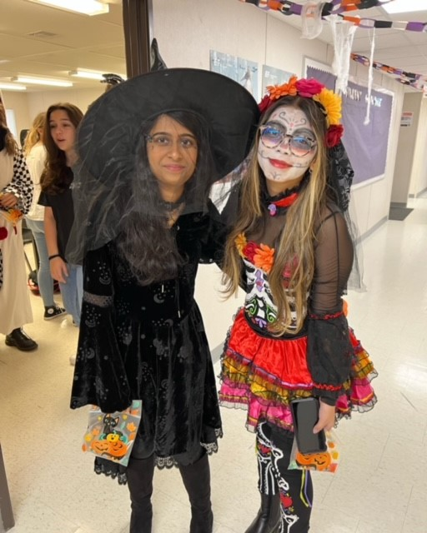


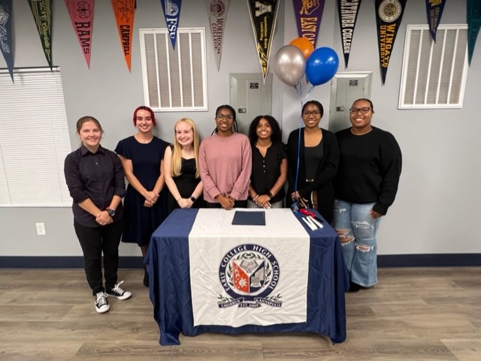
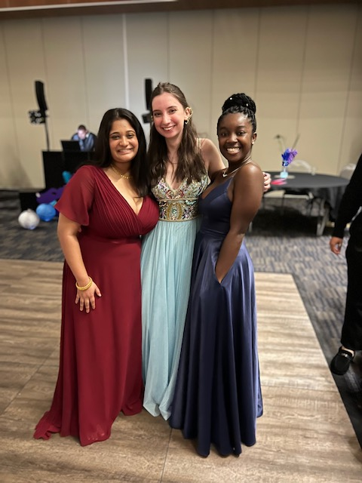
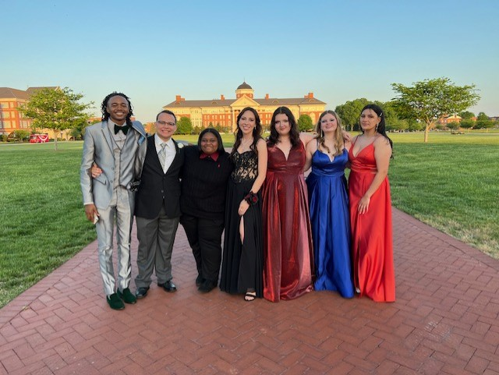

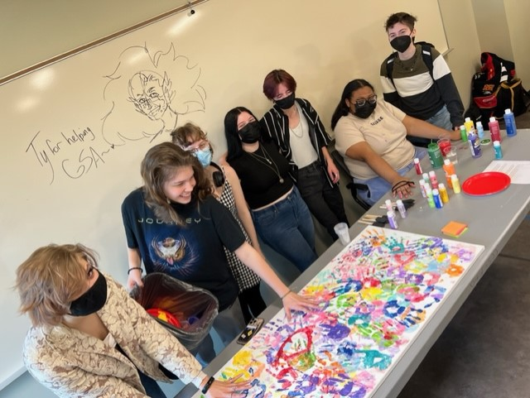
Who we are?
We are a FREE public high school
  We provide bus transportation
  1:1 Chromebooks
  Free college tuition and textbooks
We are a small school - 260 students max!
  We currently have 238 students and 16 teacher/staff
  We accept 66 freshmen each new school year
  Classes are no larger than 22 students
We are just like other high schools!
  We have Friday Clubs (Student Council, Model UN, Yearbook, Science Club, Anime, etc...)
  We have Homecoming, Prom, and other social events
  We have intramural sports with other early colleges

Slide 4
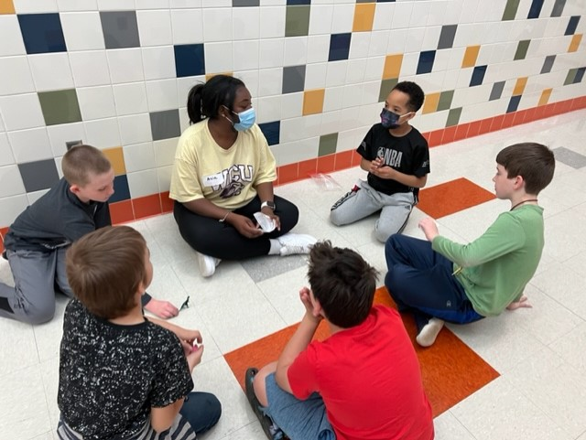
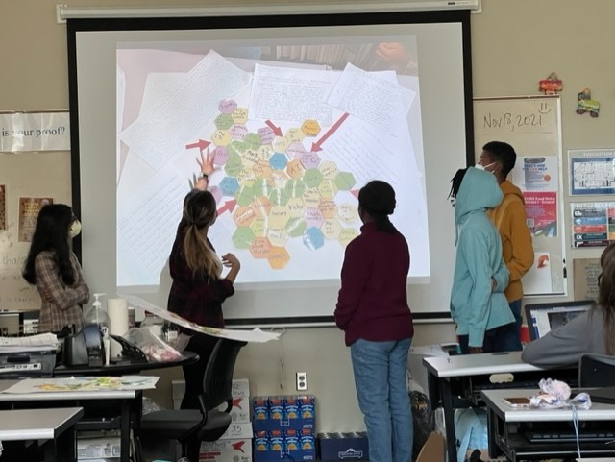
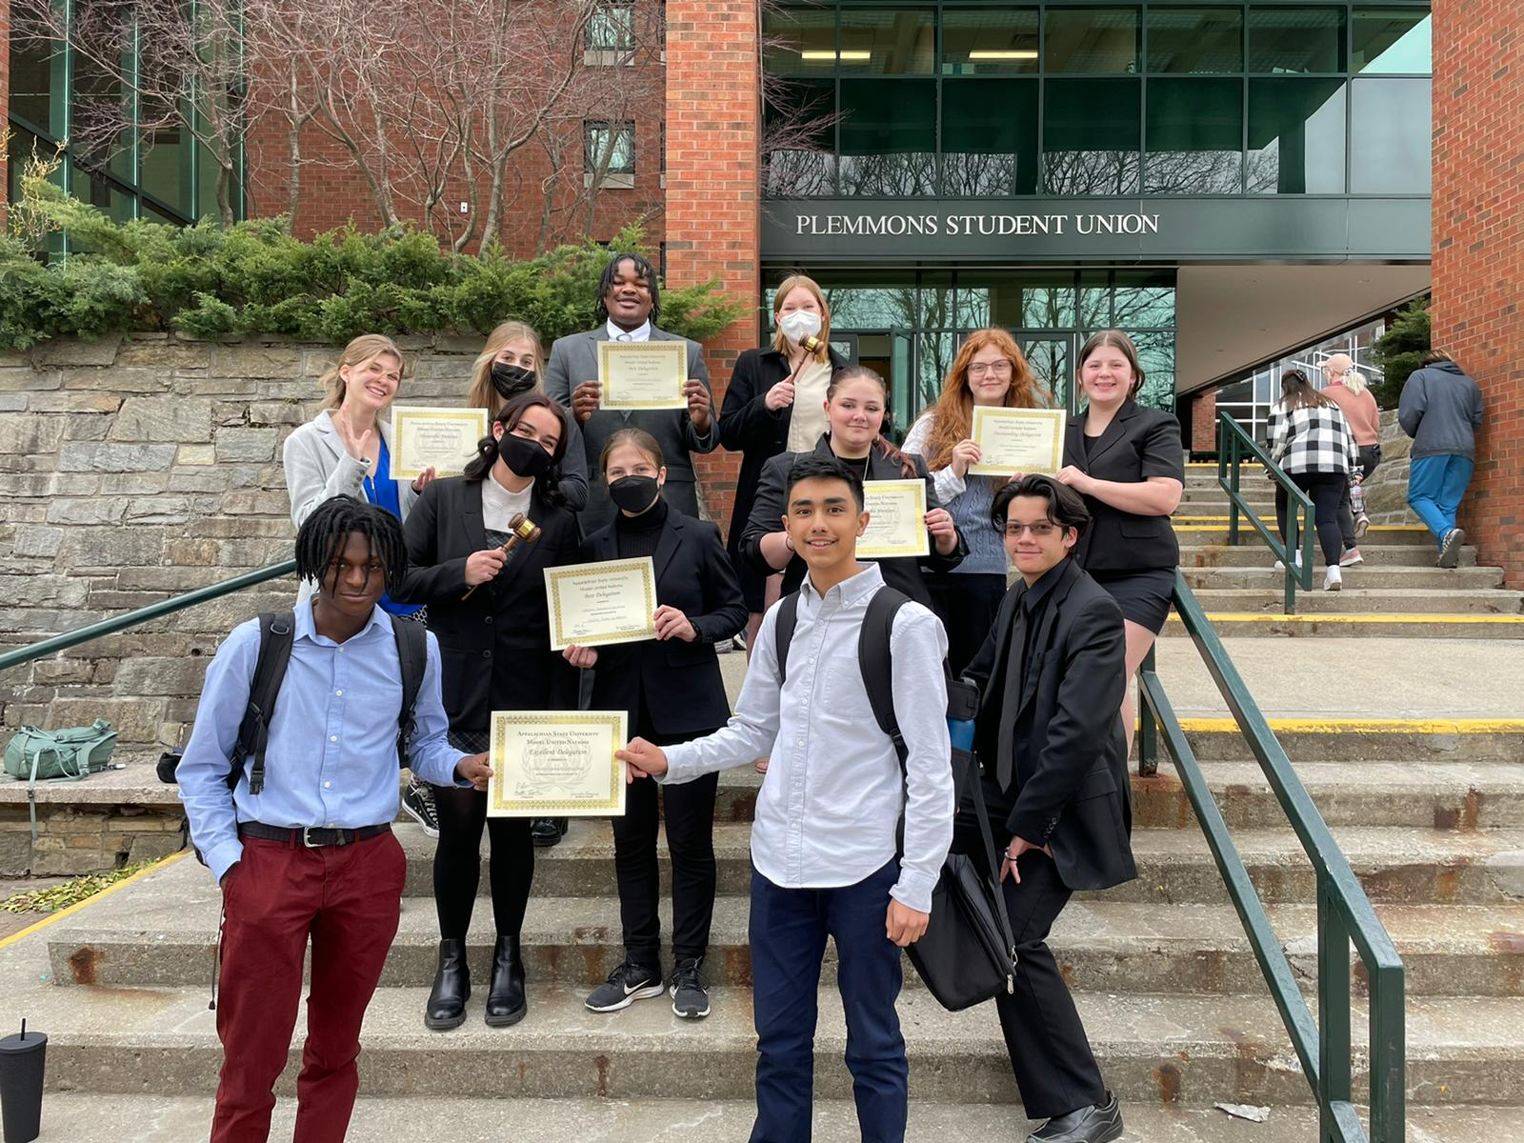
What we do?
“Empower all students for college, career, and life.”
We help you earn an associate degree in addition to your high school diploma in four years
  This means a FREE 2-year college degree!
Through Seminar we teach you how to:
  Navigate college classes
  Develop study skills
  Advocate for yourself
  Think critically
We also provide guidance for:
  all parts of college admissions plus SAT/ACT prep
  entrance into military branches
  employment after school
  mental health supports

Slide 5
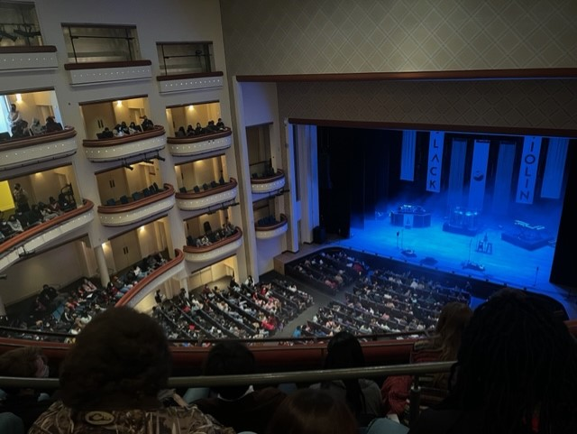
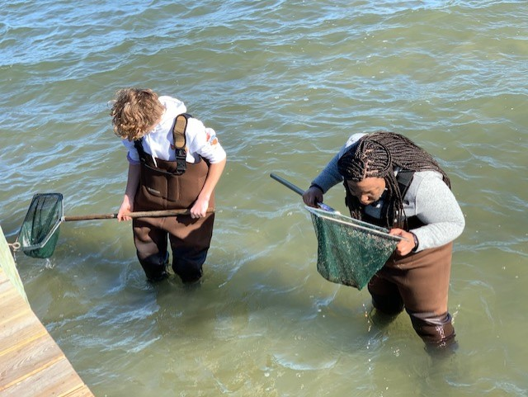
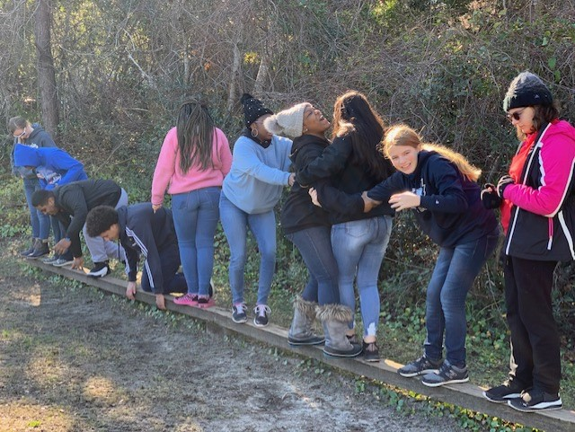
How we do it?
All of our classes are at the honors, AP, or college level
BUT... we offer strong systems of support to make this accessible to all students.
  30% - enter above grade level
  50% - enter on grade level
  20% - enter below grade level
We create a family-like atmosphere through collaborative learning to make sure all students are empowered to succeed!
To extend learning beyond the classroom and into the real-world we:
  Create various field trip opportunities, some overnight
  Have regular Friday seminar speakers, activities, and experiences
  Incorporate service projects into our clubs and seminar curriculum
  Focus on college preparation in conjunction with social emotional learning strategies for balance
  Work hard, play hard!!!

Slide 6
Why we do it?
To provide all students access to challenging high school courses
To provide all students access to college
To provide students with a nurturing environment for academic success, social experience, and emotional health
To provide students an opportunity to accelerate their academic experience so they can make an informed decision about life after high school
Everything we do with and for students is intentional in preparing them to soar once they leave the Nest.

Slide 7
A few things to know…
Transportation is provided for all of our students, both Cabarrus County and Kannapolis City.
We have cafeteria services like all other schools.
Although we are a CCS public school, we cannot offer NCHSAA athletic teams.
  Unfortunately, our students cannot participate in athletics at their home school.
  Covenant Classical School does allow our students to participate in their athletic program.
  Many of our students play club level sports, and we do have intermural competitions quarterly between the various early colleges.
We do not have programs for band or chorus, but there are opportunities for art classes through RCCC.
Unlike CCP programs at traditional high schools, Early College provides a supported path to an AA or AS, and pays for all textbooks, college fees, and transportation.
Students may only apply as incoming 9th graders.

Slide 8

What are people saying about us!
#1 Public High School in CCS
#1 Teachers in CCS
#1 College Prep in CCS
#2 in Diversity in CCS
"A" School from 2014 –2023
Exceeds Expected Growth in all EOC courses & Teacher Effectiveness

Slide 9
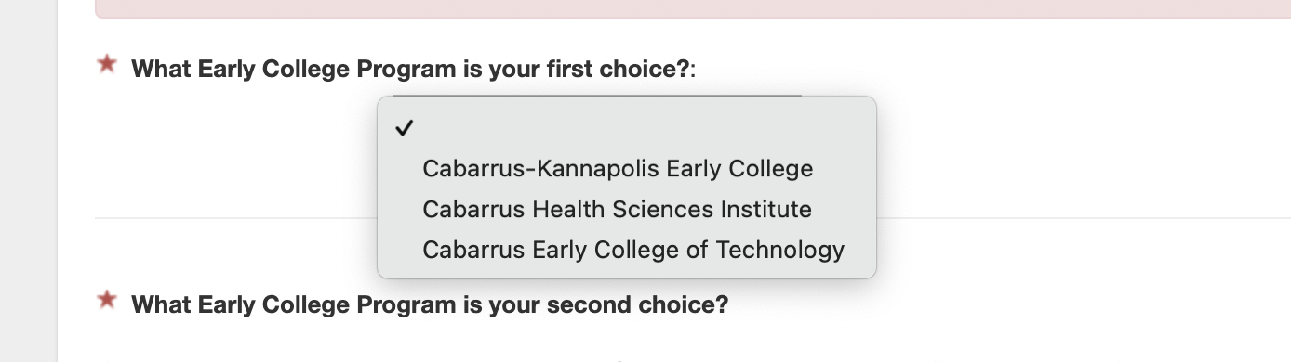

What are your next steps?
Apply on the CCS Program Choice page by December 16th!
Choose Cabarrus-Kannapolis Early College as your first choice
Submit teacher recommendations
Look for an email scheduling your interview!
We will conduct interviews in January and notify applicants the first week of February.

Slide 10
Thanks for being here!
Please jot down any questions you have before moving to your assigned classroom.
Applications due by Dec 16th

