Slide 1
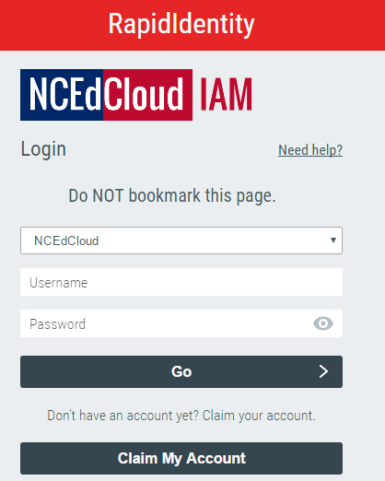
Step 1
Go to http://my.ncedcloud.org
Click “Claim My Account”

Slide 2
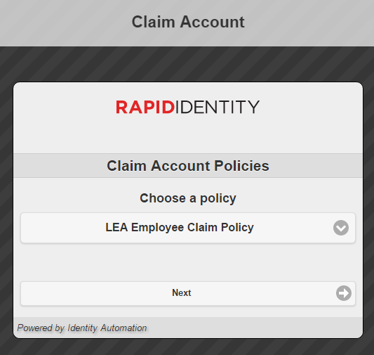
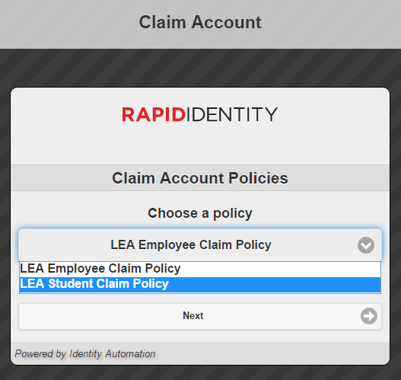
Step 2
Change to “LEA Student Claim Policy”

Slide 3
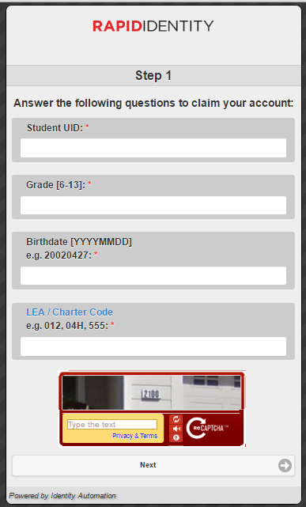
Step 3
Student ID / Lunch Number
123456789
Enter
Grade (6, 7 or 8)
6
Birthday: BE SURE TO FOLLOW FORMAT
20050203
LEA is 130
130
Type what you see
Click Next

Slide 4
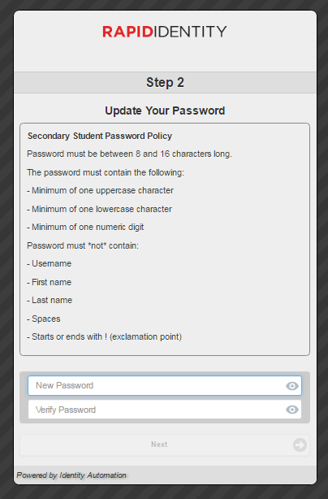
Step 4
Update your password to:
NWTitans1
NWTitans1
NWTitans1

Slide 5
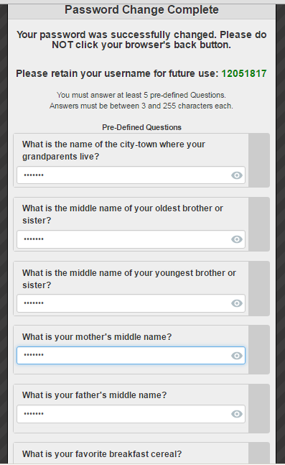
Step 5
Type in titans for each question
Answer ALL questions, not just 5!
titans
titans
titans
titans
titans

Slide 6
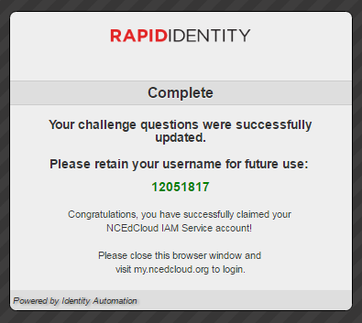
Step 6
Close browser
Go back to my.ncedcloud.org
Log in

Slide 7

Step 7
Close browser
Go back to my.ncedcloud.org
Log in
Make sure it works!

