Slide 1
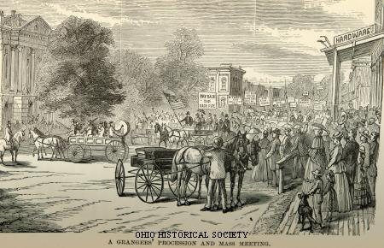
THE POPULIST MOVEMENT

Slide 2
The Plight of the Farmers
1870s-1880s
Farmers were becoming a minority in the USA.
The numbers of farmers declined from 60% of the population in 1860 to less than 37% in 1900.
They experienced falling prices.
The emergence of commercial farming and specialized farming
A rise in the costs of farm machinery and freight costs
They experienced a heavy tax burden

Slide 3
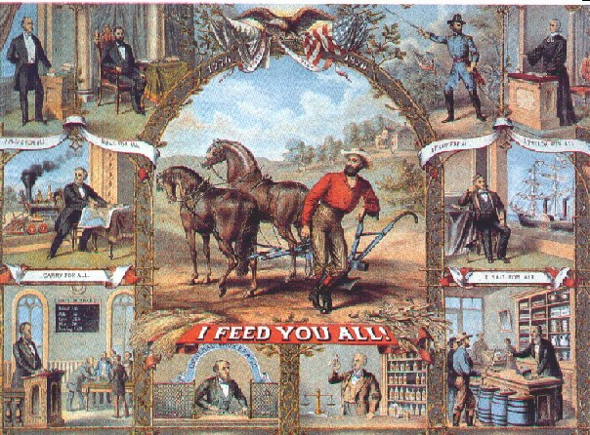
Farmer’s Problems
Droughts and storms caused crops to fail
Falling prices
Farmers cannot pay back loans, so banks foreclose on mortgages
Dependent upon railroads
Railroads overcharging the farmers

Slide 4
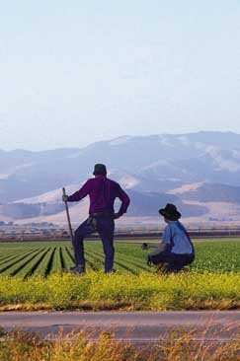
ECONOMIC DISTRESS HITS FARMERS
Between 1867 and 1887 the price of a bushel of wheat fell from $2.00 to 68 cents
Railroads conspired to keep transport costs artificially high
Farmers got caught in a cycle of debt

Slide 5
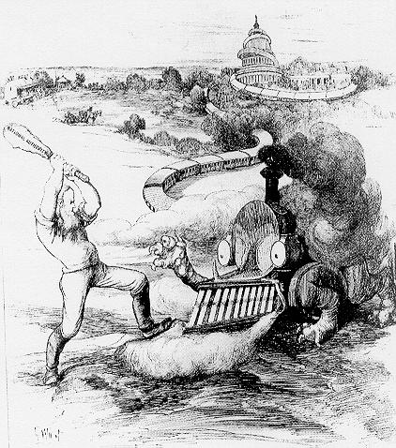
Railroad Abuses
Railroads making secret deals- bribes
Stock watering- livestock drink water to make weight increase
Unfair pricing- long haul cheaper than short hauls
Use of rebates for large customers
There are three great crops raised in Nebraska. One is a crop of corn, one is a crop of freight rates, and one is a crop of interest. One is produced by farmers who sweat and toil the land. The other two are produced by men who sit in their offices…and farm the farmers.”
~ Nebraska Newspaper Editorial

Slide 6
Agricultural Market Changes
International markets for U.S. agricultural goods expanded:
  75% of United States' total export trade (1860 to 1900)
  farmers did not understand financial complexities of commodity markets or foreign trade
  middlemen profited from their ignorance

Slide 7

Farming Prosperity
Farmers had no control over the marketplace
Prosperity depended on six factors which they could not regulate:
  Business Cycles
  Credit
  Transportation
  Labor Supply
  Price Structure
  Government policies
Farmers began to take political action

Slide 8
Farmer’s Cooperatives
Popularized by Thomas Jefferson
Self-reliant yeoman farmer as bedrock of American society
Gulf between ideal and reality of farming
Many tried to form organizations to make the myth a reality
Farmer’s Cooperatives- pool their money and resources to get cheaper equipment and a better price for crops

Slide 9
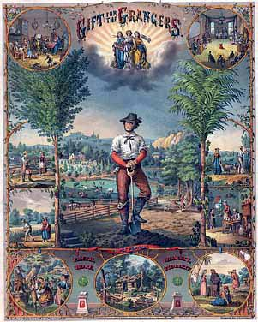
THE GRANGE MOVEMENT

Slide 10
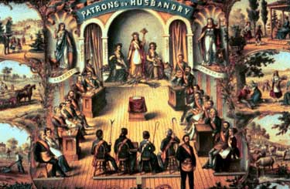
The Grange
Founded in 1867 by Oliver H. Kelley
Officially known as the Order of Patrons of Husbandry
It was primarily a social and educational organizations for farmers and their families.
By 1870 spent most of their time railroads, middlemen and trusts

Slide 11

The Grange
It’s greatest strength was in the Midwest
Established cooperatives- businesses owned by farming
advocated
  Reduced storage rates
  Reduced freight rates
  Improve living conditions for farmers
  Improvement in health and safety conditions

Slide 12
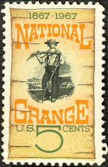
The Grange Movement
Its members called on state governments to establish fair freight rates and warehouse charges.
In several states, the Grange succeeded in having commissions established to investigate – and in some cases, regulate – railroad practices.
Succeeded in the passage of Granger Laws:
  Laws regulating storage and freight rates.
  Some laws made it illegal for railroads to fix prices by means of pools and rebates to privileged customers.

Slide 13
Munn v Illinois
Supreme Court ruling in 1877
upheld the right of state legislatures to regulate railroad rates
after legal victory, the Grange backed away from political activism
improved agricultural conditions in the Midwest caused membership to drop
Wabash v Illinois(1887) ruled the Granger laws unconstitutional

Slide 14
Interstate Commerce Commission
1st government agency created to regulate business
Designed to regulate railroads and commerce

Slide 15
The Farmer’s Revolt
A different kind of uprising was ripening in the South and trans-Mississippi West.
A farmers’ revolt grew in response to falling agricultural prices and growing economic dependency in rural areas.
Small farmers faced increasing economic insecurity.
In the South, the sharecropping system locked millions of farmers, white and black, into perpetual poverty

Slide 16
The Farmer’s Revolt
The glut of cotton on the world market led to declining prices (11 cents a pound in 1881 to 4.6 cents in 1894), throwing millions of small farmers deep into debt and threatening them with the loss of their land
In the West, farmers who had mortgaged their property to purchase seed, fertilizer, and equipment faced the prospect of losing their farms when unable to repay their bank loans

Slide 17
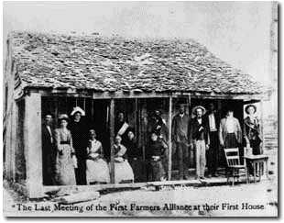
THE FARMERS’ REVOLT

Slide 18
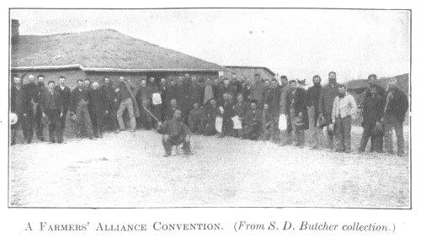
THE FARMERS’ ALLIANCE

Slide 19
The Farmer’s Alliance
Through the Farmers’ Alliance, the largest citizens’ movement in the 19th century, farmers’ sought to remedy their condition.
Founded in TX in the late 1870s, the Alliance spread to 43 states by 1890
At first, the Alliance remained aloof from politics, attempting to improve rural conditions by cooperative financing and marketing of crops.
Alliance “exchanges” would loan money to farmers and sell their
But farmers’ could not finance this plan, and banks refused to extend loans

Slide 20
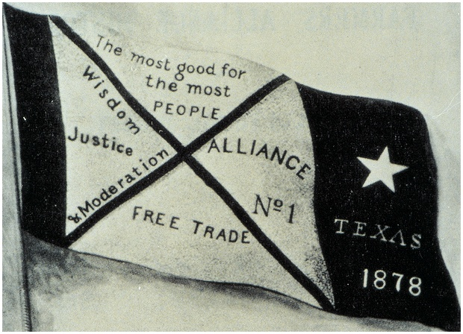
THE FARMERS’ ALLIANCE

Slide 21
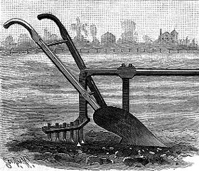
THE PEOPLE’S PARTY

Slide 22
The People’s Party
Took the place of The Grange
Leaders of the farmers organization realized they needed to build a base of political power
  Midwestern farmers formed their own local parties known as "People's Parties"
  Mary Elizabeth Lease was one of the Populist orators who traveled throughout rural America trying to whip up support for pro-farm candidates
The party did not just attract farmers.
It sought to speak for all the “producing classes

Slide 23
Populist Party is Born
Populism – the movement of the people – was born in 1892 with the founding of the Populist, or People’s Party
Influenced the Democrats
Strong support of the farmers
Reform based party, wanted change

Slide 24
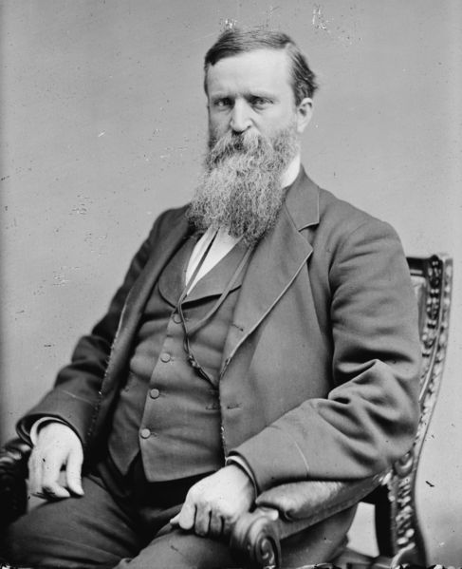
Election of 1892
The Populist Party marked its entrance into national politics in the Election of 1892.
Delegates from several states met in Omaha, Nebraska, in 1892, to draft a political platform and nominate candidates for president and vice president
James Weaver 1st Populist Candidate for President

Slide 25
THE ELECTION OF 1892
The Populist Party marked its entrance into national politics in the Election of 1892.
Delegates from several states met in Omaha, Nebraska, in 1892, to draft a political platform and nominate candidates for president and vice president.

Slide 26
THE OMAHA PLATFORM OF 1892
Provisions/Blanks:
  Direct popular election of US Senators.
  Enact state laws through initiatives and referendums.
  Unlimited coinage of silver (increase $ supply)
  A graduated income tax
  Public ownership of railroads, telegraph, and telephone systems.
  Loans and warehouses for farmers to stabilize prices.
  8 hour work day for industrial workers.
  Secret ballots
  Immigration controls

Slide 27
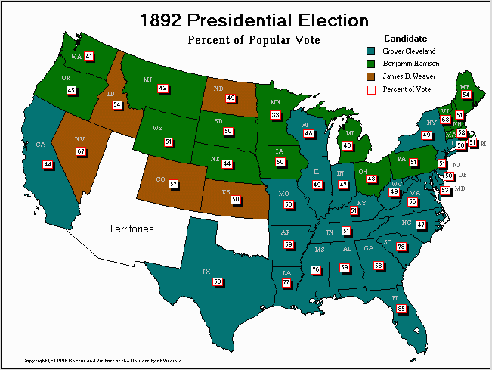
Populist Strength 1892
In the 1892 Presidential election, the Populist candidate won almost 10% of the vote
Weaver received over a million votes.
The party carried 5 Western states.
22 electoral votes.
Elected 3 governors and 15 members of Congress

Slide 28
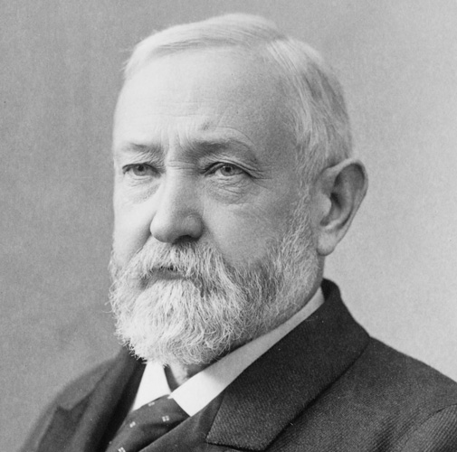
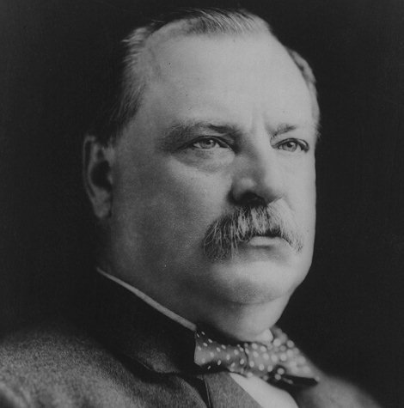
THE ELECTION OF 1892
BENJAMIN HARRISON
GROVER CLEVELAND

Slide 29
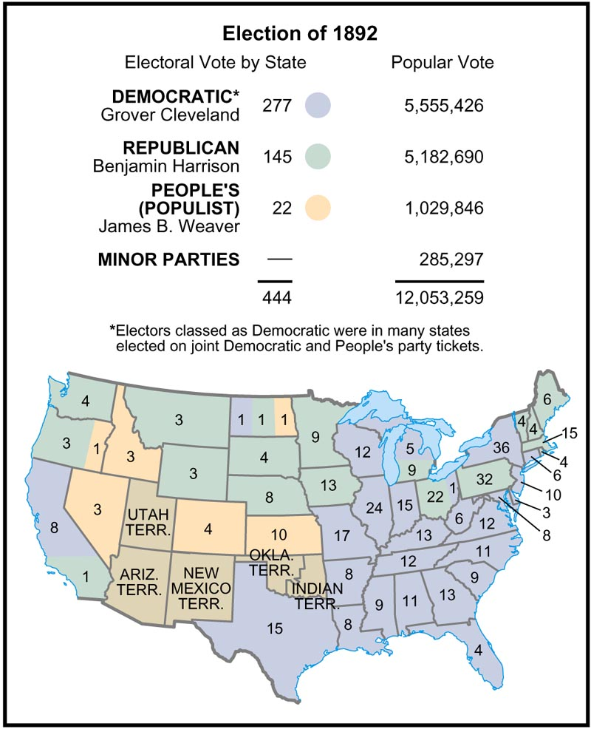
THE ELECTION OF 1892

Slide 30
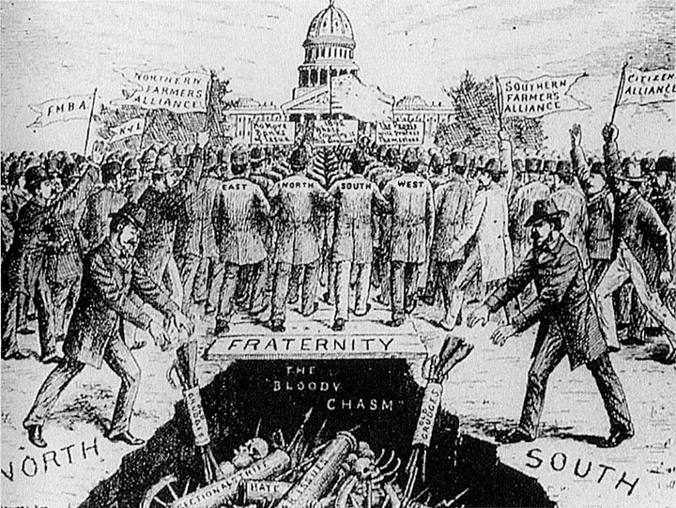
Main Criticisms made by Populists
legal system placed too much emphasis on property rights
monopolies were an economic and social evil
Social Darwinism and laissez-faire were bankrupt ideologies
individuals had been turned into economic commodities
wealth was unevenly distributed

Slide 31
Main criticisms made by Populists:
legal system placed too much emphasis on property rights
monopolies were an economic and social evil
Social Darwinism and laissez-faire were bankrupt ideologies
individuals had been turned into economic commodities
wealth was unevenly distributed
Notes:
The main critiques of the United States which were made by the Populists were:
The American legal system placed too much emphasis on property rights
Monopolies were an economic and social evil
Social Darwinism & laissez-faire were bankrupt ideologies
Industrial society had turned individuals into economic commodities
Wealth was unevenly distributed

Slide 32
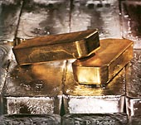
Money Supply
Government policy:
  inflation (silver backed currency) or
  deflation (gold backed currency
  Farmers push to increase the amount of money in circulation
  Support bimetallism both a gold and silver standard

Slide 33
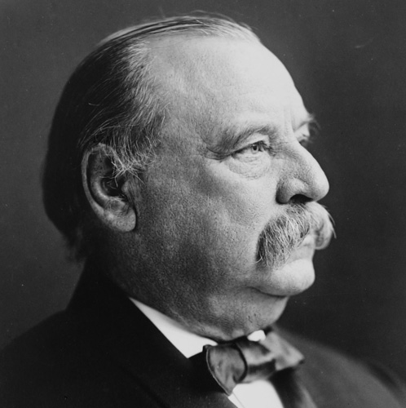
THE CLEVELAND PRESIDENCY

Slide 34
THE CLEVELAND PRESIDENCY
Cleveland won a solid victory in both the popular and electoral vote.
Cleveland became the first and only former president thus far to return to the White House after having left it.
No sooner had Cleveland entered the office than the country entered into one of its worst and longest depressions.

Slide 35
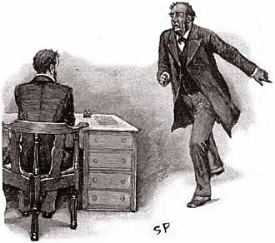
The Panic of 1893
Nationwide economic problems took center stage in America in 1893
Railroads went bankrupt, the stock market lost value, 15,000 businesses and 500 banks collapsed,
3 million people lost their jobs – putting unemployment at 20%

Slide 36
Panic of 1893
Railroad overspeculation
Govt. gold supply depleted, leads to rush on banks
Business, banks collapse
Panic become depression lasted 4 years
J.P. Morgan bails out govt.

Slide 37
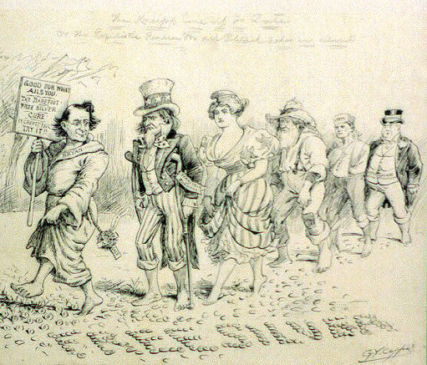
Free Silver Crusade
Panic of 1893
Farmers in deep debt
-nation enters a recession
Farmer’s wanted to inflate the money supply
-farmer’s promote silver and gold standard for currency (bimetallism

Slide 38
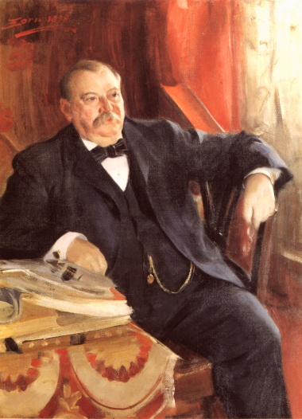
THE PANIC OF 1893
Cleveland, more conservative than he had been in the 1880s, dealt with the crisis by championing the gold standard and otherwise adopting a hands-off policy toward the economy.

Slide 39
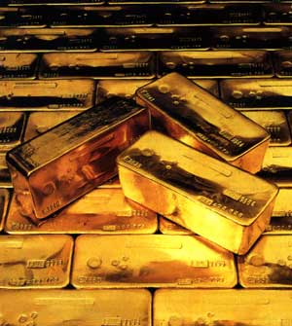
The Gold Reserve
A decline in silver prices encouraged investors to trade their silver dollars for gold dollars.
The gold reserve feel to a dangerously low level.
Pres. Cleveland saw no alternative but to repeal the Sherman Silver Purchase Act of 1890.
This failed to stop the gold drain.

Slide 40
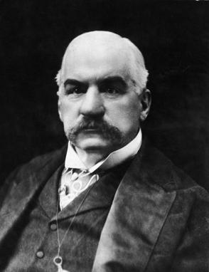
THE GOLD RESERVE AND TARIFF

Slide 41
THE GOLD RESERVE AND TARIFF
This deal convinced many Americans that the government in Washington was only a tool of rich eastern bankers.
Workers became further disenchanted with Cleveland when he used court injunctions to crush the Pullman Strike of 1894.

Slide 42
WILSON-GORMAN TARIFF
The Democrats did enact one measure that was somewhat popular.
The Tariff: (1) provided a moderate reduction in the tariff rates and (2) included a 2% income tax on incomes of more than $2,000.
Within a year after passage, the Supreme Court declared an income tax unconstitutional.

Slide 43
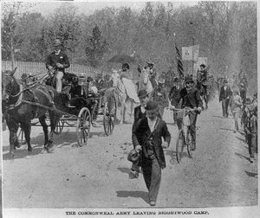
Coxey’s Army
Jobless march on Washington D.C.
Led by Jacob Coxey
Upset over President Cleveland’s handling of Panic of 1893
Demanded a public works programs to give people jobs
Protestors were arrested for walking on the grass

Slide 44
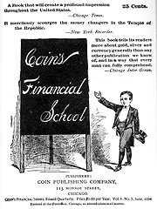
COIN’S FINANCIAL SCHOOL
Book written in 1894 by William H. Harvey.
Seemed to offer easy answers for ending the depression.
Taught millions of Americans that their troubles were caused by a conspiracy of rich bankers.
Prosperity would return if only the govt., coined silver in unlimited quantities

Slide 45
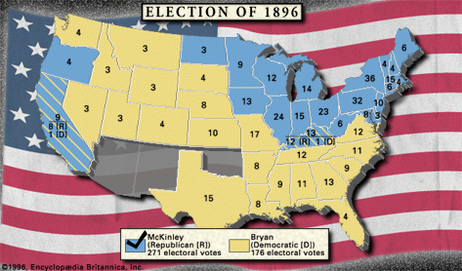
THE ELECTION OF 1896 AND THE END OF POPULISM

Slide 46
THE ELECTION OF 1896 AND THE END OF POPULISM
The Election of 1896 was one of the most emotional in U.S. history.
Cleveland’s handling of the depression thoroughly discredited the Democrats.
The Republicans buried the Democrats in the congressional elections of 1894.
The Populists continued to gain both votes and legislative seats.
The stage was set for a major reshaping of party politics in 1896.

Slide 47

Silver or Gold ?
The central issue of the 1896 Presidential campaign was which metal would be the basis of the nation’s monetary system
Bimetallism (those who favored using both) vs. those that favored the Gold Standards alone

Slide 48
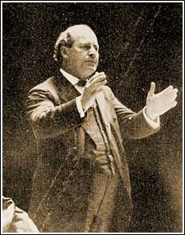
Populist Back Bryan
Many Populists were initially cool to Bryan’s campaign.
Their party had been defrauded many times by the Democrats in the South.
Veteran Populists feared that their broad program was in danger of being reduced to “free silver.”
But realizing that they could not secure victory alone, the party leaders endorsed Bryan

Slide 49
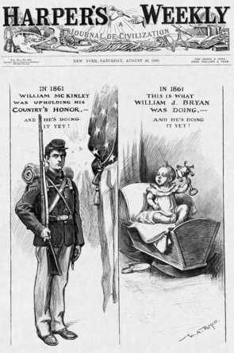
The Campaign
This election is sometimes called the first modern presidential campaign because of the money spent by the Republicans and the efficiency of their national organization.
McKinley’s campaign raised some $10 million.
Bryan’s campaign raised around $300,000.
McKinley remained at home – “the front porch” campaign.
Bryan embarked on a nation wide speaking tour.

Slide 50
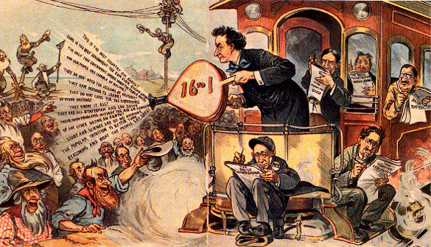
Bryan: The Farmers Friend
(The Mint Ratio)
18,000 miles of campaign “whistle stops.”

Slide 51
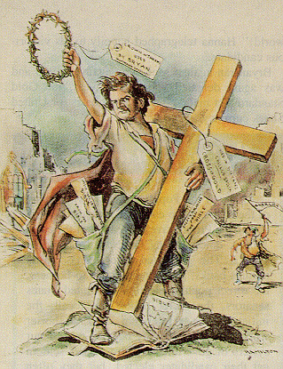
BRYAN AND THE
“CROSS OF GOLD”
Republicans favored the Gold standard and nominated William McKinley
Democrats favored Bimetallism and nominated William Jennings Bryan
Despite Bryan’s stirring words, “You shall not crucify mankind upon a cross of gold,” McKinley won the 1896 election
BRYAN’S CROSS OF GOLD SPEECH

Slide 52
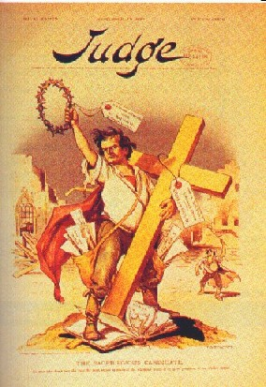
“We reply that the great cities rest upon our broad and fertile prairies. Burn down your cities and leave our farms, and your cities will spring up again as if by magic; destroy our farms and the grass will grow in the streets of every city in the country…”
“Having behind us the producing mass of this nation…we answer their demand for a gold standard by saying to them: You shall not press down upon the brow of labor this crown of thorns, you shall not crucify man upon a cross of Gold.”
William Jennings Bryan, Democratic Convention Speech, 1896

Slide 53
McKinley Wins
The results revealed a nation as divided along regional lines as in 1860.
Bryan carried the South and West and received 6.5 million votes.
McKinley swept the more populous industrial states of the Northeast and Midwest.
He received 7.1 votes.
His electoral margin was 271 to 176.

Slide 54
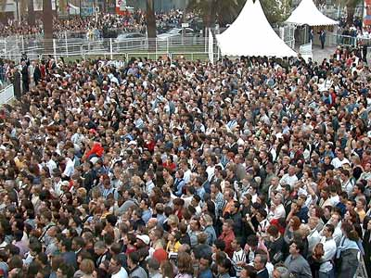
The End of Populism
With McKinley’s election victory, Populism collapsed, burying the hopes of the farmer
Many of the more liberal/progressive ideas of the Populist were absorbed by the two major parties

Slide 55
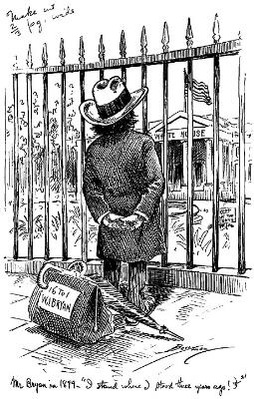
William Jennings Bryan standing outside the White House after losing the Presidential election to William McKinley. Although he won many votes, Populism eventually dies out.

Slide 56
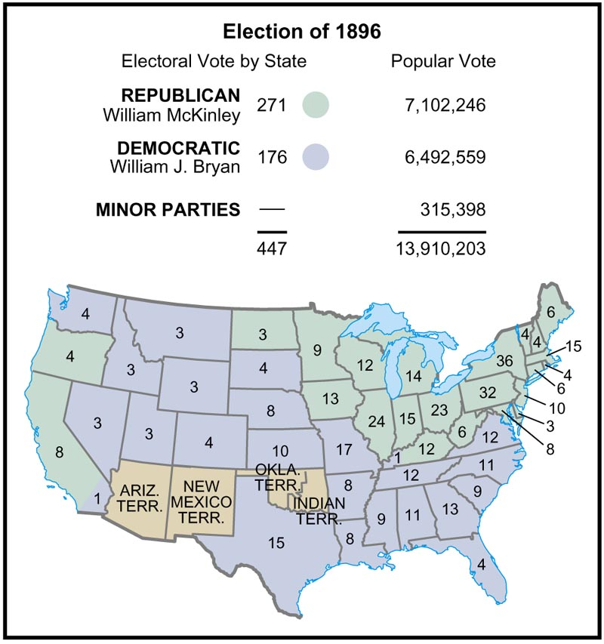

Slide 57
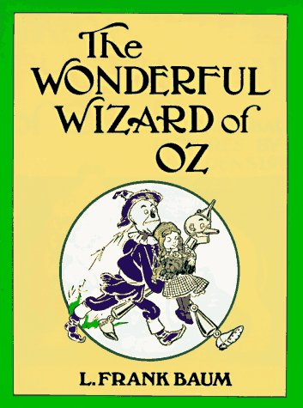
THE WONDERFUL WIZARD OF OZ AND THE ELECTION OF 1896

Slide 58
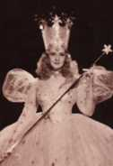
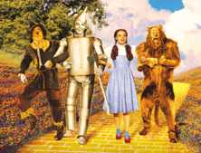


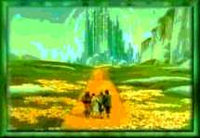
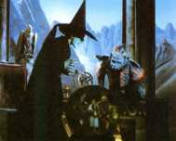
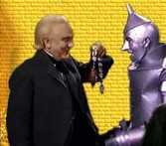
1964: Henry Littlefield’s
“Thesis”?

Slide 59
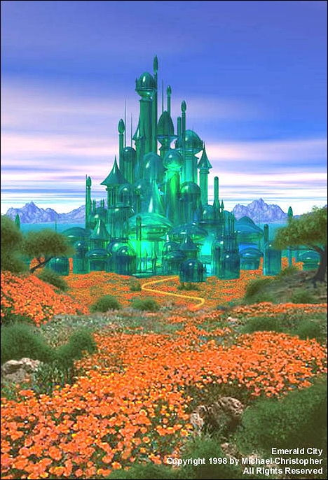
THE WIZARD OF OZ
The Emerald City, where everything is colored green, represents Washington, D.C.

Slide 60
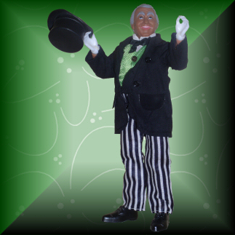
THE WIZARD OF OZ
The Wizard of Oz, who remains invisible, represents President William McKinley.

Slide 61
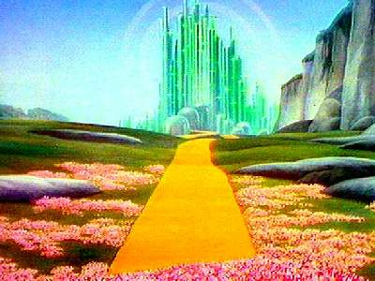
THE WIZARD OF OZ
The only way to get to the Emerald City is via a Yellow Brick Road, the color of gold.

Slide 62
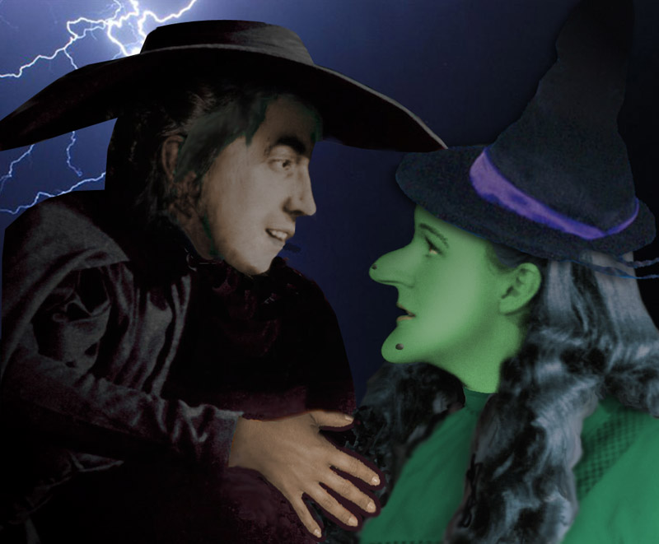
THE WIZARD OF OZ
The Wicked Witches of the East and West represent oppressive industrialists and mine owners.

Slide 63
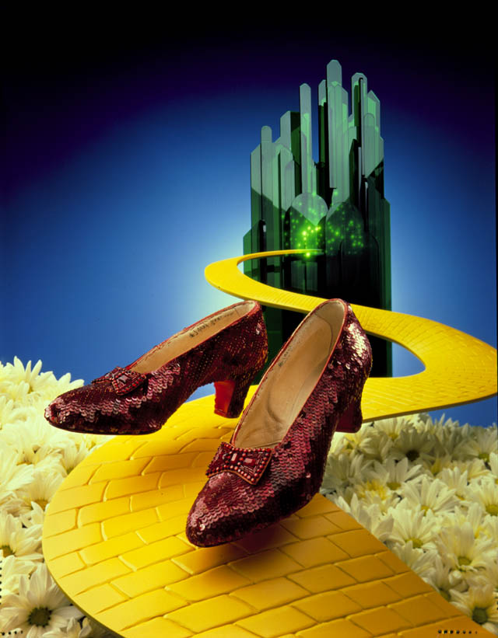
THE WIZARD OF OZ
In the much-beloved film version made in the 1930s, Dorothy, the all-American girl from the heartland of Kansas, wears ruby slippers.
But in the book, her slippers are silver, supposedly representing the money preferred by ordinary people.

Slide 64
“Parable of the Populists”?
Tornado → Dorothy’s inner rage (also her last name….?)
Dorothy → everyman of the west/pure
Toto → teetotalers or prohibitionists who were allies of the populists
Kansas → Kansas was a stronghold of populism
Wicked Witch of the
East → wealth of the East
Tin Woodsman → labor victimized by wicked witch of East
Scarecrow → midwestern farmers (seen as stupid but actually has wisdom)
Cowardly Lion → William J. Bryan (big roar- no bite)
Yellow Brick Road → gold standard

Slide 65
“Parable of the Populists”?
Silver Slippers → soft money (nobody really knows how to use their power)
Emerald City → Washington D.C.
Oz → ounce of gold or silver
The Wizard → President
Munchkins → simpleminded people in the East who didn’t understand how the wizard worked
Wicked Witch of the West → Harsh frontier environment
Flying Monkeys → Indians subdued by wicked witch
Yellow Winkies → reference to the capture of the Philippines and refusal to grant them freedom
March to Oz- Coxey’s Army

