Slide 1
Cask of Amontillado
Mood and Irony

Slide 2
Fictional Elements
We will read several stories in this unit and focus on different elements of fiction for each one. For “Cask of Amontillado,” we will study Mood and Irony.
Characters
Setting
Plot
Conflict
Theme
Point of View
Mood
Irony

Slide 3
Allan Parsons Project Song
“The Cask of Amontillado”
By the last breath of the four winds that blow
I’ll have revenge upon Fortunato
Smile in his face I’ll say “come let us go
I’ve a cask of Amontillado”
Sheltered inside from the cold of the snow
Follow me now to the vault down below
Drinking the wine as we laugh at the time
Which is passing incredibly slow
What are these chains that are binding my arms?
Part of you dies each passing day
Say it’s a game and I’ll come to no harm
You’ll feel your life slipping away
You who are rich and whose troubles are few
May come around to see my point of view
What price the Crown of a King on his throne
When you’re chained in the dark all alone
Spare me my life only name your reward
Part of you dies each brick I lay
Bring back some light in the name of the Lord
You’ll feel your mind slipping away
This song is titled after the Poe story we are about to read. Read lyrics while we listen to song. Based on the lyrics, write a paragraph predicting what will happen in the story. Refer to lyrics when writing prediction.

Slide 4
A Poison Tree By: William Blake
I was angry with my friend;
I told my wrath, my wrath did end.
I was angry with my foe;
I told it not, my wrath did grow.
And I watered it in fears,
Night and morning with my tears;
And sunned it with smiles,
And soft, deceitful wiles.
And it grew both day and night,
Till it bore an apple bright;
And my foe beheld it shine,
And he knew it was mine.
And into my garden stole.
When the night had veiled the pole
In the morning glad I see
My foe outstretched beneath the tree.
Think of a time when you wanted to get back at someone. What did that person do to make you want revenge?
Write a paragraph about that time.
Connection: “Cask of Amontillado” is a story of revenge

Slide 5
Behind the Story
Poe had a real fear of being buried alive
After reading Poe’s work, a Russian inventor created a device that allowed “deceased” to ring a bell so that live people above ground would know the buried person was not really dead
Think about this as we read “Cask of Amontillado”

Slide 6
Mood
Emotion evoked in the reader by a piece of writing
Mood can be identified by descriptive details author uses
Example-We walked down the hallway (shows no mood)
We crept down the long, dark hallway (you can identify the suspenseful mood by the vivid verb crept and the descriptive details long and dark)

Slide 7
Mood Words List
(Starter List-Can you think of more??)
POSITIVE MOOD WORDS
Playful
Tender
Enlightened
Optimistic
Light-Hearted
Warm
Hopeful
Nostalgic
Peaceful
Welcoming
Harmonious
Vivacious
Confident
Idyllic
Joyous
Dignified
Ecstatic
Empowered
NEGATIVE MOOD WORDS
Tense
Gloomy
Violent
Insidious
Pessimistic
Confining
Cold
Hopeless
Haunting
Nightmarish
Hostile
Suspenseful
Foreboding
Threatening
Desolate
Merciless
Terrifying
Vengeful
While reading Poe’ “Cask of Amontillado,” write down words/phrases that create mood (and label with a mood word)

Slide 8
IRONY
  The result of a contrast between appearance or expectation and reality
*Hiding what is actually the case to achieve special, artistic effects

Slide 9
Verbal Irony
Words are used to suggest opposite of what is meant
Example- Someone says, “Don’t be nervous; it’s only the most important test of your life.”

Slide 10
Dramatic Irony
Example-A boy tells his mother he is late because he was at a friend’s house. The audience knows that the mother talked to friend’s mother and knows son was not there.
What appears to be true to a character is not what the reader or audience knows to be true

Slide 11
Situational Irony
Example-A story has a mouse chasing a cat
Expectations are a cat chasing a mouse
An event occurs that goes against expectations that have been built up

Slide 12
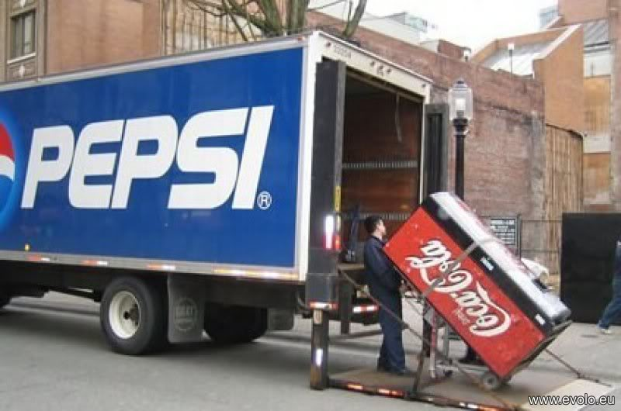
Explain the irony
Turn to your elbow partner and discuss the irony of the following images (over the next seven slides)

Slide 13
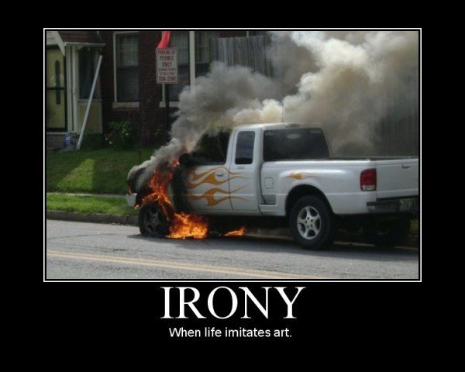
Explain the irony (cont’d)

Slide 14
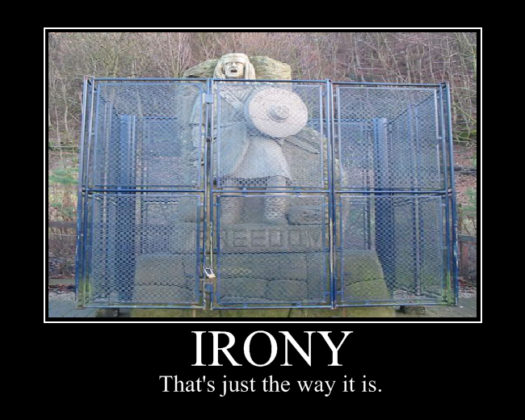
Explain the irony (cont’d)

Slide 15

Explain the irony (cont’d)

Slide 16
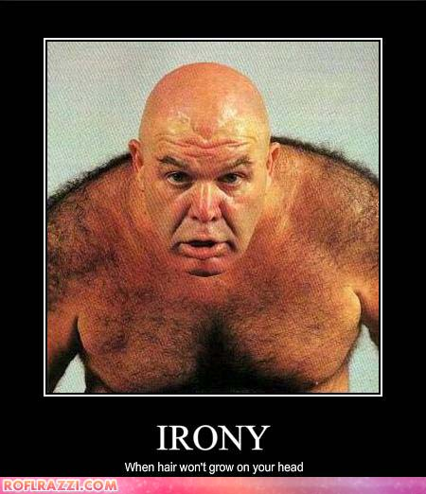
Explain the irony (cont’d)

Slide 17
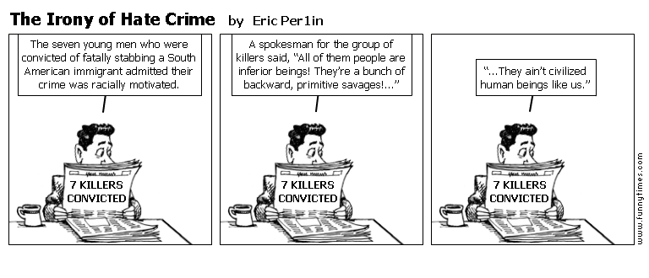
Explain the irony (cont’d)

Slide 18
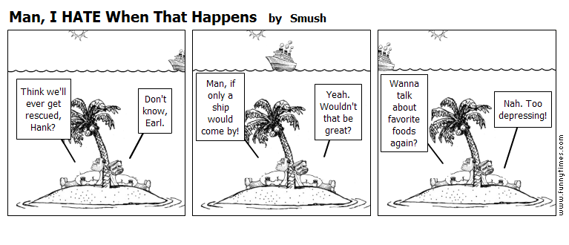
Explain the irony (cont’d)

Slide 19
“Cask of Amontillado”
Irony Example
“’I drink to the buried that repose around us,” says Fortunato. “And I to your long life,” Montresor replies.”
Montresor is not really drinking to Fortunato’s long life; he is playing on the fact that he will soon kill Fortunato.
What type of irony is this?

Slide 20
Irony Practice
Find three more examples of irony from “The Cask of Amontillado.”
Create a 4-columned chart that has the following information:
    Quote
    Paraphrase
    Explanation of how quote shows irony
    Label type of irony (verbal, dramatic, or situational)

