Slide 1
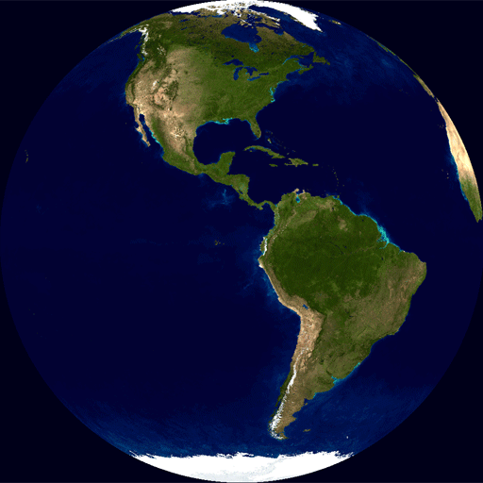
Planetary Motion

Slide 2
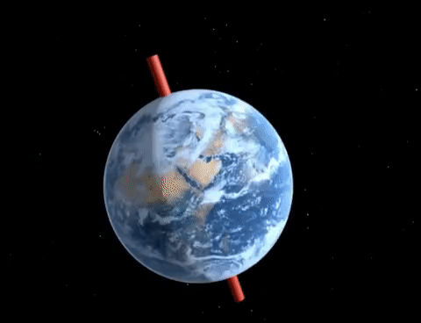
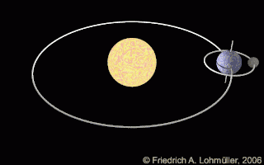
Planetary Motion
Earth’s Motion around The Sun
Each planet spins on its axis. The spinning of a body, such as a planet, on its axis is called rotation ( Earth spins at 1,038 miles per hour!).
The path that a body follows as it travels around another body in space is called the orbit.
One complete trip along an orbit is called a revolution. (Earth moves at 67,000 mph!)

Slide 3
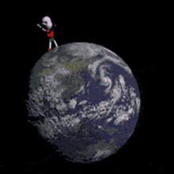
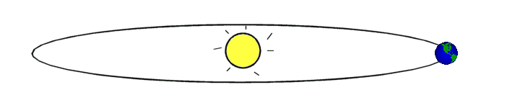
Days and Seasons on Earth
It takes the Earth one year or 365 ¼ days, for the Earth to revolve once around the sun.
The Earth revolves around the sun in an ellipse, or an elongated circle.
The Earth takes 23 hours and 56 minutes to rotate once on its axis.
A day is the time required for the Earth to rotate once on its axis.

Slide 4
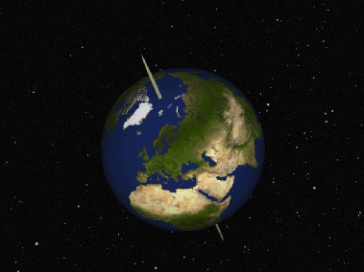
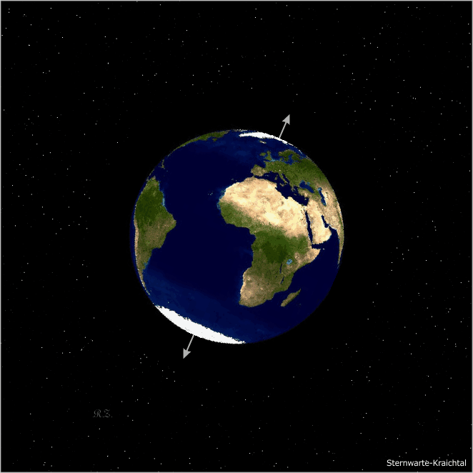
Days and Seasons
The Earth’s rotation causes day and night.
The seasons are caused by the 23.5˚ tilt of the Earth’s axis.
During the summer months, the Northern Hemisphere has warmer temperatures and longer days because it is tilted towards the sun.
During the winter months, the Northern Hemisphere has colder temperatures and shorter days because it is tilted away from the sun.

Slide 5
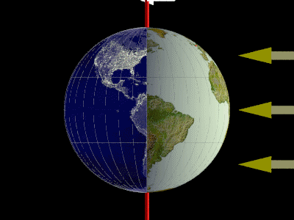
Days and Seasons
The time when the sun is directly above the equator is called equinox.
At the equinoxes, the number of daylight hours equals the number of nighttime hours (12 and 12).
The months of March 20-21 and September 22-23 are the equinoxes.

Slide 6
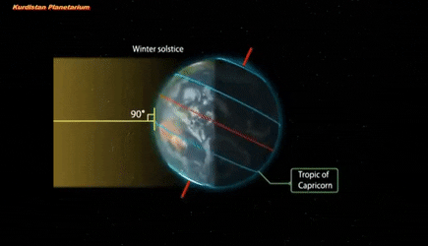
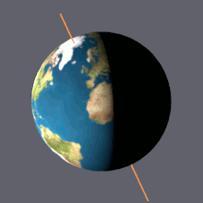

Days and Seasons
A solstice is the time when the sun is farthest north or south of the equator.
The months of June 20-22 (most amount of daylight ) and December 21-22 (least amount of daylight) are the solstices.
The temperature and amount of daylight stays about the same all year at the equator.
WINTER
SUMMER

Slide 7
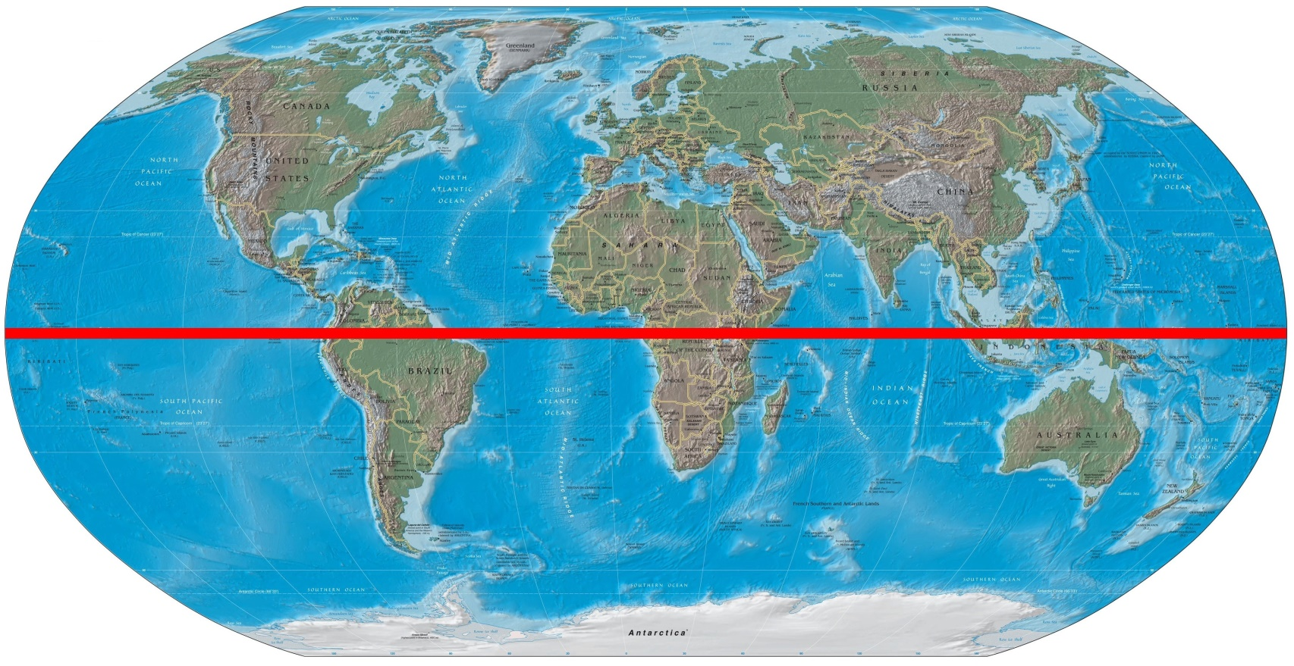
Where Are We Located?
Concord, North Carolina, is located 35⁰ north of the equator.
Therefore, we live in Earth’s Northern Hemisphere.

