Slide 1
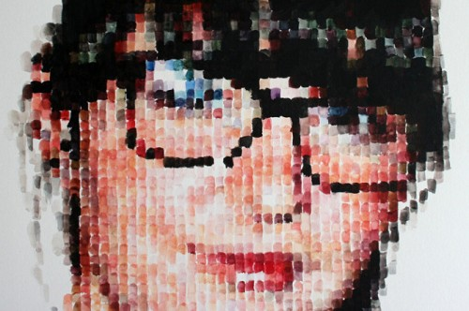
Art II: Pixel Paintings
Objective: Students will create an enlarged pixelated painting, using acrylic .

Slide 2
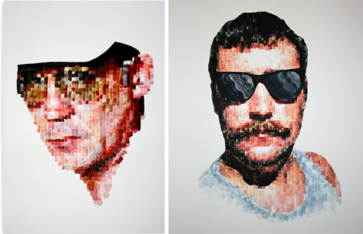

Slide 3
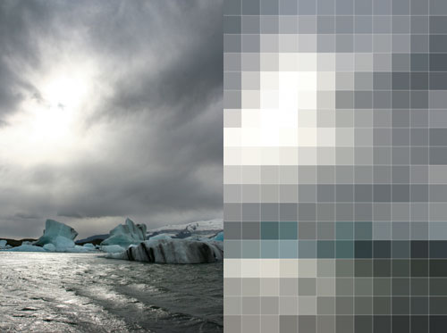
Problem base learning: How do you get from an image on the left, to the creation on the right?
Keep in mind your references will be no larger than 8”x10” and paintings should be much larger. How is this done?
Consider your storage space before you go too big though…

Slide 4
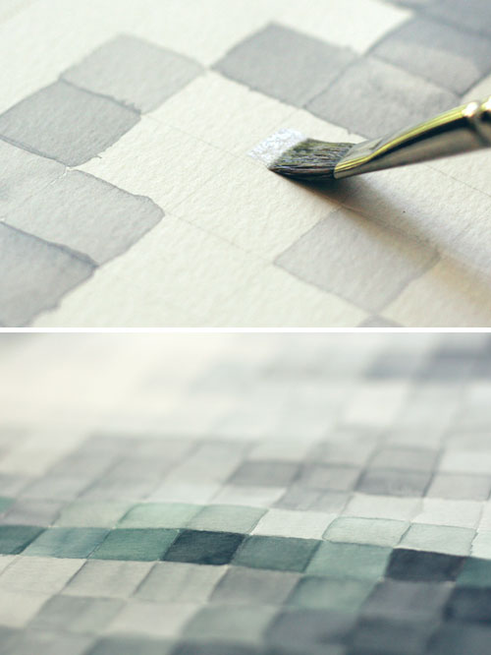
Things to keep in mind…
A ruler will obviously be your friend to create precise guide lines.
Make your lines very light, not dark, to ensure they will not be visible in your final.
PBL….how do you ensure perfectly parallel lines?

Slide 5

Any idea who I am? Does this make me original?

Slide 6
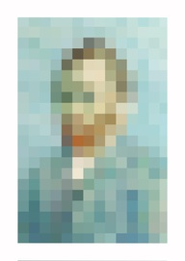
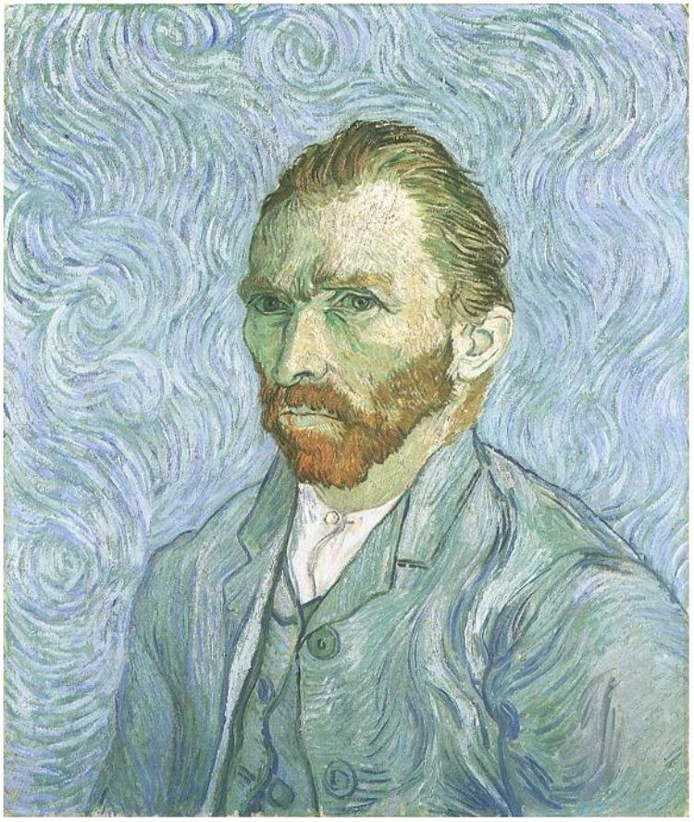

Slide 7
How to begin…
Aspiring AP Art students, make certain it is an original!
Decide among a chosen landscape, seascape or portrait (either you or someone else)
Make sure your image is in color!!
Email a large copy to me
jessica.floeter@cabarrus.k12.nc.us

Slide 8
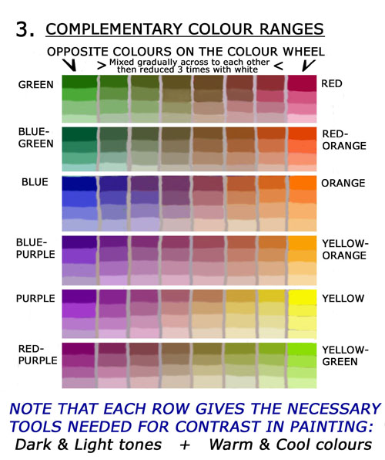
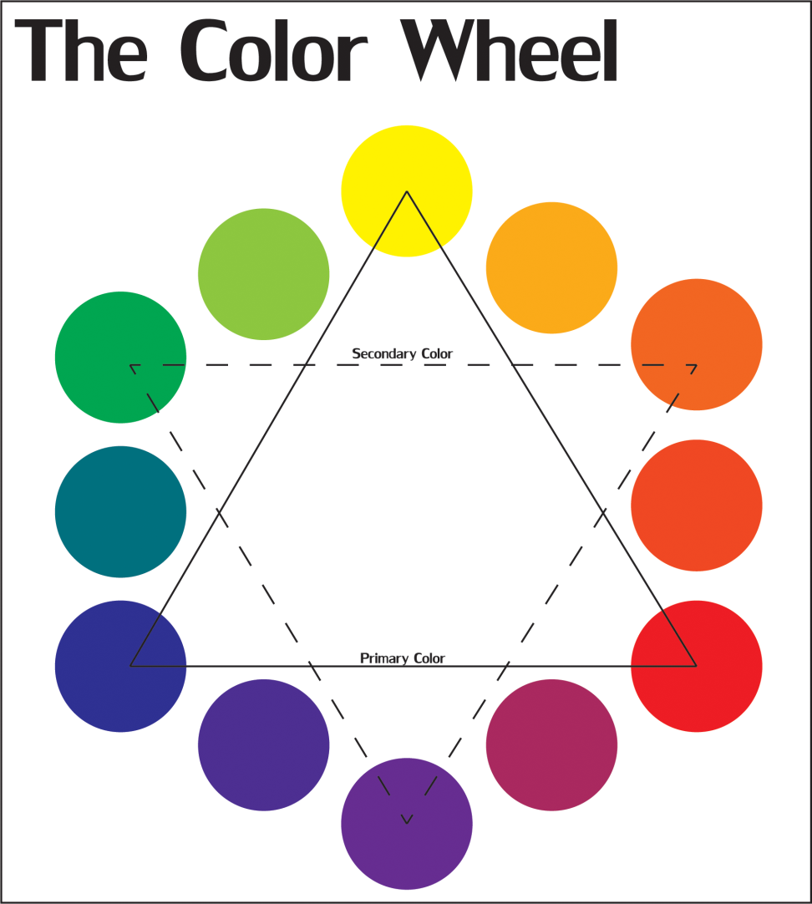
How important is this?

Slide 9
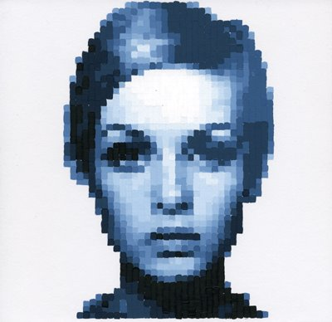

Slide 10
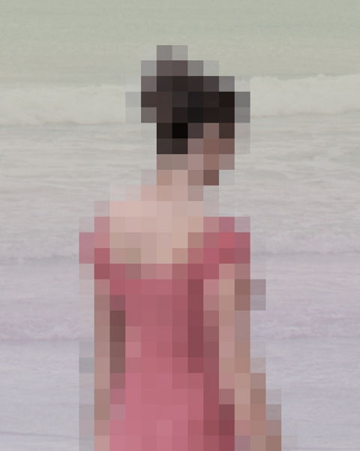
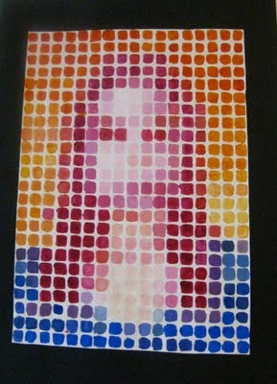

Slide 11
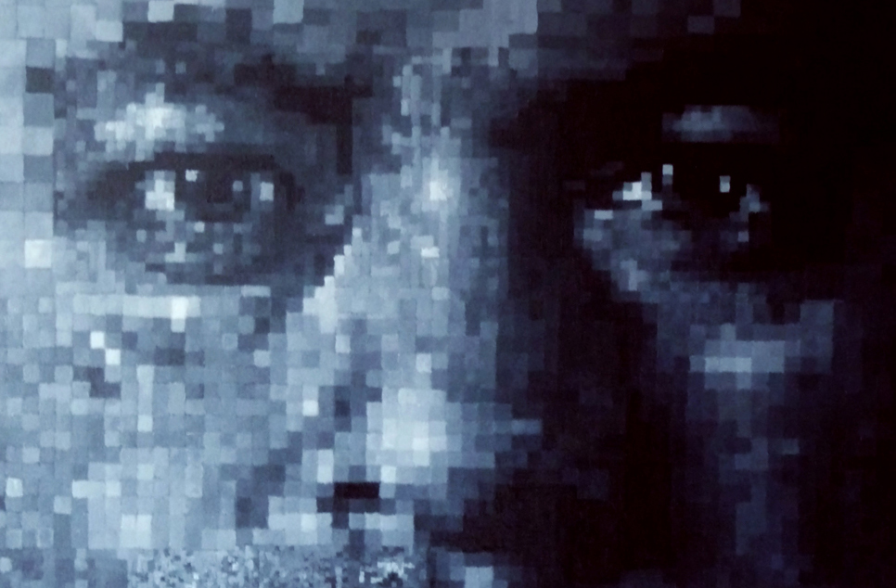

Slide 12
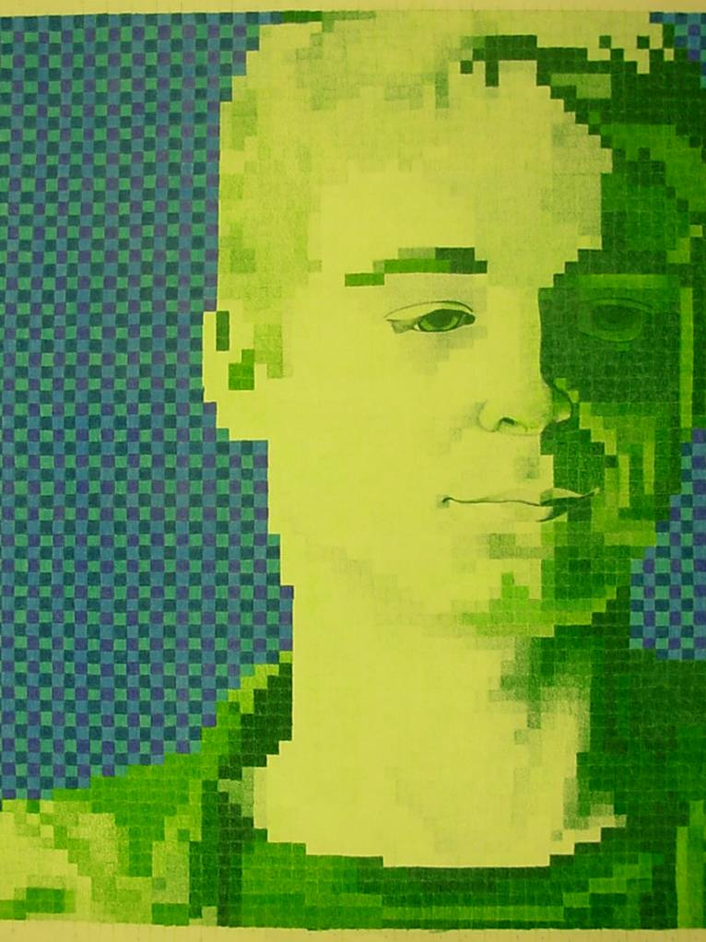

Slide 13
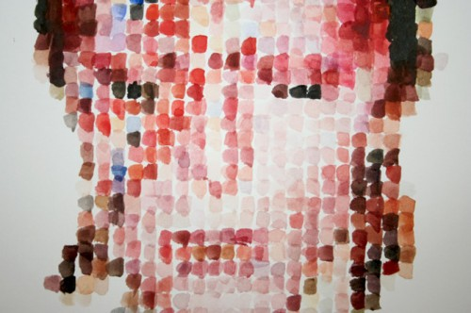
What are some things this artist could improve and should consider in his or her creation process?

