Slide 1
Mrs. Dixon’s Parent Handbook
2017-2018 School Year

Slide 2
About The teacher
Welcome to Kindergarten! I am very excited to teach your little one this year! This will be my third year teaching kindergarten in Cabarrus County, and my second year teaching at Odell. I am homegrown and completed all of my schooling in Cabarrus County. I even went to Odell as a child! I am the youngest of six children in a family originally from Pittsburgh who are all die hard Steelers fans. I just got married this past June and was known as Ms. Heslop last year. I graduated from UNCC earning my bachelors in Elementary Education with a minor in Visual and Performing Arts. I absolutely love Disney, reading, baking, and spending time with my husband and sweet rescue dog Nala. I can’t wait to get to know you and your child this school year!
https://www.youtube.com/watch?v=RwlhUcSGqgs

Slide 3
How to contact the teacher
After school hours…
By email: kelsey.heslop@cabarrus.k12.nc.us
All emails received before 8 pm will be answered the same day
I do not generally check email on the weekends
During school…
I can answer emails during my planning time from 10:35 to 11:20, otherwise I do not check my email during school hours
If you have an urgent message for me, such as a transportation change, please call the office and ask them to give me the message. They will call into my classroom and give me the message.

Slide 4
Class schedule
8:30-8:15 Attendance
8:30-8:50 Dragon Time/Enrichment Time
8:55-10:30 Literacy
10:35-11:20 Encore
11:20-12:00 Science/Social Studies
12:00-12:30 Writing
12:40-1:10 Lunch
1:15-2:15 Math
2:20-2:50 Recess

Slide 5
Encore rotation
Day 1 PE (Please wear tennis shoes!)
Day 2 Art
Day 3 Makerspace/Technology
Day 4 Chinese
Day 5 Library
Day 6 Music

Slide 6
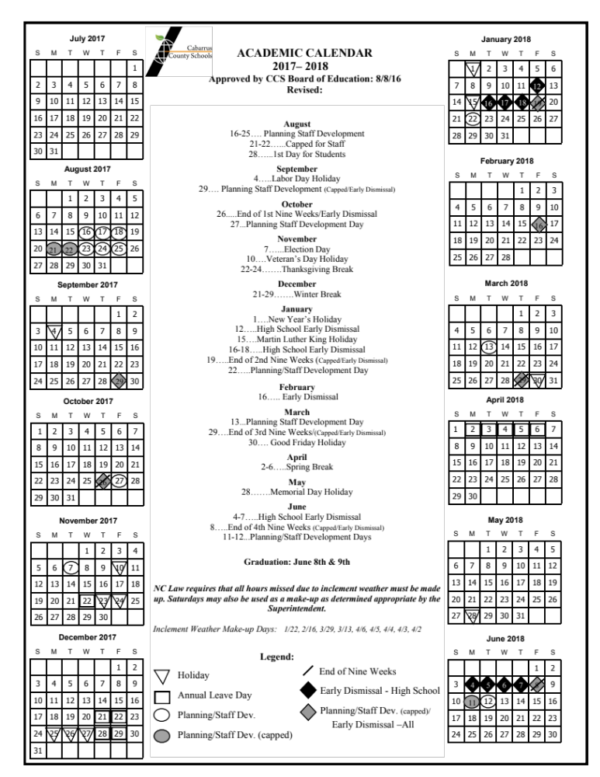
2017-2018 Calendar https://www.cabarrus.k12.nc.us/cms/lib/NC01910456/Centricity/Domain/337/CCS_ACADEMIC_CALENDAR_2017-18.pdf

Slide 7
School hours
-8:15-3:00
-Students may arrive starting at 7:50

Slide 8
Attendance and Absences
If your child is absent, please send a note explaining the reason for their absence upon their return. If your child was sick and visited the doctor, please include a doctors note. The following is the list of valid reasons for an excused absence:
1. Illness or injury
2. Isolation ordered by the State Board of Health
3. Death in the immediate family
4. Medical or dental appointment
5. Participation under subpoena as a witness in a court proceeding
6. Observance of an event required or suggested by the religion of the student or parents.
7. Educational opportunity with prior principal approval
8. Deployment activities (children of military families)

Slide 9
At the elementary level, an accumulation of 10 absences per semester or 20 per year is considered excessive.
If your child has excessive absences…
-Parent/guardian will receive written notification when a student accumulates 6 unexcused absences
-Parent/guardian will be invited to conference with the social worker and principal at 10 unexcused absences
-Absences due to extended, ongoing illnesses will need a statement from a physician

Slide 10
Tardies and early checkouts
-An accumulation of 10 tardies and early checkouts (or a combination of) per semester is considered excessive at the elementary level.
Steps taken with excessive tardies/early checkouts…
-5-teacher contact
7-Administrator/designee contact with parent to problem solve
-10-Student not elligible for perfect attendance, begins make up time, make up time continues for each additional tardy/early checkout during the semester, admin has discretion to impose additional consequences and refer for additional services.
-Information from the last 3 slides was taken directly from CCS attendance policy.
Kindergarten is fun but we learn a lot! Please make every effort to have your child at school and on time as much as possible so they don’t miss out on fun and learning! ☺

Slide 11
Breakfast, Lunch, and snack
Breakfast:
Offered daily in the cafeteria
$1.15 a day
Students come and check into the classroom/unpack, and then are dismissed to the cafeteria.
Lunch:
We will go to lunch at 12:40
Daily lunch cost is $2.55
You can send in money with your child or add money to your child’s account by visiting this link https://www.k12paymentcenter.com/
You can eat with your child at any time and do not need to inform me ahead of time. If you plan to eat with your child please meet us in the cafeteria. You will sit at a separate table next to the stage
Snack:
We will have snack in the classroom daily.
You are responsible for sending snack with your child on a daily basis.
Please send healthy items for snack, and avoid things such as chips, cookies, or candy. It is hard to learn on a sugar high!
I do have extra snack in the classroom in case you forget, but please do not make this a habit as I purchase the extra snack with my own money.
If you would like to send in some extra snack it is greatly appreciated!

Slide 12
Homework
There will be 2 components to nightly homework:
1. Reading on RAZ Kids-After the beginning of year reading assessment has been completed, I will send home a letter containing your child’s log in information for RAZ Kids. They can use this to read books on their level electronically as well as answer comprehension questions. This is expected to be done nightly.
2. Weekly sight words- Each week I will send home a half sheet of paper with sight words. You can cut these out as flash cards and keep them at home for practice. Please practice nightly! I will begin sending home sight words on Tuesday, September 5th.

Slide 13
Birthdays
On your child’s birthday we will work as a class to make them a special book. They will also receive a birthday crown.
If you would like to send in cupcakes or cookies you are welcome to do so as well as come visit at lunch! Please bring only store bought items in the original container so that ingredients can be seen.
Please do not send birthday party invitations to school for your child or I to pass out. I am not allowed to pass out invitations at school or allow your child to do so.
Please do not send in treat bags for your child’s birthday. I am not allowed to pass them out and they will be sent home.
Please do not bring party items, balloons, candles, or presents to school on your child’s birthday.

Slide 14
Toys at school
Toys are not allowed to come to school unless your child has show and tell. If your child has show and tell I will inform you ahead of time. If your child brings out a toy in the classroom I will keep it in the classroom and you will need to come pick it up. This is to ensure they do not lose or damage it on the bus or in the car rider line.

Slide 15
Scholastic book order
-Each month I will send home an order form for the Scholastic Book Club. On the form there will be a URL to the website as well as our class code so that you can place your order online. You can also mark the items you want on the back of the form and send in cash. Please make your online order or send in your money before the due date also listed on the order form.
-This is completely optional, however when orders are made the class receives points that I can spend to buy items for our classroom!

Slide 16
transportation changes
-If you have prior knowledge that your child will go home a different way than normal please send a WRITTEN NOTE with your child on the day that the change will occur. Please do not send an email as there is a chance I will not see it.
-If you have an emergency transportation change please call the office and inform them, they will intercom into the classroom and inform me or find me on a walkie talkie. This ensures that I will receive the message. Please do not email or call my class phone as there is a chance I will not receive the message.

Slide 17
Volunteers
I would love to have you come in and volunteer throughout the school year. If you are interested in helping with crafts, parties, or coming regularly to help with clerical work, please let me know. In order to be a volunteer you need to go through a process with the county. You can get started by visiting this link https://www.cabarrus.k12.nc.us/Page/3767

Slide 18
Money
-Send all money to school in your child’s money envelope that should stay in their communication folder.
-Be sure to designate what the money is for.
-If the envelope is not in your child’s folder I will not see it. I do not go through book bags!

Slide 19
Supply Fee
$10.00
pay online
check to WR Odell Primary
cash

Slide 20
Class Shirt
$5.35
pay online
check to WR Odell Primary
cash correct change please
due September 6th

Slide 21
Weekly Newsletter
-I will send a weekly newsletter on Fridays to your e-mail called Smores with important information. Please read the Smores weekly and contact me if you have any questions or concerns.

Slide 22
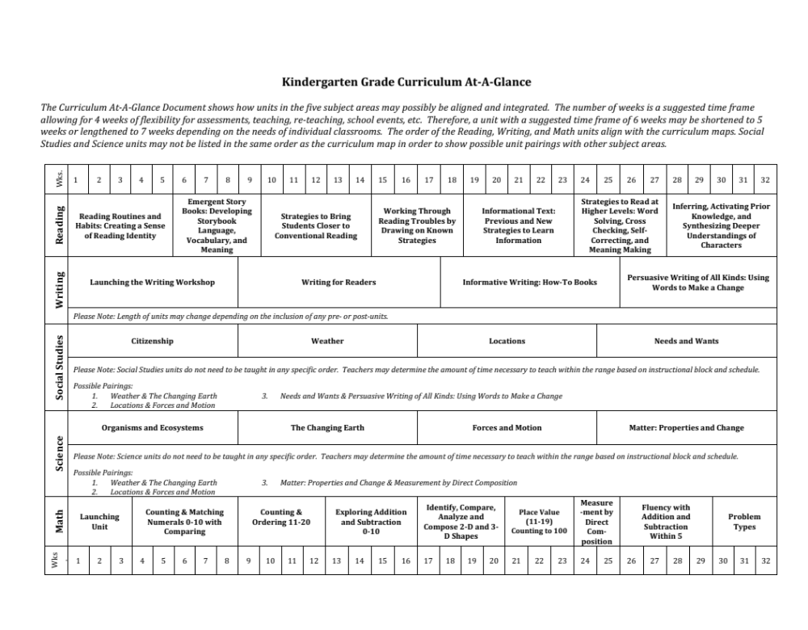
Kindergarten Curriculum https://www.cabarrus.k12.nc.us/cms/lib/NC01910456/Centricity/domain/527/curriculum/curriculum%20at%20a%20glance/Knd%20Grade%20Curriculum%20At-a-Glance.pdf

Slide 23
School rules
-Be safe
-Be respectful
-Be responsible

Slide 24
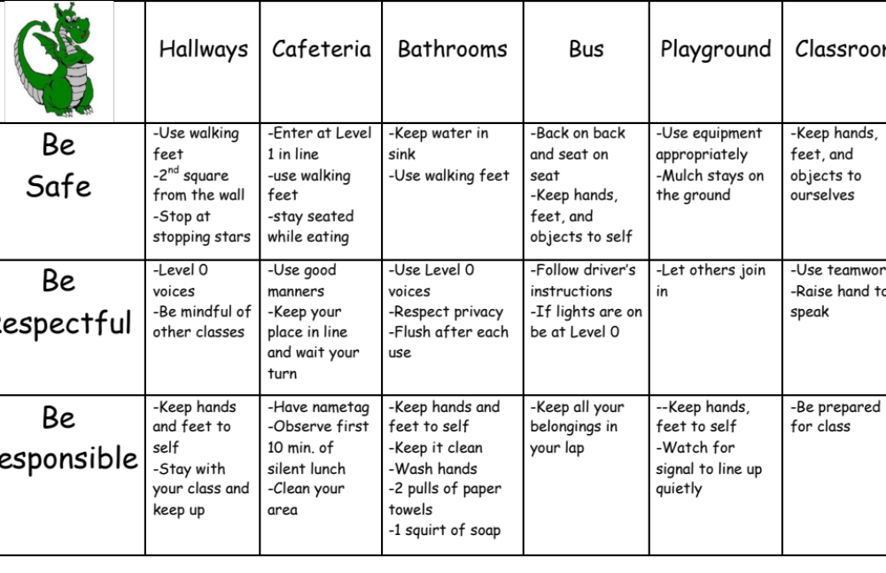

Slide 25
Pockets
Students will have an empty pocket each morning.
If a student breaks a rule they will put the corresponding color card in their pocket. At the end of the day students will check their pockets and put a color dot for each pulled card on their Behavior Calendar in their folder.
If a student has an empty pocket they will get to put a smile on their calendar.
Please check your child’s Behavior Calendar daily and reward them for great behavior.
Please initial each day to verify that you’ve seen their behavior calendar.

Slide 26
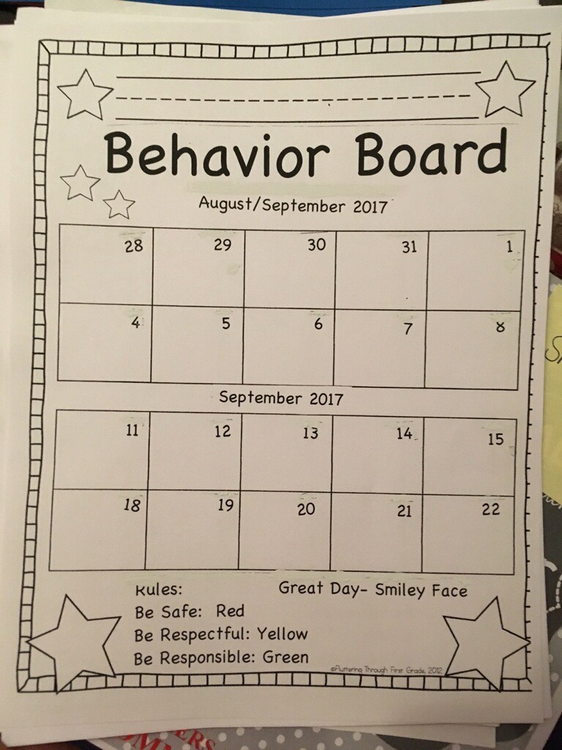

Slide 27
Uh Oh Clothes
Please be sure to send in a change of clothes in a ziplock bag for your child to keep in their cubby just in case of emergency. Unfortunately I do not have extra clothes in the classroom other than some shirts so this is very important. Please remember to send in fresh clothes if we do need to use the originals.

Slide 28
Technology
Dreambox - https://play.dreambox.com/login/9ukn/wroe
I-Ready - https://login.i-ready.com/
Students are expected to have 45 minutes of iReady time a week as well as 45 minutes of Dreambox time a week. Students can move at their own pace and are certainly welcome to do these at home. This is a great alternative to mindless iPad time!

Slide 29
Thank you!
I will upload this file to my class page so that you can review it at any time! ☺

