Slide 1

PARENT
MEETING
MARCH 19, 2019
6:00 PM
Cafeteria

Slide 2
8th Grade Trip
To Our Nation’s Capitol
Washington, D.C.

Slide 3
Meet the Nurse!
Ms. Bridgett Phillips, R.N.
If you have any medical questions, new information, etc. be sure to see her before you leave tonight.

Slide 4
STUDENT MEETING
Students met with teachers March 6 regarding rules and general guidelines for the trip.
The week before the trip, they will receive a packing list, a reminder of the rules and guidelines, and a room number.
This will be the room that they will report to on Monday, April 15.

Slide 5
April 15, 2019
Arrive at HRMS at 5:30 AM
Bring luggage inside
Check in to the assigned room

Slide 6
Bus Guidelines
Stay seated
Earphones must be used
Snacks from home ok
Only plastic bottles with caps
Keep it clean
NO GUM
DO NOT bring food from meal stops on bus
NO aerosols
NO loud or distracting noises

Slide 7
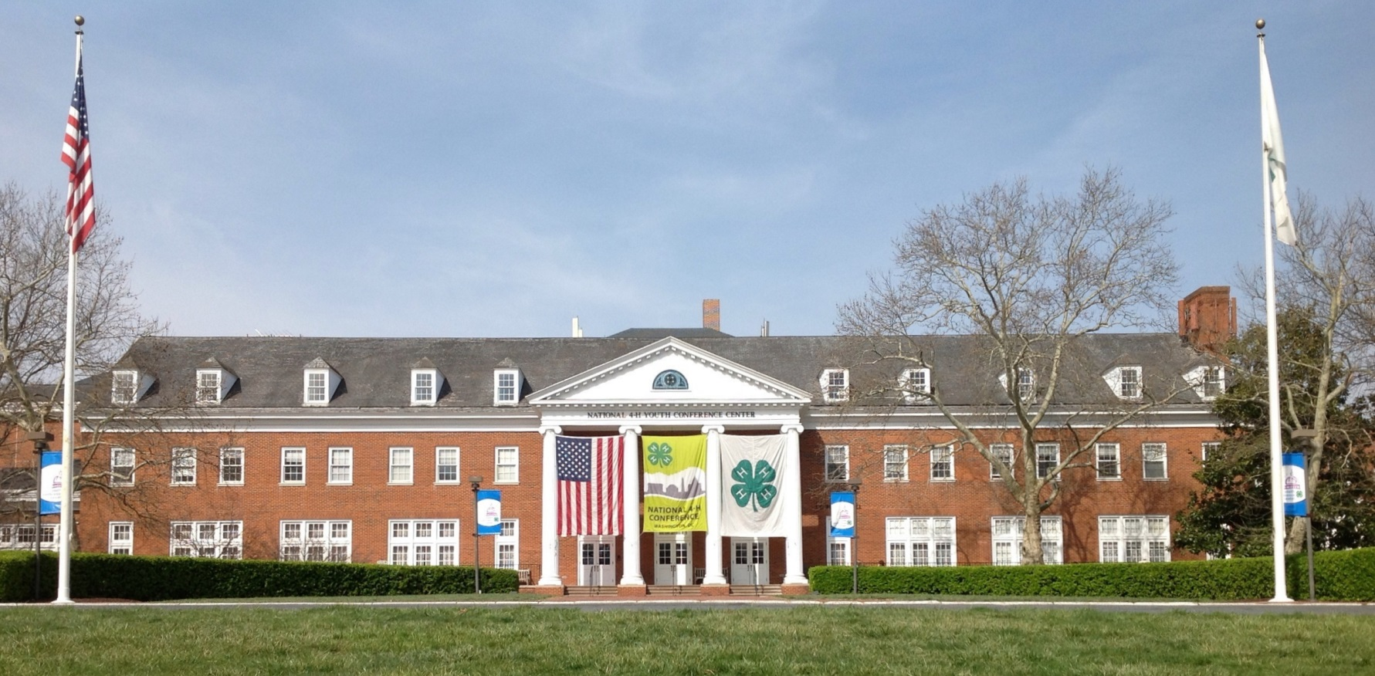
National 4H Center
7100 Connecticut Ave.
Chevy Chase, Maryland
301-961-2801

Slide 8
The 4H Center
Set up like hotel
Bunk Beds
Hotel amenities
No Swimming!
Cafeteria-style meals
All you can eat!!!
24-Hour Security

Slide 9

Cafeteria Style Meals

Slide 10
DAY 1
Depart HRMS at 6:00 AM
Take your sack lunch to eat at rest stop
Arrive in DC at approximately 2:00 PM
  Buses will split up upon arrival
Arrive @ National 4H Center about 5:00 PM for check-in (Get your name tag/meal ticket)
Dinner at 4H Center

Slide 11
End of DAY 1
Illumination Tour 6:30 PM
Arrive back at 4H Center at 10:30 PM
Lights out at 11:00 PM!

Slide 12
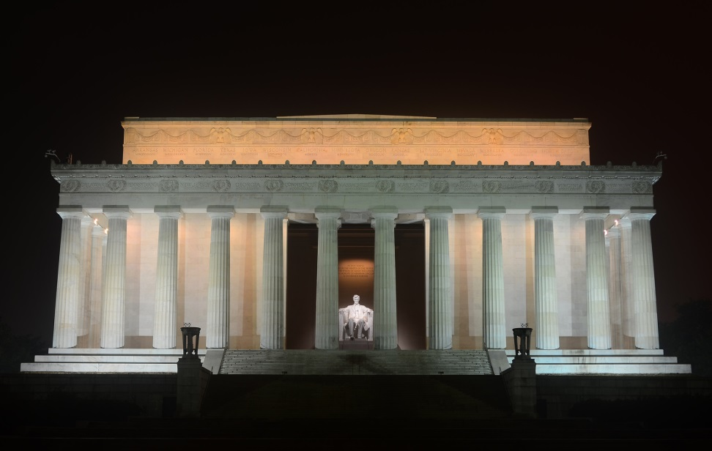
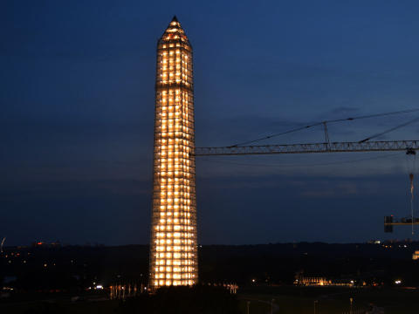
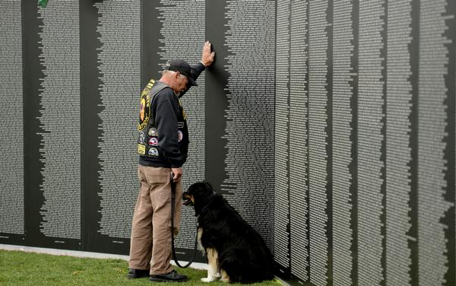
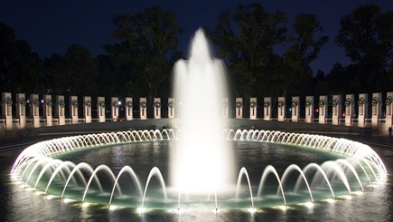
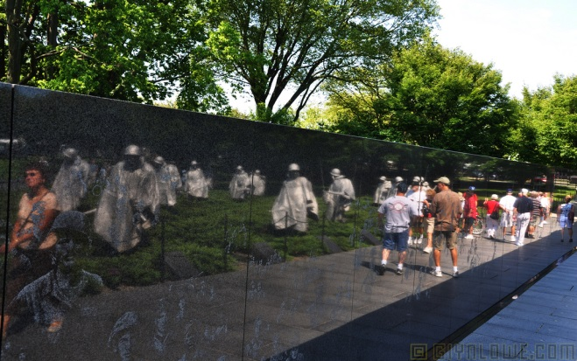
Illumination Tour

Slide 13
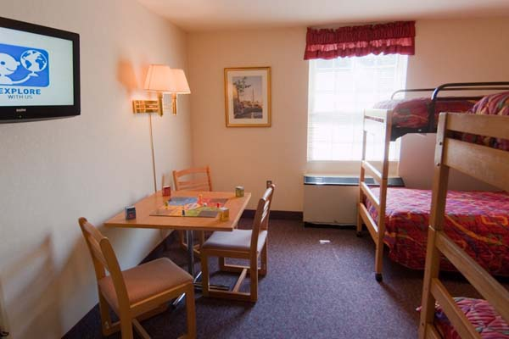
Student Rooms

Slide 14
DAYS 2 & 3
Bus itineraries will vary
Everyone will see the same sites
Lunch will be on your own
  Lunches can be expensive!
  Expect to pay $10-20 for each meal.
Souvenir Shopping
  All buses will stop at a mall at some point during the trip.

Slide 15
SAMPLE ITINERARY
6:00 AM WAKE UP
7:00 AM BREAKFAST
8:00 AM DEPART 4H CENTER
9:00 AM WHITE HOUSE
10:30 AM CAPITOL TOUR
12:00 PM (LUNCH)
1:30 PM SUPREME COURT
2:00 PM LIBRARY OF CONGRESS
3:00 PM NATIONAL ARCHIVES
5:00 PM EMBASSY ROW
6:30 PM DINNER

Slide 16
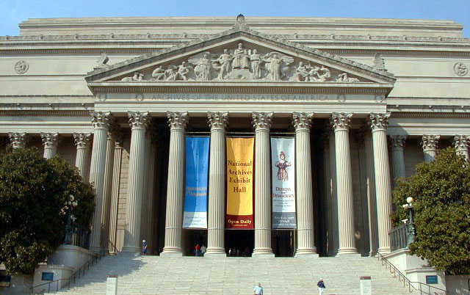
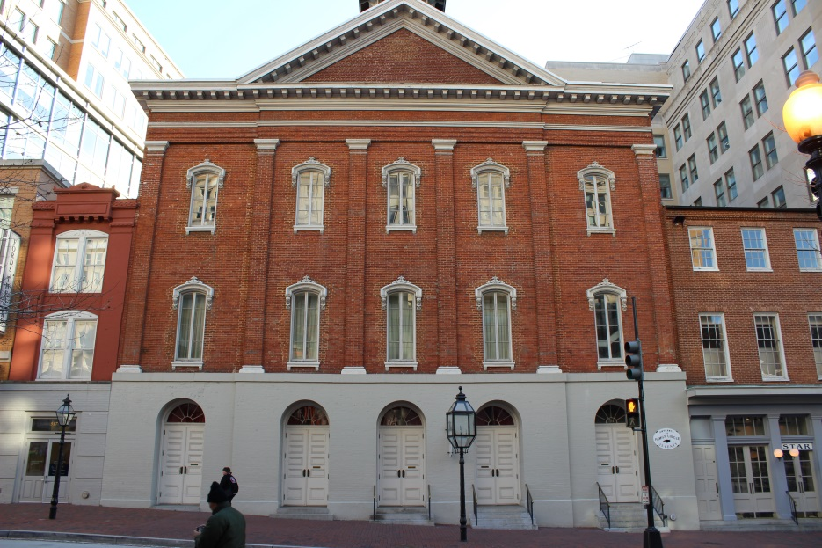
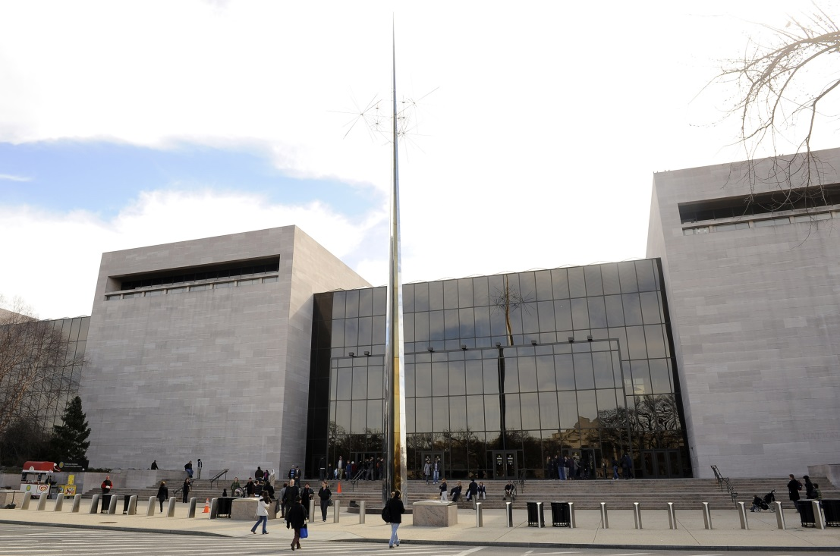
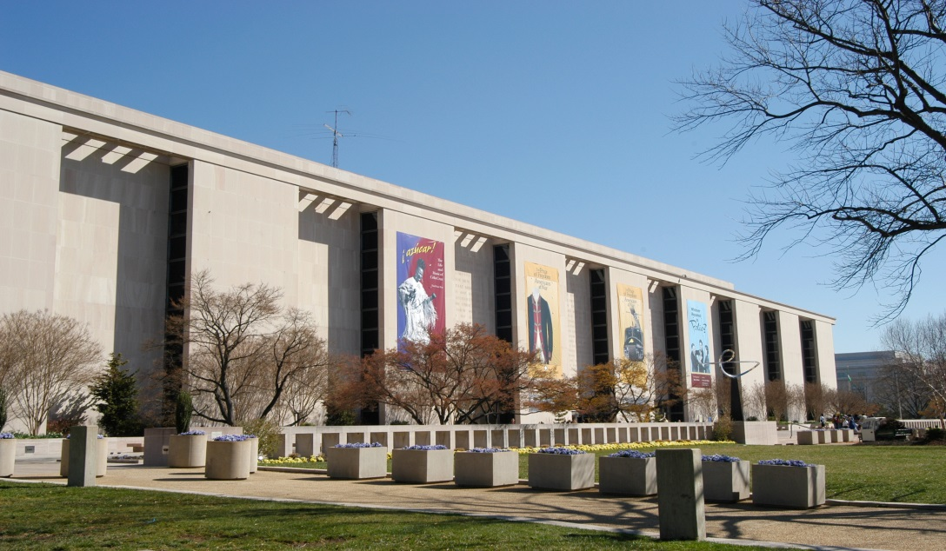
Museums

Slide 17
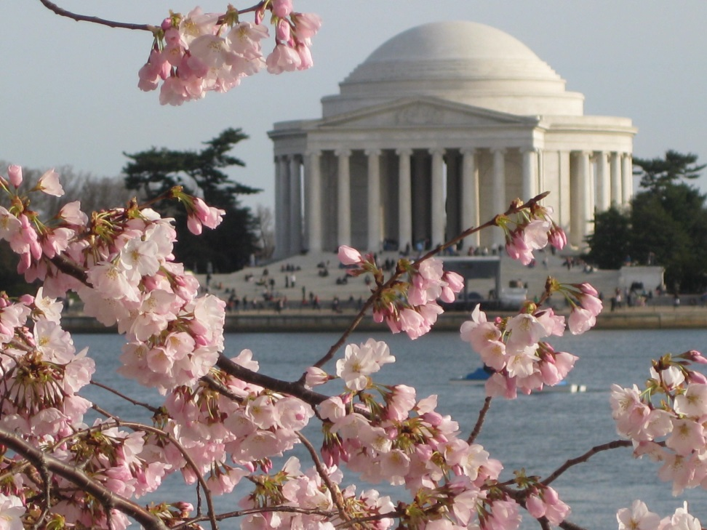
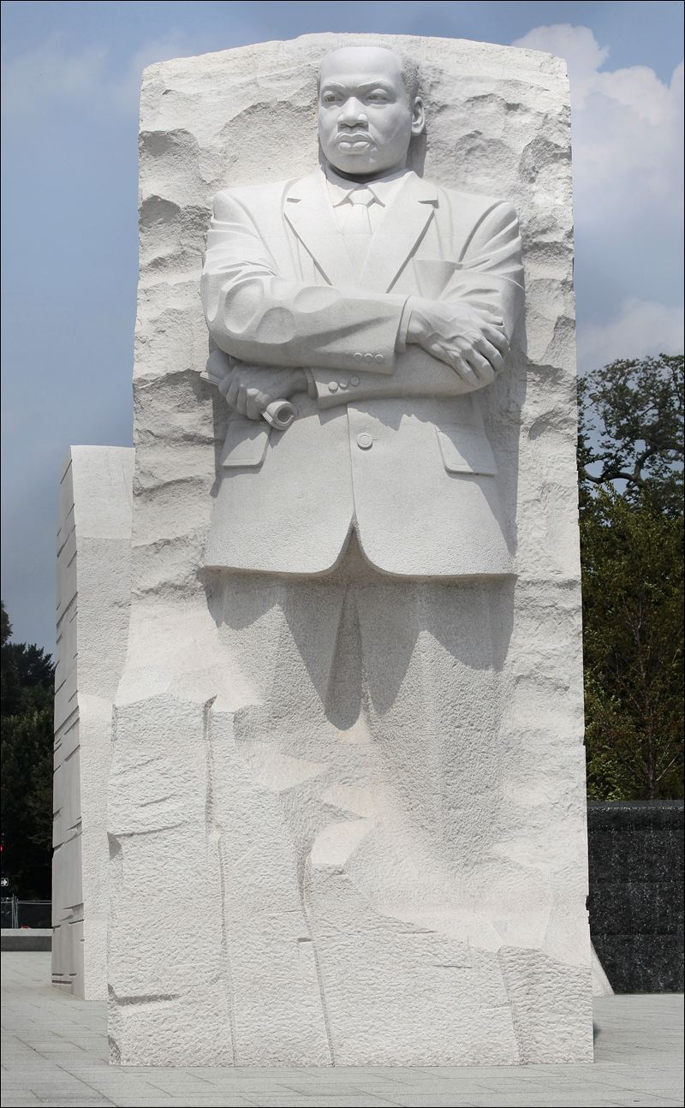
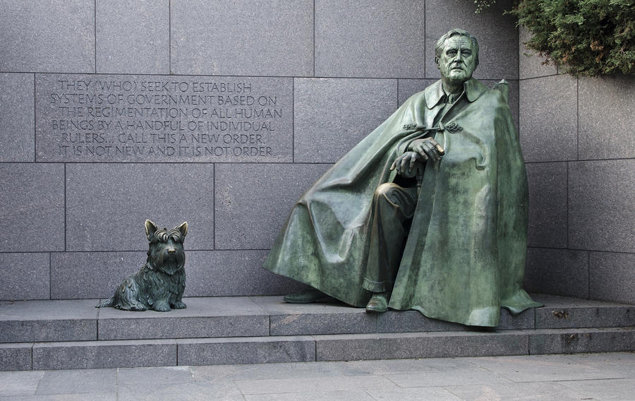
Memorials

Slide 18
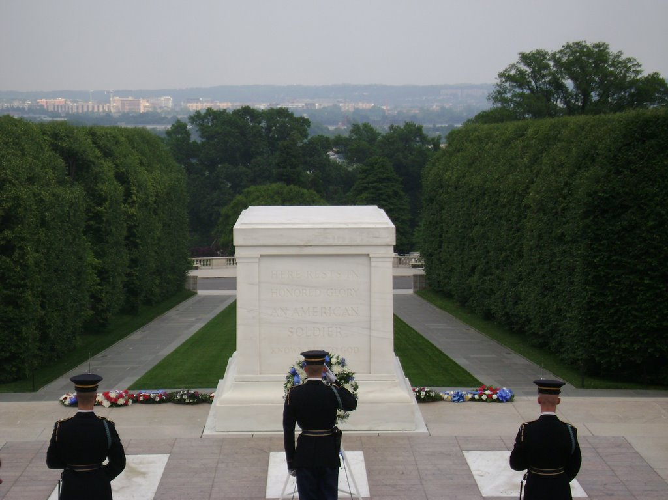
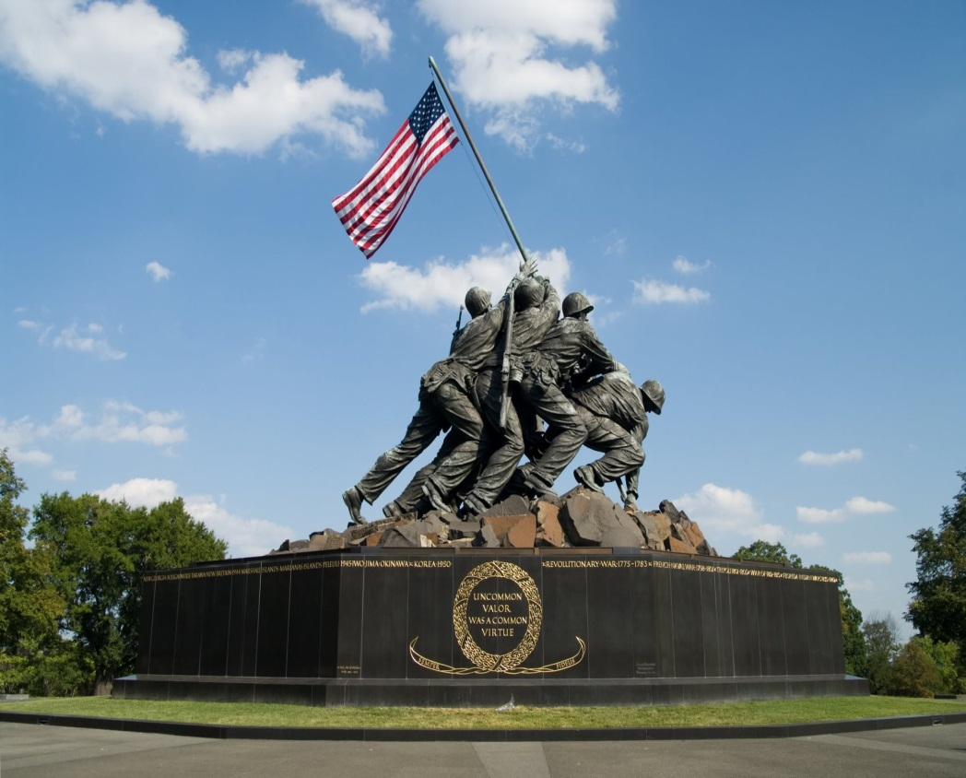
OTHER STOPS

Slide 19
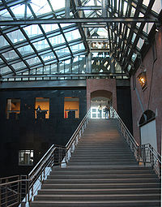
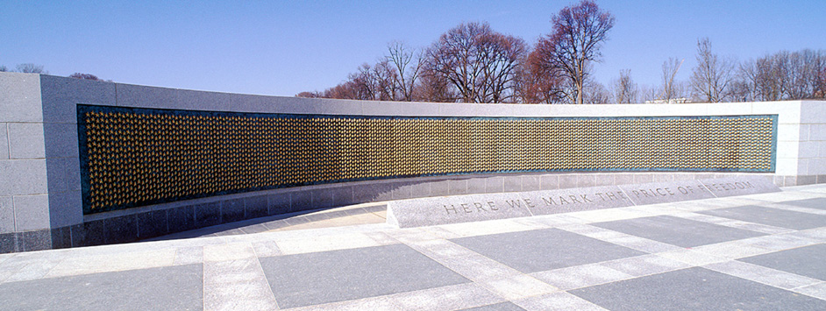
MORE PLACES TO SEE

Slide 20
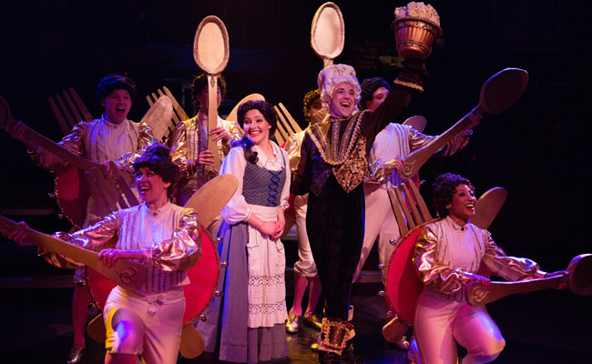
Fun Stuff!

Slide 21
D.C. Things to Know
Lots of Strict Searches!
  Especially at indoor venues
  No large bags/book bags at most locations
  No water or other liquid at some locations
  No sprays or lotions at some locations
  No gum at most locations
  Metal detectors & X-ray machines at most locations

Slide 22
General Rules
School dress code applies
Wear your hoodie.
Name tag is your meal ticket! Don’t lose it!
No energy drinks!
Stay hydrated!
  Don’t text or use headphones or ear buds while with a tour guide or inside a building.
  Use your phone only as a camera while with a tour guide or inside a building

Slide 23
PACKING GUIDELINES
1 SMALL SUITCASE
1 BAG FOR THE BUS (like a book bag)
Sack lunch on the way
2 pair comfortable shoes
Dress in layers
Poncho/Umbrella, Hat/Gloves
Money for 3 lunches, 1 dinner, and 1 fast-food meal on the way home (HOLD BACK about $10)

Slide 24
Information for Students
Students picked their roommates earlier
They will receive written Packing Guidelines & Rules handout the week before the trip.
Teachers will make group and bus assignments
Students will be informed on the day of the trip of their bus# and small group assignment

Slide 25
When do they return?
Thursday night
About midnight
Students will call you when we are 1 hour away from Harris Road
No student will be allowed to walk home!
Please pick up your child on time.
Staggered arrival times for each bus.
Don’t base your child’s arrival on someone else’s child.
Parked in MARKED SPACES and wait patiently for your child. EVERYONE will want to go home.
Don’t yell for your child! Teachers will dismiss the students. Be nice!
The next day begins SPRING BREAK!

Slide 26
What’s Covered?
Accommodations for three evenings
Night-time security
All you can eat breakfasts at 4H Center
Two (2) dinners
All ticket costs
Taxes and gratuities are included for attractions and evening meals
Professional Tour Guide on each chartered motor coach
Stylish hoodie

Slide 27
WHAT’S NOT COVERED?
MONEY FOR LUNCHES
(about $45+)
MONEY FOR FAST FOOD STOP ON THE WAY HOME
(about $10+)
MONEY for 1 DINNER
(about $20+)
MONEY FOR SOUVENIRS
(optional)

Slide 28

Questions?

