Slide 1
Parasites

Slide 2
Vocabulary
18. Parasite: Organisms that live in or on another organism known as a host;
*Steal nourishment from the host
*Ex. worms (tapeworm, hookworm), lice, fleas, ticks, flies, protozoa (animal-like protists such as amoeba and giardia).

Slide 3
19. Adaptation: Any body structure, function, or behavior that helps an organism survive in its environment.
Ex. Tapeworm has no digestive system/lives in the intestine of its host and absorbs nutrients through its skin

Slide 4
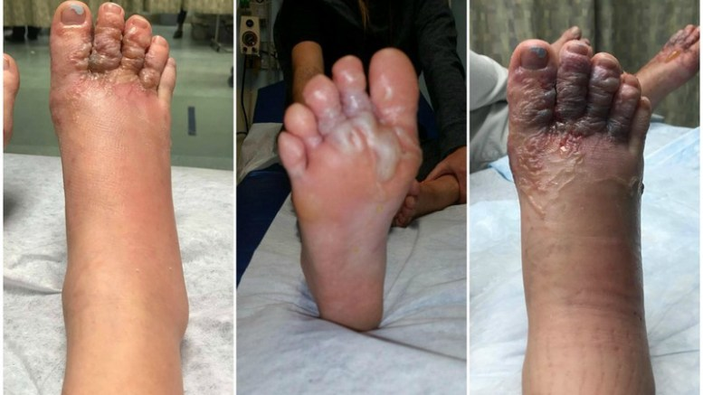
A Canadian couple, on vacation in Punta Cana, Dominican Republic, picked up hookworm larvae while walking barefoot through the sand. It’s not uncommon in the Caribbean, South America, Mexico, and southeast Asia. It occurs a lot in Jamaica.

Slide 5
Malaria is a world health concern. It is caused by a parasite! The parasite is a protist that lives in water; mosquitoes lay eggs in/mature in water. They can pick up the protist and transmit it to a human when it bites them. OR, a “healthy” mosquito can bite an infected person and carry it to another person infecting them. Mosquitoes are NOTORIOUS vectors! Eliminate standing water, and you cut down on the mosquito population.
You MUST know this. It is specifically mentioned in the science standards from the state.
Malaria is a parasitic disease carried by mosquitoes (vectors).
It is NOT caused by a virus, bacteria, or fungus.
Malaria is caused by a PARASITE!!!!!!!
Any questions???

Slide 6
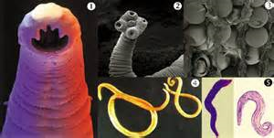
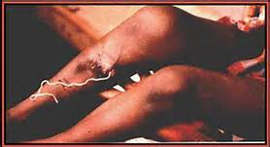

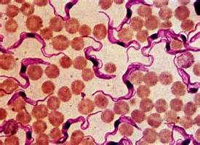
Guinea Worm-gets in through the soles of the feet…wear shoes!
Tapeworms, hookworms, other worms
Blood-sucking things; not only suck blood, but carry diseases
Trypanosoma worms-cause African sleeping sickness (shown here in the blood)

Slide 7
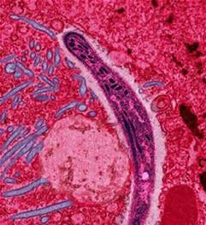
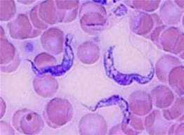
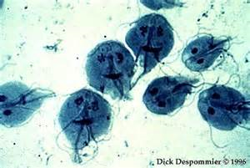
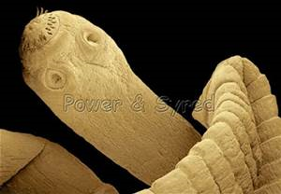
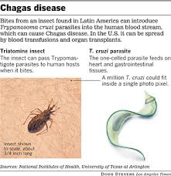
Examples of Parasitic Diseases
1.Malaria Vector: Mosquito
(Plasmodium-a protist-lives in water)
2.African Sleeping Sickness Vector: Tsetse
(Trypanosoma worms) fly
3.Giardia- Contaminated water (no vector)
a protist
4.Tapeworm
Contaminated
water; under-
cooked meat.
5.Chagas Disease- Vector-Triatomine (kissing bugs)

Slide 8
Malaria is a world health concern. It is caused by a parasite!
You MUST know this. It is specifically mentioned in the science standards from the state.
Malaria is a parasitic disease carried by mosquitoes (vectors).
It is NOT caused by a virus, bacteria, or fungus.
Malaria is caused by a PARASITE!!!!!!!
Any questions???

Slide 9
Treatment & Prevention of Parasitic Diseases
Treatment:
Antibiotics may work for some
Other prescription medications
Prevention:
Pasteurization
Cooking foods well
Vaccines (malaria)
Wearing shoes (you can get parasites through your feet)
Avoid non-chlorinated water
Avoid body fluids of people with parasitic diseases

