Slide 1


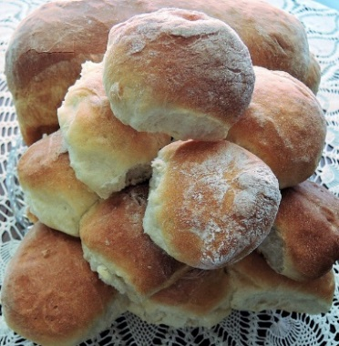
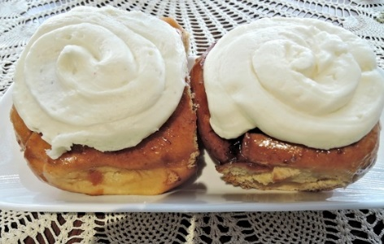
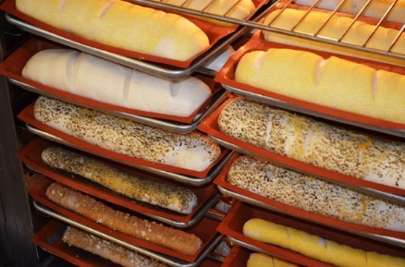

Yeast Breads

Slide 2
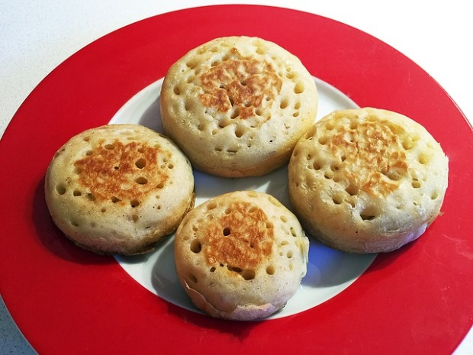
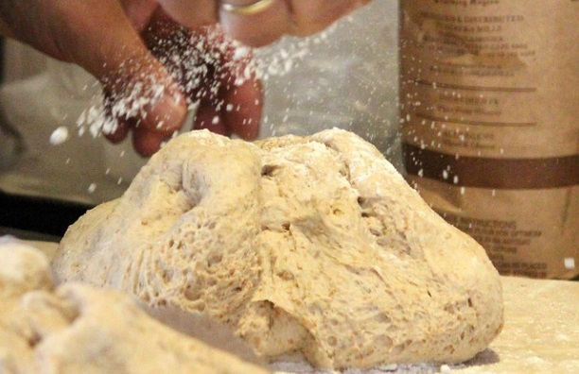
What is a yeast bread?
Yeast breads are leavened (risen) with yeast
Take longer to prepare
  kneading & rising time
EXAMPLES:
White breads and rolls
Most cinnamon rolls
Pizza dough
English muffins
Yeasted doughnuts
… and more!

Slide 3
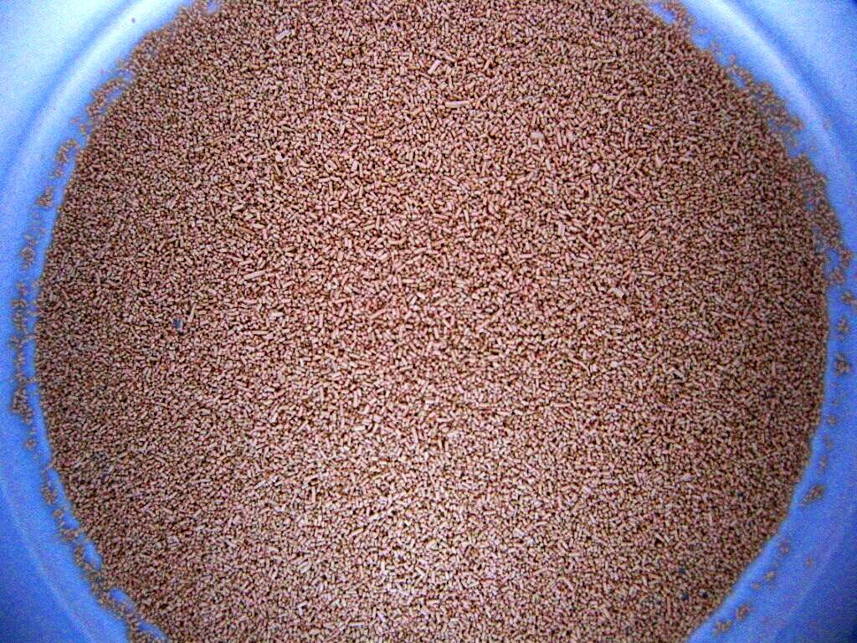
What is yeast?
Yeast is a single-celled fungi… it’s ALIVE!
Yeast can be purchased in several forms:
  FRESH/CAKE yeast
  ACTIVE DRY yeast
  INSTANT/RAPID RISE yeast
Pay attention to the expiration date!

Slide 4
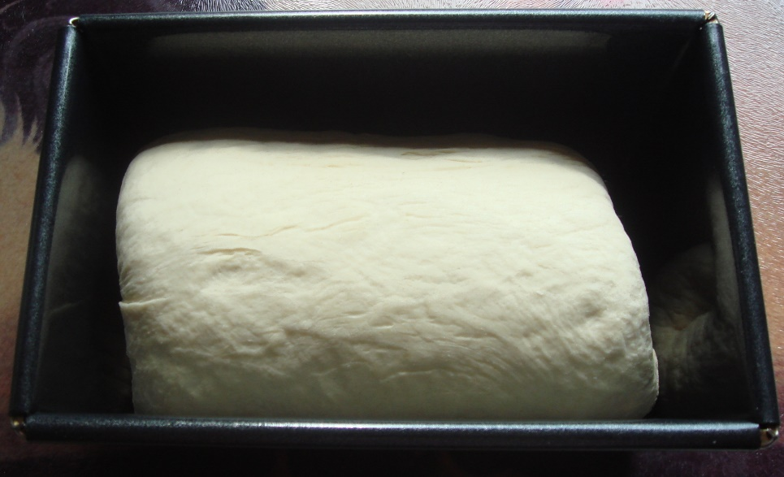
What is fermentation?
Yeast eat sugar & starch in bread dough
They produce alcohol and carbon dioxide (CO2), which causes bread to rise
FERMENTATION:
YEAST + SUGAR = ALCOHOL & CO2
When we let yeast breads rise, we are allowing fermentation to occur!

Slide 5
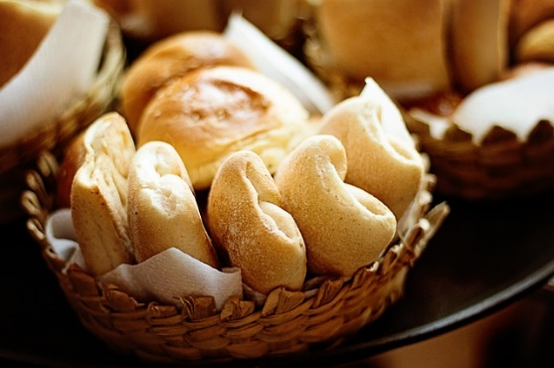
What is gluten & how does it work?
Gliadin & glutenin are proteins in wheat
When wheat flour is combined with liquid and mixed thoroughly (or kneaded), GLUTEN is formed.
Think of gluten like bubble gum…
Gluten forms a stretchy framework that “traps” the CO2 produced by the yeast inside, which makes your bread dough rise!
Bread flour has the most gluten, cake flour has the least

Slide 6

When you first put the gum into your mouth, it is soft & easy to chew (like gliadin and glutenin).
As you chew the gum (like kneading), it becomes more elastic, and you can blow bubbles (or trap carbon dioxide).
As you continue to chew the gum for a long time, it becomes so elastic it makes your jaws hurt (in bread, over kneading will cause gluten to snap- bread will be dense and tough!)

Slide 7

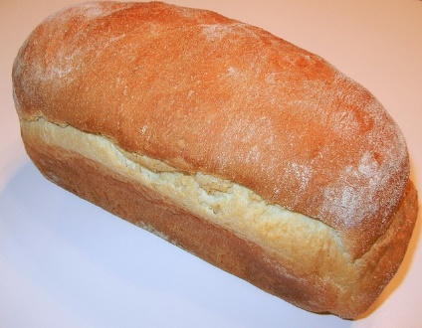
Yeast Bread Ingredients
FOUR MUST HAVES:
  Flour (all-purpose or bread)
  Yeast
  Liquid (usually water or milk)
  Salt
Salt not only adds flavor, but also slows down yeast for manageable rising!
Optional ingredients in yeast breads function like in quick breads:
  EGGS: add richness & color
  SUGAR: adds sweetness & browning
  FAT: adds tenderness and richness

Slide 8
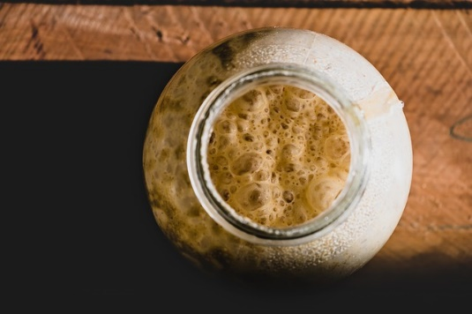
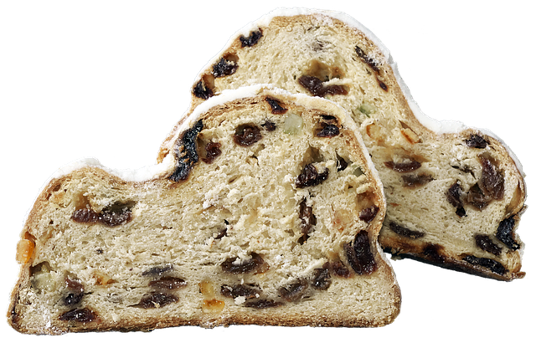
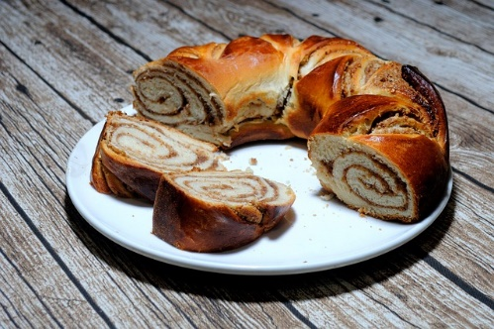
Yeast Bread Variations
BATTER breads: have more liquid; are beaten vigorously instead of kneading
WHOLE GRAIN breads: use whole-wheat flour (but most only substitute PART of the flour)
SOURDOUGH: leavened with a sourdough starter (fermented mix of yeast, water, & flour)
Add flavor & variety by adding:
  Dried fruit
  Nuts
  Cheese
  Herbs
  Spices

