Slide 1
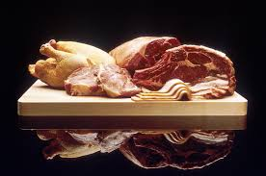
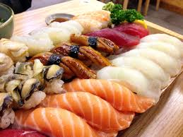


Meat, Poultry, and Seafood
All images are available on www.google.com with a Creative Commons 0 License.

Slide 2
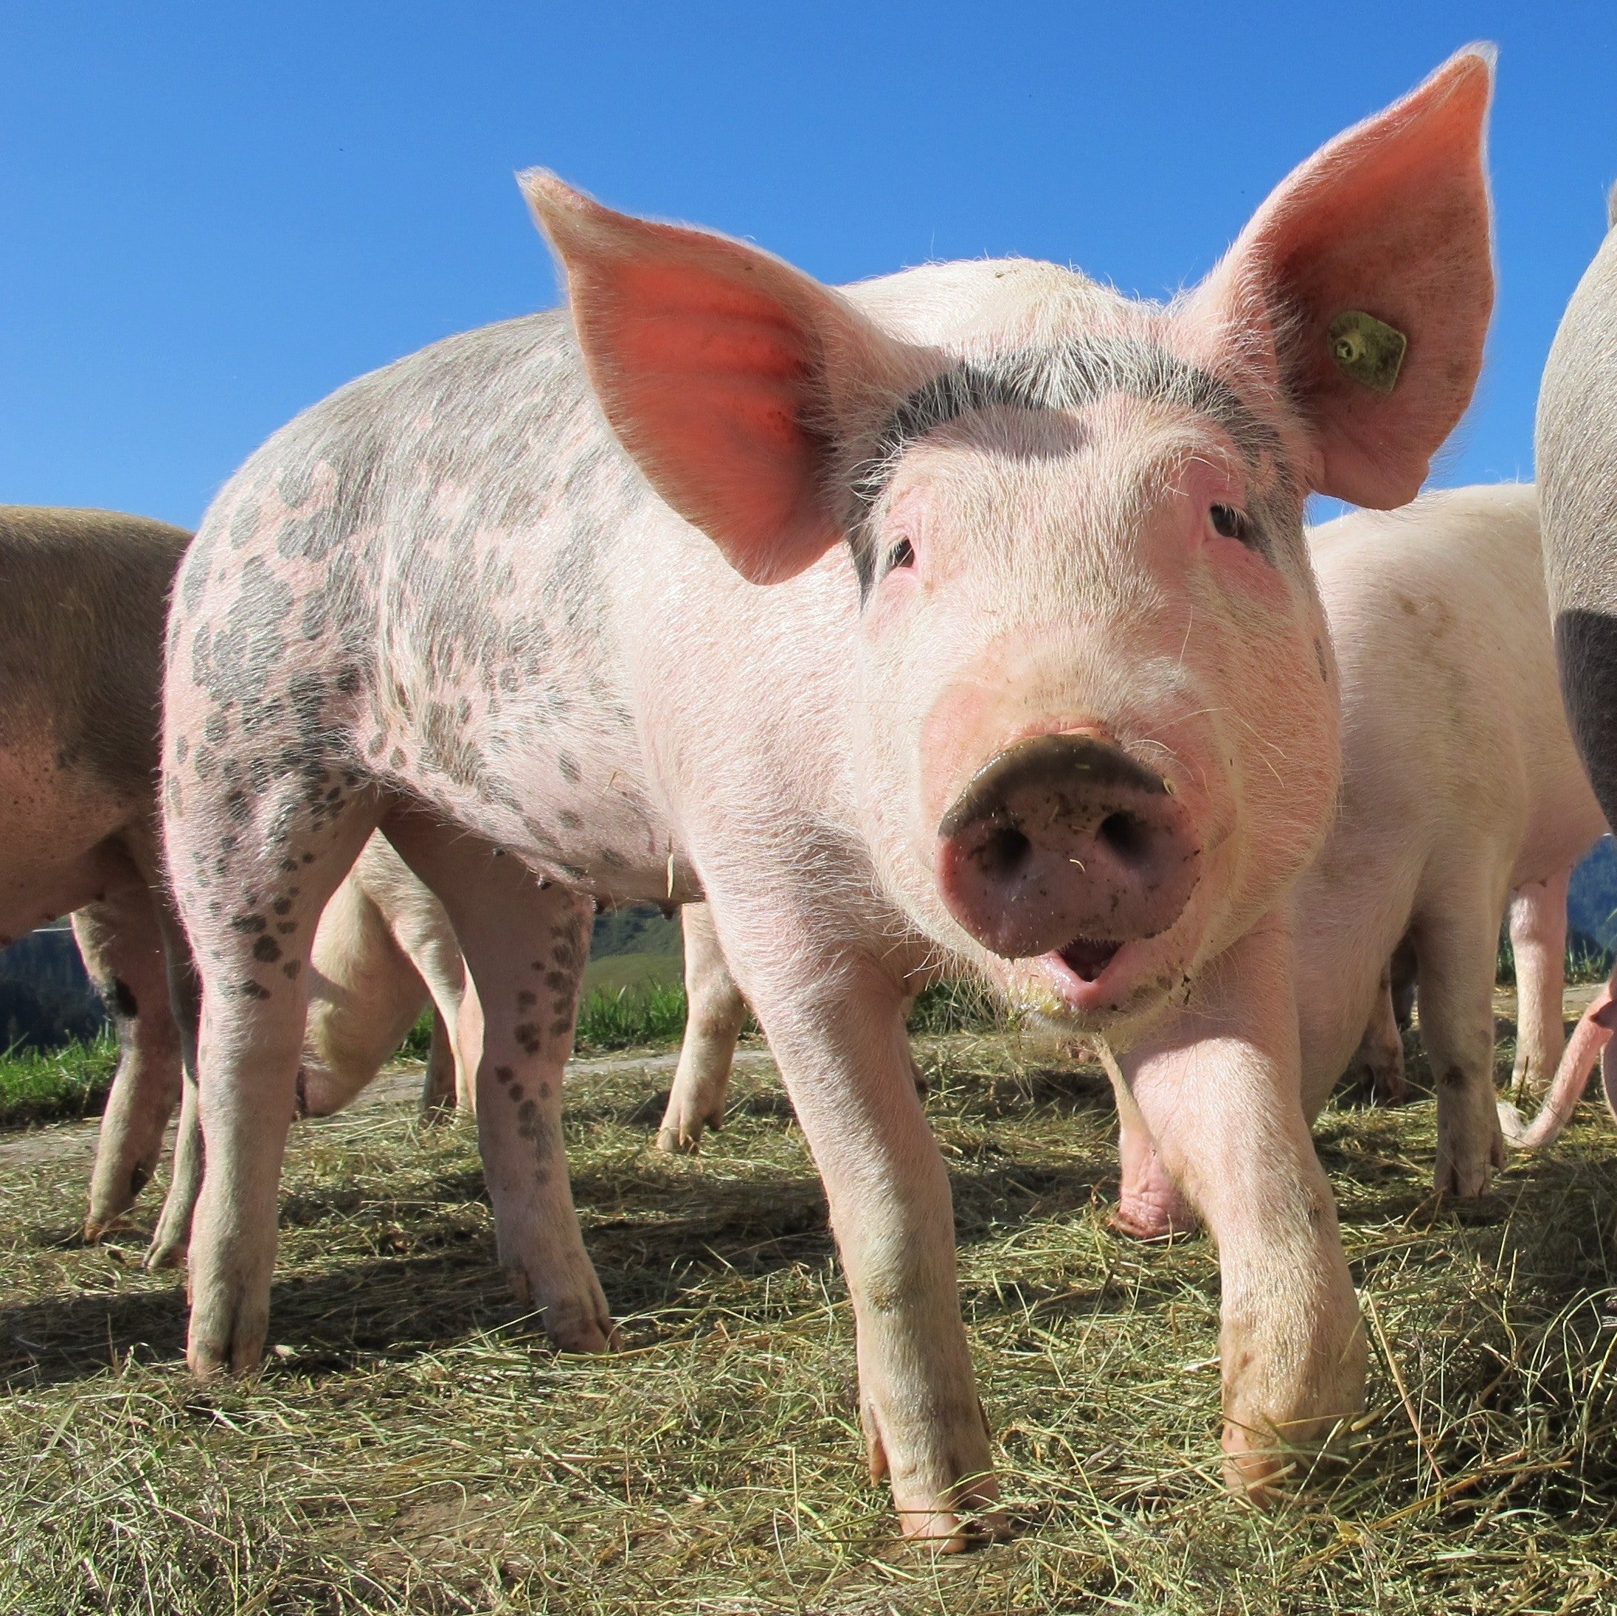
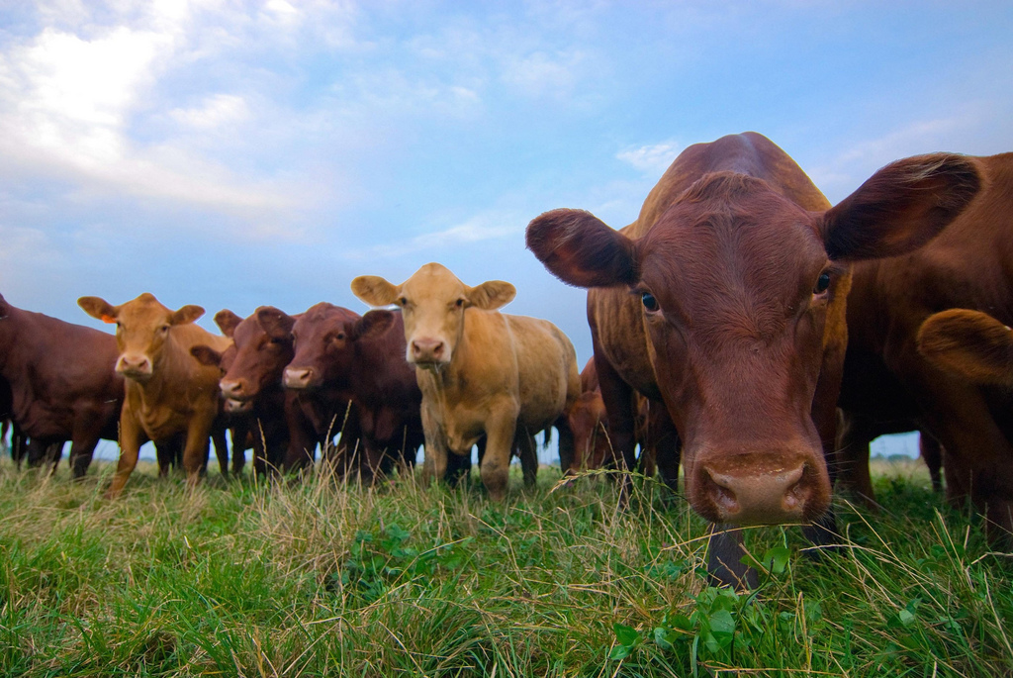
Meat
Beef
Pork
What other types of meat are there?

Slide 3
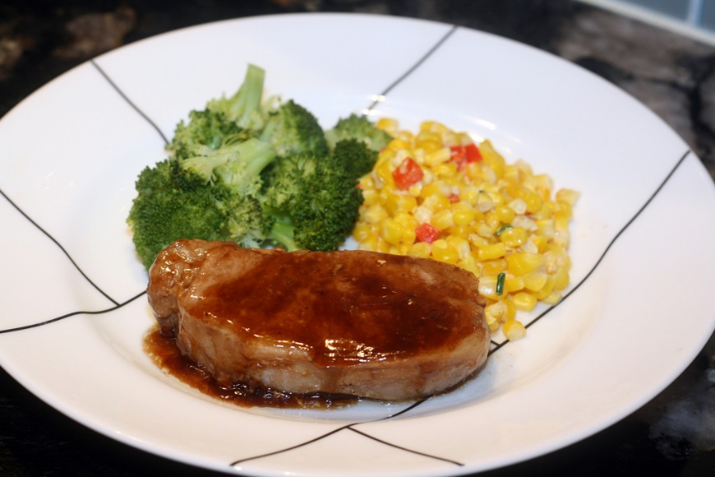
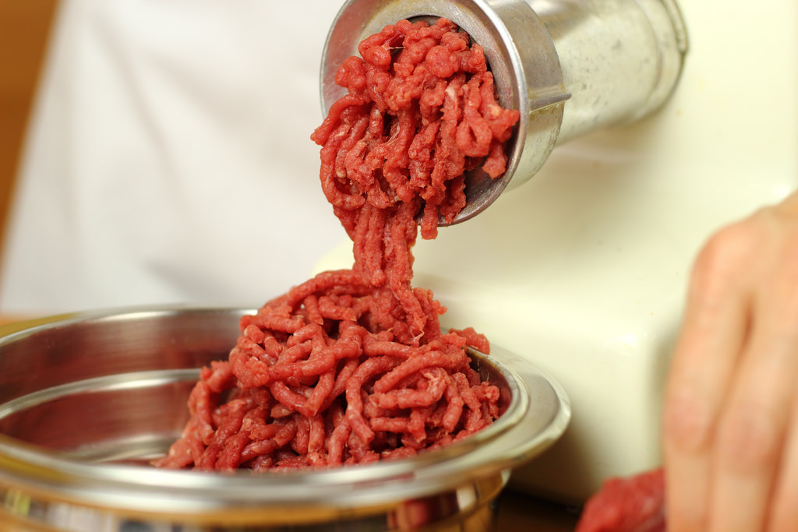
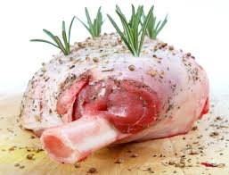
Cut forms
Roasts
Steaks and chops
Ground meat

Slide 4
Components of a Cut of Meat
Muscle: meat without bones or fat
Connective Tissue: connects or surrounds the tissue or organs contains elastin and collagen
Marbling: flecks of fat throughout the lean meat, indicates the tenderness of a cut
Elastin: protein that can not be softened by cooking; tough and elastic

Slide 5
Other Meats
Processed Meat: meat that has had some further preparation; very few nutrients, high fat and sodium contents
  Examples: bacon, salami, sausage, hotdogs, ham, bologna
Variety meat: edible parts of animal other than muscle, inexpensive, rich in vitamins and minerals
  Examples: liver, heart, kidney, tongue, sweetbreads (thymus gland), tripe (stomach lining), brains, chitterlings (cleaned intestines) tail, feet, ears, snout
Veal and Lamb

Slide 6
Selecting Meat and Poultry
Look for unopened, non-leaky packaging (if it leaks, ask butcher for paper towels/bag)
Look for sell by dates-for freshest, look for packages with later dates
The number of servings in a pound of meat will depend on the amount of fat, gristle and bone
  Round generally has the lowest fat content
Bargain bin meats, check for good color and odor, use immediately or freeze

Slide 7
Selecting Meat and Poultry
Check for freshness and leanness
  Beef-cherry red, little fat
  Pork-pink to red, little fat
  Lamb and veal-pink, little fat
  Chicken and turkey-dark and white meat, little fat
Avoid meats that have sour odors, dull-grayish-brown colors, and/or slippery to touch

Slide 8
Preparing Meat to Cook
After cutting raw meat; *wash and sanitize the cutting board and knife*

Slide 9
Tenderizing Methods
Grinding- breaks down elastin in meat
Marinate- soak in a solution to make softer
Simmering

Slide 10
Cooking Methods
Tender Meats
  Broiling
  Roasting
  Pan-broiling
  Stir frying
Less Tender Meat
  Braising
  Cooking in Liquid (Stewing, Simmering)

Slide 11
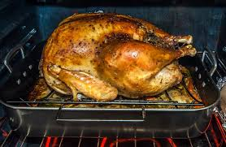
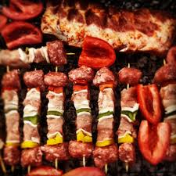
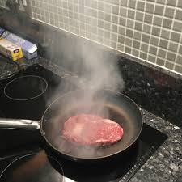
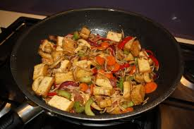
Cooking Methods
Roasting
Broiling
Pan-broil
Stir-fry

Slide 12
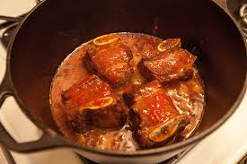
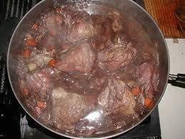
Cooking Methods
Braising
Cooking in Liquid

Slide 13
Cooking Meats
Cook steaks (rib eye, t-bone, flank etc.) by *Broiling* 3-4 inches from the heat source
The safest way to check the doneness of meat is by *measuring the internal temperature using a meat thermometer*
Smaller cuts of meat will cook most efficiently in the microwave ex. *Sausage links*

Slide 14
Poultry
Any domesticated bird
Examples: Chicken, Turkey, Goose, Duck

Slide 15
Nutritional Value
Protein
Phosphorus
Iron (also in red meats)
B Vitamins

Slide 16
Other Nutritional Information
Boneless, Skinless Chicken Breast contain the least amount of fat.
Dark meat has higher fat content
Lower in saturated fat compare to red meat
Most of the fat is contained in the skin of poultry

Slide 17
Selection & Storage
Poultry contains more bone in proportion to meat
To prevent spoilage fresh poultry can be stored 2-3 days rewrapped

Slide 18
Cooking Principles
Thaw frozen chicken in the refrigerator
Place meat thermometer in the thickest part of the thigh; poultry is done when thermometer reaches appropriate temp.
When poultry cooks, a harmless chemical reaction sometimes occurs causing the flesh to turn pink

Slide 19
Cooking Methods
Roasting: best for whole birds; place breast side up
  Can be done in a cooking bag to shorten the cooking time
Stewing: cover completely with water & simmer
  Best method for large older birds
Stir-frying: quickest cooking method 10 minutes or less

Slide 20
Fish and Shellfish
A great source of omega-3 fatty acids!
Try to eat 8 oz. a week!

Slide 21
Categories
Finfish and Shellfish
Finfish: have fins and backbones and may live in fresh or saltwater
Swordfish
Cod
Flounder
Catfish
Salmon
What others have you had?
Shellfish: have shells instead of backbones
Shrimp
Crabs
Lobsters
Oysters
Scallops

Slide 22
Selection Guidelines
No odor, tightly closed bivalves, firm flesh on shrimp, crab, and lobster
Shrimp can be purchased with the intestinal tract removed and will be labeled as “deveined”
Fresh finfish should meet the follow characteristics:
  Firm flesh
  Red gills
  Bright, bulging eyes
  Fresh smell (strong fish odor indicates spoilage)
  No slime

Slide 23
Storage
Both fish and shellfish are highly perishable and should be stored in the refrigerator or freezer tightly wrapped.
  Refrigerator: 1-2 days

Slide 24
Cooking Fish and Shellfish
Fish are generally tender because they have little connective tissue.
Cook both fish and shellfish are cooked for short periods of time.

Slide 25
Questions
Which would have the lowest amount of fat?
  Grilled hamburger steak
  Fried shrimp
  Grilled hot dog
  Broiled fish fillet
Which is a great source of omega-3 fatty acids?
  Hamburger
  Salmon filet
  Pork chop
  Beef roast

Slide 26
Foodborne Illness Reminders
Temperature zone that allows for the growth of bacteria is:
  40° - 140° F
Improperly cooked ground beef can be contaminated with:
  E. Coli
Fresh poultry can be contaminated with:
  Salmonella

