Slide 1
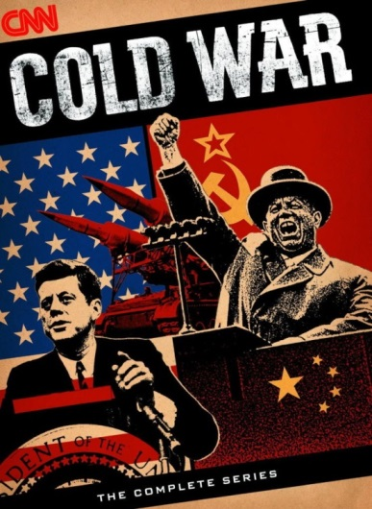
Cold War & Postwar Change, 1945 – 1970
The Cold War
Objective: Trace the course of the Cold War and assess its impact on the global community including but not limited to the Korean War, the satellite nations of Eastern Europe, and the Vietnam War.

Slide 2
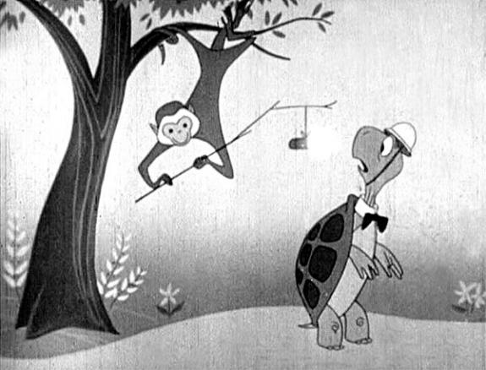
Meet Bert the Turtle

Slide 3
Communism Around the World
USSR (Soviet Union)- World Superpower supports communism
Eastern Europe- Soviet satellite states completely influenced by Soviet Union after WW2
  German Democratic Republic (East Germany), Poland, Hungary, Bulgaria, etc.
China- Communists took control of China in 1949 led by Mao Zedong

Slide 4
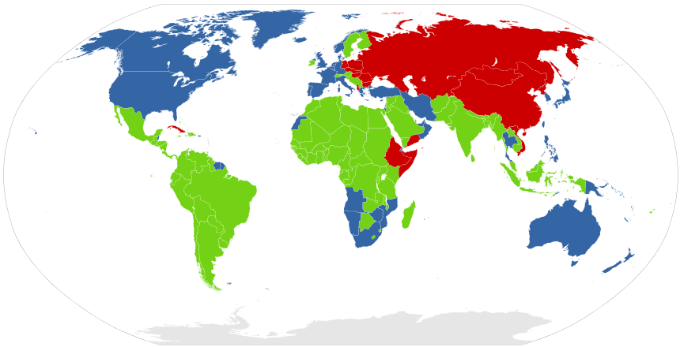
Communism Around the World

Slide 5
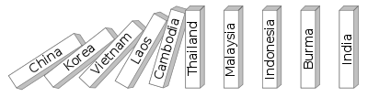
Domino Theory – If one nation became Communist (from Soviet pressure), nations bordering would soon become Communist as well

Slide 6
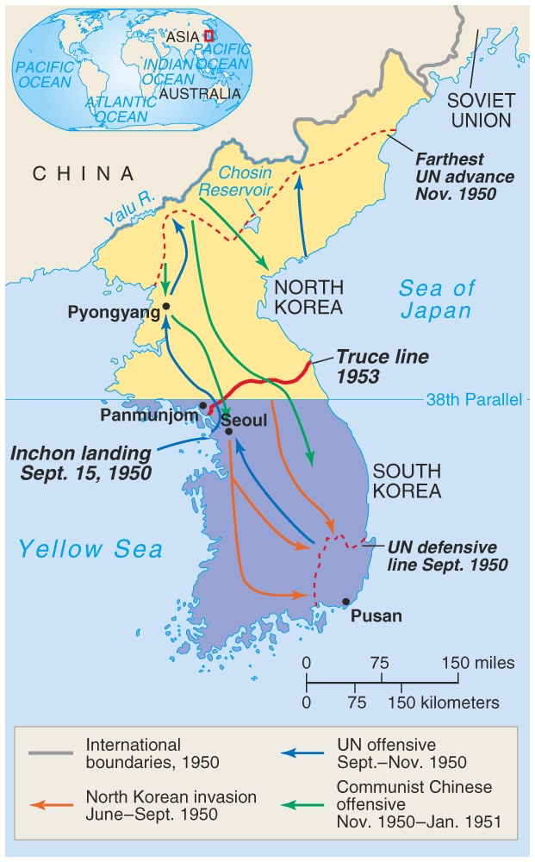
Korea and The Korean War
Korea controlled by Japan from 1910 through WW2
End of WW2 Korea divided at 38th Parallel- Soviets occupy North and US occupy the South
North Korea- becomes communist supported by Soviet Union and China
North Korea invades South Korea- June 25th, 1950

Slide 7
Korea and The Korean War Continued…
United Nations and the United States send 520,000 troops to push North Korea back
China helps North Korea push Americans out
Stalemate!- no clear winner the borders remain basically the same

Slide 8
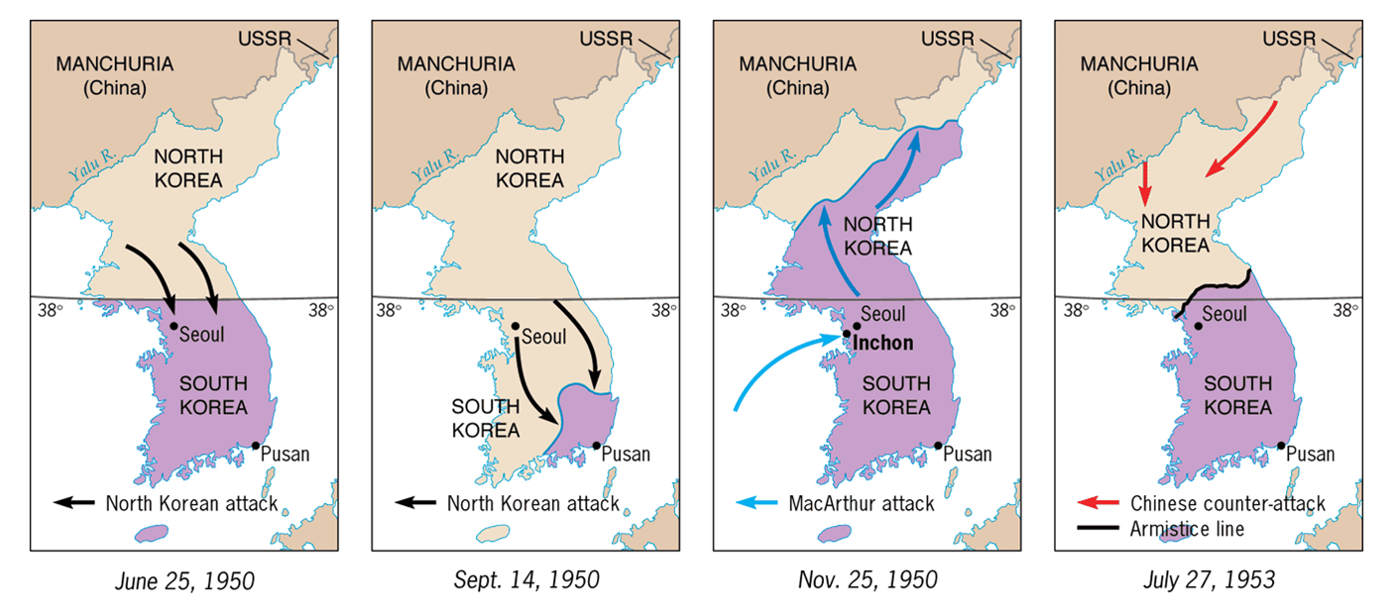
The Korean War

Slide 9
Cuba in Crisis- the Bay of Pigs
Fidel Castro- Communist dictator- comes to power 1959
Soviet Union provides aid to Cuba to promote Communism and US cuts relations with Cuba
Cubans see Castro as a tyrant & 10% take refuge in US
Refugees train for an invasion of Cuba- to be backed by US and President JFK
  Land at Bay of Pigs but US air support never shows
  Embarrassment for US and President Kennedy

Slide 10
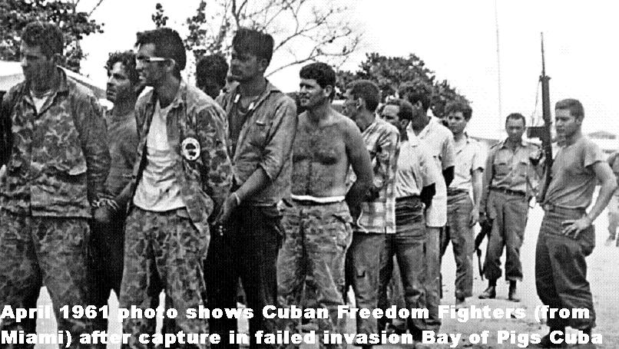
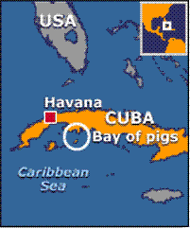
Bay of Pigs

Slide 11
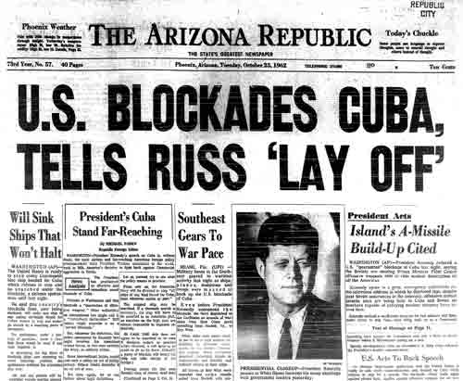
The Cuban Missile Crisis-
October 14-28, 1962
US spy planes photographed missiles in Cuba and JFK tells world of missiles
US blocks Cuba- NO other Russian ships with weapons to enter
US troops were ready to invade Cuba but Soviet ships stop to avoid confrontation
Khrushchev leader of Russia removes missiles from Cuba
http://www.youtube.com/watch?v=VGx7dimJ6ns&feature=related&safety_mode=true&persist_safety_mode=1&safe=active

