Slide 1
Orbit and Tilt
6th Space Colonization PBL

Slide 2
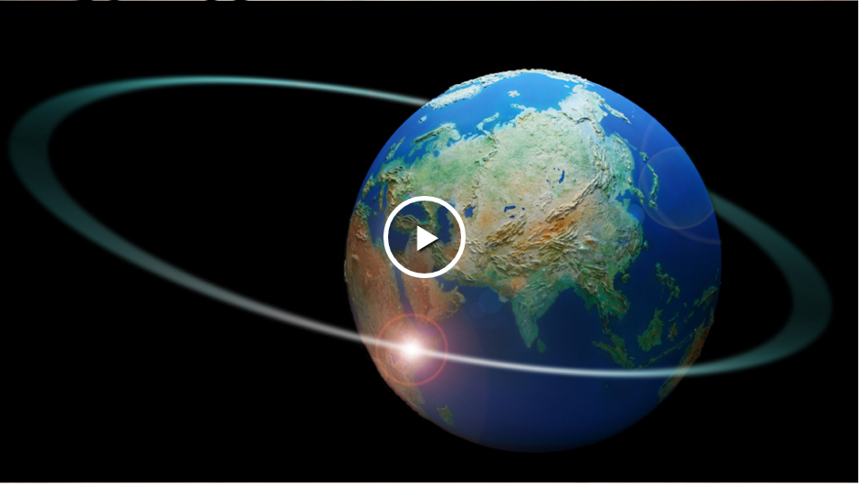
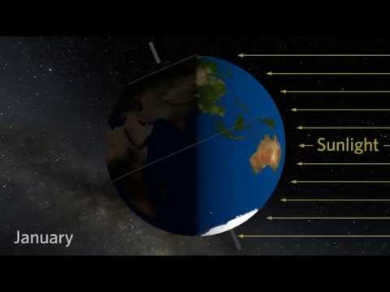
Let’s Review:
What is an Orbit? Why we Have Seasons?

Slide 3
What does this mean for your colony?
Use the chart on the next page to figure out what the orbital information is for your colony.
  Length of Day
  Length of Year
  Does it tilt or have an unusual shape?
  Is it in a tidal locked?
Fill in the information on your Note-taking Sheet.

Slide 4
Planet | Orbital Distance | Length of Day | Length of Year | Other Information
Mercury | 35,983,125 miles | 59 days | 88 days
Venus | 67,238,251 miles | 243 days | 225 days | Retrograde rotation: Rotates East-West
Mars | 141,637,725 miles | 24.5 hours | 687 days | Titled: length of seasons varies
Jupiter | 483,638,564 miles | 10 hours | 12 years | No Real tilt
Saturn | 886,489,415 miles | 10.5 hours | 29.46 years | Tilted: 26.73 degrees like Earth and experiences seasons
Uranus | 1,783,744,300 miles | 17 hours | 84 years | Retrograde Rotation: East-west Equator: right angle to its orbit so extreme season. 25% of year, the sun shines directly over each pole plunging the other half into a 21 year-long dark winter.
Neptune | 2,795,173,960 miles | 6.5 days | 165 years

Slide 5
Planet | Orbital Distance | Length of Day | Length of Year | Other Information
Titan (Moon of Saturn) | 759,000 miles | 10.5 hours | 15 days and 22 hours | Tidal Lock
Europa (Moon of Jupiter) | 417,002 miles | 10 hours | 3.5 days | Tidal Lock Tides
TRAPPIST-1f | 3,439,365 miles | 12 hours | 9 days | Tidal Lock: never really gets brighter than twilight and the sun produces a salmon-colored light.
Proxima Cen-B | 4.7 million miles | 83 Earth Days | 11 days | Tilted like Uranus, Poles are in complete darkness for half a year. No ultraviolet light and no blue light from star.
Kepler-22b | 79 million miles | 20 hours | 290 days

Slide 6
How Does the orbital information you collected affect life there?
How does your orbital information compare to Earth’s orbit?
What affect does this have on us if we colonize there?
  Would our daytime/nighttime change?
  Would plants be able to grow?
  Would there be seasons?
  How would our sunlight change (type of electromagnetic waves)?

Slide 7
How could we fix this?
As a team, brainstorm ways to address the issues that make your planet inhabitable.
Some links to look at:

