Slide 1
IB
Sports, exercise and health science
Optimizing physiological performance
Option A
A3.1 Define the term ergogenic aid.
Ergogenic aid: An ergogenic aid is any substance or phenomenon that improves an athletes performance.
Sub-topics
A1. Training
A2. Environmental factors
A3. Non-nutritional ergogenic aids
Notes:
1

Slide 2
IB
Sports, exercise and health science
Optimizing physiological performance
Option A
A3.1 Define the term ergogenic aid.
https://www.youtube.com/watch?feature=player_embedded&v=rFCdhr6l3ls
http://news.bbc.co.uk/2/hi/health/2634499.stm
http://listverse.com/2013/02/16/10-crazy-facts-about-the-placebo-effect/
Sub-topics
A1. Training
A2. Environmental factors
A3. Non-nutritional ergogenic aids
Notes:
2

Slide 3
IB
Sports, exercise and health science
Optimizing physiological performance
Option A
A3.2 Describe, with reference to an appropriate example, the placebo effect.
Research task: Give an example of a reported placebo effect associated with a specific ergogenic aid in the sport of your choice.
Randomised control trial (RCT)
Blind or double blind?
Sub-topics
A1. Training
A2. Environmental factors
A3. Non-nutritional ergogenic aids
Notes:
3

Slide 4
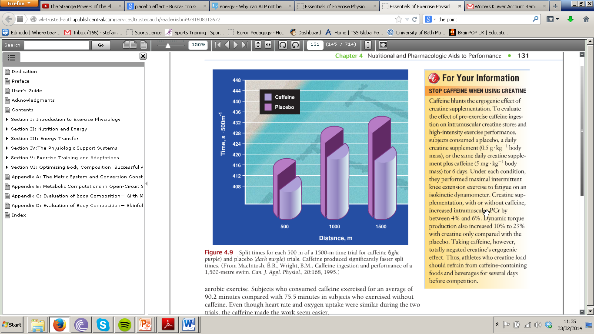

Slide 5
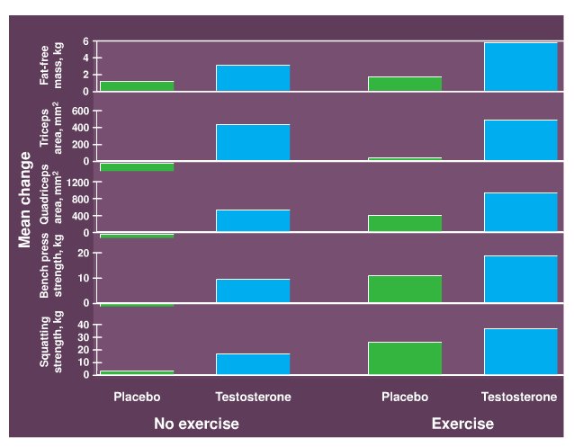

Slide 6
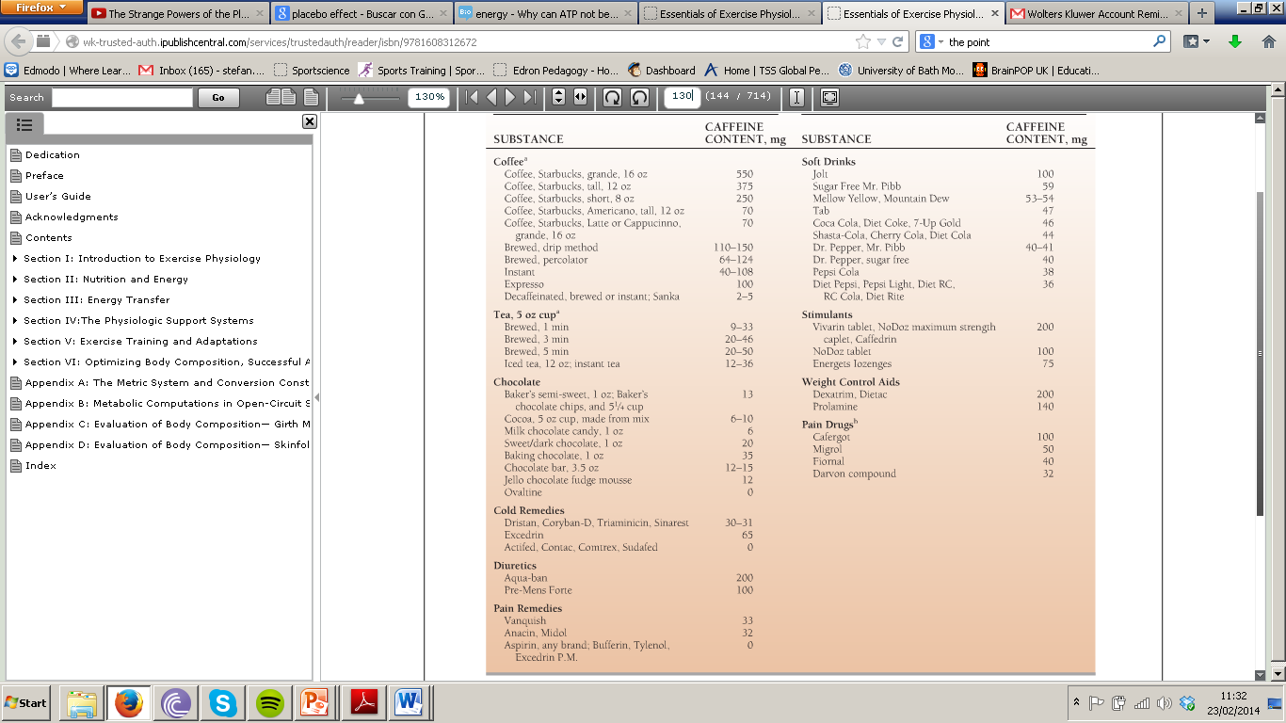

Slide 7
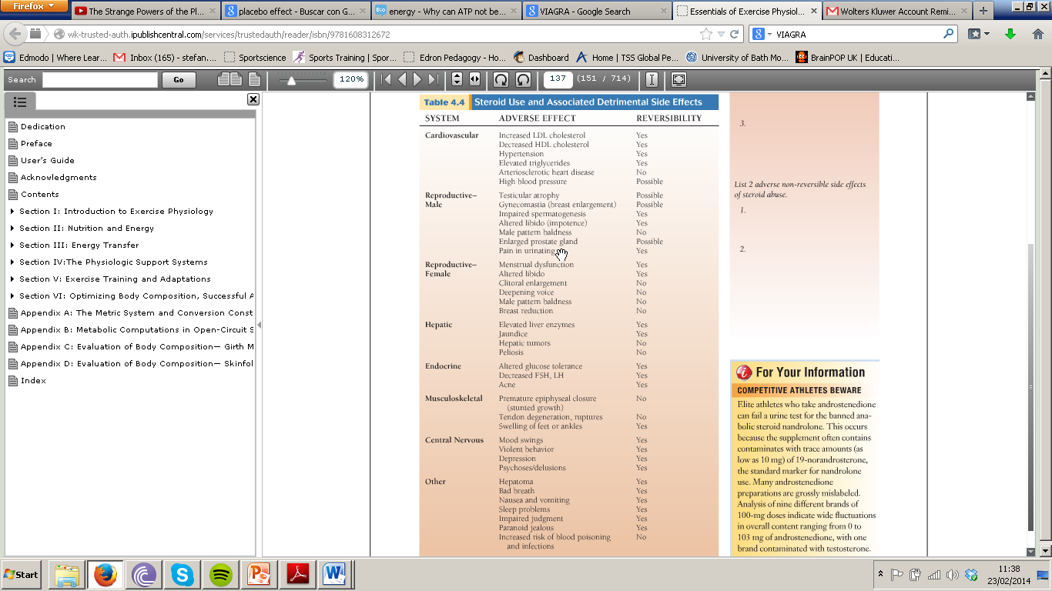

Slide 8
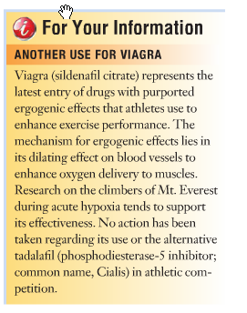


Slide 9
IB
Sports, exercise and health science
Optimizing physiological performance
A.3.3 List 5 classes of non-nutritional ergogenic aids that are currently banned by the IOC and WADA
Option A
You have 15 minutes to plan your information to complete the table. Make use of the course text and the internet to gather up-to-date research.
Sub-topics
Expert in:
Anabolic steroids
Hormones and related substances
Diuretics and masking agents
Beta blockers
Stimulants
A1. Training
A2. Environmental factors
A3. Non-nutritional ergogenic aids
Notes:
9

Slide 10
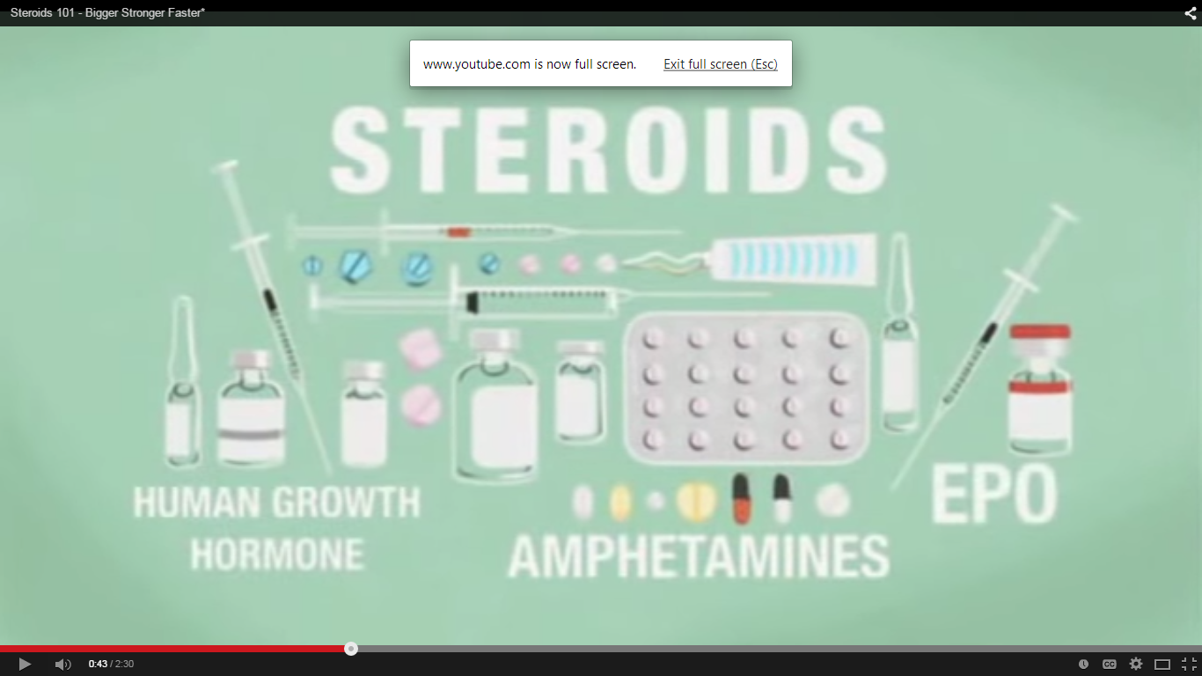

Slide 11
Review this website
What do you see?

Slide 12

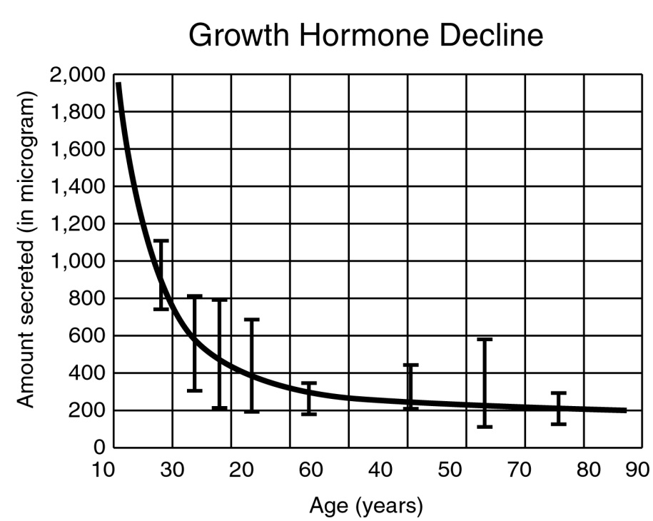

Slide 13
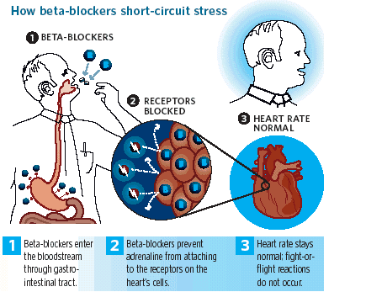

Slide 14
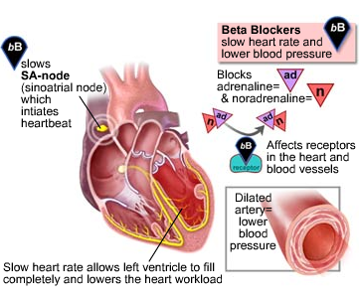

Slide 15
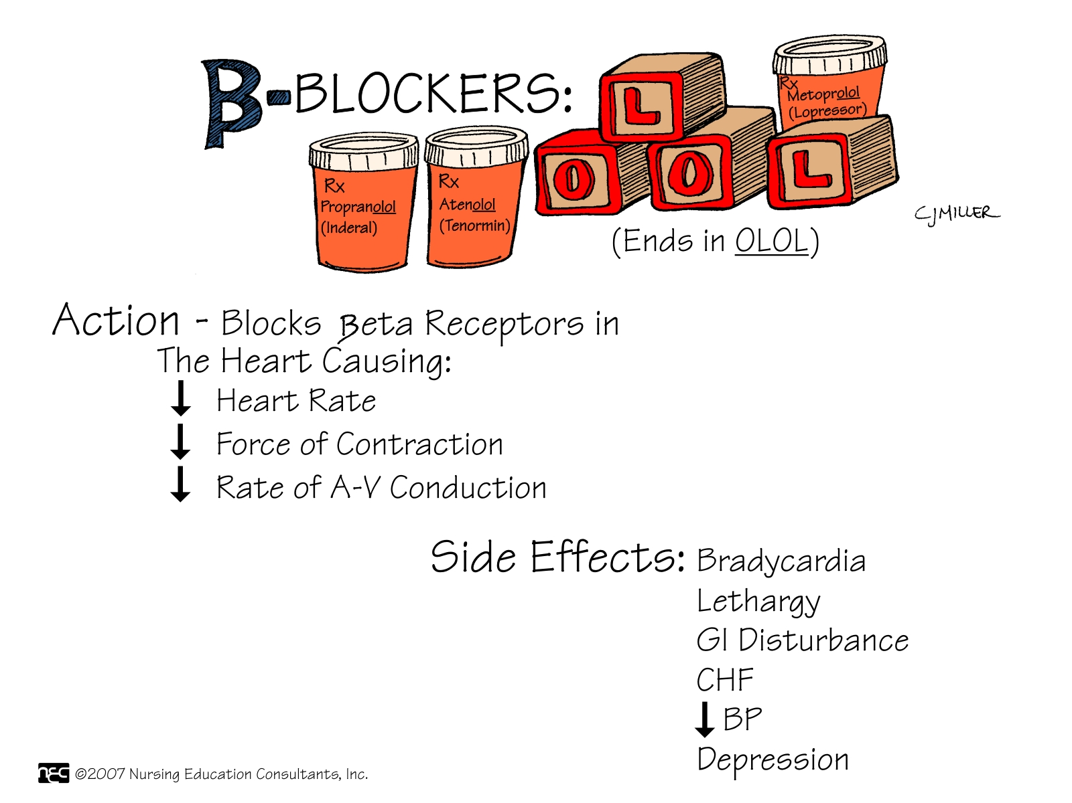

Slide 16
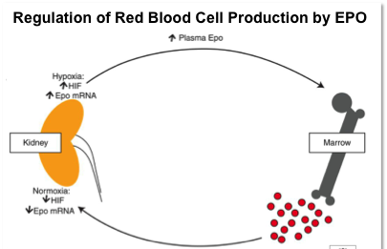

Slide 17
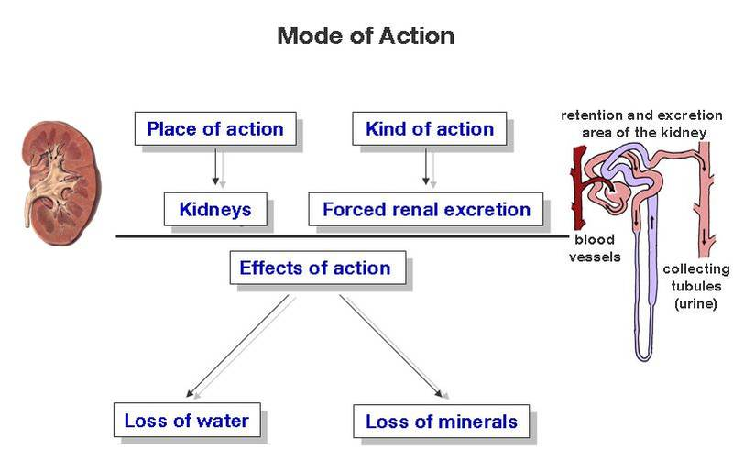

Slide 18
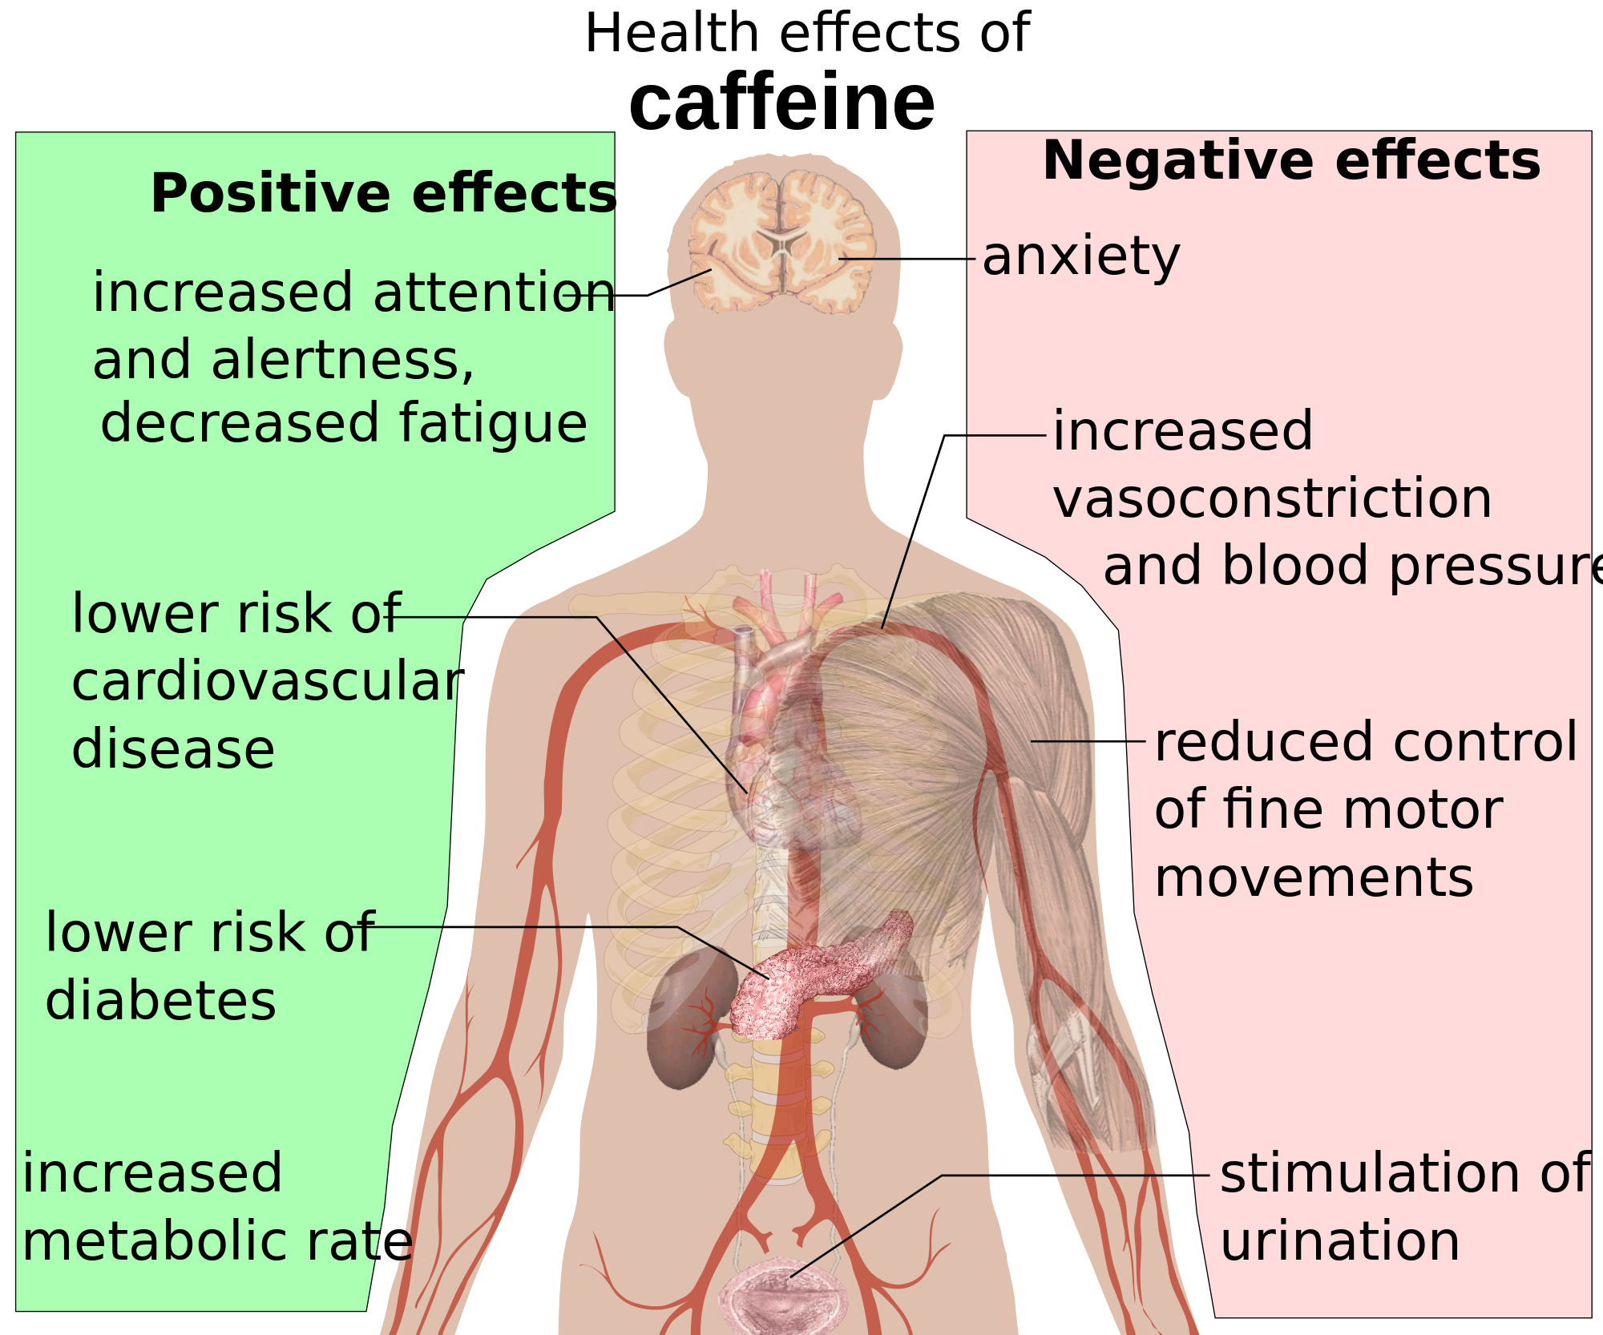

Slide 19
IB
Sports, exercise and health science
Optimizing physiological performance
Option A
A3.4 Discuss why pharmacological substances appear on the list of banned substances.
Essay question: The discussion should focus on the moral obligation of athlete to compete fairly and on the safety issue around the use of these substances.
(500 words for submission in hard copy)
Sub-topics
A1. Training
A2. Environmental factors
A3. Non-nutritional ergogenic aids
Notes:
19

