Slide 1
Opinion Writing
Essay Writing Structures

Slide 2
On Demand Writing
Think of a topic or issue that you know and care about, an issue around which you have strong feelings. Tomorrow, you will have 45 minutes to write an opinion text in which you will write your opinion and tell reasons why you feel that way. When you do this, draw on everything you know about essays, persuasive letters, and reviews. If you want to find and use information from a book or an outside source, you may bring that with you tomorrow. Please keep in mind that you’ll have 45 minutes to complete this, so you’ll need to plan, draft, revise and edit in one sitting. In your writing, make sure you:
Write an introduction Acknowledge counterclaims
State your opinion or claim Use transition words
Give reasons and evidence Write a conclusion
Organize your writing

Slide 3
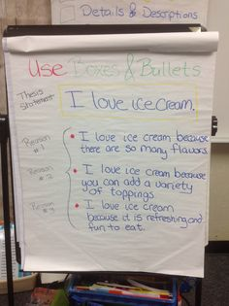
Boxes and Bullets
Put a box around the main idea of what you are writing about. (The box)
List supporting ideas/facts that support your main idea. (The bullets.)

Slide 4
Strategies for coming up with essay ideas
Take a subject that matters to you and list ideas related to that subject
Take one of those ideas and write about it
Observe then write
Let writing spark new thoughts
Take those sparks and write new entries
Reread earlier writing and ask questions about those entries

Slide 5
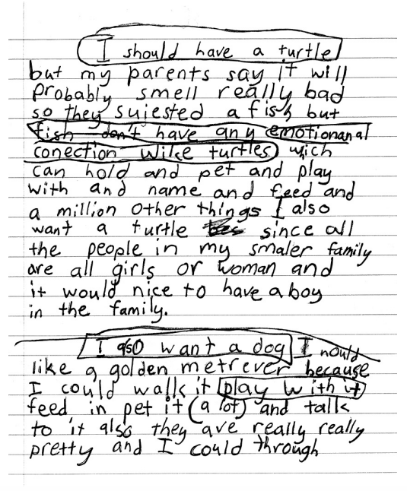
Freewriting

Slide 6
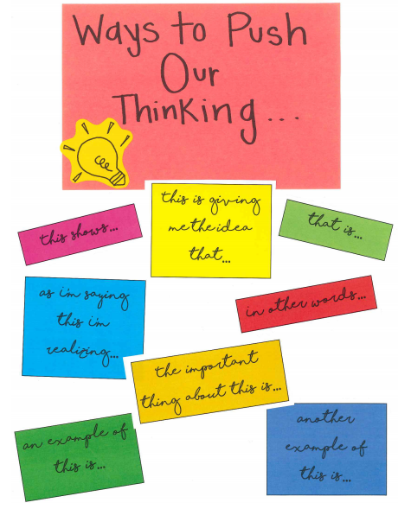
Ways to push our thinking

Slide 7
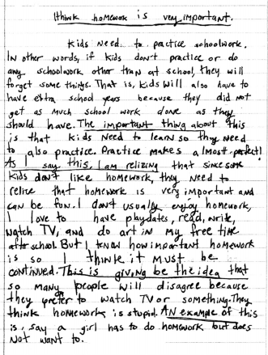
Ways to push our thinking

Slide 8
Choosing a thesis (a topic)
If you look up the word “claim” in the dictionary it will say:
verb : to state as a fact : insist to be true <“But our friend the Woggle-Bug claims to be highly educated …” — L. Frank Baum, The Marvelous Land of Oz>
noun : a statement that others may dispute <Do you believe his outrageous claims?>
Make a claim about a topic. Choose something that you know about, something you have personal experience with. It can be something that you like or do not like. Something you think is the best or the worst. Something that you think is important or not important.
“I think that ____ is ______. I think this because ________.”

Slide 9
On Demand
SESSION 6 HOMEWORK
Boxes and Bullets
Fast and Furious Flash-Drafting
Writers, we are about to start a new bend in our unit. You will be developing your essay. To do this work well, you will want to keep your personal goals right in the front of your minds. Tonight I am asking you to do another on-demand. Set your clock for a half hour or forty minutes and write fast and furiously to support a strong opinion. Bring that piece with you tomorrow because you’ll spend tomorrow assessing your work and reminding yourself of your personal goals as you head into the next part of the unit!

Slide 10
The structure of an essay
Start with the big idea (the topic, the thesis)
Give reason
Give a variety of evidence
Repeat the reason and big idea (the thesis)

Slide 11
The structure of an essay
Start with the big idea (the topic, the thesis)
Give reasons, tell a story, ask a question
Repeat the big idea
Start with the big idea
Give one of the reasons
Give a variety of evidence
Repeat the reason and the thesis
Start with the big idea
Give one of the reasons
Give a variety of evidence
Repeat the reason and the thesis
Start with the big idea
Give one of the reasons
Give a variety of evidence
Repeat the reason and the thesis
Start with the big idea
Review the reasons
Finish with the big idea

Slide 12
Lead - Introduction
Have you ever been to Washington D.C.? Whether you have or have not, I think Washington D.C. is a great place to visit. When I was around 10 years old, my big sister and my older brother both went to college in Washington D.C. and I got to visit them when I was just a kid. Then when I was old enough for college myself, two of my best friends went to school in Washington D.C. and I was able to visit them on weekends and during school breaks. Many years later I met a girl, and before she became Mrs. Lurie, she lived in Washington D.C. and I would visit her there all the time. Throughout the years I have had a chance to visit this awesome city, and because of all I have seen there, I think that it’s a great place to visit.

Slide 13
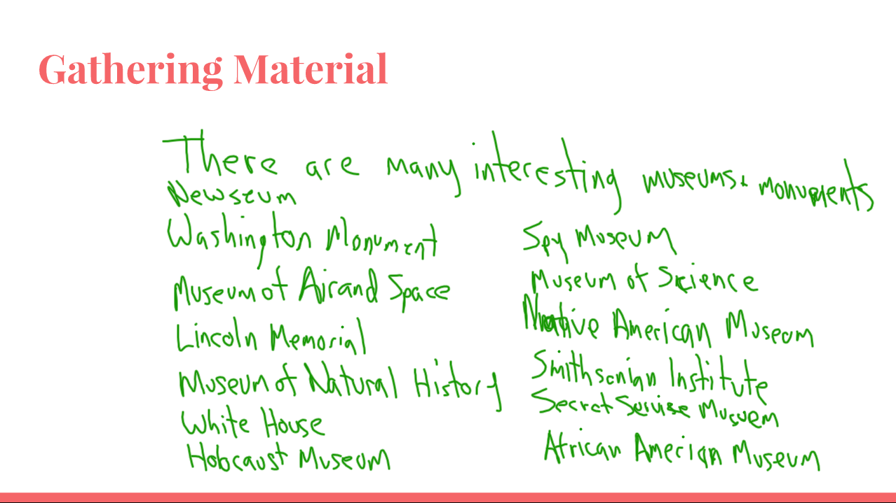
Getting Material

Slide 14
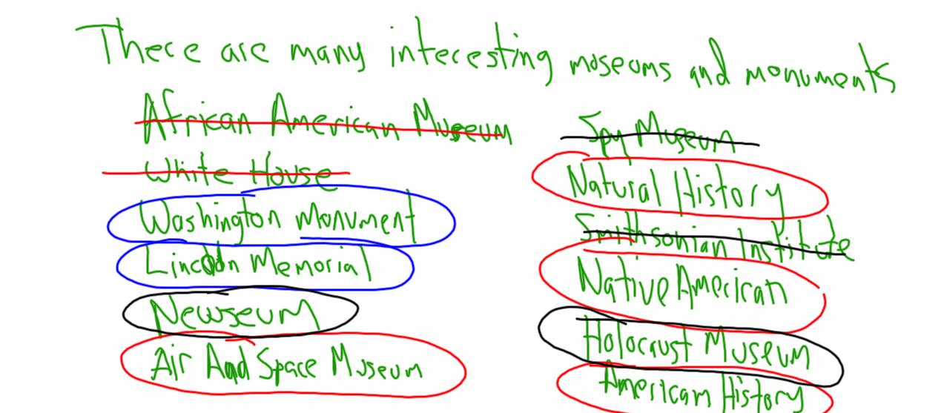
Gathering Material

Slide 15
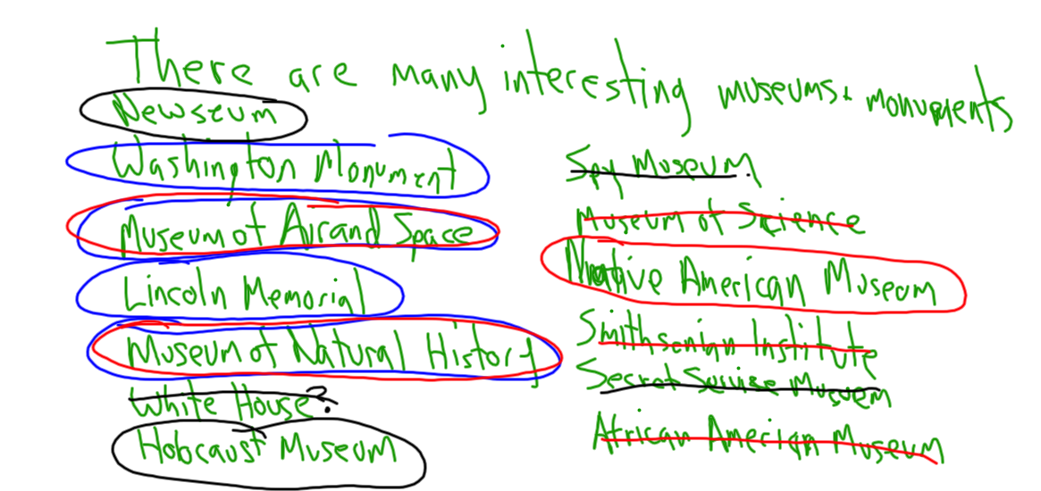
Gathering Material

Slide 16
1st Reason
When visiting Washington D.C., one of the best parts of being there are all of the interesting museums to see. One example of this can be found at the National Mall in Washington D.C. As I’m saying this, I’m realizing that it’s not the type of mall where you go shopping, it’s a large area where you can see many monuments and museums. One example is the Air and Space Museum where you can see planes and space capsules. Also, the Museum of Natural History has fossils and interesting things from nature. Plus, the Museum of American History has a giant American flag while the Native American Museum has all types of art and a cafeteria with really interesting food from Native American cultures.
In addition to the National Mall, there are other museums around the city as well. Unlike the national museums, these are museums you have to pay admission to get into. There is a Holocaust Museum where you can learn about a tragic time in and around Germany during World War II. Another example of a museum elsewhere in the city is the Newseum. It’s a great place to learn all about newspapers, radio and TV, throughout our history. All of the museums and monuments are definitely a reason to visit Washington DC.

Slide 17
2nd Reason
Another reason Washington DC is such a great place to visit is because there are so many awesome places to eat. If you like chili, there’s a place called Ben’s Chili Bowl, where they put chili on top of tater tots, or on a special hot dog called a half smoke. A second example of a great place to eat is Wisemiller’s near Georgetown University. Georgetown is an area full of great places to eat, but if you like a big, delicious sandwich, Wisemiller’s is the place to go. In addition, if you like pizza, there’s an area called Adam’s Morgan where you can get a Jumbo Slice, with your choice of topping. It’s like two slices of pizza in one. One of the best parts about visiting Washington DC can be eating some really good food.

Slide 18
3rd Reason
One more reason Washington DC is a great place to spend some time is Nationals Park. A baseball team called the Washington Nationals play there. If you’re a baseball fan, it’s a great place to watch a game. Even if baseball is not your thing, you might enjoy the race they have every game where people dressed like presidents from history have a race around the outfield. Plus, they have an area outside the stadium called the bullpen where you can play bean bag toss or listen to live music. Nationals Park is a fun place to hang out for a while and going there is a great excuse to visit Washington DC.

Slide 19
Ending
Washington DC is such an interesting place to go. There are cool museums and monuments to visit all over the city. If you like to eat like I do, there’s so many great places to choose from. If you like baseball, or even just a fun place to hang out, Nationals Park is a great place to spend some time. For all these reasons, I think that Washington DC is a great place to visit. You should check it out for yourself, I think that you would really enjoy it too!

