Slide 1



7th
Grade
Social Studies
Mrs. Hill
UNCC Team

Slide 2
About Mrs. Hill
Bachelor’s Degree in Dance Education from University of NC Greensboro
Master’s Degree in Elementary Education from Gardner Webb University
Middle Grades Social Studies Certified
25 Years in Education – 4 of those at Mt. Pleasant
Subjects I have taught:
  Dance 6-8
  3rd grade at Rockwell Elementary School
  7th Grade Social Studies

Slide 3
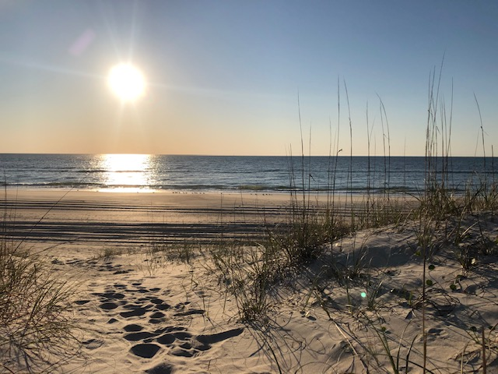
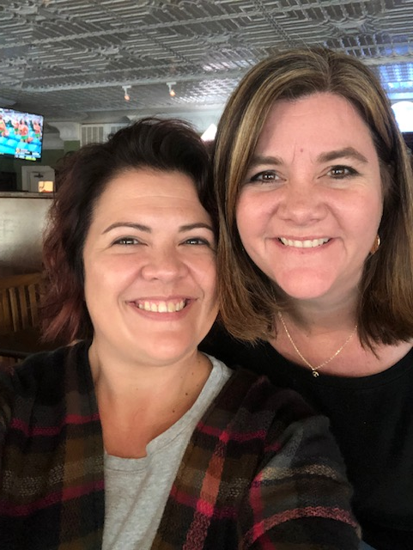
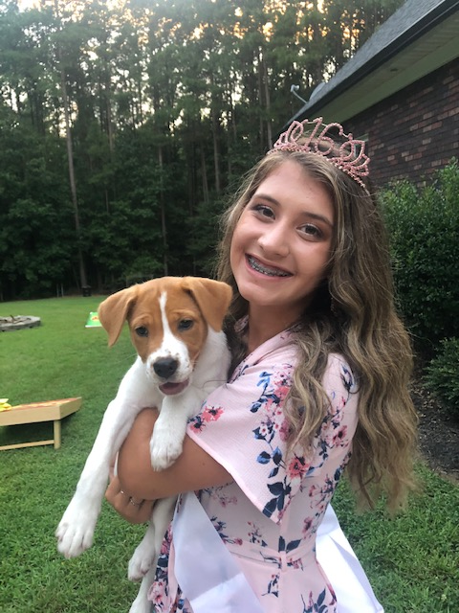
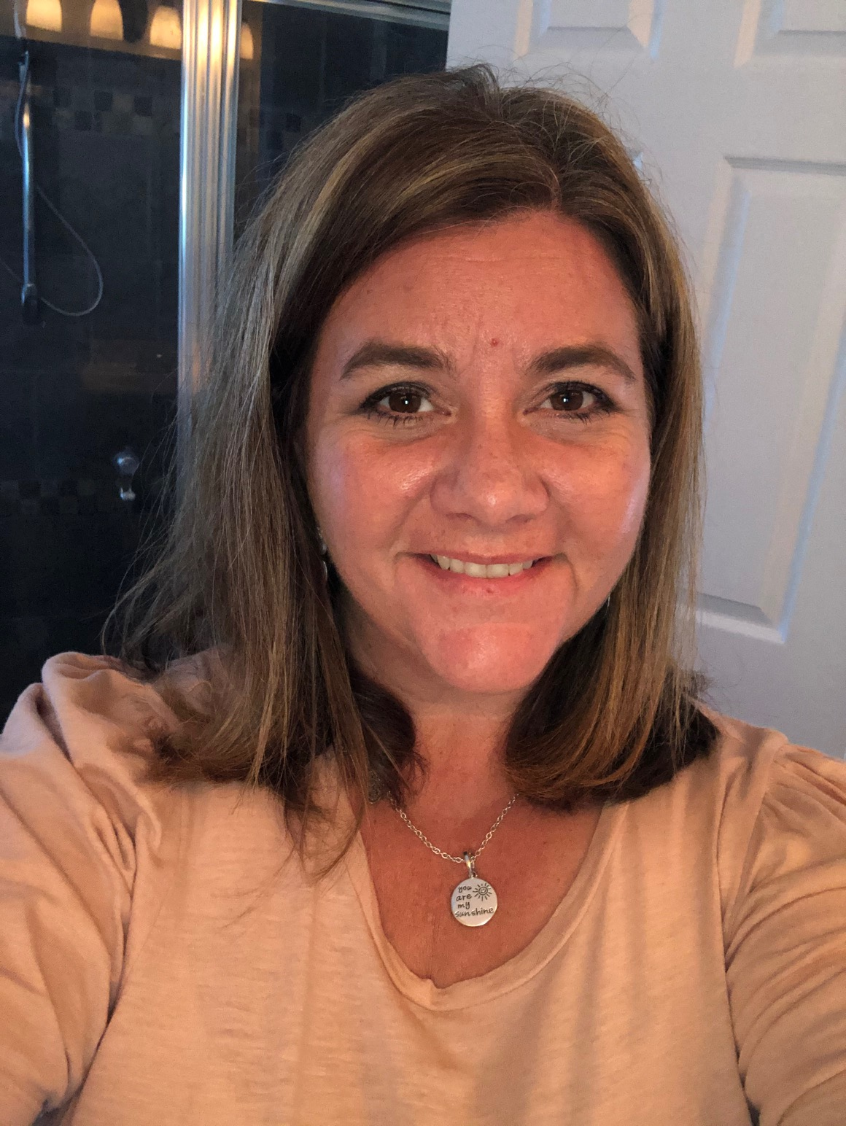
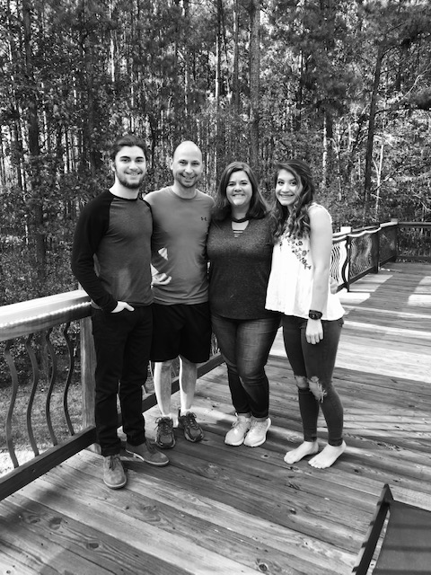
About Mrs. Hill
I am married to Tim Hill and have 2 kids Brendan and Brennah.
We have a new puppy Ava.
My hobbies and passions include:
  Going to Carolina Beach (sunrise to sunset)
  Walking/Running and listening to all kinds of music
  Spending time with family and friends

Slide 4
Supplies you will need at Home:
A 100 page Marble Composition Notebook (no spirals)
2 pocket folder
glue stick
notebook paper
colored pencils
colored pens
pencils
We will be creating an interactive notebook.
Writing is a very important memory process.

Slide 5
synchronous Classes
Live classes on Microsoft Teams.
Monday – Thursday
About 30 minutes of direct instruction and 30 minutes of practice.
Practice time may be independent or may be in groups.
I will be available during practice time to answer any questions.

Slide 6
7th Grade Remote Learning Schedule
Live Classes Monday-Thursday
9:00 – 9:20 Homeroom
9:25 – 10:16 1st Block Encore (M,W)
9:25 – 10:16 2nd Block Encore (T, TH)
10:18 – 11:18 3rd Block
11:18 – 12:10 Lunch/Screen Break
12:10 - 1:10 4th Block
1:12 – 2:12 5th Block
2:15 – 3:15 6th Block

Slide 7
Asynchronous Classes
Fridays
Independent assignment posted on Canvas.
You must check in on Fridays at 9:00 am to be counted present for the day.
Work will be assigned and, sometimes, due on Friday.

Slide 8
7th Grade Social Studies Units
World History
Geography
Systems of Government
Systems of Economics
Review/Plague/Renaissance
Reformation
New World Exploration
Absolute Monarchies
Enlightenment/Age of Reason
Revolutions
Napoleon/Congress of Vienna
Industrialism/Industrial Revolution
Imperialism/Nationalism
World War I
The World Depression
World War II
Modern World/Cold War
Current Events

Slide 9

Grading policy
All assignments will be submitted on Canvas.
Unlike in the Spring, all assignments this fall will be graded!
Students are expected to try their best on all assignments.
Assignments must be completed on time. Work submitted late will have points taken off.

Slide 10
Mrs. Hill's contact info
Email: Rebecca.hill@cabarrus.k12.nc.us
Office Hours:
  Monday – Thursday
  10:00 – 11:15 and 3:15 – 4:00
  I suggest students and parents join both Reminds. I usually post about upcoming events and assignments. Only parents should use the Google Phone Number!!!
Remind Code:
UNCC Team: @unccteam
Class Code: @hillssmp
Google Phone Number:
(919) 526-0275

