Slide 1
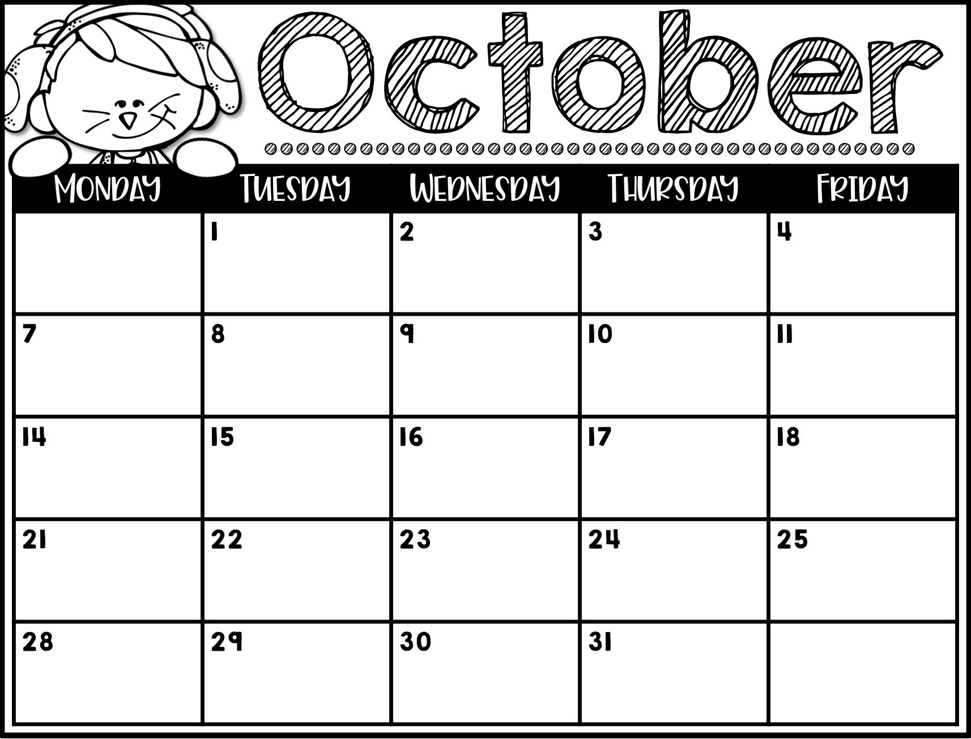
Chinese
Media
PE
Art
Fit Lab
MakerSpace
Chinese
Media
Zootastic
Art
PE
Music
Chinese
Media
PE
Art
Fit Lab
MakerSpace
Chinese
Art
Letterland Parade
No School
Media
PE
Type Here

