Slide 1

HUMANITARIAN SOCIETY
10/18/2018 Meeting
(Enjoy the Peanuts gifs.)

Slide 2
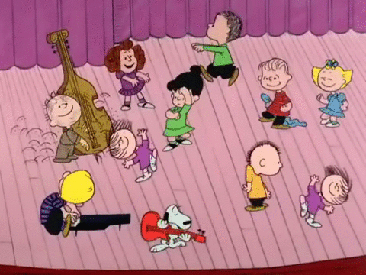
Attendance
Please fill out:
http://bit.ly/1018meeting
*Next meeting: Thursday, November 15*
Notes:
Girls on the run sign up genius fall festival holiday party winter wear everything but jackets OCT TO DEC

Slide 3
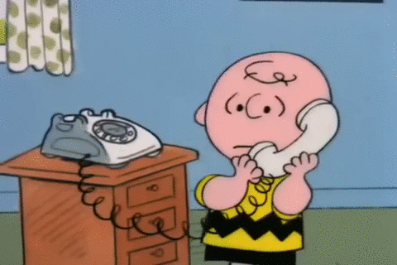

Socials
Twitter:
@CMHShumanitary
Remind:
Text @cmhum to 81010

Slide 4
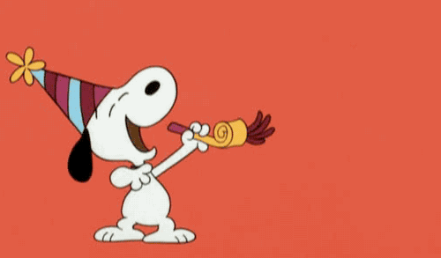
T-Shirt Update!
Notes:
Update people with progress of tshirt ordering, when* they are expected to get shirts, process to pick up shirts

Slide 5

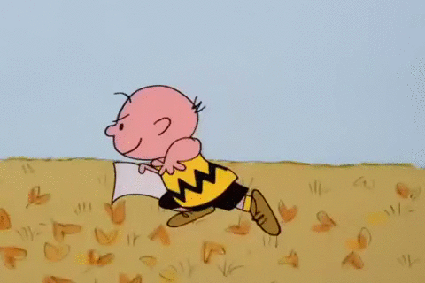
Girls on the Run - North Region 5k
When: Sat, Dec. 1
  Times vary on position
Where: Concord Mills
Star Power Course Crew
  10 spots reserved for us: PRIORITY!
  Cheering runners along course, 7:15 AM - 10:30 AM.
Other Positions
  Merch, Face Painting, Set Up, etc.
Wear HUMSO or CMHS shirt, take pictures!
http://bit.ly/gotrhumso
Notes:
*add in link and information about signing up,,, wearing shirts?? https://www.raceplanner.com/register/index/5kvolregfall18-NORTH?sid=3f449978f078465282d43cb2c73b3549 -> humso society category

Slide 6
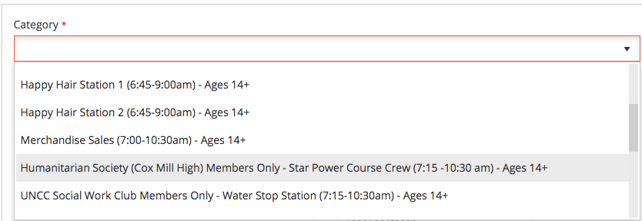

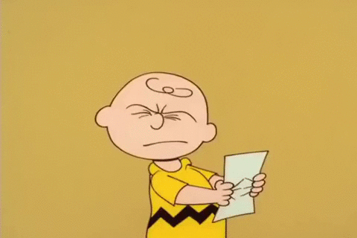
We have 10 spots reserved. Please consider this position and sign up ASAP before the spots are opened to the public!
(That’s us.)
*Unsure if option goes away once it reaches 10 sign ups. If it does, don’t panic; choose another position. :)

Slide 7
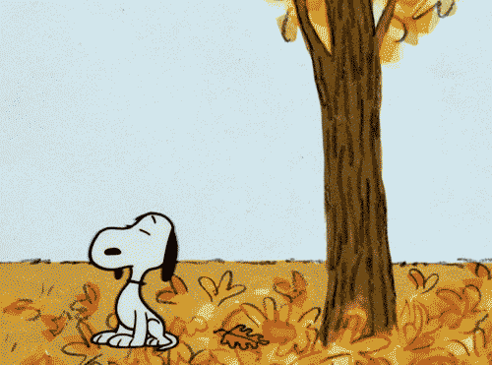
CMES Fall Festival
When: Sat, Nov. 3
  10am-1pm ish
Where: Cox Mill Elementary
Wear HUMSO or CMHS shirt, take pictures!
http://bit.ly/humsofall
Notes:
*email stout, hopefully get a sign up genius link https://docs.google.com/forms/d/e/1FAIpQLScAdDM61pNw9N-DiZeTpOgWbLUStpIN5IkaQFVH3QO8R5WNtA/viewform

Slide 8
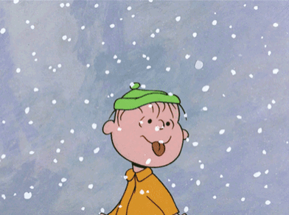
Winter Wear Drive
For the Boys & Girls Club
Donate winter gear
  Gloves, Hats, Scarves, Mittens
  NO JACKETS
Collecting items today through the December meeting
  December 14th*, subject to change.

Slide 9
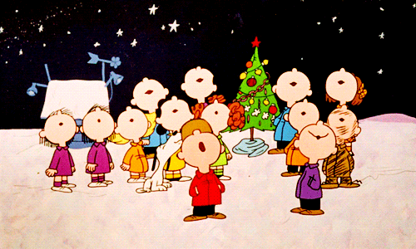
Holiday Baskets
Merry Christmas!
Holiday baskets for teachers
Collecting donations
Due: Tues, Dec. 4th
Maximum of 2 volunteer hours (~ 4 items)
http://bit.ly/humsodonate

Slide 10
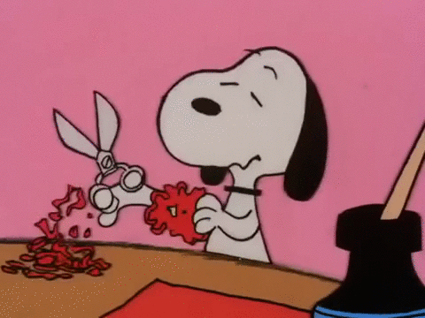
Mini Project - Valentine Grams
Happy Valentines Day!
We are helping assemble the Valentines Grams for CMES!
Estimated to sell over 1500 of them.
Ongoing, quick hours.
Today: adding on stickers
Notes:
*add in example picture

Slide 11
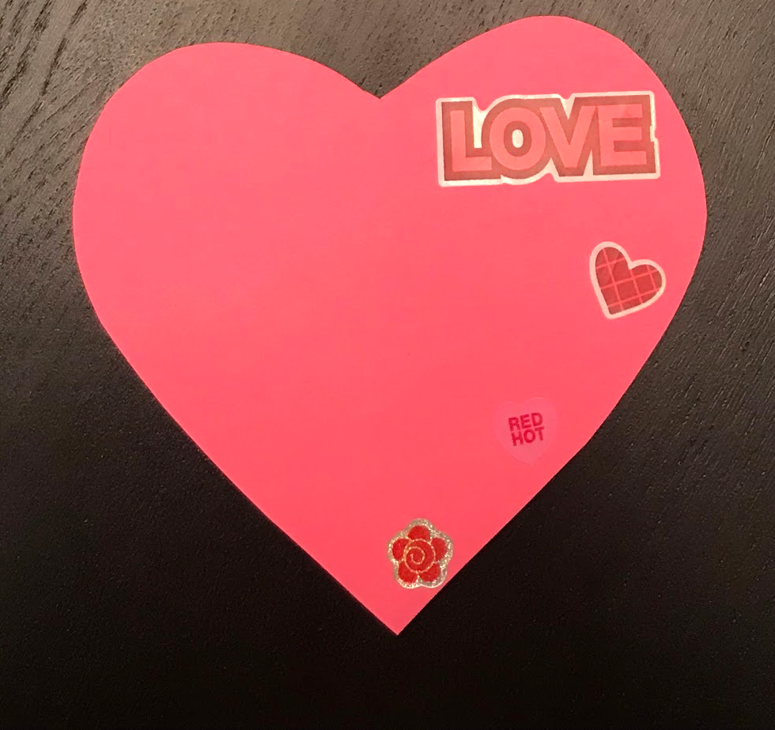
30-ish VALENTINE GRAMS = 1 HOUR!
Big Sticker
2-3 Little Stickers
Keep everything on the right side of the heart!
Show an Officer when you are done to sign sheet. You are free to leave when you are done. Thank you!

