Slide 1
Nutrition
Match each title to the correct definition

Slide 2
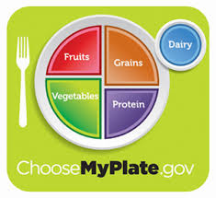
5 Food Groups
Dairy
Grains
Protein
Vegetable
Fruits

Slide 3
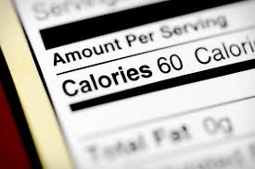
Calorie
A measurement of energy in food. The more calories a food has the more energy it provides the body. 2,000-2,500 calories per day is a healthy amount.

Slide 4
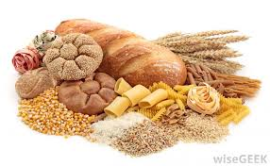
Carbohydrates
The starches and sugars found in food. The bodies preferred source of energy. Comes from food such as pasta, bread, and cereal.

Slide 5
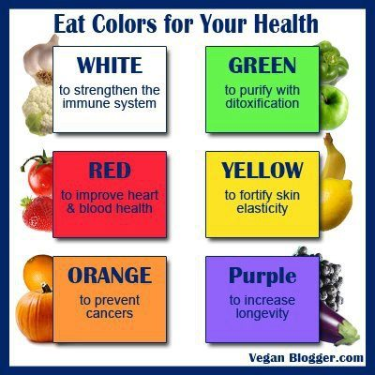
Color
A healthy meal should have plenty of color on your plate. If it has many colors then you are likely to have eaten from all of the food groups.

Slide 6
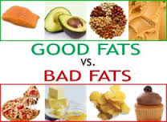
Fats
Represents the most concentrated form of energy available. Too much is unhealthy but your body still needs some.

Slide 7
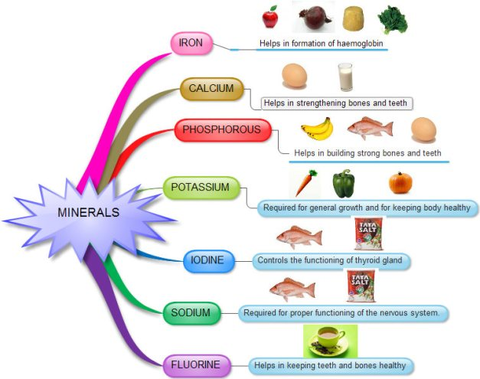
Minerals
Substances the body cannot manufacture but help to regulate many body processes. Examples are calcium, iron, and potassium.

Slide 8
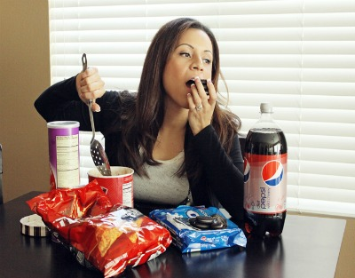
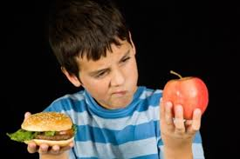
Moderation
Not eating more than we need. Eating small portions of each food group per meal.

Slide 9
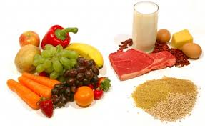
Nutrients
Substances in food that the body needs to function properly. Examples: protein, carbohydrates, fats, water, vitamins, and minerals.

Slide 10
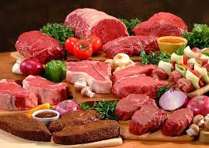
Protein
Helps build and maintain strong muscles. Comes from different animal products such as chicken, beef, turkey, and eggs.

Slide 11
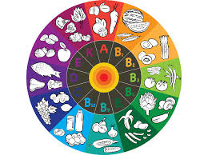
Vitamins
Compounds that help regulate vital body processes such as digestion and metabolism of foods. Examples are Vitamin A, Vitamin D, and Vitamin C.

Slide 12
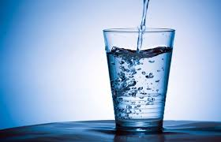
Water
A regulator and vital to every body function, Makes up the greatest percentage of your body. 2/3=66%

