Slide 1
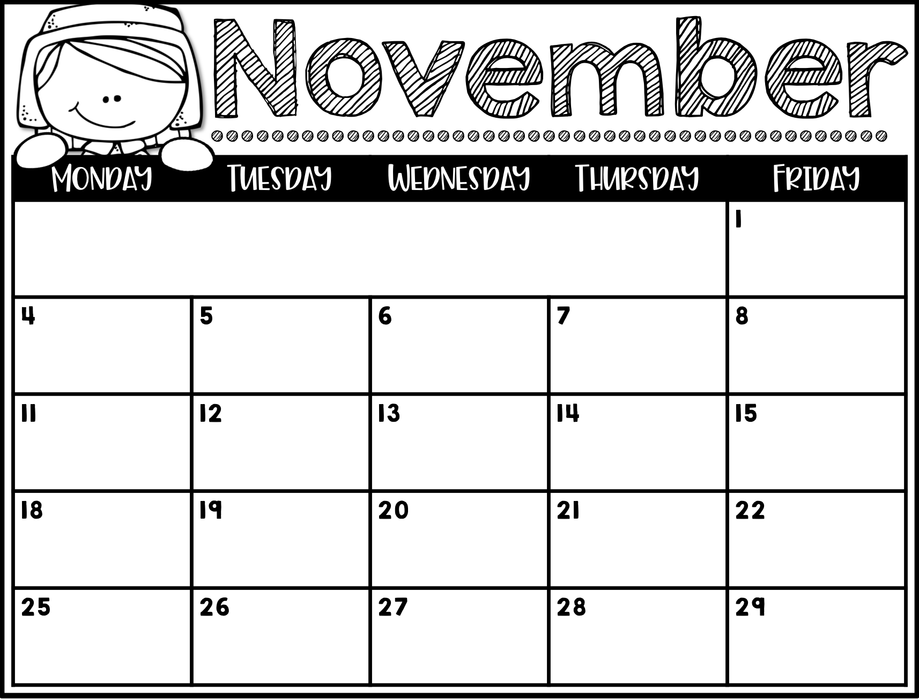
PE
Type Here
Playground
Music
No School
Chinese
Media
PE
Playground
Courtyard
Courtyard
Swings
Art
Fit Lab
Makerspace
Chinese
No School
Swings
Playground
Playground
Courtyard
Media
PE
Art
PE
Music
Courtyard
Swings
Swings
Playground
Playground
Chinese
Media
No School
No School
No School
Happy Thanksgiving!
Courtyard
Courtyard

