Slide 1
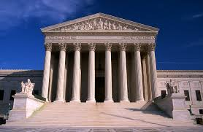
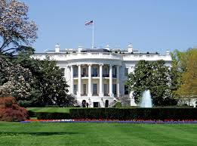
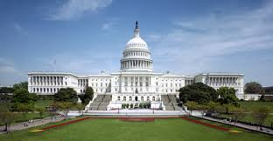

What is Civics?

Slide 2
Define: Government?

Slide 3
DEFINE: Citizen?

Slide 4

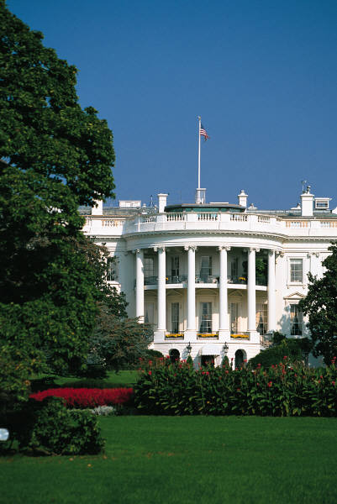

What is Civics?
Civics: the study of government and citizenship
  Government: the power or authority that rules an area
In our government we have 3 branches
  Legislative Branch: makes the laws
    Made up of the US Congress
  Executive Branch: executes (carry out) the laws
    Made up of the President, VP, and executive agencies
  Judicial Branch: judge the laws
    Supreme Court, Courts of Appeals, District Courts

Slide 5
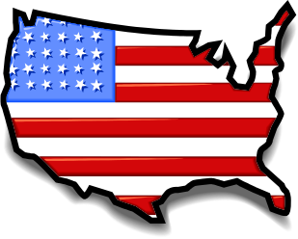
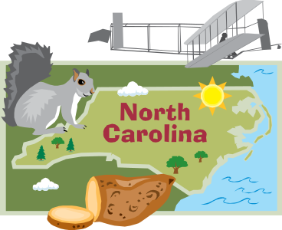

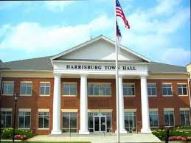
Levels of Government
Nation-US
State-NC
Local
  County/Parish-Cabarrus
    City
    Town-Harrisburg
    Village
But what’s the purpose of government???

Slide 6
TPS:
Make a List of The Legitimate Purposes Of Government?

Slide 7


The purpose of government is to…
Make Laws
Enforce laws
Keep order
Security
Provide services
Guide the community
What do we call people who
live in a community? How can
you become one?

Slide 8
How can one become a citizen?

Slide 9

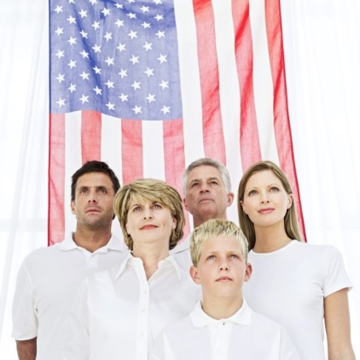
A Citizen is…
a member of a community with a government and laws who share a common history, customs, and values
The 14th amendment of the US Constitution establishes two ways to become a citizen:
By blood:
  Born on US soil (or American territory)
  Parent is a US citizen
By naturalization
  Naturalization: the process to becoming a US citizen
***A child born abroad to American parents may hold dual citizenship

Slide 10
Naturalization
More than 40% of the foreign-born people who live in the US are naturalized citizens
To apply for citizenship you must:
  Be at least 18 years or older
  Be a lawful permanent resident for 5 years
  Be able to read, write, and speak English
  Must be of good moral character
  Show an understanding of US civics
  Naturalization Process
  1-Complete an application-officials make sure the applicant meets the 5 requirements
  2-Take a citizenship exam

Slide 11
Explain America as a “Melting Pot?”

Slide 12

Foreign-Born Residents
Many people in the US are aliens (foreign born residents who have not been naturalized)
Legal aliens: are in the US lawfully
  Have many of the same rights as US citizens, can hold jobs, own property, attend public schools, and receive government services
  They pay taxes and have the right to be protected by the law
  They cannot vote in elections, run for office, serve on juries, or work in most government jobs
  They must carry identification cards at all times

Slide 13
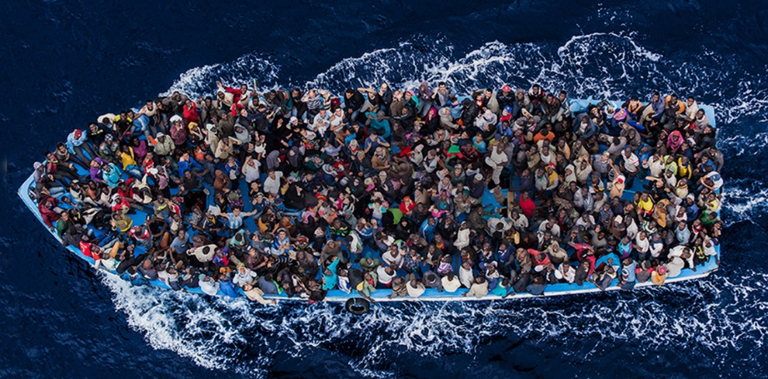
Foreign-Born Residents
The US accepts some people as refugees
A refugee is someone fleeing his/her country to escape danger
  Persecution from the government
  Natural disaster
  Political refugees-the government promises to protect him/her; only grant this status to people if they can prove that they really are in danger if they return to their homeland

Slide 14

Foreign-Born Residents
The US limits the number of immigrants who can enter the country each year to about 1 million people
The relatives of US citizens receive the highest priority, as well as those with job skills that are in high demand
As a result, some people decide to come to the country without the government allowing/knowing about it
  Called "illegal aliens"
Each year, about 1 million aliens enter or remain in the country illegally

Slide 15
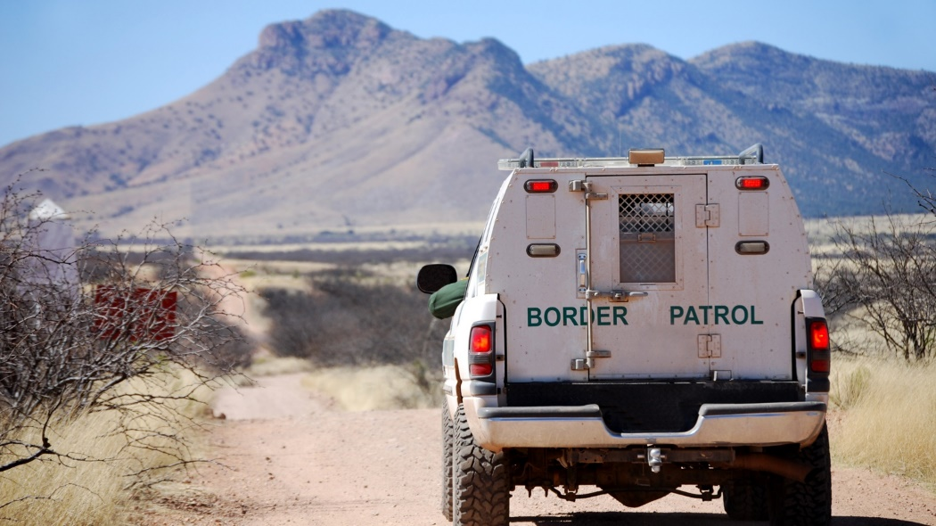
Foreign-Born Residents
These illegal aliens can be arrested and deported back to their home countries if they are discovered
Close to 12 million people are living in the US illegally

Slide 16
Define: Values
Why are they important to a nation like the US?

Slide 17
American Values
Values: are ideas about what is good or desirable that are shared by people in society
US Basic Values:
  Freedom
  Equality
  Opportunity
  Justice
  Tolerance
Values unify a nation

Slide 18
Where Do Values Come From?

Slide 19

American Values
Our government is based on our country’s political heritage
  Declaration of Independence
  US Constitution
  Bill of Rights
Popular sovereignty: government by the consent of the people
  We give our consent to the government by voting in elections
  All US citizens are eligible to vote

Slide 20
What is the difference between a Duty and a Responsibility?

Slide 21
Civics Responsibilities & Duties
Civic Responsibilities: what citizens should do voluntarily
  Examples: voting, staying informed on current events, volunteering in the community
Civic Duties: what citizens are required to do; penalties for not doing so
  Examples: Following the law; going to school (until 16); drafted in the military

Slide 22

Volunteerism
Offering your time and services to others without receiving payment
More than 63 million people, aged 16 and older participate in volunteer work
More than 1 million charities in the US
  AmeriCorps: members work in education, public safety, health and the environment. For a year of service, they receive money to help them live and to pay for college
  Senior Corps: volunteer organization for older people
  Learn & Serve America: promotes service learning in schools such as analyzing the local water supply, links community service with classroom work

Slide 23
C&E Journal Entry #1
In 6-8 sentences, answer the following questions?
What is Civics?
What problems could result from a society that lacks Civic knowledge?

Slide 24
Citizenship test Kahoot
https://create.kahoot.it/details/us-citizenship-quiz/3e3dd88b-a5bc-417f-9656-cf946b37f6ab

