Slide 1
Our First Gov’t & The Constitution

Slide 2
What happened after independence?

Slide 3
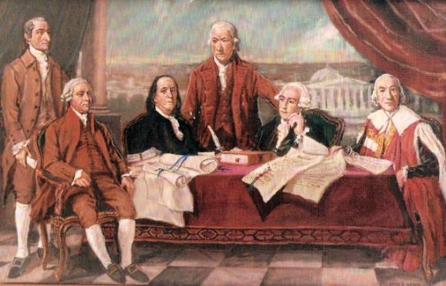
After Independence
American Revolution ended in 1783 with signing of the Treaty of Paris
The 13 colonies came together to form a confederate style government (states are more powerful than national government)
New Hampshire was the first colony to organize as a state and create a state constitution

Slide 4
Was the constitution our first system of govt?

Slide 5
Articles of Confederation
The first government after the American Revolution was the Articles of Confederation
  Drafted by the 2nd Continental Congress in 1777
  Gave little power to the federal government
  Gave most powers to the states
  States began fighting against each other and people feared America would not survive

Slide 6
Why would the founders create a weak federal govt?

Slide 7
What problems result from a weak govt?

Slide 8
Why was the Articles of Confederation so bad?
Extremely difficult to pass laws or amend the Articles
The Federal government could not enforce the laws
Unable to levy taxes, Congress had borrowed money to pay for the war
States also had big debts and overtaxed their citizens

Slide 9
Anything good about the AOC?

Slide 10
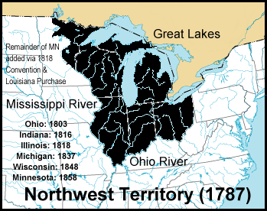
Anything “good” come from the AoC?
Northwest Ordinance of 1787
  Detailed how to achieve statehood (become a state)
    Congress appointed 3 judges and a government to a territory
    When population reached 5,000 adult male landowners -> elect territorial legislature
    When population reached 60,000 -> elect delegates to a state constitutional convention

Slide 11
Why did the founders scrap the AOC?

Slide 12
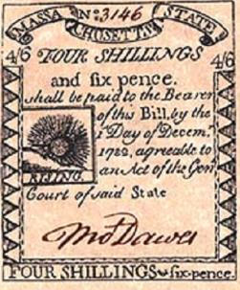
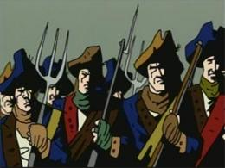
Shays Rebellion 1786-1787
Daniel Shays, an indebted farmer, felt the state had no right to take his farm away because of a problem (over-taxation) the state had created
He led an uprising, known as Shay’s Rebellion…included 1200 farmers
This unrest convinced leaders to revise the Articles of Confederation and make the national government stronger

Slide 13
Its time to create a new government! Do you do this in public or private?

Slide 14
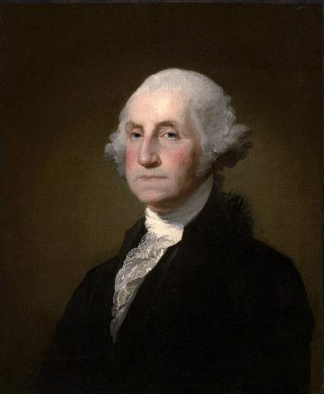
US Constitutional Convention
May 25, 1787
12 states send delegates
Rhode Island did not
Native Americans, African Americans, and Women were not present
George Washington was chosen to preside
Meetings held in secret
Decided quickly to discard (get rid of) the Articles of Confederation and start from scratch

Slide 15
2 Opposing Plans for Government
Virginia Plan - James Madison
  3 Branches of Government
  Bicameral (2 houses) legislature
    Representation based on state’s population
  Appealed to states with large populations
New Jersey Plan
  3 Branches of Government
  Unicameral (1 house) legislature
    Each state would have 1 vote
    Similar to AOC
  Large states opposed the plan because they thought they should have more power

Slide 16
2 sides have a disagreement! How do we bring them together?
How would you solve this?

Slide 17
The Great Compromise
Roger Sherman of Connecticut proposed a compromise to the Virginia & New Jersey plan
Bicameral Legislature (Congress)
  Senate-each state has 2 representatives
  House of Representatives-representation is based on population

Slide 18
New problem: If population determines representation, who do we count towards the population?

Slide 19
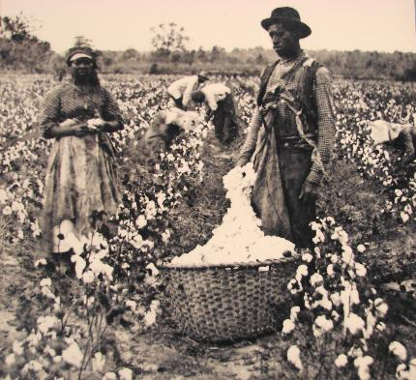
The Three-Fifths Compromise
In 1787, more than 550,000 African Americans were enslaved in southern states
The southern states wanted to count the enslaved toward their populations to ensure more votes in the House of Representatives
The northern states had few enslaved people and argued that slaves were legally property and did not vote or share in government and should not be counted
The Three-Fifths Compromise decided that three out of five slaves would be counted toward the population and toward taxes

Slide 20

Other Compromises
Northern states wanted Congress to regulate foreign trade and trade between states but the Southern states feared that Congress would then tax exports
  The Southern delegates agreed that Congress could regulate trade between the states and trade with foreign countries and in return, the North agreed that Congress could not tax exports and they could not ban the slave trade before 1808 (20 years later)
Some delegates thought Congress should elect the President while others thought it should be the people
  The Constitution established the electoral college, made up of people who would select a president and vice president
  Electors were named by the state legislators (today voters choose the electors)

Slide 21
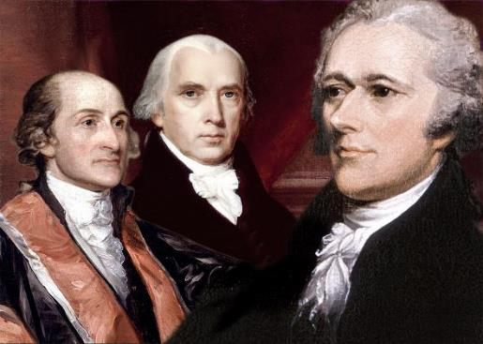
Approving the Constitution
Ratification required 9 of 13 states
Supporters called Federalists
  Wanted power divided between state & national government
  Federalist Papers: Hamilton, Madison, John Jay
    Published why the Constitution should be ratified
Opponents called Anti-Federalists
  Favored states rights (more rights for states)
  Wanted Bill of Rights included to protect individual rights
Both sides agreed on the Bill of Rights
Constitution took effect when New Hampshire became 9th state to ratify it on June 21, 1788

