Slide 1
Review
- What do you know about the Enlightenment?
What have been the greatest influences on the American Government? Or Who?

Slide 2
Influences on American Government
Intro to Citizenship & Government

Slide 3
The Foundations of Democracy
The rights, freedoms, and forms of government that we enjoy as Americans today did not begin with the ratification of the US Constitution
They can be traced to ancient times
One of the earliest foundations for democracy comes from Judaism which teaches that every person has worth and is equal before the law

Slide 4
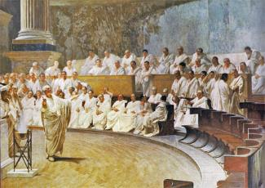
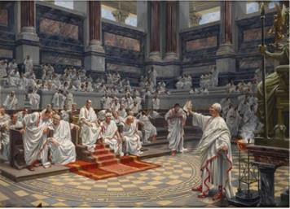
The Foundations of Democracy
The Greek city-state of Athens created the world’s first democracy
  All free men over 18 were considered citizens and could take part in the right to speak
  Citizens took turns serving on the council which governed Athens and were paid for their work
As the Athenians created democracy, the Romans created the world’s first republic
The Romans put the government into the hands of a senate where members were chosen from amount Rome’s wealthy upper class who were led by 2 consuls

Slide 5
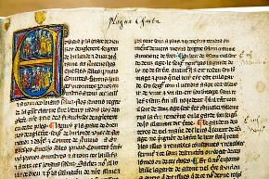
Early English Influences
Magna Carta:
  many nobles started to lose their wealth and power to developing towns
  In England, they rose up against King John in 1215 and forced him to sign the Magna Carta (Latin for “Great Charter”)
  This document limited the king’s power, forbade him from placing certain taxes on the nobles without their consent, gave rights to free men such as equal treatment under the law and to trial by one’s peers
  Also gave nobles the right to rebel if the king broke his part of the agreement
  Established the principle of ”limited government,” the idea that a ruler or a government is not all-powerful

Slide 6
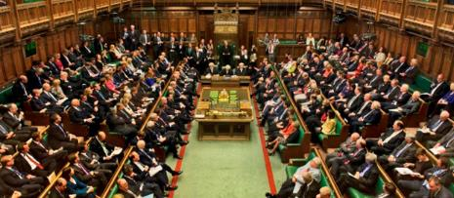
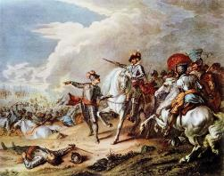
Early English Influences
Parliament:
  Early on, nobles and church officials would advise kings, eventually common folk became part of this group
  By the late 1300s, the advisers had become a “parliament”, or lawmaking body
  In the mid-1600s, a power struggle developed between King Charles I and Parliament
  In 1625, Charles I dismissed Parliament and ruled alone
  Eventually civil war broke out and Parliament removed the king and ruled without a monarch for about 20 years

Slide 7
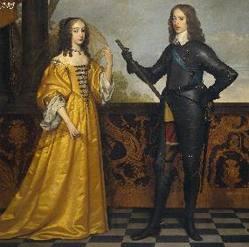
Early English Influences
The English Bill of Rights
  In 1688, Parliament forced King James II, the son of Charles I, from the throne
  Parliament asked Mary and her husband William, to rule instead
  This is known as the Glorious Revolution
  Before Mary & William could rule, they had to accept rules set by Parliament
  Parliament established these rules in the English Bill of Rights
    English citizens had rights that no king could violate
    Citizens had the right to a fair trial
    Citizens could not be taxed unless Parliament agreed

Slide 8

The Enlightenment
During the 1600s, scientific discoveries led to the belief that God had created an orderly universe
Some people thought that its laws could be discovered through human reason
During the Enlightenment, philosophers tried to apply the laws that ruled nature to people and society
This significantly influenced the political thinking in Europe and the Americas

Slide 9
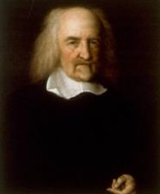
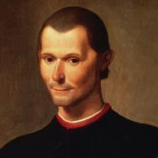
Enlightenment Thinkers
Niccolò Machiavelli was an Italian Renaissance writer and thinker best known for his book The Prince
  He argued that it is safer for a ruler to be feared than loved
  He praised republics as the best form of government
Thomas Hobbes an English philosopher who experienced the English Civil War
  Believed in a “social contract” which existed between government and the people
    In this contract, the people agree to give up some freedom and be ruled by government in return the government had to protect the people’s rights
  Thought people needed a strong leader because they were too selfish to be able to rule themselves

Slide 10
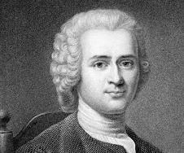
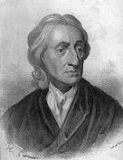
Enlightenment Thinkers
John Locke was an English philosopher who was influenced by the Glorious Revolution
  He published “Two Treatises of Government”
  Believed all people were born equal with certain God-given rights, called “natural rights” which included life, liberty, and property
  Also believed in social contract theory
  He believed that if a ruler failed to protect the rights of the people, the social contract was broken and the people could choose new leaders
Jean-Jacques Rousseau wrote The Social Contract where he said that “man is born free, yet everywhere he is found in chains.”
  This referred to the many Europeans living with little freedom
  He thought people had the right to decide how they should be governed

Slide 11
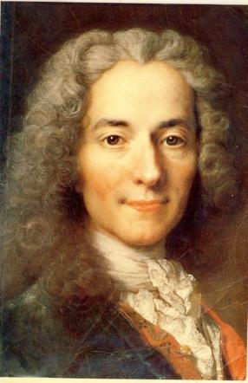
Enlightenment Thinkers
Baron de Montesquieu was a French writer who developed the idea that the power of government should be divided into branches
  He believed, no one branch would become too strong and threaten people’s rights
  This is know as separation of power
Voltaire was a French writer who believed people should have liberty
  Supported freedom of religion and freedom of speech

