Slide 1
The Diversity of Americans

Slide 2

Fast Facts
Today, about 13% of all Americans were born in another country
About 98% of all the people now living in the United States are descended from families who once lived in another country

Slide 3
E Pluribus Unum
E Pluribus Unum is Latin for: “Out of Many, One”
This phrase illustrates that out of many different nationalities, beliefs, values, languages, etc., one country was formed
All persons in our country are descendants from families that immigrated at one time or another
  Scholars believe that the very first people to live in what is now the US came from Asia and first arrived over 20,000 years ago

Slide 4
A Nation of Immigrants
Until the mid 1900’s, most immigrants came from Europe
The first Europeans to settle permanently in North America arrived from Spain during the 1500s and lived in Florida, California, and the Southwest

Slide 5
Early Immigration
Beginning in the 1600s, people from France, England, and the Netherlands came to North America
The French settled primarily in Canada but also in parts around the Mississippi River
English immigrants settled mainly along the east coast of North America, creating the thirteen colonies
The Dutch established New Amsterdam, which we know today as New York
During the late 1600s and the 1700s, immigrants from Germany, Ireland, Scotland, and Sweden joined these English settlers

Slide 6
1750 Division of North America

Slide 7
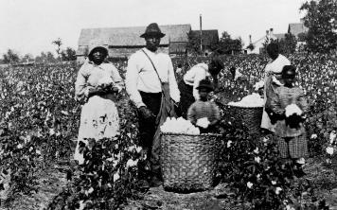
Enslaved Africans
Africans from Western and Central Africa were forcibly taken from their homes and shipped to the Caribbean Islands, and North & South America
Between 1619 and 1808, some 500,000 people were brought to the country this way
Most African Americans today are descendants of enslaved persons; others are immigrants from various countries in African and the Caribbean region

Slide 9
After Independence
After the US gained independence, it was known in Europe as a land of promise
The number of immigrants grew from 600,000 in the 1830s to more than 2 million by the 1850s.
Between 1860 and 1890, more than 11 million Europeans poured into the country (many from Denmark, Norway, and Sweden)

Slide 10

A Shift in Immigration
Between 1890 and 1924 another flood of immigrants streamed into the US (around 22 million)
Most of these immigrants came from southern and eastern Europe, from countries such as Italy, Greece, Poland, and Russia
During the past 50 years, immigration from Europe to the US has lagged far behind
Latin America now accounts for the largest share of foreign newcomers, followed by Asia

Slide 11
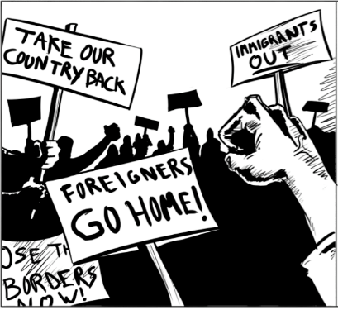
Nativism
Definition: hatred or dislike of immigrants. Proponents advocate a policy of protecting the interests of native-born or established inhabitants against those of immigrants.

Slide 12
Assignment #1: Nativism Research
Using the paper template you have been provided: Research AT LEAST 4 Specific Examples of Nativism in American History.
Fill in the appropriate information with detail.
Random individuals will be asked to share some findings

Slide 13
Notable Examples of Nativism
Colonial Times: Catholics
  Most of the British were Protestant and dislike Catholics
1840-1860: Irish
  Disliked by “Natives” because they took jobs for very low wages
1880s: Chinese
  disliked by “Natives” because they took jobs for very low wages
1920s: Eastern Europeans
  Seen as Communists/Anarchists, took jobs for low wages
  Strict anti-immigration laws passed (1924)
  Leads to increase in illegal immigration
1950s-Present Day: Latinos
  High number of illegal immigrants
  Often denied citizenship requests

